Slide 1
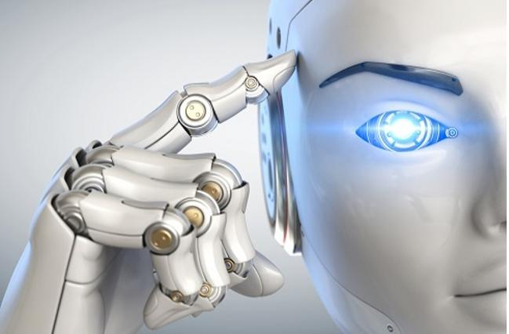
Use and Implementation of Computational Intelligence
S. Lakshmanaraj
lakshmana@teloxis.com
9225518035

Slide 2

Use and Implementation of Computational Intelligence
Agenda
Components of Computation Intelligence
Computation Intelligence-Data Analytics Maturity Path
Example Applications of Computation Intelligence
IoT
Healthcare
eCommerce
Finance
Cyber Security
Education
…and so on
Architecture to Implement
Business Component Architecture of Computation Intelligence
Connectivity Architecture of Computation Intelligence
Data Horizons
Implementation Approach
9 Steps Approach

Slide 3
Computational Intelligence
Fuzzy Logics
Approximate reasoning and Decision making
Neural Networks
Data analysis, Classification, Associative memory, Clustering generation of patterns and Control of patterns
Evolutionary Computation
Natural evolution to bring up new artificial evolutionary methodologies
Learning Theory
Process of bringing together behaviorism, cognitivism, constructivism along with emotional and environmental effects
Probabilistic Methods
Randomness to predict the problem and prescribe the solution combining mathematical relations and or above methods
STEP 6
Connectedness
STEP 5
Principles
Decisions
STEP 4
Applications
STEP 3
Patterns
STEP 2
Relations
STEP 1
Collections
Wisdom
Units
Skill
Knowledge
Information
Dimension
Data
Understanding

Slide 4
High Level Machine Intelligence - Data Analytics Maturity Path
Foresight
Insight
Value
Hindsight
STEP 5
STEP 4
How Can We Make It Happen?
STEP 3
What Will Happen?
STEP 2
Why Did It Happen?
STEP 1
What Happened?
Feeling and Thinking
Prescriptive Analytics
Predictive Analytics
Diagnostic Analytics
Association Analytics
Descriptive Analytics
Difficulty

Slide 5
Where Can be Used for IoT?
Information – Diagnostic Analytics
Moving Speed Detections as well as oscillation frequencies
Removal of Data noise and Self Correctness
Growth/Decline rate – Support Cases, Manufacturing Defects rate, Devices Wear & Tear Rate, Financial Growth
Knowledge – Activation Functions for AI/ML
Preventative Maintenance Schedule - modelling by sound and temperature in motors of fan, washing machine, fridge etc.
Prescriptive Methods - Auto switch on/off A/C based on temperature, products pair well together and how to price products

Slide 6
Where Can be Used for Healthcare?
Information – Diagnostic Analytics
Clinical Document Quality Index
Growth/Decline rate – Support Cases, Recovery rate, Readmission rate, Financial Growth
Knowledge – Activation Functions for AI/ML
Preventative and Corrective actions – Diagnosis data with Patient education materials
Predictive Methods- Number of patients visiting hospitals, Diseases seasonal patterns
Prescribing Methods – Number of resources needed like beds, pills, injections, nurses etc.

Slide 7
Where Can be Used for e-Commerce?
Information – Diagnostic Analytics
Optimal Logistics Route planner
Decoration Pattern to connect irregular shapes
Product Grouping to maximize Buyers and to minimize stock
Growth/Decline rate – After sales support cases, Financial Growth
Knowledge – Activation Functions for AI/ML
Predictive Method- Where to invest money, Which products can be retired, Customer segmentations
Prescribing Methods – Price response functions, Supply and Demand generating seasonal patterns

Slide 8
Where Can be Used for Cyber Security?
Information – Diagnostic Analytics
Network (network traffic analysis and intrusion detection)
Endpoint (anti-malware)
Application, Users, Process (anti-fraud)
At Rest, At Transit or Historical
Knowledge – Activation Functions for AI/ML
Prediction Methods – Anomalies, Forensic analysis
Prescribing Methods – Encrypted Blockchain

Slide 9
Where Can be Used for Education?
Information – Diagnostic Analytics
Digital Library
Questions, Answers
Markings / Categorization as Easy to Difficult from Novice to Expertise
Knowledge – Activation Functions for AI/ML
Prediction Methods – Most wanted materials, Attendance, Productive hours, teaching preferences
Prescribing Methods – Assigning Education Materials to overcome Weak Skills, Auto scheduler

Slide 10
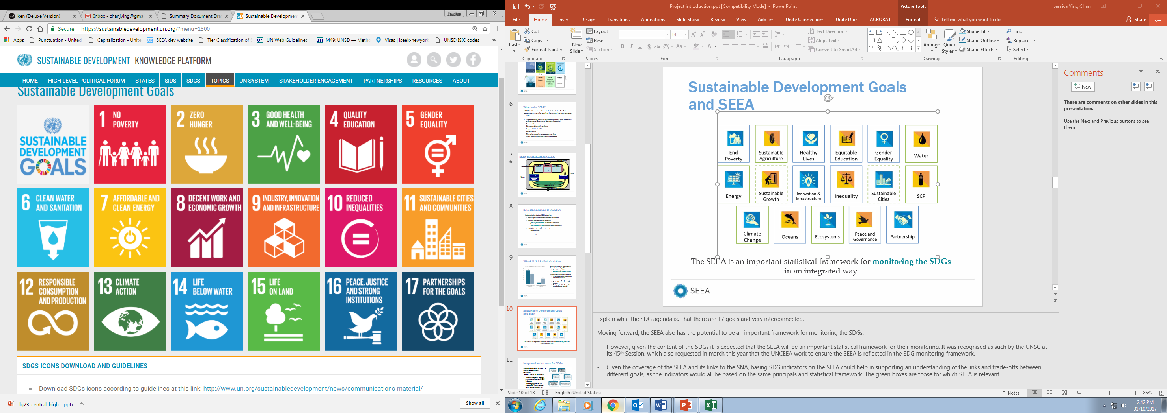
Where Can be Used …and So on…
Society 1.0
Society 2.0
Society 3.0
Society 4.0
Digital Society
Hunter-Gatherer Society
Agrarian Society
Industrial Society
Society 5.0
Machine Intelligence to expand human capabilities and address social challenges

Slide 11
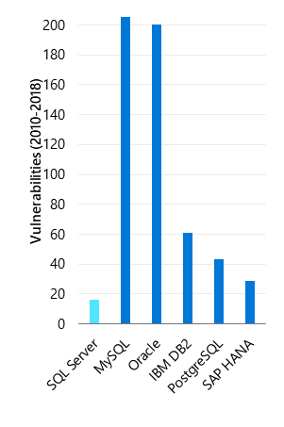

High Level Example of Preventative and Maintenance System
Operational data in Cloud SQL Server
Machine Learning Rule Editor and Pattern Updater
Time-series built-in
AI built-in
Unparalleled performance and security
Predictions/
Other data
Sensitive Pump Data
Time-Series
Trained ML
Machine in field
Maintenance
Cloud SQL
Shut-off
Data Streaming
Anomaly Detection
Real-time actions
Machine learning for low-latency analytics
Core Engine
Built-In Time-Series Streaming and Analytics
Most secure with industry leading performance

Slide 12


High Level Generic Business Components Architecture
AUTOMATE
PROTECT
ANALYZE & INFUSE
(Present & Interact)
TRUST MONITORING
WORKBENCH
RULE EDITOR
AI RULE ENGINE
MACHINE LEARNING
IDENTITY & ACCESS
MANAGEMENT
ORGANIZE
(Transform & Manage)
BIG DATA
AS A SERVICE
KNOWLEDGE
CATALOG
DATA PREPERATION
COLLECT
(Store or
Destroy)
X
AUDITING
FUNCTION AS
A SERVICE
ACTIONABLE DATA
MEANINGFUL DATA
OBJECTS STORAGE
OBJECTS AT REST
COLLECT
(Ingest)
TIME SERIES DATA
RELATIONAL DATA
UNSTRUCTURED DATA
KEY
MANAGEMENT
EVENT STREAMING
SERVERLESS ETL
DATA SOURCES
LOG ANALYSIS
NoSQL
RDBMS
DATA WAREHOUSE
EXTERNAL DATA
IoT DATA

Slide 13
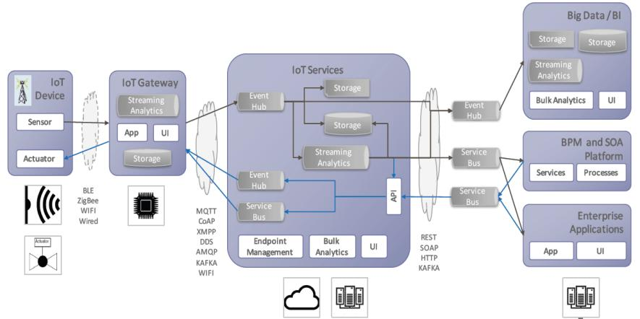
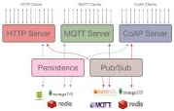
High Level Generic Connectivity Architecture

Slide 14
Data Horizons
Reporting, Analytics and Data Science Services
Reporting
Self-service BI
Open Data API
Data Science
Data Availability
Data Quality
Data Consistency
Data Security
Data Auditability
Data Lineage
Master Data Management, Metadata Management and Data Governance
Data Standards
Data Policies and Procedures
Business Metadata
Technical Metadata
Data Grouping and Indexing
Data Sharing Process
Data Architecture and Data Technology
Relational
Dimensional
In-memory
Polyglot
Data Integration, Data Services and Data Adapters
Structured Data
Unstructured Data
Semi-structured Data
Binary Data
Data Sources
Internal
External
Third party
Future M&A

Slide 15
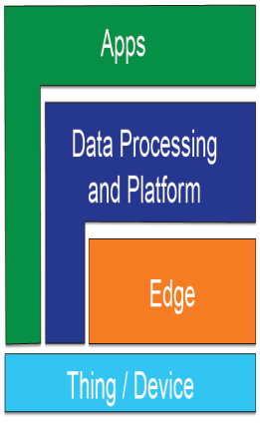
High Level Generic Data Analytics 9 Steps Approach
Identify the problem and the stakeholders
Identify what data are needed and where those data are located
Develop a plan for analysis and a plan for offline or periodic or near-time or real-time data retrievals or access
Extract, transform, load the data
Check, clean and prepare the data for analysis and automate in minimizing time
Analyze and interpret the data
Visualize the data
Disseminate the new knowledge
Implement the knowledge in the organization

Slide 16
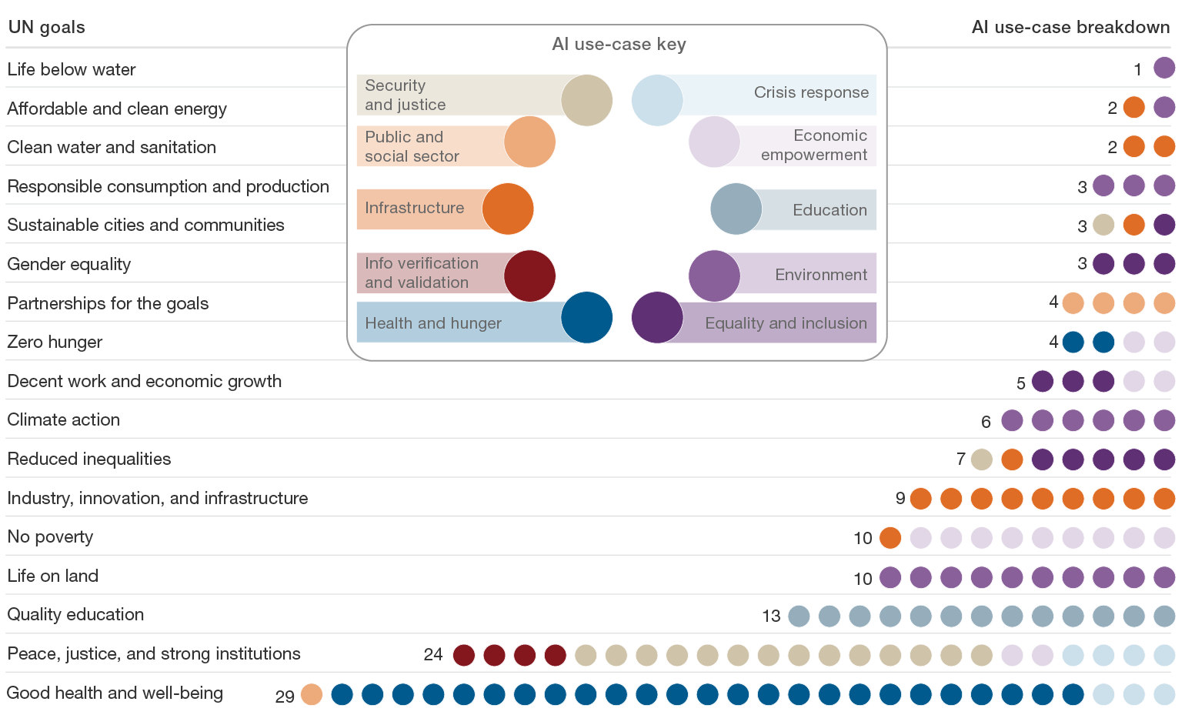
1st and 2nd Step Data Points for UN SDG Goals

Slide 17
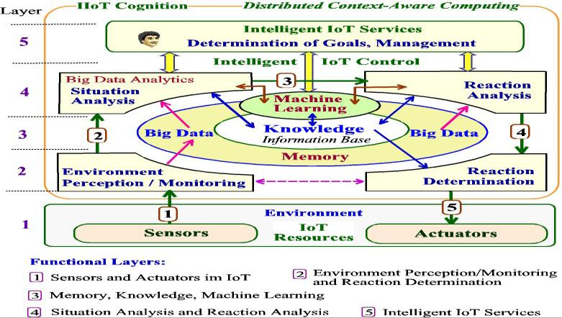
Data Analytics Initial 1st to 5th Steps - IoT

Slide 18
Data Analytics Initial 1st to 5th Steps - Healthcare
Results, medications
Vitals, Allergies
DC Summaries
Clinical Doc
Proteomics, SNPs,
Publications
Clinical Trials
PubMEd
Data
Access
Analysts and Reviewers
Physicians/Admin
Patients
Access & Collaborative Portal
CLINICAL
Informatics
RESEARCH
Informatics
Payer
Clinical Intelligence
Clinical Decision Support
Health
Analytics
Intelligence &
Data access
Evidences & Knowledge
Decision
Data/text search & mining
-
Support
Data/text analysis
Guidelines
Rules
Solution
-
Portfolio
Patients
ADMINISTRATIVE
Informatics
Data
Integrated Clinical Data Warehouse
Integration
(HIW, CG, HCN etc.)
ADT, Demographics
Provider, Scheduling
Diagnosis, CPT, AR, Billing, Claims
Data
Financial Data
Clinical Data
Acquisition
Code, Operation, Billing, Fee,
Public data, disease, procedure,
Coverage, Risk Factor, Competitor,
provider, treatment plan, lab
Customer Background, etc.
tests, patient history, etc.

Slide 19
Data Analytics Algorithms Used in Step 6
Easy to Interpret Hard to Interpret
Supervised Unsupervised
Linear Nonlinear
K-Means Expectation Self-Organizing
Maximization Maps
Linear
Regression
Logistic
Regression
Perceptron
Single Combined
Bagging Random Forests Boosting
(Bootstrap
Aggregating)
Decision Trees Rule Learning
Naïve K-Nearest
Bayes Neighbors
Multi-Layer SVM Perceptron Hidden Markov
Perceptron

Slide 20



Data Analytics Mid 6th and 7th Steps
Predictive & Stat Models
Tests
Optimization
Simulations
Strategy / Scenarios
Decision Support & Strategy
Models
Tests
Evaluation
Simulation
& Optimization
Insights
& Strategy
Dashboards
Biz Apps
Plan
Do
Check
Portal/Kiosks
BI & Analyses
Reports
Integrated Analytics
Marts/Cubes
EDW
Unstructured Big Data

Slide 21
AI/ML Initiatives for Step 7
01. Feature Elicitation
02. Structure Discovery
03. Meaningful compression
04. Big data Visualisation
02
09
08. Objects Classification
09. Objectives fulfilment
10. Diagnostics
11. Fraud Detection
01
08
03
10
Dimensionally Reduction
Classification
04
11
12
12. Forecasting
13. Predictions
14. Process Optimization
15. New Insights
Unsupervised learning
data
mining
Control
theory
Supervised learning
05. Recommended Systems
06. Targeted Systems
07. Segmented Systems
05
statistics
Machine
Learning
Decision
theory
13
Clustering
Regression
Information
theory
Cognitive
science
06
14
databases
Psychological
models
07
neuroscience
15
evolutionary
models
Reinforcement Learning
16. Real-Time Decisions
17. Gamifications
18. Learning Tasks
16
20
19. Skill Acquisition
20. Robot Navigation
17
19
18

Slide 22









Data Analytics Final 8th and 9th Steps
Disseminating the new knowledge
Write up the findings
Disseminate to the stakeholders
Implementing the new knowledge
Requires participation of stakeholders
Findability
Behavioral Insights
Predictive Analytics
Collaborative Interactions
Precision
Marketing
Self-Management
Tools
Targeted Content
Compelling Calls
to Action
Advanced Personalization

Slide 23









Final Thoughts... Any Questions?
For more information, my Concept AI/ML activation models are published in
https://www.ijmttjournal.org/Volume-66/Issue-11/IJMTT-V66I11P502.pdf
You can connect me at https://www.linkedin.com/in/lakshmanarajsankaralingam/
Thank you

