Slide 1
Components
Overview
Class components
Functional components

Slide 2
1. Overview
The story so far…
A more modular approach…
Defining components in React

Slide 3
The Story So Far…
The examples so far have created a monolithic dollop of React elements in one giant block of code
Not feasible in a real app - too much content!
let prodList = …
let shopList = …
let retailer = React.createElement('div', null,
React.createElement('h1', null, 'Catalog'),
prodList, …, shopList, …
)
ReactDOM.render(retailer, …)

Slide 4
A More Modular Approach…
Divide-and-conquer
Partition the UI into a bunch of components
Each component is responsible for one part of the UI
Benefits of the component approach
Each component is relatively small and focussed
Easier to develop
Potential reuse
Easier to test

Slide 5
How to Define Components in React
There are several ways to develop components in React
Via classes and inheritance - see Section 2
Via functional components - see Section 3
In earlier versions or React, you could also create a component using React.createClass()
But this is deprecated nowadays

Slide 6
2. Class Components
Overview
Example scenario
Example data
Component classes
ItemsList component class
Retailer component class
Creating/rendering Retailer

Slide 7
Overview
React has a class named React.Component
Has common capabilities needed by all components
E.g. render React elements for a component
To define your own component as a class:
Define a class that inherits from React.Component
Override render() function, to render your elements
Access properties on the component, via this.props

Slide 8
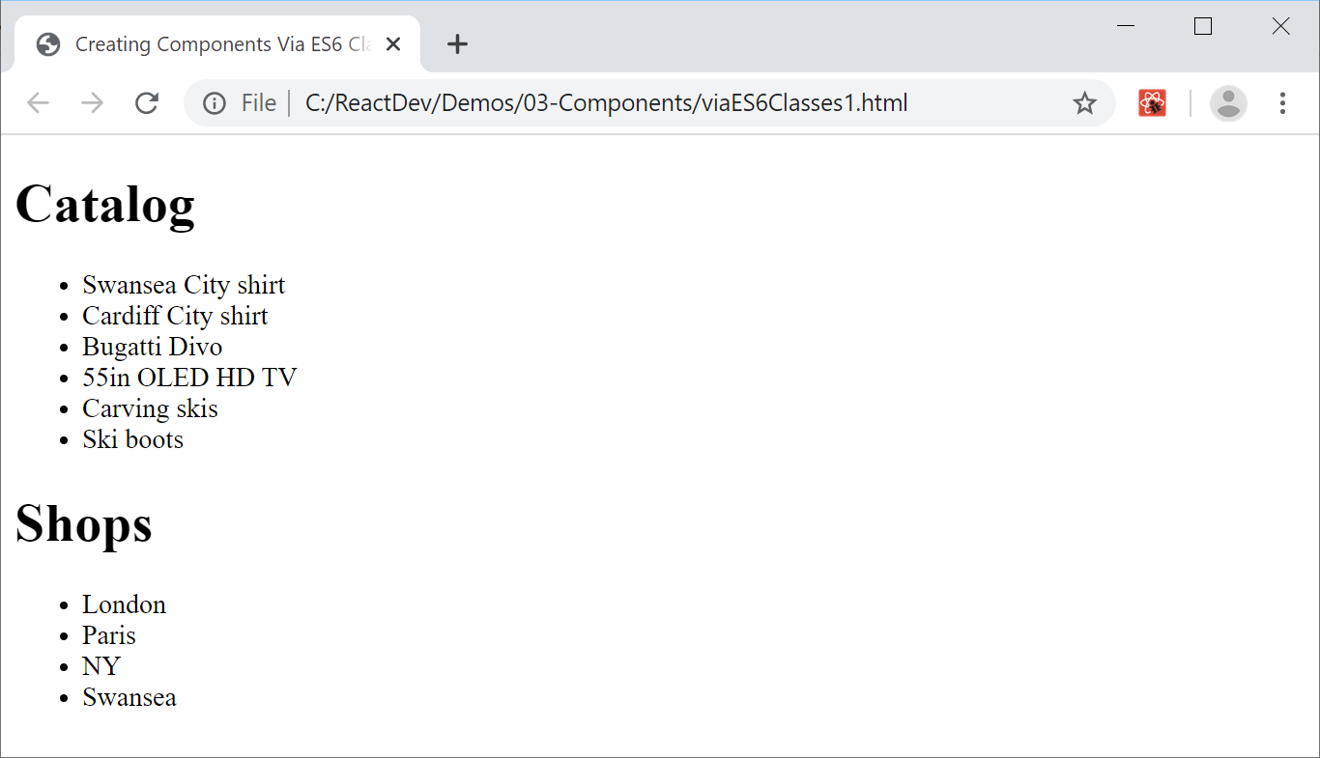
Example Scenario
viaES6Classes1.html has several components
Retailer component instance
ItemsList component instance
ItemsList component instance

Slide 9
Example Data
Here's the familiar data for our components
const products = [
'Swansea City shirt',
'Cardiff City shirt',
…
]
const shops = [
'London',
'Paris',
…
]

Slide 10
Component Classes
Here's how to define a component class:
Inherit from React.Component
Override render(), return React element(s) to render
Use this.props.items to access items property, passed into component by its parent component

Slide 11
ItemsList Component Class
class ItemsList extends React.Component {
render() {
return React.createElement(
"ul", null,
this.props.items.map((item, i) =>
React.createElement("li",
{key:i},
item))
)
}
}

Slide 12
Retailer Component Class (1 of 2)
The Retailer component is similar
class Retailer extends React.Component {
render() {
// Create a <div> that contains:
// <h1>
// ItemsList component for products
// <h1>
// ItemsList component for shops
}
}

Slide 13
Retailer Component Class (2 of 2)
Retailer creates ItemsList for products like so:
Retailer creates ItemsList for shops like so:
React.createElement(ItemsList,
{items: products},
null)
React.createElement(ItemsList,
{items: shops},
null)

Slide 14
Creating/Rendering Retailer
We create/render a Retailer component as the root React element as follows:
Also see viaES6Classes2.html
Encapsulates the creation of each <li>
const retailer =
React.createElement(Retailer, null, null)
ReactDOM.render(
retailer,
document.getElementById('osl-container'))

Slide 15
3. Functional Components
Overview
How to do it
ItemsList component
Retailer component
Creating/rendering Retailer

Slide 16
Overview
Let's see another way to define components in React
As functional components
This is usually simpler than defining class components
See viaFunctionalComps.html
A functional component:
Is just a function (i.e. not a class)
Receives properties as params (i.e. not this.props)

Slide 17
How to do it
To define a component as a functional component:
Define an arrow function, a.k.a. lambda
Receive an object parameter (from parent component)
Destructure the object, to access its property
Create and return a React element - React automatically renders this element

Slide 18
ItemsList Component
Here's ItemsList as a functional component
Receives an object with items property, from parent
const ItemsList = ({items}) =>
React.createElement(
"ul",
null,
items.map((item, i) =>
React.createElement("li",
{key:i},
item))
)
viaStatelessFunctionalComponents.html

Slide 19
Retailer Component (1 of 2)
Here's Retailer as a functional component
Receives an object with products, shops properties
const Retailer =({products,shops}) =>
// Create a <div> that contains:
// <h1>
// ItemsList component for products
// <h1>
// ItemsList component for shops
viaStatelessFunctionalComponents.html

Slide 20
Retailer Component (2 of 2)
Retailer creates ItemsList for products and shops the same way as before
React.createElement(ItemsList,
{items: products},
null)
React.createElement(ItemsList,
{items: shops},
null)

Slide 21
Creating/Rendering Retailer
We create/render a Retailer component like so
Note that we now pass an object into the Retailer component, with products and shops properties
const retailer = React.createElement(
Retailer,
{products,shops},
null)
ReactDOM.render(
retailer,
document.getElementById('osl-container'))

Slide 22
Summary
Overview
Class components
Functional components

