Slide 1
JSX
Overview of JSX
JSX syntax
Complete example
JSX gotchas

Slide 2
1. Overview of JSX
The story so far…
Introducing JSX
Transpiling JSX

Slide 3
The Story So Far…
In all the examples so far, we've created elements programmatically using React.createElement()
class Retailer extends React.Component {
render() {
return React.createElement(… … …)
}
}
const Retailer =({products, shops}) =>
React.createElement(… … …)

Slide 4
Introducing JSX
React supports a lightweight syntax called JSX
Create React elements concisely and directly
HTML-like syntax, can embed directly inside ES6 code
Elements can be HTML, or your own components
const productsList =
<ul>
<li>Skis</li>
<li>Boots</li>
</ul>
const basket =
<Basket>
<Item>Skis</Item>
<Item>Boots</Item>
</Basket>

Slide 5
Transpiling JSX (1 of 2)
Browsers don't understand JSX syntax
You must convert JSX into React.createElement() calls - this is known as "transpiling"
Use the Babel transpiler
Transpiles ES6 into ES5
Also transpiles JSX into pure React

Slide 6
Transpiling JSX (2 of 2)
You can add Babel directly into your web page
Add a <script> to download the Babel transpiler
Embed JSX inside <script type="text/babel">
<script src="…URL for Babel on unpkg.com…">
</script>
<script type="text/babel">
… Put your JSX-enhanced code here …
</script>

Slide 7
2. JSX Syntax
JSX content
Using JSX for components
Simple example of JSX

Slide 8
JSX Content (1 of 2)
JSX elements can contain plain text
Note, attribute values must be enclosed in quotes
const productsList =
<ul>
<li title="swans">Swans shirt</li>
<li title="leeds">Leeds shirt</li>
</ul>

Slide 9
JSX Content (2 of 2)
JSX elements can also contain JavaScript expressions
E.g. variables, arrays, objects, functions
Must be enclosed in braces
const data = ["Swans shirt", "Leeds shirt"]
const summaryElem =
<div>There are {data.length} items</div>

Slide 10
Using JSX for Components (1 of 2)
Let's rewrite the following component using JSX:
const ItemsList = ({items}) =>
React.createElement("ul", null,
items.map((item, i) =>
React.createElement("li",{key:i},item))
)
const ItemsList = ({items}) =>
<ul>
{items.map((item,i) =>
<li key={i}>{item}</li>
)}
</ul>

Slide 11
Using JSX for Components (2 of 2)
Render the ItemsList component as follows:
const data = ["Swans shirt", "Leeds shirt"]
ReactDOM.render(
<ItemsList items={data} />,
document.getElementById("osl-container")
)

Slide 12
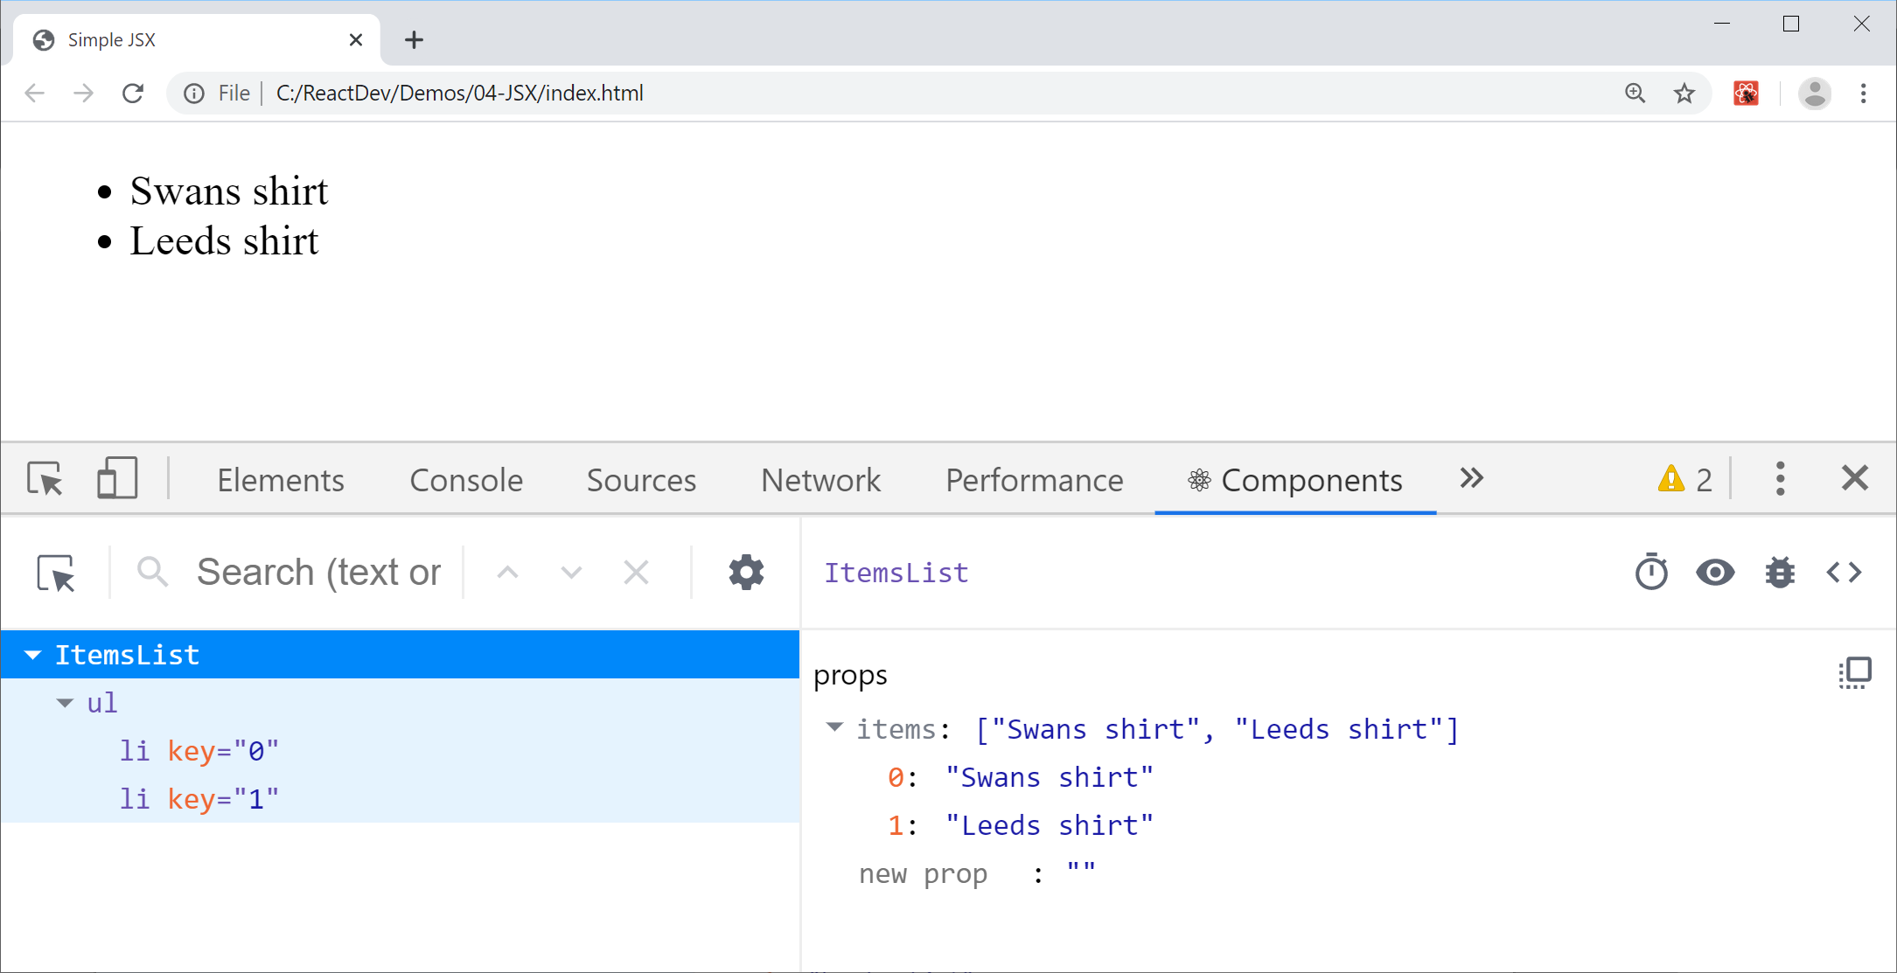
Simple Example of JSX
Example - see index.html

Slide 13
3. Complete Example
Overview
Running the example
Viewing the web page

Slide 14
Overview
In this section we review a more interesting and realistic example of JSX
See the following files
retailerDirectory.html
retailerDirectory.js
styles.css

Slide 15
Running the Example
You must run the example through a web server
E.g. npm provides live-server
Reloads Web pages automatically when you save a file
Install live-server using npm
Start the server in your project root folder
npm install live-server -g
live-server

Slide 16
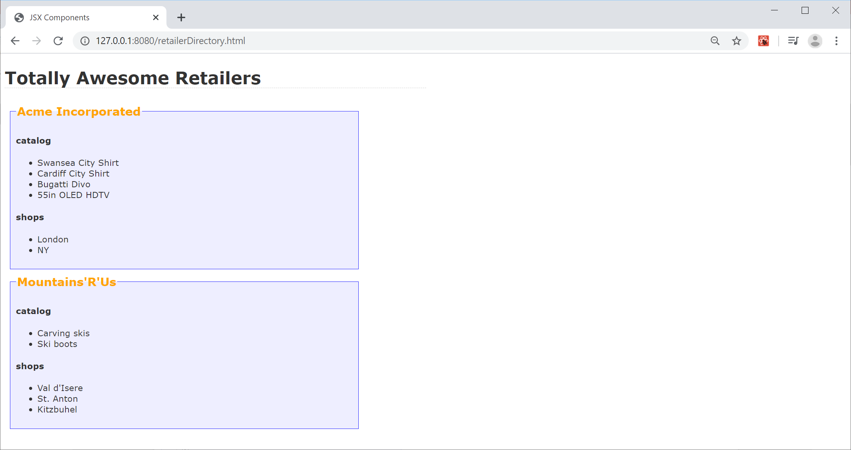
Viewing the Web Page
In the browser, navigate to the following address:
127.0.0.1:8080/retailerDirectory.html

Slide 17
4. JSX Gotchas
JSX gotchas - 1
JSX gotchas - 2

Slide 18
JSX Gotchas - 1
JSX is case-sensitive
JSX tags must be closed
const badElem1 = <SpotTheBug>oops</SpotTheBUG>
const badElem2 = <input type="text">

Slide 19
JSX Gotchas - 2
Adjacent JSX elements must be wrapped inside an enclosing tag
To assign a CSS class, use className (not class)
const badElem3 =
<h1>Greeting</h1>
<div>This won't work. Sorry!</div>
const badElem4 =
<div class="emphasis">Won't work!</div>

Slide 20
Summary
Overview of JSX
JSX syntax
Complete example
JSX gotchas

