Slide 1
SRA DASHBOARD
2013-11-14

Slide 2
SRA Dashboard - Intro
SRA Dashboard is an application used to monitor various Service Manager background activities in a timely manner with current status.
SRA Dashboard monitors two base activities in all the regions.
Schedulers
Events

Slide 3
Regions under SRA Dashboard
SRA Dashboard currently monitors Events and Schedulers for the below Regions.
AMS
APJ
EMEA
The Instances covered under this regions are
AMS | EMEA | APJ
AMS AMS-2 VALE | EMEA EMEA-2 ALU | APJ -1 APJ -2

Slide 4
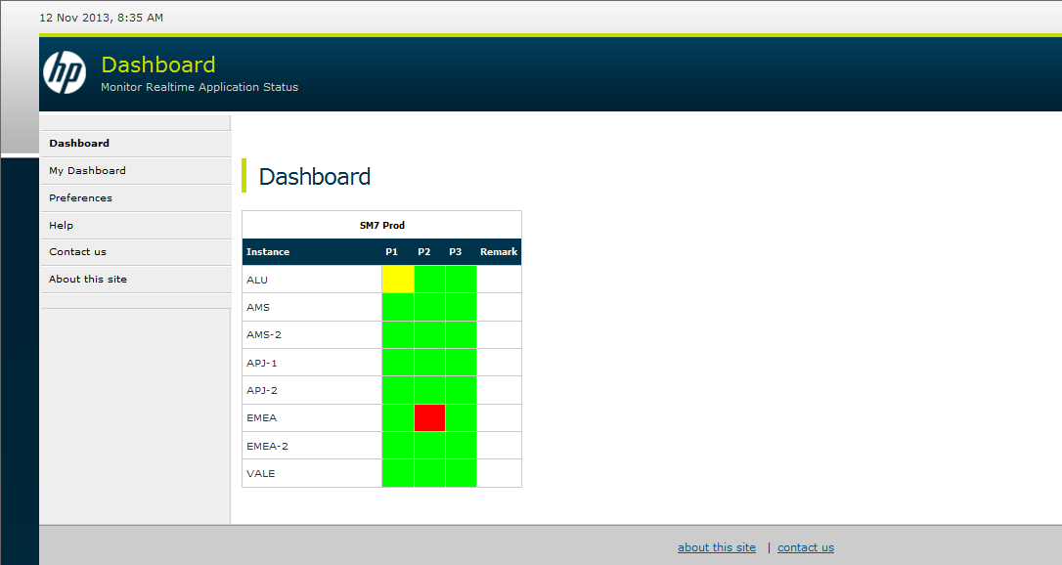
SRA Dashboard Home Page
URL to Access SRA Dashboard :
https://am-i.serviceportal.hp.com/DashBoard/Main.aspx

Slide 5
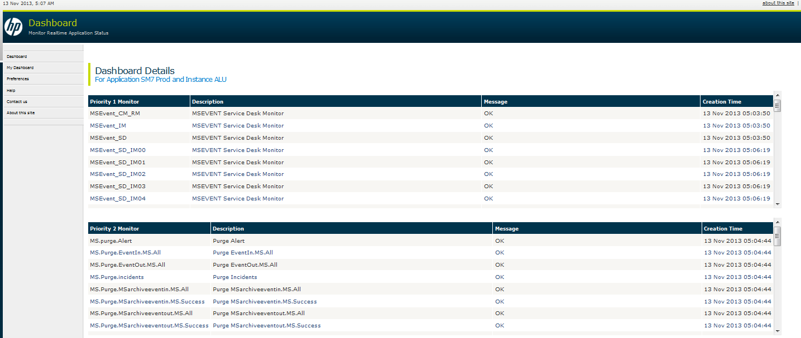
SRA Dashboard Detail View
We can see this detail view by clicking on the specific environment from Home Page.

Slide 6
SRA Dashboard Colors
The dashboard has four colors for user reference.
Purple color indicates some or all monitor’s are not receiving the current update.
Red can be seen, if there is any backlog.
Yellow indicates a problem in initial stage.
Green indicates that all the monitor’s are working fine.

Slide 7
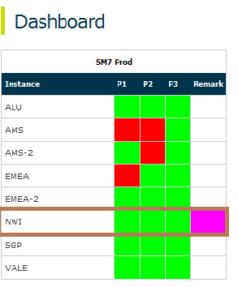
Monitoring SRA Dashboard
SRA Dashboard Refreshes every 30 seconds to display the current status.
If the monitor’s are not updating for 5 minutes, you will see the purple color in Remarks column.

Slide 8
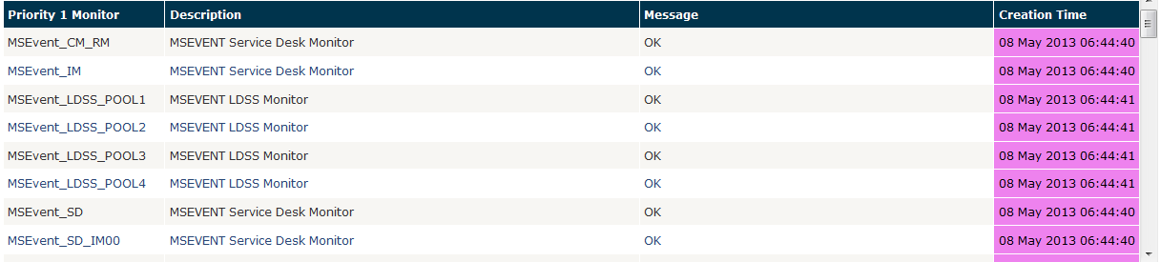
Monitoring SRA Dashboard
We can also see the purple color in Detail View under the Create Time.

Slide 9
Purple Dashboard
Dashboard will turn purple due to below reasons.
Connectivity Problem (Network problem).
Firewall Problem.
SM Database outage.

Slide 10
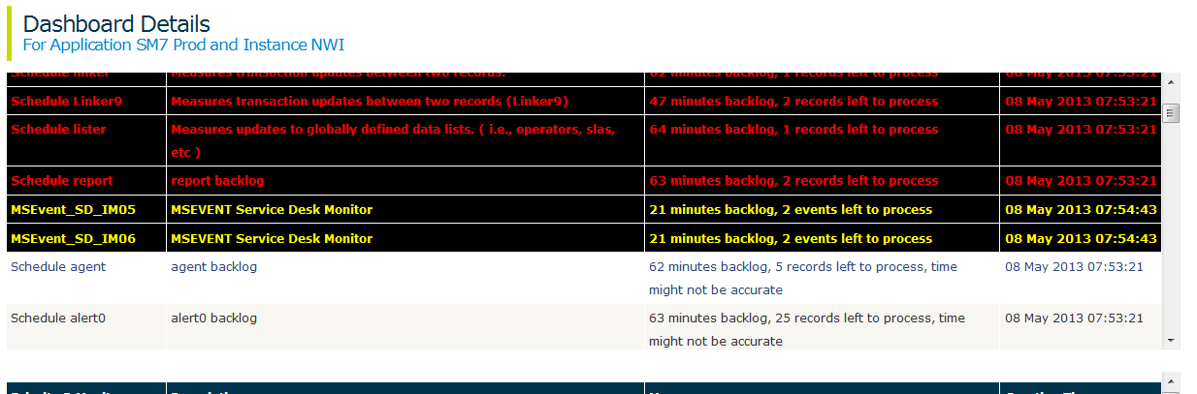
Yellow Dashboard
Dashboard will turn Yellow, if there is any backlog between 20 Minutes and 30 Minutes.

Slide 11
Red Dashboard
Red color can be seen if there is any backlog greater than 30 Minutes.
This can indicate there is some serious problem in SM Scheduler or Events.
Exceptions:
LDSS Monitors ( Can be backlogged due to onboarding data )
ESL Monitors ( Can be backlogged due to onboarding data )

Slide 12
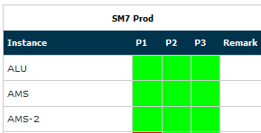
Green Dashboard
Dashboard will remain green, if there is no backlog.

Slide 13
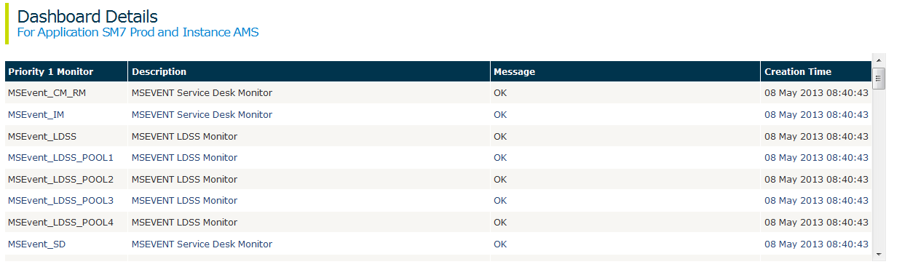
Green Dashboard Detail View
Detail View for Green will be white with message “ok”

Slide 14
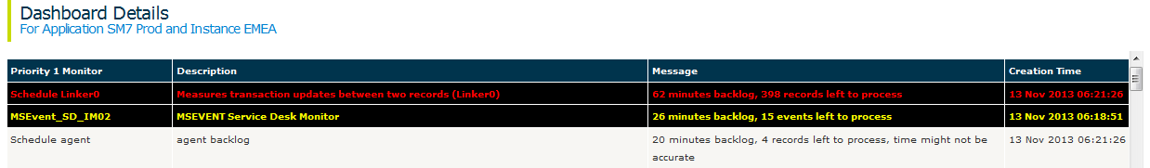
Additional Backlog Messages
We can see other backlog messages in SRA Dashboard.
Message : “20 minutes backlog, 4 records left to process, time might not be accurate”
You can see this message when the backlog count is >2 and <100
If the backlog count is >100, we can see the Red or yellow based on the minutes of backlog.

Slide 15
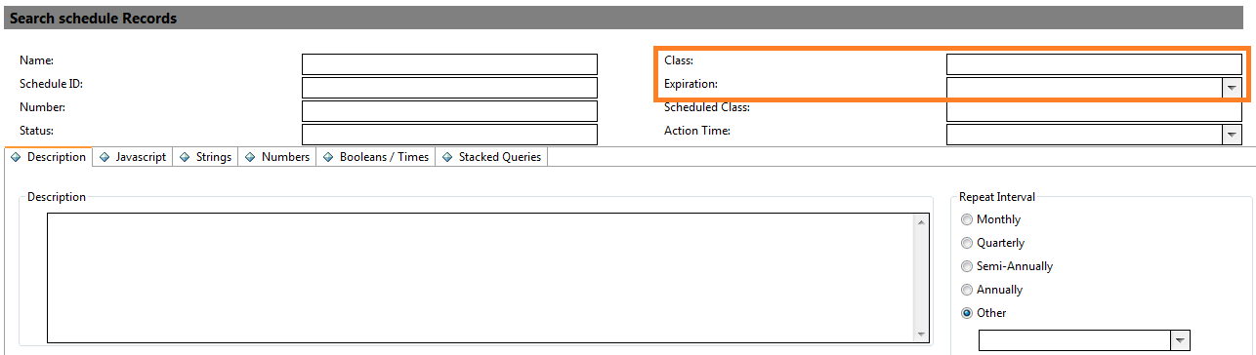
Schedule Backlog
For backlog in Scheduler, we search by Class and Expiration time.
Example : Class ‘linker’ , Expiration <= current Time.

Slide 16
Event Backlog
Event backlogs can be seen in eventin table in SM.
For MSEvent_IM, the below query is used in Eventin (Expert Search) as an example:
evtype isin {"MS.probsum.task.update", "MS.probsum.update.all", "MS.probsum.close.all", "MS.master.duplicate.update","MS.master.duplicate.close","MS.close.incident"} and evtime<='08/05/2012 13:22:43‘
We can get the evtype value or query by searching the Scheduler for the specific class.
Notes:
Note : Usually there will be some count difference between the Dashboard and SM, this is due to the update time from SM to Dashboard.

Slide 17
New Purge Monitors
We have added New Purge Monitors under “Priority 2 Monitor”.
MSarchiveeventoutandin
MS.Purge.MSHPSXInBoundIM success records Table
MS.purge.MSHPSXInBoundIM errored/locked records Table
MS.purge.MSHPSXOutBoundIM Pending Confirmation records Table
MS.purge.MSHPSXOutBoundIM SUCCESS records Table
MS.Purge.EventIn.MS.All
MS.Purge.EventOut.MS.All
MS.Purge.MSarchiveeventin.MS.All
MS.Purge.MSarchiveeventin.MS.Success
MS.Purge.MSarchiveeventout.MS.All
MS.Purge.MSarchiveeventout.MS.Success
MS.Purge.incidents
MS.Purge.probsummary
MS.purge.Alert

Slide 18
New Purge Monitor…
For this Purge Monitors we can see two kinds of error.
Application Failed
xxxx minutes backlog
If we see “Application Failed”, Login to Service Manager, search for the schedule record, and make the following changes:
Change the status on the schedule record from application failed to rescheduled
Copy the value in the Scheduled Class field to the Class field.
Click Save.

Slide 19
New Purge Monitor…
For “xxxx minutes backlog”
Change the status on the schedule record from application running to rescheduled
Copy the value in the Scheduled Class field to the Class field.
Click Save
This Purge Monitor will turn red, if the backlog is greater than 24 hours or the status is “Application Failed”.

Slide 20
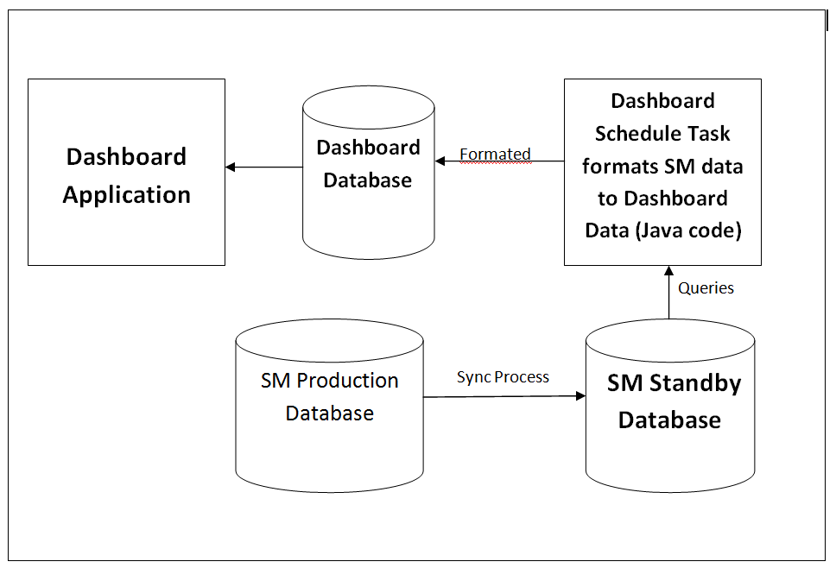
How SRA Dashboard Works
Dashboard Schedule task executes every 5 minutes to update the Dashboard Database.

Slide 21
List of Monitors under P1
We have the list of Monitors under P1.
1. MSEvent_CM_RM | 11. Schedule lister
2. MSEvent_IM | 12. Schedule message 1 – 9
3. MSEvent_SD 1- 9 | 13. Schedule ocm
4. Schedule agent | 14. Schedule problem 1- 4
5. Schedule alert 0-9 | 15. Schedule report
6. Schedule anonymise | 16. Schedule sla 0-9
7. Schedule change | 17. Schedule suspendhold
8. Schedule event
9. Schedule linker 0-9
10. MSEvent_SD_IM 0 -9

Slide 22
List of Monitors under P2
We have the list of Monitors under P2.
MSEvent_ESL 0 – 9
2. MSEvent_ESL a – f
Schedule inactive
4. Schedule Msbgmonitor A – H MSEvent_LDSS 1- 9 Purge Schedulers

Slide 23
SRA Dashboard Made Consistent
SRA Dashboard Made consistent by performing the below activity.
Dashboard Schedule task will auto restart if there is any failure.
We also have activated the Auto Paging from SRA Dashboard when the dashboard is not able to restart after 15 minutes.

Slide 24
Servlet Dashboard
Servlet Dashboard is used to Monitor the Servlet status under the Load Balancer for the specific Instance.
For each region we have one Servlet Dashboard.
Link to Regional Servlet Dashboards can be viewed from the SRA Dashboard detail view under Priority 3 Monitor.

Slide 25
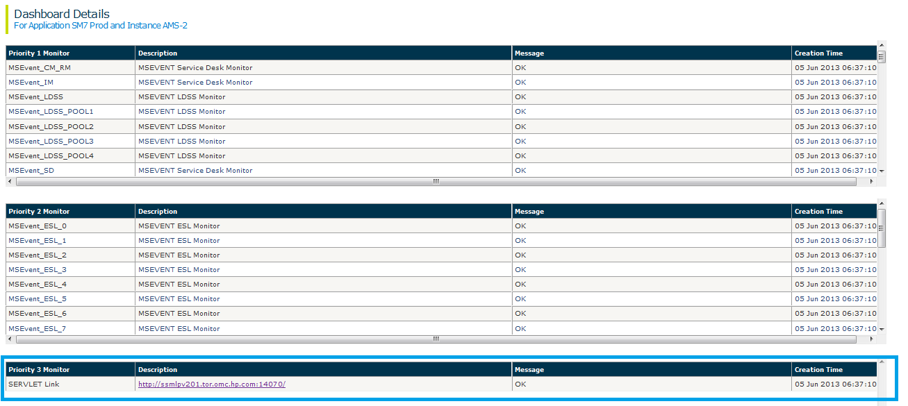
Servlet link in SRA Dashboard

Slide 26
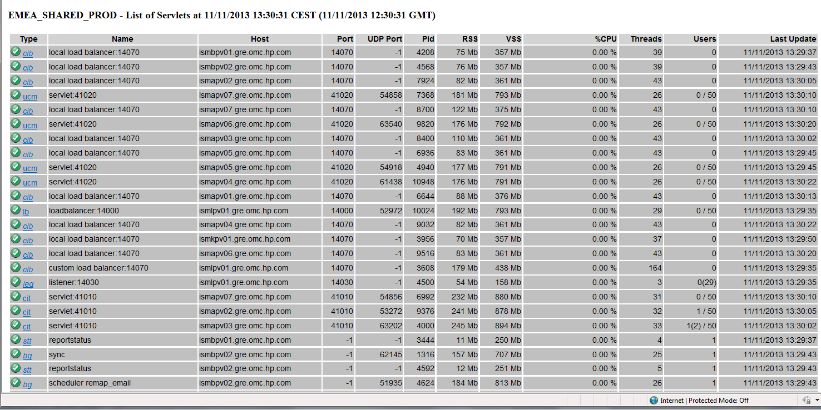
Servlet Dashboard View
Notes:
RSS- REAL MEMORY/PHYSICAL MEMEORY VSS-Virtual Memory/Swap Memory
UDP – User Datagram Potocol

Slide 27
Servlet Dashboard
The custom load balancer checks the status of all servlets approximately once every minute.
The “last update” column will provide the time at which the report was generated to your browser.
It also checks the standard load balancer status to verify that servlets have not been excluded from the cluster group.
Notes:
Note : Members of the cluster group have a valid UDP

Slide 28
Servlet Dashboard
List of some servlet Monitors
Win: windows client users (balanced via this custom load balancer)
Web: web client users (balanced via the standard load balancer – servlet of type “lb”)
Cit: Connect-IT client users (balanced via the custom load balancer)
Wsc: Web services users (balanced via a GSLB url)
Lb: out-of-the box load balancer servlet
Bg: non-users servlets (background jobs servlets)
Leg: ServiceCenter legacy listeners for Service-Center Connect-it clients

Slide 29
Colors in Servlet
Green, if the servlet is available to receive incoming connections
Yellow, if the servlet is still running but not available anymore (has already reached its capacity limit in terms of users, number of threads or real / virtual memory segment)
Purple, if the servlet has been suspected of losing its connections
Notes:
UDP - User Datagram Protocol is an unreliable, connectionless oriented protocol that uses an IP address for the destination host and a port number to identify the destination application.
Purple, if the servlet has been suspected--- (ie the custom load balancer servlet explorer has not found this servlet on the server anymore in the past 5 minutes).
Note : The UDP Port column is in purple if it is not reported as a member of the cluster group anymore (and is therefore suspected of not being available to service end-users requests)

Slide 30
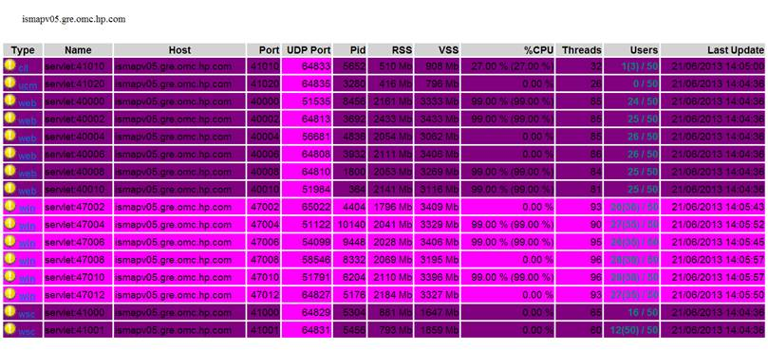
Purple Servlets
We can see Servlet in Dark and Light Purple
Notes:
We can see Dark Purple or Light Purple in “Custom Load Banalcer”
Light Purple – Indicates that the custom load Balancer servlet has not found this servlet on the server anymore in the past 5 mins
Dark Purple – If we restart the Servlet, we can see this Color. Once the Servlet is restarted , The row related to the Servlet will be removed and a New Row will be added to the Custom Load Balancer.

Slide 31
Technical Reference
If no “win” type servlet is displayed or all “win” type servlets are highlighted in yellow or purple, then that means that the load balancer could not find any candidate to redirect end users.
If they are highlighted in yellow, your system has reached its maximum capacity.
Notes:
(either completely or only in the UDP port column)

Slide 32
Technical Reference…
If there are candidate servlets you can test the servlets individually by connecting (via your standard windows client) to the actual servlet host and port. If one of the candidate servlet is not responding, you will have to check servlet’s log to identify the reason why it is not available

Slide 33
Questions

