Slide 1
Online Retail Platform
High-Level System Design & Implementation Strategy Senior Backend Developer — Technical Assignment

Slide 2
Agenda
1. System Architecture View (High-Level Design)
2. Scaling Strategy
3. Security and Authentication
4. Key Components and Their Responsibilities
5. Integration with External Services
6. Monitoring and Alerting
7. Code Delivery Plan (CI/CD)

Slide 3
Section 1
System Architecture View

Slide 4
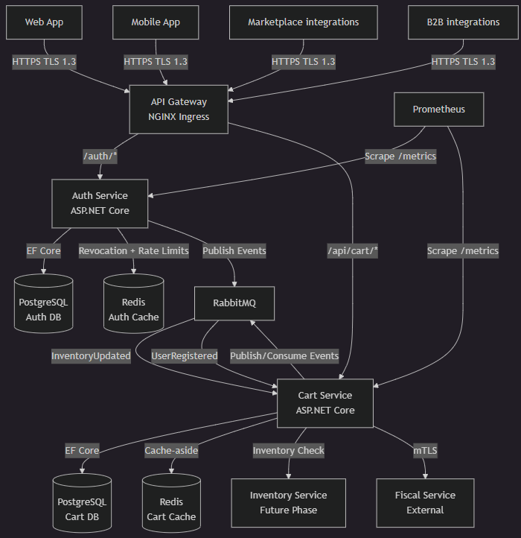
High-Level Architecture Diagram

Slide 5
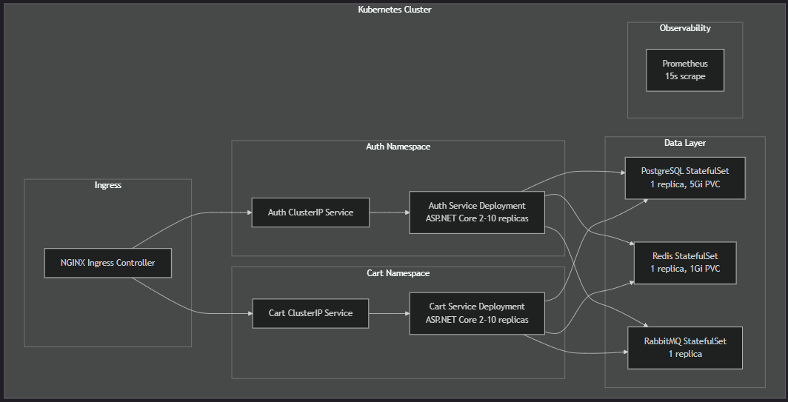
Kubernetees Cluster Diagram

Slide 6
Core Technology Stack
▸ Runtime: .NET 8 / ASP.NET Core Web API
▸ ORM: Entity Framework Core + Npgsql (PostgreSQL)
▸ Caching: StackExchange.Redis (cache-aside pattern)
▸ Messaging: RabbitMQ.Client (topic exchange, DLQ)
▸ Resilience: Polly v8 (circuit breakers, retry policies)
▸ Auth: RS256 JWT, Argon2id password hashing
▸ Observability: prometheus-net, structured JSON logging
▸ Orchestration: Kubernetes (Deployments, HPA, StatefulSets)
▸ API Gateway: NGINX Ingress Controller
▸ Containers: Docker multi-stage builds (SDK → Runtime)

Slide 7
Section 2
Scaling Strategy

Slide 8
High-Level Overview
Three Scaling Dimensions:
1. Compute — HPA scales pods based on CPU, latency, and custom metrics
2. Data — Read replicas, cache clustering, and queue-based offloading
3. Traffic — Gateway rate limiting + load-balanced ingress
Key Principles:
• Scale out (horizontal) before scaling up (vertical)
• Each service scales independently based on its own bottleneck
• Stateless services enable instant horizontal scaling
• Stateful components (DB, Redis, MQ) use clustering and replication
• Cost-aware: scale-down stabilization prevents over-provisioning

Slide 9
Horizontal Pod Autoscaling (HPA)
▸ Auth Service: 2–10 replicas, scales at CPU > 70%
▸ Cart Service: 2–10 replicas, scales at CPU > 70% or P99 > 200ms
▸ Scale-down stabilization window: 5 minutes (prevents flapping)
▸ Rolling updates: maxUnavailable=1, maxSurge=1
▸ PodDisruptionBudgets: minAvailable=1 per service

Slide 10
Data Layer Scaling
PostgreSQL:
• Primary + Read Replicas for read-heavy operations (not implemented for demo)
• StatefulSet with persistent volume claims (5Gi+)
• Separate databases per service (auth_db, cart_db)
Redis:
• Cache-aside pattern (24h TTL on cart entries)
• Cluster mode for production (6 nodes) (not implemented for demo)
• Used for: session cache, rate limit counters, token revocation
RabbitMQ:
• Topic exchange for event routing
• Decouple services, queuing while under heavy load
• StatefulSet with durable storage

Slide 11
Traffic Scaling
Gateway-level (NGINX Ingress):
• Auto scaling when needed
• Token validation at the edge
• Unauthorized requests never reach actual services

Slide 12
Section 3
Security and Authentication

Slide 13
Security Measures
Infrastructure
Transport & Data Protection
Access Control & Rate Limiting
• RHEL Linux machine (or Rocky) with SELinux enabled
• Minimal docker images (alpine + only what’s needed)
• TLS 1.3 only (reject TLS < 1.3)
• Argon2id: 64MB memory, 3 iterations
• Passwords hashed in database
• AES-256 for sensitive data at rest
• Kubernetes Secrets for credentials
• Parameterized queries (SQL injection)
• Content Security Policy headers
• RBAC: Customer, Admin, B2BPartner
• Permission-based endpoint access
• Claims in immutable JWT token
• 5 failed logins/email/15 min lockout
• 100 req/min/IP on auth endpoints
• 1000 RPS global limit at gateway
• JWT token flow
• Token validation at the edge
• Unauthorized requests never reach actual services
• Token revocation
• Refresh token family-wide revocation

Slide 14
Authentication Flow (JWT RS256)
1. Client → POST /auth/login (email + password)
2. Auth Service → verifies password (Argon2id hash)
3. Auth Service → issues Token Pair:
• Access Token: RS256-signed, 15-min expiry
• Refresh Token: 7-day expiry, single-use with rotation
4. Subsequent requests: Bearer token in Authorization header
5. API Gateway → validates token via auth subrequest
6. Gateway forwards X-User-Id, X-User-Role to downstream services
Key Advantage: Asymmetric signing — only Auth Service has private key,
all other services verify with public key (zero-trust principle)

Slide 15
Token Lifecycle & Revocation
▸ Access Token: 15 min, contains userId, role, permissions, jti
▸ Refresh Token: 7 days, single-use (rotation on each refresh)
▸ Token Family Tracking: reuse detection → revoke entire family
▸ Revocation List: Redis SET with TTL matching token expiry
▸ Graceful Degradation: if Redis unavailable, validate signature + expiry only
JWT Payload Claims:
sub (userId) | role | permissions[] | iat | exp | jti

Slide 16
Section 4
Key Components and Their Responsibilities

Slide 17
Auth Service
Responsibilities
Technical Details
• User registration and login
• JWT token issuance (RS256)
• Token refresh with rotation
• Token validation (subrequest endpoint)
• Token revocation (logout)
• Rate limiting (per-email, per-IP)
• RBAC permission enforcement
• Password hashing (Argon2id)
• Endpoints:
• /auth/login, /refresh, /logout
• /auth/validate (gateway subrequest)
• /auth/register
• Publishes: UserRegistered events
• Storage: PostgreSQL (users, failed events)
• Cache: Redis (revocation, rate limits)
• Circuit breaker on Redis dependency
• Prometheus metrics at /metrics

Slide 18
Cart Service
Responsibilities
Technical Details
• Cart CRUD (add, update, remove, view)
• Guest cart support (anonymous sessions)
• Cart merge on login (conflict resolution)
• Price calculation (integer cents, EUR)
• Inventory availability verification
• Checkout flow orchestration
• Payment authorization & capture
• Third party integration (Croatian fiscalization)
• Endpoints: /api/cart/*, /api/guest-cart/*
• /api/checkout, /api/inventory
• Cache-aside: Redis L1, PostgreSQL L2
• 24h TTL on cached cart entries
• Publishes: CartCleared, InventoryUpdated
• Consumes: InventoryUpdated events
• Circuit breakers: Redis, Payment, Fiscal
• RepeatableRead isolation for checkout

Slide 19
Supporting Components
API Gateway (NGINX Ingress):
Data Layer (StatefulSets):
• TLS termination, path-based routing, rate limiting
• Token validation via auth subrequest before forwarding
• Generates X-Correlation-Id for distributed tracing
• PostgreSQL 16: persistent user/cart/order data (5Gi PVC)
• Redis 7: caching, rate limits, revocation lists (1Gi PVC)
• RabbitMQ 3: async event bus, dead-letter queues
Shared Library:
• DTOs, event schemas, interfaces, middleware
• Correlation ID propagation, common error handling

Slide 20
Team Ownership
Team A — Customer Experience:
• Cart Service (CRUD, pricing, guest carts)
• Order Service (checkout, order tracking)
• Frontend integration (Web SPA, Mobile)
• Notification Service
Team B — Platform & Infrastructure:
• Auth Service (authentication, RBAC)
• Inventory Service (stock management)
• Payment Service (gateway integration)
• Infrastructure (K8s, CI/CD, monitoring)
• External integrations (Tax Authority, Marketplace)

Slide 21
Section 5
Integration with External Services

Slide 22
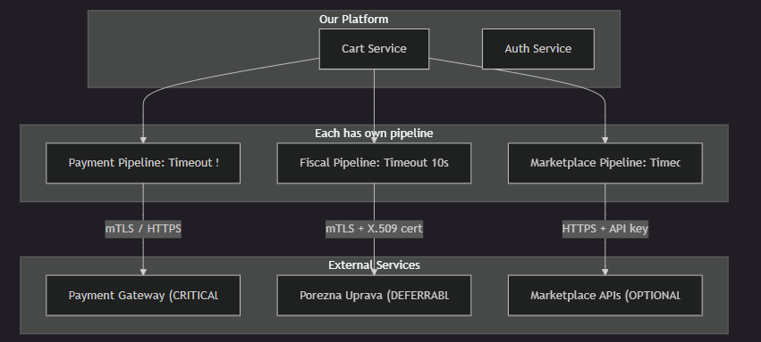
Integration High Level Architecture

Slide 23
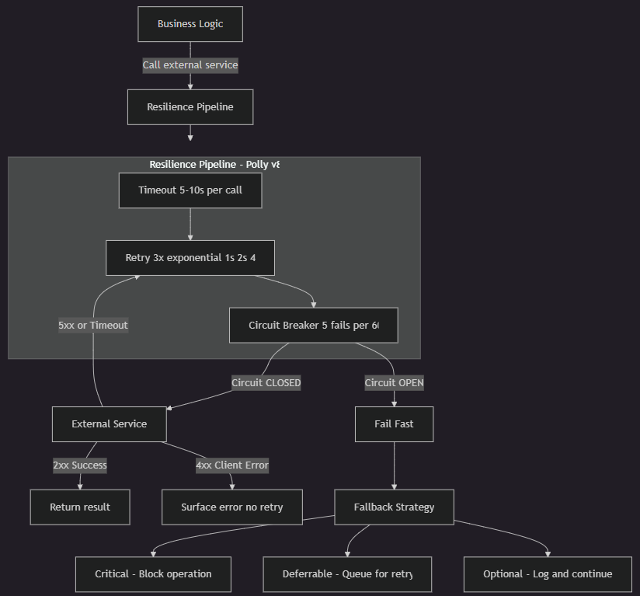
Generic Resilience Flow

Slide 24
Resilience Patterns for External Services
Circuit Breaker (Polly v8):
• Failure threshold: 5 failures in rolling 60s window
• Open state: returns 503 immediately (no calls to dependency)
• Half-open: allows 3 probes after 30s reset timeout
• Closed: normal operation resumes after successful probes
Fallback Strategy:
• Redis unavailable → direct DB reads + in-memory rate limits
• RabbitMQ unavailable → local queue (1000 msgs) + DB persistence
• Payment failure → order stays in Pending state for retry
• Fiscal failure → ZKI-only receipt, async retry within 48h

Slide 25
Section 6
Monitoring and Alerting

Slide 26
Health Checks
Every service exposes /health endpoint reporting:
• Healthy (200): all dependencies respond within 2s
• Degraded (200): some dependencies slow (2–5s) but functional
• Unhealthy (503): one or more dependencies unreachable
Kubernetes Probes:
• Liveness: /health, initial delay 15s, interval 30s, threshold 3
→ Restart pod if unhealthy for 90s
• Readiness: /health, initial delay 5s, interval 10s, threshold 2
→ Remove from load balancer if unhealthy for 20s
Dependency Checks: PostgreSQL, Redis, RabbitMQ, Inventory Service

Slide 27
Monitoring Stack
Metrics Collection:
• Prometheus scrapes /metrics every 15 seconds
• Pod annotations: prometheus.io/scrape, /path, /port
• Metrics: request count, latency (P50/P95/P99), error rate
• 15-day retention for metric data
Visualization & Alerting:
• Grafana dashboards: per-service, per-endpoint breakdown
• Alertmanager rules with PagerDuty/Slack integration
Structured Logging:
• JSON format: timestamp, level, service, correlationId,
method, path, statusCode, responseTimeMs
• Centralized aggregation (ELK Stack / CloudWatch)

Slide 28
Distributed Tracing
▸ Correlation ID generated at API Gateway (X-Correlation-Id)
▸ Propagated to all downstream services via headers
▸ Included in every log entry and inter-service call
▸ Enables end-to-end request tracing across services
Request Flow Visibility:
Client → Gateway → Auth Validate → Cart Service → Redis/DB
Each hop logs the same Correlation ID for full trace
▸ Future: OpenTelemetry integration for spans and trace

Slide 29
Section 7
Code Delivery Plan

Slide 30
CI/CD Pipeline
Build Stage:
• Trigger: push to feature branch or PR
• Steps: restore → build → unit tests → integration tests
• Docker multi-stage build (sdk:8.0 → aspnet:8.0 runtime)
• Image tagged with git SHA + semantic version
Deploy Stage:
• Dev: auto-deploy on merge to develop
• Staging: auto-deploy on merge to main (with integration tests)
• Production: manual approval gate after staging validation
• Rolling update strategy (zero-downtime deployments)
Quality Gates:
• All unit + integration tests pass
• Code coverage > 80%
• No critical/high security vulnerabilities (SAST scan)

Slide 31
Branching Strategy (Git Flow)
▸ main — production-ready code, tagged releases
▸ develop — integration branch, auto-deploys to staging
▸ feature/* — individual features (branch from develop)
▸ hotfix/* — urgent production fixes (branch from main)
▸ release/* — release preparation and stabilization
Workflow:
1. Developer creates feature/TICKET-description from develop
2. Opens PR → triggers CI pipeline (build + test + SAST)
3. Code review by team member (min 1 approval)
4. Merge to develop → auto-deploy to staging
5. Release branch → final QA → merge to main → tag → deploy

Slide 32
Questions?
Thank you for your attention

