Slide 1
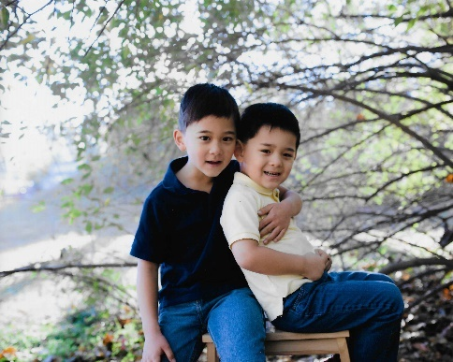
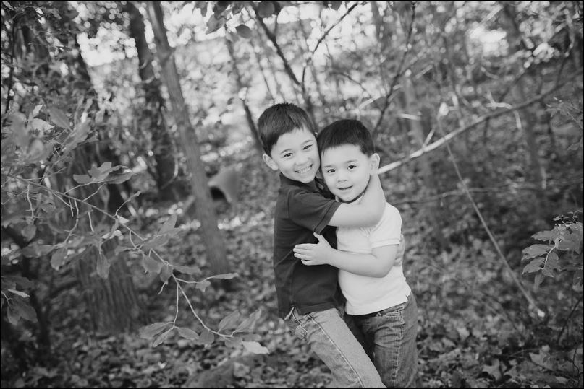










Thank you for a wonderful 2016! Wishing you every happiness this Holiday Season and throughout the coming year!
THE Collins FAMILY

