Slide 1
SolutionPack for Isilon Watch4net Official Content v 1.0
2013-02-27 -- A.Lemay – Initial version

Slide 2
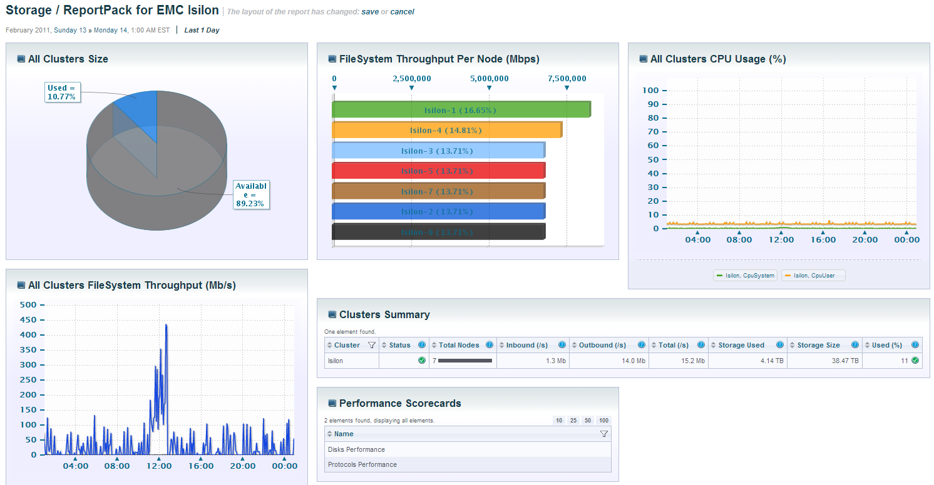
Global Dashboard
Important Multi Isilon Performance and Capacity
Cluster specific drill-down

Slide 3
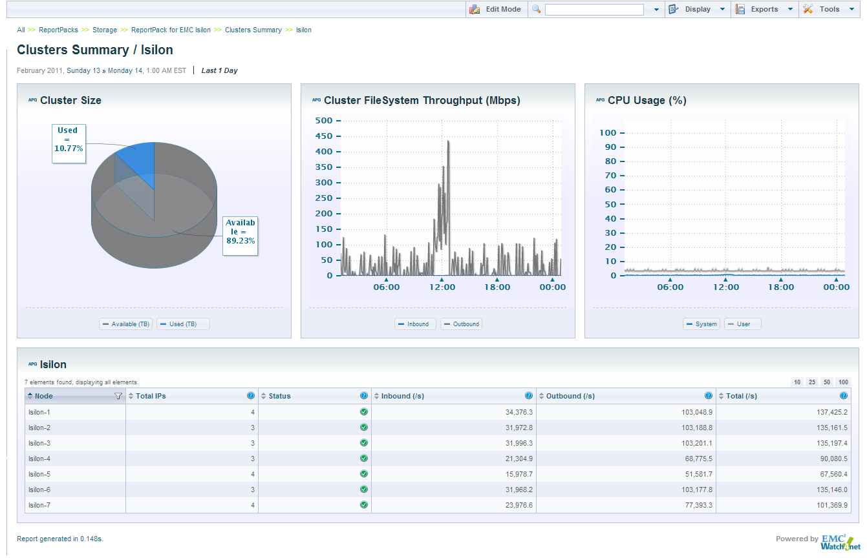
Isilon Cluster Dashboard
Throughput total for the cluster
Validate in one look that all the Isilon of your cluster work with the same load
Drill down to any Isilon of that cluster

Slide 4
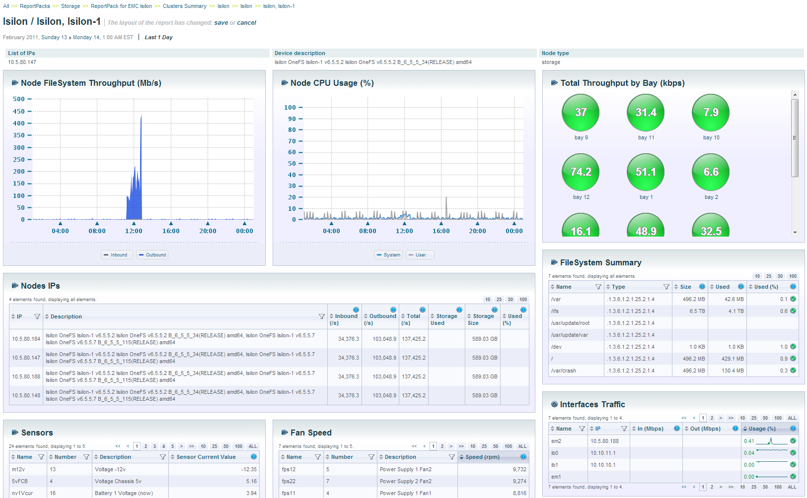
Isilon Specific Dashboard
Usage distribution by Nodes IP
Environmental statistics
Top VM using disk IO on that Datastore

Slide 5
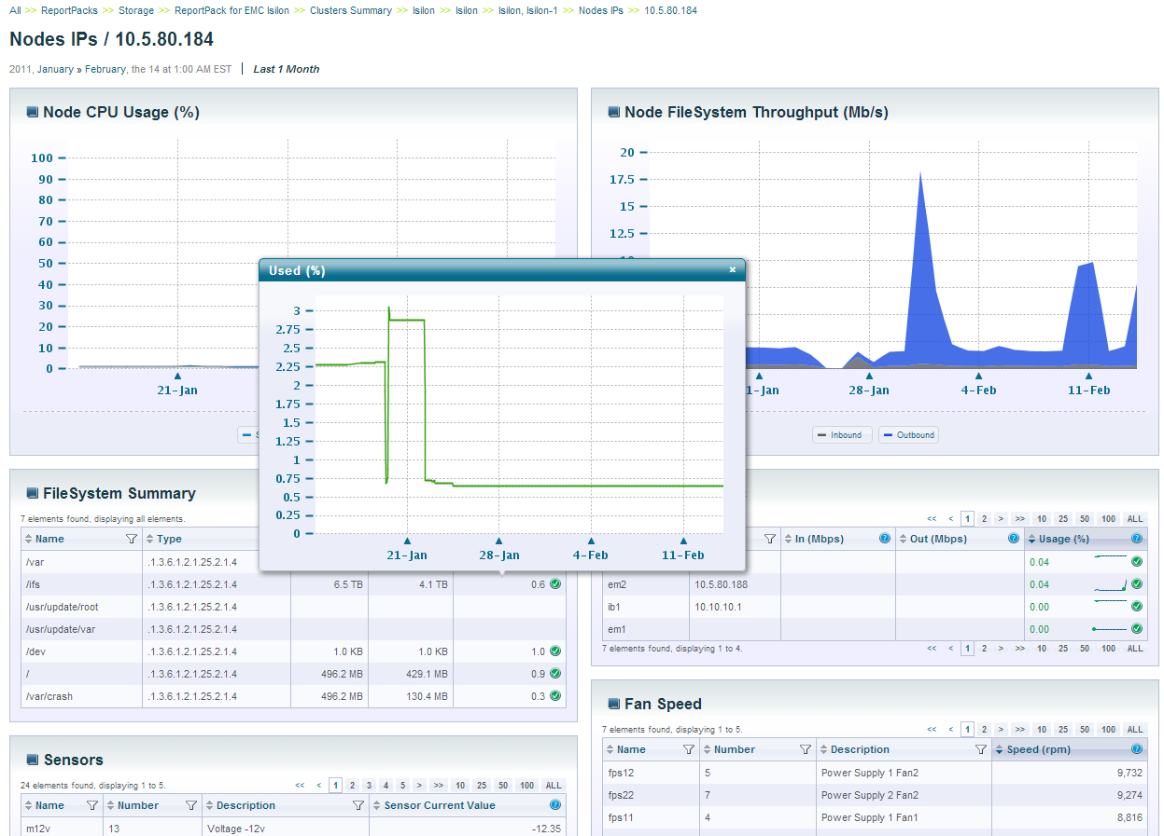
Isilon Nodes IP View
Click to see historical details for any metric

