Slide 1
Fashion MNIST Dataset
Why Fashion-MNIST?
The original MNIST dataset contains a lot of handwritten digits. Members of the AI/ML/Data Science community love this dataset and use it as a benchmark to validate their algorithms. In fact, MNIST is often the first dataset researchers try. "If it doesn't work on MNIST, it won't work at all", they said. "Well, if it does work on MNIST, it may still fail on others.“
To Serious Machine Learning Researchers
Seriously, we are talking about replacing MNIST. Here are some good reasons:
- MNIST is too easy. Convolutional nets can achieve 99.7% on MNIST. Classic machine
learning algorithms can also achieve 97% easily. Check out our side-by-side benchmark for
Fashion-MNIST vs. MNIST, and read "Most pairs of MNIST digits can be distinguished pretty
well by just one pixel."
- MNIST is overused. In this April 2017 Twitter thread, Google Brain research scientist and
deep learning expert Ian Goodfellow calls for people to move away from MNIST.
- MNIST can not represent modern CV tasks, as noted in this April 2017 Twitter thread, deep
learning expert/Keras author François Chollet.

Slide 2
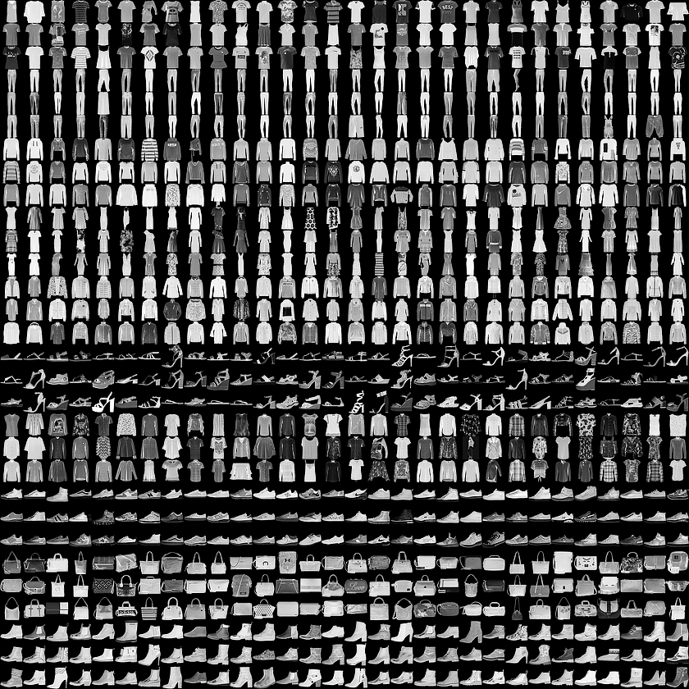
Fashion MNIST Dataset
Fashion MNIST Dataset

Slide 3
< Fashion MNIST Dataset Load >
https://github.com/zalandoresearch/fashion-mnist
Data Load
# 위 사이트에서 데이터를 다운받아 작업 디렉토리에 복사
# /data/fashion : directory name
from tensorflow.examples.tutorials.mnist import input_data
fashion_mnist = input_data.read_data_sets('data/fashion', one_hot=True)
count = 0
nrows = ncols = 4
plt.figure(figsize=(12,8))
for n in range(0,8):
count += 1
plt.subplot(nrows, ncols, count)
plt.imshow(fashion_mnist.test.images[n].reshape(28, 28), cmap='Greys', interpolation='nearest')
plt.show()

