Slide 1
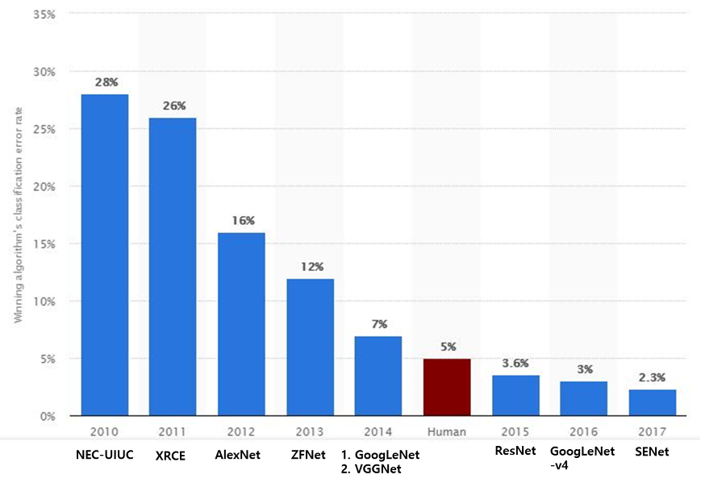
Google Inception model
- Google은 Going Deep with Convolutions(Szegedy et al.)은 Inception이라는 개념을 제안
- 이를 바탕으로 구현한 모델인 GoogLeNet은 ImageNet Large-Scale Visual Recognition
Challenge 2014(ILSVRC14)에서 좋은 성적을 거둔다.
- The ImageNet Large Scale Visual Recognition Challenge (ILSVRC)
Autoencoder의 기본 개념

Slide 2
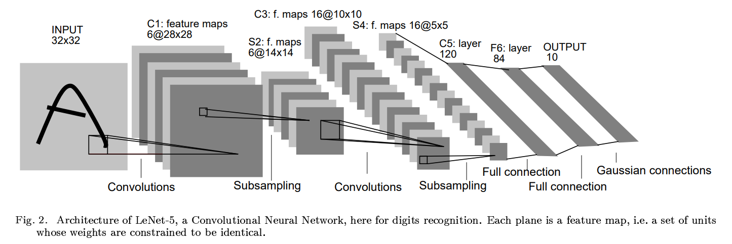
Google Inception model
History of CNN-related Networks
1. LeNet-5
- Gradient Based Learning Applied To Document Recognition - Y. Lecun, L. Bottou,
Y. Bengio, P. Haffner; 1998
- Helped establish how we use CNNs today
- Replaced manual feature extraction
Autoencoder의 기본 개념

Slide 3









Google Inception model
History of CNN-related Networks
1. LeNet-5
conv
avg pool
conv
avg pool
. . .
5$×$ 5
s = 1
f = 2
s = 2
5$×$ 5
s = 1
f = 2
s = 2
32$×$32$×$1
28$×$28$×$6
14$×$14$×$6
10$×$10$×$16
FC
FC
. . .
$$\hat{y}$$
$$⋮$$
$$⋮$$
10
5$×$5$×$16
120
84
Reminder:
Output size = (N+2P-F)/stride + 1
Autoencoder의 기본 개념

Slide 4
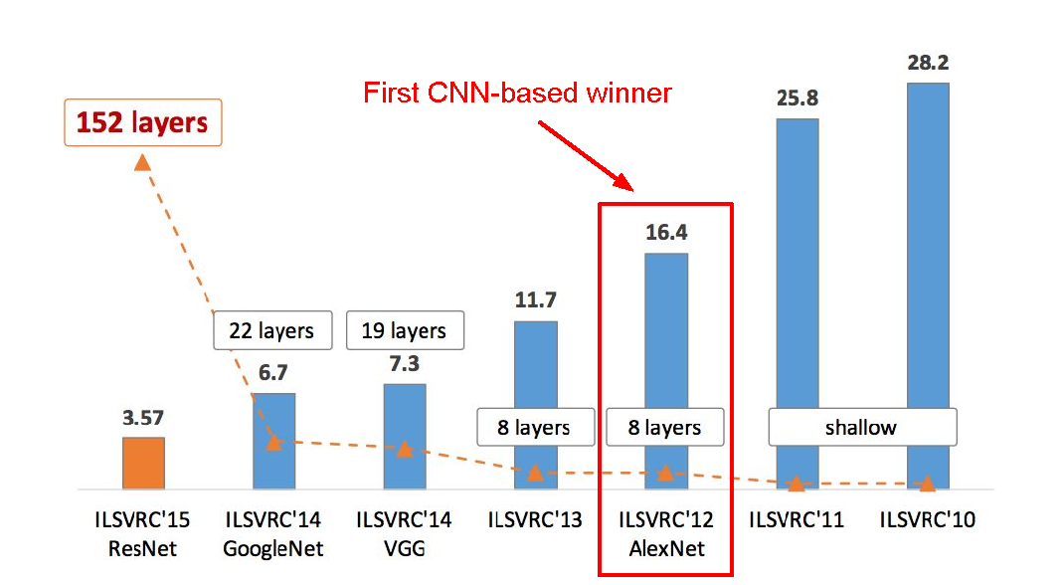
Google Inception model
History of CNN-related Networks
2. AlexNet
- ImageNet Classification with Deep Convolutional Neural Networks - Alex Krizhevsky, Ilya
Sutskever, Geoffrey E. Hinton; 2012
- Facilitated by GPUs, highly optimized convolution implementation and large datasets
(ImageNet)
- One of the largest CNNs to date
- Has 60 Million parameter compared to 60k parameter of LeNet-5
Autoencoder의 기본 개념

Slide 5





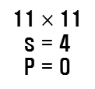











Google Inception model
History of CNN-related Networks
2. AlexNet
FC
FC
. . .
$$⋮$$
$$⋮$$
Softmax
1000
4096
4096
conv
max pool
conv
max pool
. . .
11$×$ 11
s = 4
P = 0
3$×$ 3
s = 2
5$×$ 5
S = 1
P = 2
3$×$ 3
s = 2
227$×$227 $×$3
55$×$55 $×9$6
27$×$27 $×$96
27$×$27 $×$256
conv
conv
conv
max pool
. . .
. . .
3$×$ 3
S = 1
P = 1
3$×$ 3 s = 1
P = 1
3$×$ 3
S = 1
P = 1
3$×$ 3
s = 2
13$×$13 $×$256
13$×$13 $×$384
13$×$13 $×$384
13$×$13 $×$256
6$×$6 $×$256
Autoencoder의 기본 개념

Slide 6
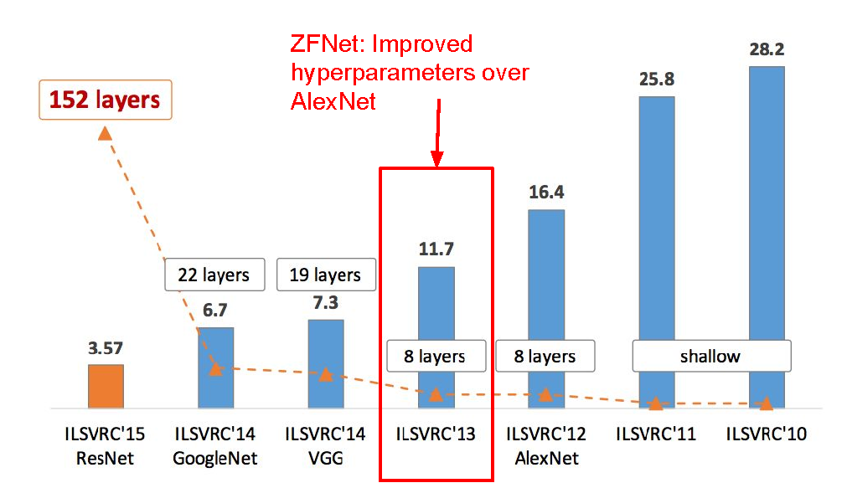
Google Inception model
History of CNN-related Networks
3. ZFNet
Autoencoder의 기본 개념

Slide 7
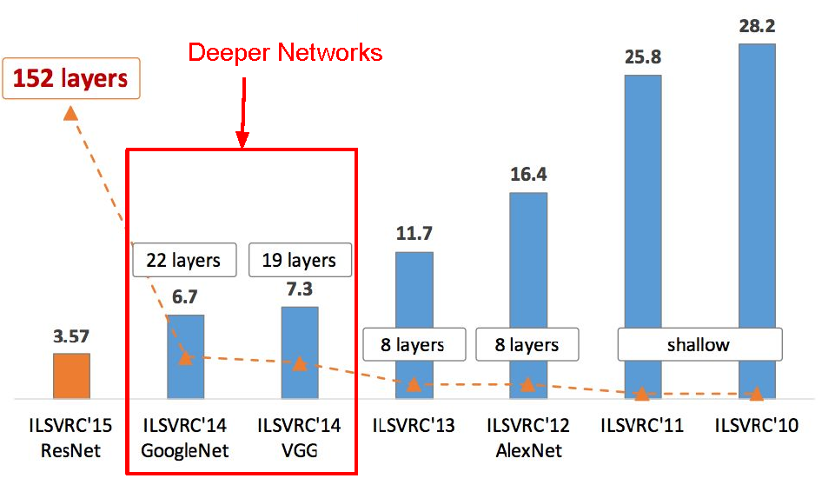
Google Inception model
History of CNN-related Networks
4. VGGNet
- Very Deep Convolutional Networks For Large Scale Image Recognition - Karen Simonyan and
Andrew Zisserman; 2015
- The runner-up at the ILSVRC 2014 competition
- Significantly deeper than AlexNet
- 140 million parameters
Autoencoder의 기본 개념

Slide 8
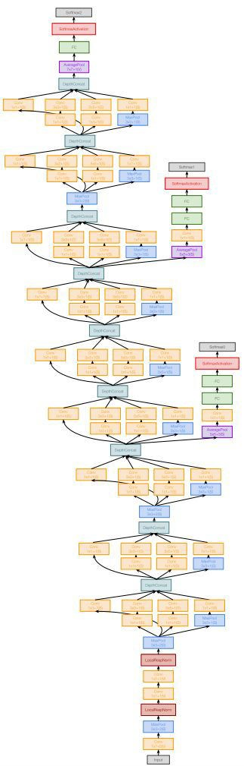
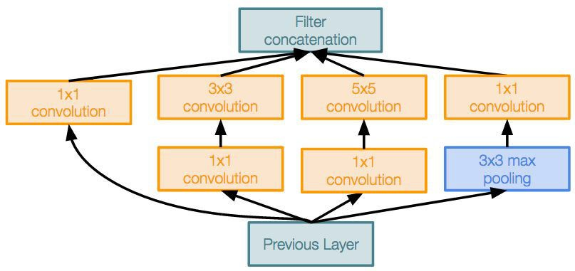
Google Inception model
History of CNN-related Networks
5. GoogleNet
- Going Deeper with Convolutions - Christian Szegedy et al.; 2015
- ILSVRC 2014 competition winner
- Also significantly deeper than AlexNet
- x12 less parameters than AlexNet
- Focused on computational efficiency
“Inception module”: design a good local network topology (network within a network) and then stack these modules on top of each other
Filter concatenation
1x1 convolution
3x3 convolution
5x5 convolution
1x1 convolution
1x1 convolution
1x1 convolution
3x3 max pooling
Previous layer
Autoencoder의 기본 개념

Slide 9
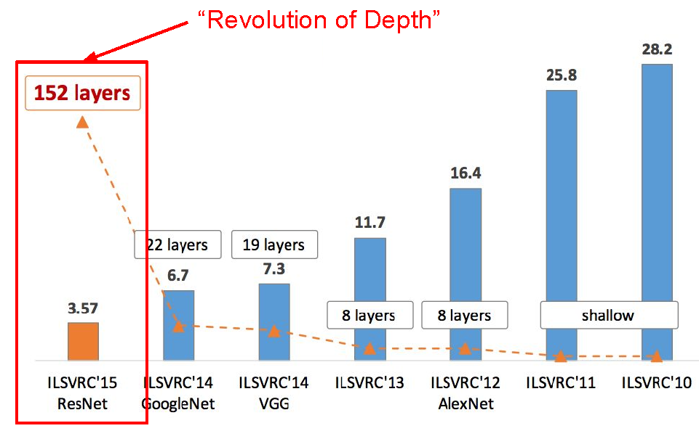
Google Inception model
History of CNN-related Networks
5. ResNet
- Deep Residual Learning for Image Recognition - Kaiming He, Xiangyu Zhang, Shaoqing Ren,
Jian Sun; 2015
- Extremely deep network – 152 layers
- Deeper neural networks are more difficult to train.
- Deep networks suffer from vanishing and exploding gradients.
- Present a residual learning framework to ease the training of networks that are substantially
deeper than those used previously.
Autoencoder의 기본 개념

Slide 10
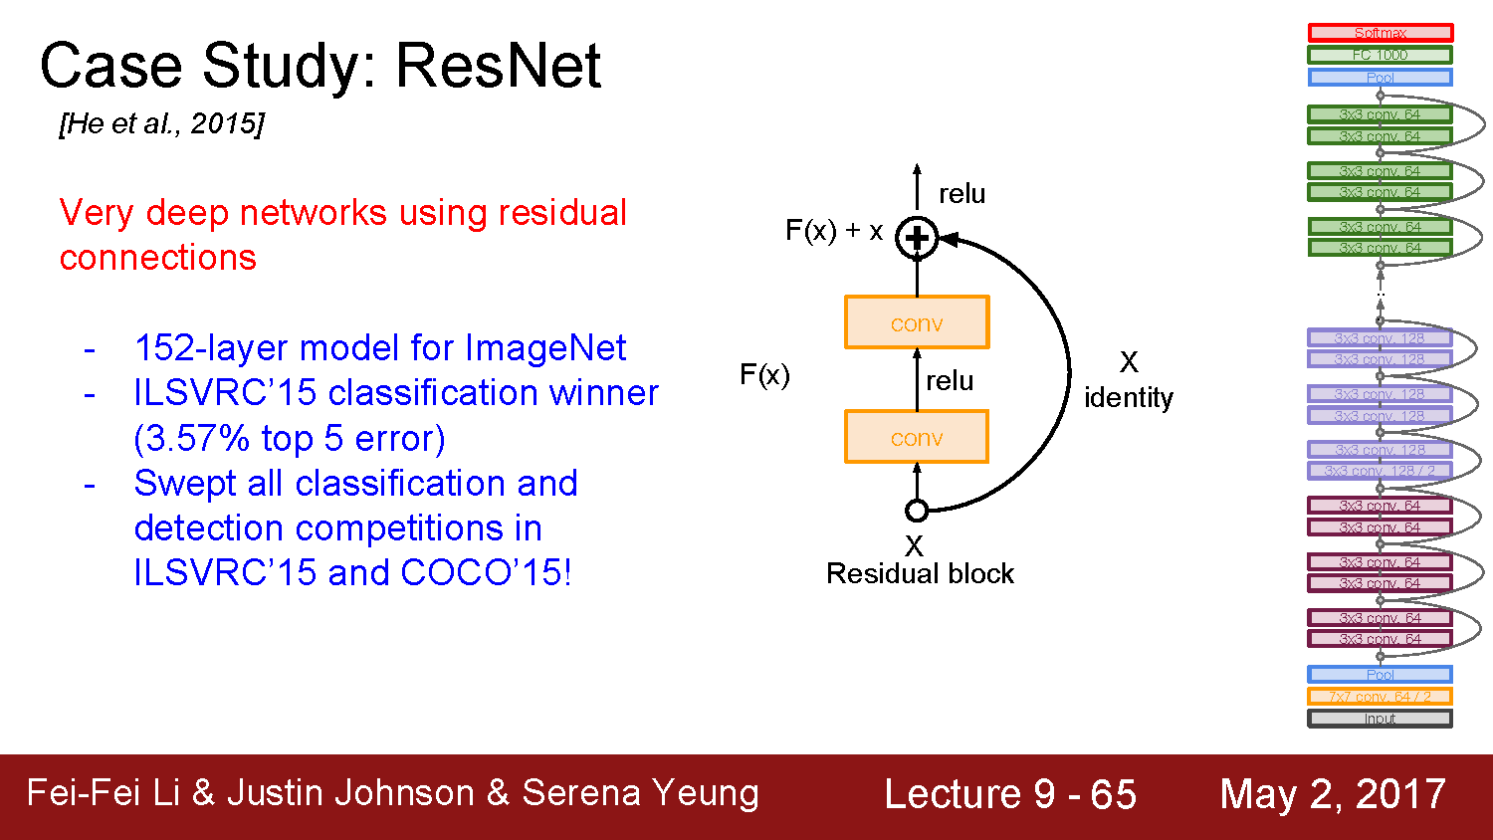
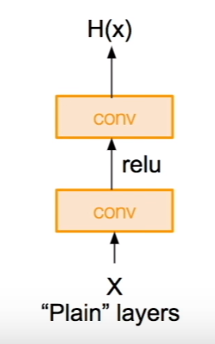
Google Inception model
History of CNN-related Networks
5. ResNet
Autoencoder의 기본 개념

Slide 11
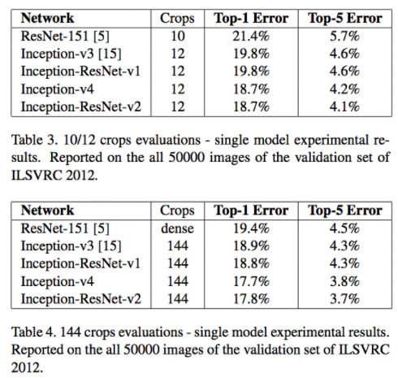
Google Inception model
History of CNN-related Networks
6. GoogleNet Version
- Inception v1 (2014)
- Inception. v2. / v3. (2015)
: Inception.v3 모델을 Inception.v2++ 정도로 봐도 무방
: VGG를 선호
: 구현과 사용의 어려움
- Inception v4.
: 기존의 Inception.v3 모델에 몇 가지 기능을 추가시켜
업그레이드한 모델
- Inception-ResNet v1
: ResNet 구조를 빌려서 사용
- Inception-ResNet v2
Autoencoder의 기본 개념

Slide 12
Google Inception model
Inception 모델의 Transfer Learning
- Data Set : flower
: 작업 디렉토리에 /workspace만들고 아래 데이터를 다운 및 압축풀기
: http://download.tensorflow.org/example_images/flower_photos.tgz
- Training : Retrain Inception Model
python retrain.py \
--bottleneck_dir=./workspace/bottlenecks \
--model_dir=./workspace/inception \
--output_graph=./workspace/flowers_graph.pb \
--output_labels=./workspace/flowers_labels.txt \
--image_dir ./workspace/flower_photos \
--how_many_training_steps 1000
### retrain.py 주요 옵션
- --bottleneck_dir : 학습할 사진을 인셉션 용으로 변환해서 저장할 폴더
- --model_dir : inception 모델을 다운로드 할 경로
- --image_dir : 원본 이미지 경로
- --output_graph : 추론에 사용할 학습된 파일(.pb) 경로
- --output_labels : 추론에 사용할 레이블 파일 경로
- --how_many_training_steps : 얼만큼 반복 학습시킬 것인지

Slide 13
< predict.py >
import tensorflow as tf
import matplotlib.pyplot as plt
import matplotlib.image as mpimg
import sys
tf.app.flags.DEFINE_string("output_graph", "./workspace/flowers_graph.pb","학습된 신경망이 저장된 위치")
tf.app.flags.DEFINE_string("output_labels","./workspace/flowers_labels.txt","학습할 레이블 데이터 파일")
tf.app.flags.DEFINE_boolean("show_image",True, "이미지 추론 후 이미지를 보여줍니다.")
FLAGS = tf.app.flags.FLAGS
def main(_):
labels = [line.rstrip() for line in tf.gfile.GFile(FLAGS.output_labels)]
with tf.gfile.FastGFile(FLAGS.output_graph, 'rb') as fp:
graph_def = tf.GraphDef()
graph_def.ParseFromString(fp.read())
tf.import_graph_def(graph_def, name='')
with tf.Session() as sess:
logits = sess.graph.get_tensor_by_name('final_result:0')
image = tf.gfile.FastGFile(sys.argv[1], 'rb').read()
prediction = sess.run(logits, {'DecodeJpeg/contents:0': image})
print('=== 예측 결과 ===')
for i in range(len(labels)):
name = labels[i]
score = prediction[0][i]
print('%s (%.2f%%)' % (name, score * 100))
if FLAGS.show_image:
img = mpimg.imread(sys.argv[1])
plt.imshow(img)
plt.show()
if __name__ == "__main__":
tf.app.run()
<실행 >
python predict.py workspace/flower_photos/roses/이름.jpg
Ex) python predict.py ./workspace/flower_photos/roses/20409866779_ac473f55e0_m.jpg

