Slide 1
FARAWAY
Login with Google
Login with …
No acc? Sign up

Slide 2
Signup page
Enter

Slide 3
Question
Personal
Organization

Slide 4
Workspace / Personal
Explore my pathway
(Scroll down)

Slide 5
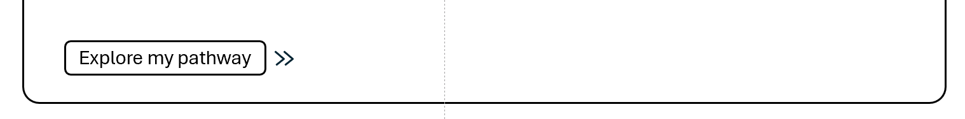
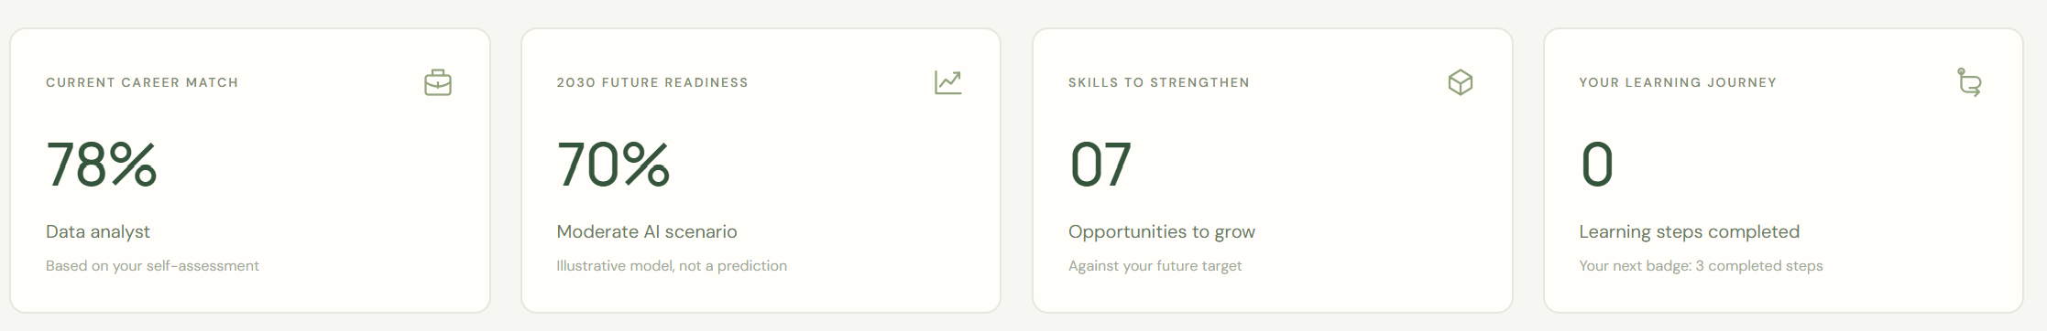
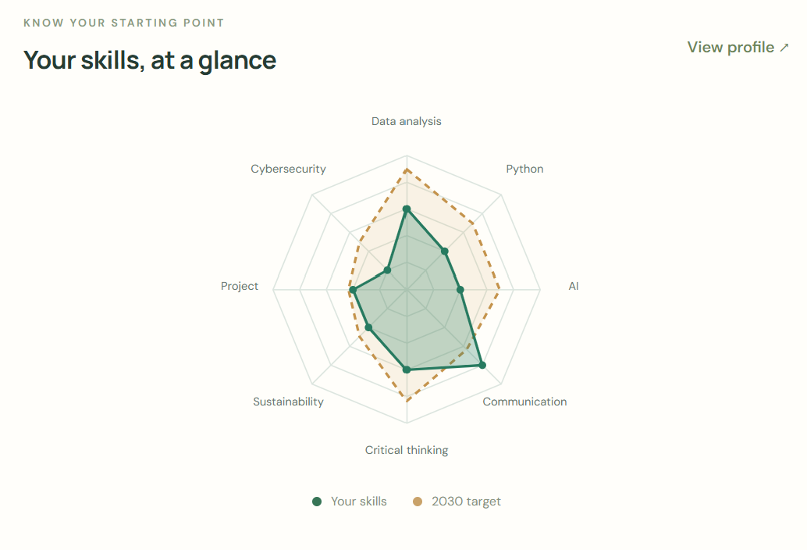
Workspace / Personal
(remain empty or dash when cv not uploaded)
Skill trend chart
Moderate | Fast AI

Slide 6
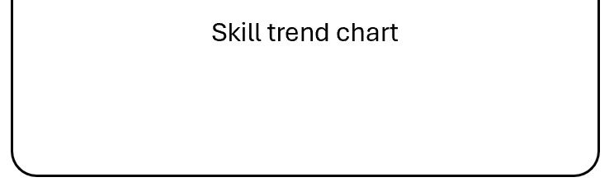
Workspace / Personal
Study plan overview | [Job Name]
Python
SDG explanation
(shows when hover)
C++
SQL

Slide 7
Explore Pathway Interface (Info)
Interest
Upload CV
Education
Experience
SKILLS
(Scroll down)

Slide 8
Radar Map (Real time update)
If not yet select job, no overlapped hexagon, just pure skill sum
If selected job, then have overlapped hexagon (job requirement) along with skill sum
Its like when u adjust skill assessment (4 → 5), radar map change together
SKILLS
Python
3/5
C
3/5
C++
3/5
HTML
3/5

Slide 9
Skill Analysis
Horizontal Bar Chart (Skill Trend)
Click to see future scenarios
Flip left and right
Source 1 Vertical Bar Chart (Job Trend)
Source 2 Vertical Bar Chart (Job Trend)

Slide 10
Skill Analysis
Source 1 Vertical Bar Chart (Job Trend)
Source 2 Vertical Bar Chart (Job Trend)
Bare reflection ( future scenarios of job trend)
- Click to flip 180 degrees up and down

Slide 11

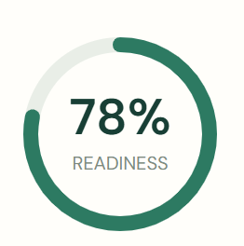
Skill Analysis
Bare reflection ( future scenarios of job trend)
- Click to flip 180 degrees up and down
JOB
JOB
JOB
Set Career Target →
Set Career Target →
Set Career Target →

Slide 12
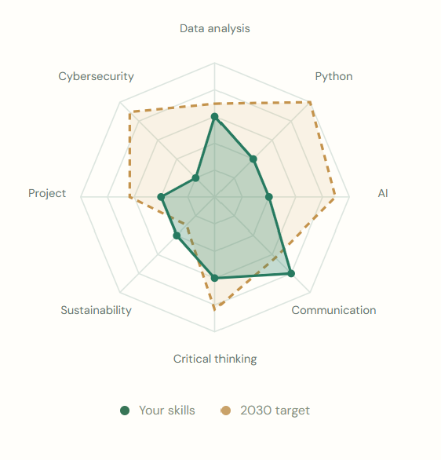
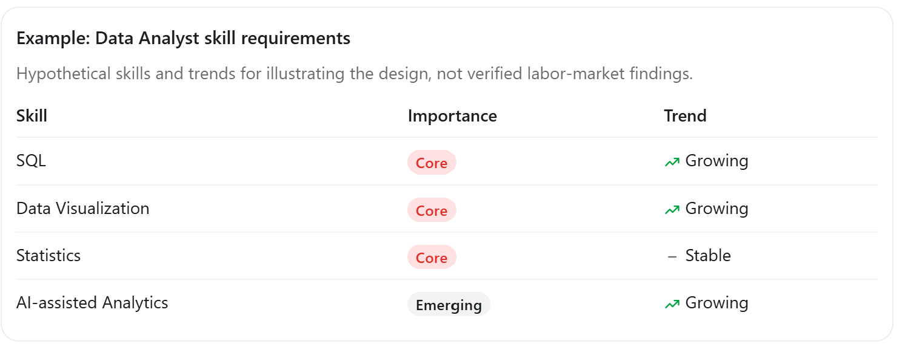
[Job Name]
SDG explanation
(shows when hover)
- Job’s SDG
SDG explanation
(shows when hover)
- Skill’s SDG
Toggle between Moderate / Fast
- Can explain what does it mean

Slide 13
[Job Name]
SDG explanation
(shows when hover)
- Job’s SDG
SDG explanation
(shows when hover)
- Skill’s SDG
Toggle between Moderate / Fast
- Can explain what does it mean

