Slide 1
SCIE1500
Week 1 Laboratory
Analysis of Global Plastics Production Data

Slide 2

SCIE1500 | Instructions
1. Get the data - follow this link (or scan the QR code) to download the dataset global-plastics-production.csv:
* Scroll down to “How much plastic does the world produce?”
* Select the tab “DOWNLOAD” on the right chart.
* Download the Full data (CSV).
2. Guided analysis - select a software to read in the data on global plastics production, visualise and explore it, and then determine what type of equation or mathematical model would describe the relationship between production and time. We will guide you along the way!
3. Softwares - the exercises can also be done in Excel, Jupyter notebooks (Python) or other softwares.

Slide 3
2. Read in the data on global plastics production, visualise and explore it, and then determine what type of equation or mathematical model would describe the relationship between production and time.
3. The exercises can also be done in Excel or other software (e.g. Python).
Get the data

Slide 4
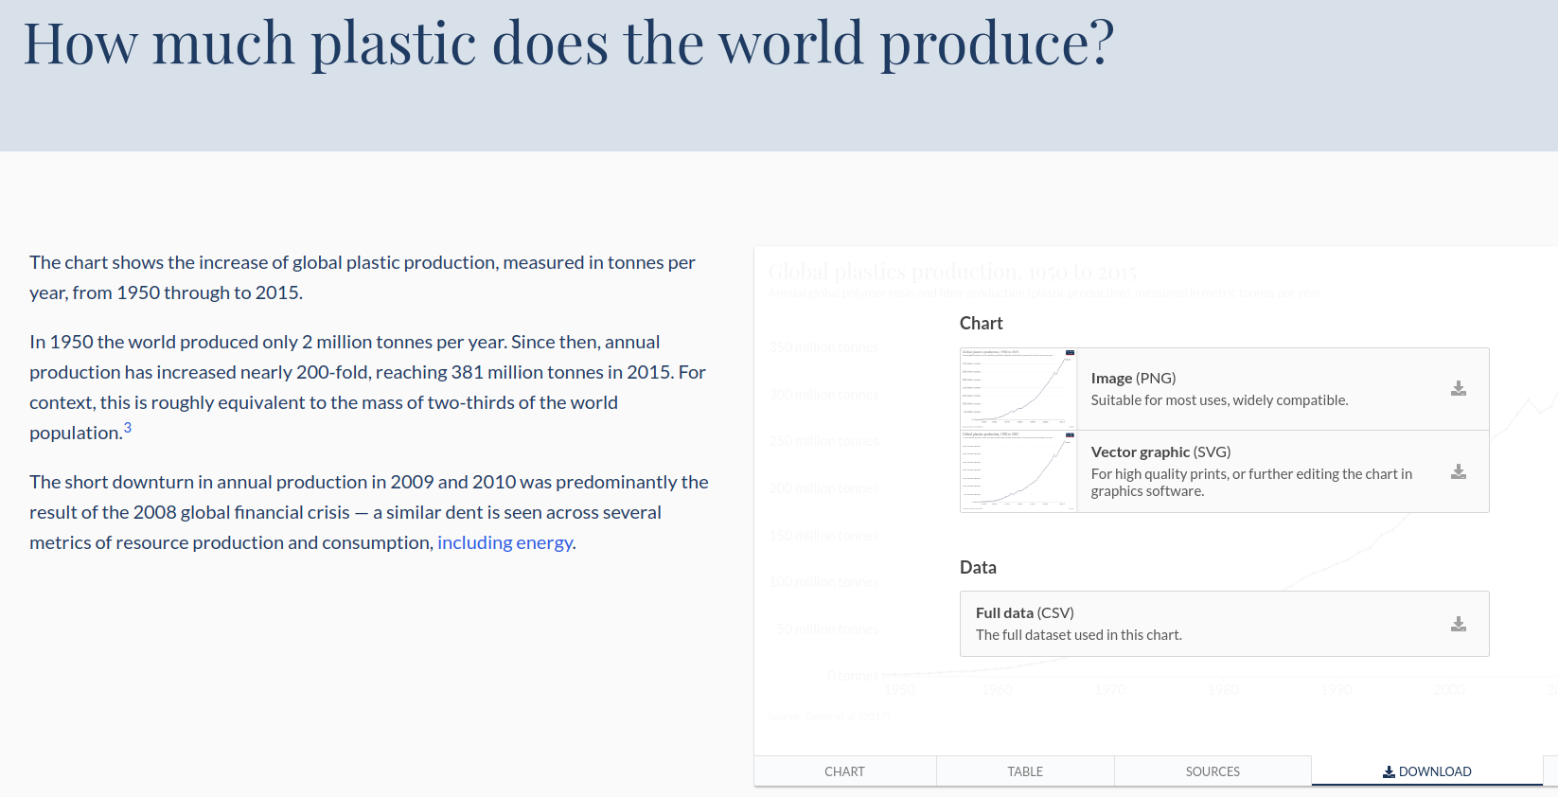
SCIE1500 | Get the data
1. Go to (QR code) https://ourworldindata.org/plastic-pollution
2. Scroll down to “How much plastic does the world produce?”
3. Select the tab “DOWNLOAD” on the right chart.

Slide 5
2. Read in the data on global plastics production, visualise and explore it, and then determine what type of equation or mathematical model would describe the relationship between production and time.
3. The exercises can also be done in Excel or other software (e.g. Python).
Guided analysis

Slide 6
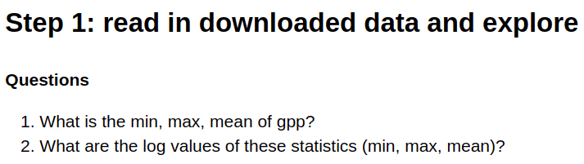
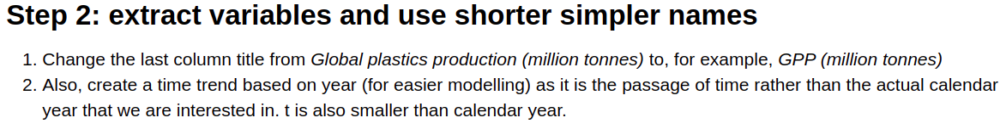

SCIE1500 | Guided analysis

Slide 7
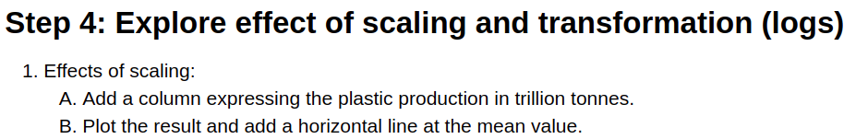
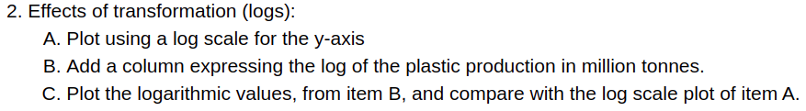
SCIE1500 | Guided analysis

Slide 8
SCIE1500 | Guided analysis
Steps 5 - 6

Slide 9
SCIE1500 | Guided analysis
Steps 5 - 6

Slide 10
SCIE1500 | Guided analysis
Steps 5 - 6

Slide 11
Student Exercise

Slide 12
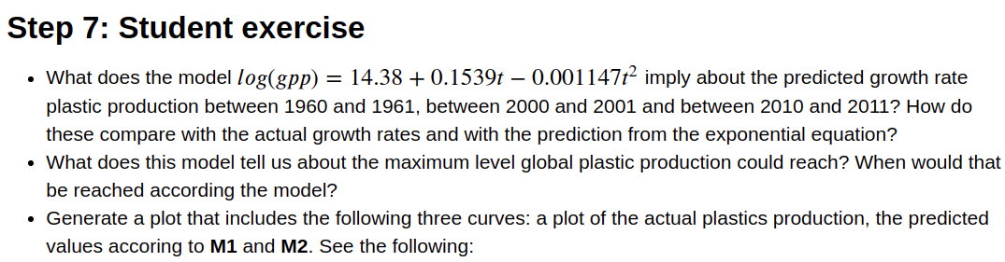
SCIE1500 | Student exercise

Slide 13
Examples of expected results

Slide 14
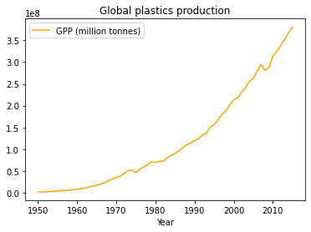

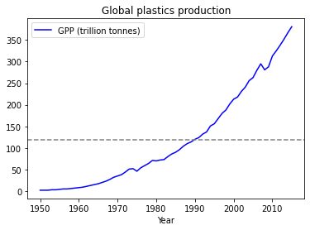
SCIE1500 | Example of expected results
Step 3: Visualise the data

Slide 15
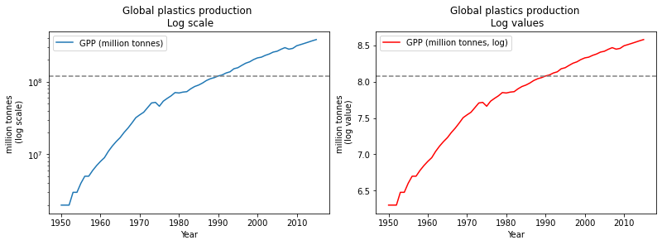
SCIE1500 | Example of expected results
Step 4: Explore effect of scaling and transformation (logs)

Slide 16
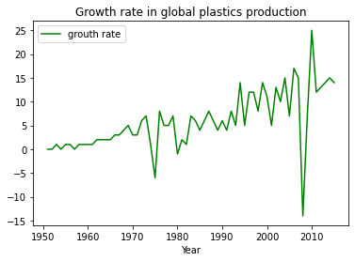
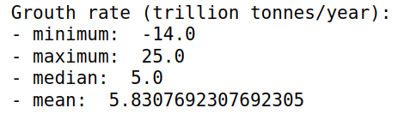
SCIE1500 | Example of expected results
Step 5: What is the story about the growth rates in plastic production?

Slide 17
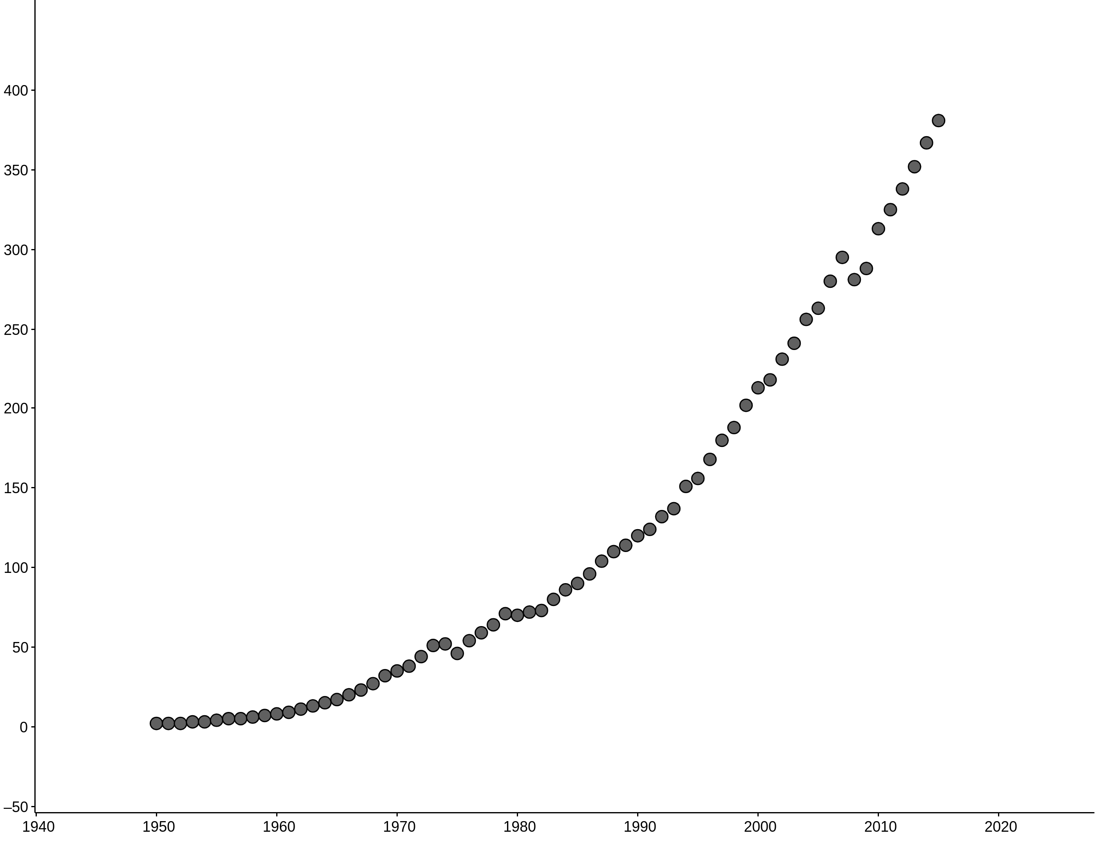
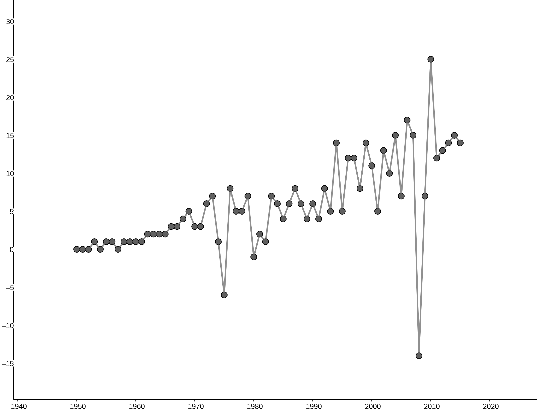
SCIE1500 | Example of expected results
Step 3: Visualise the data

Slide 18
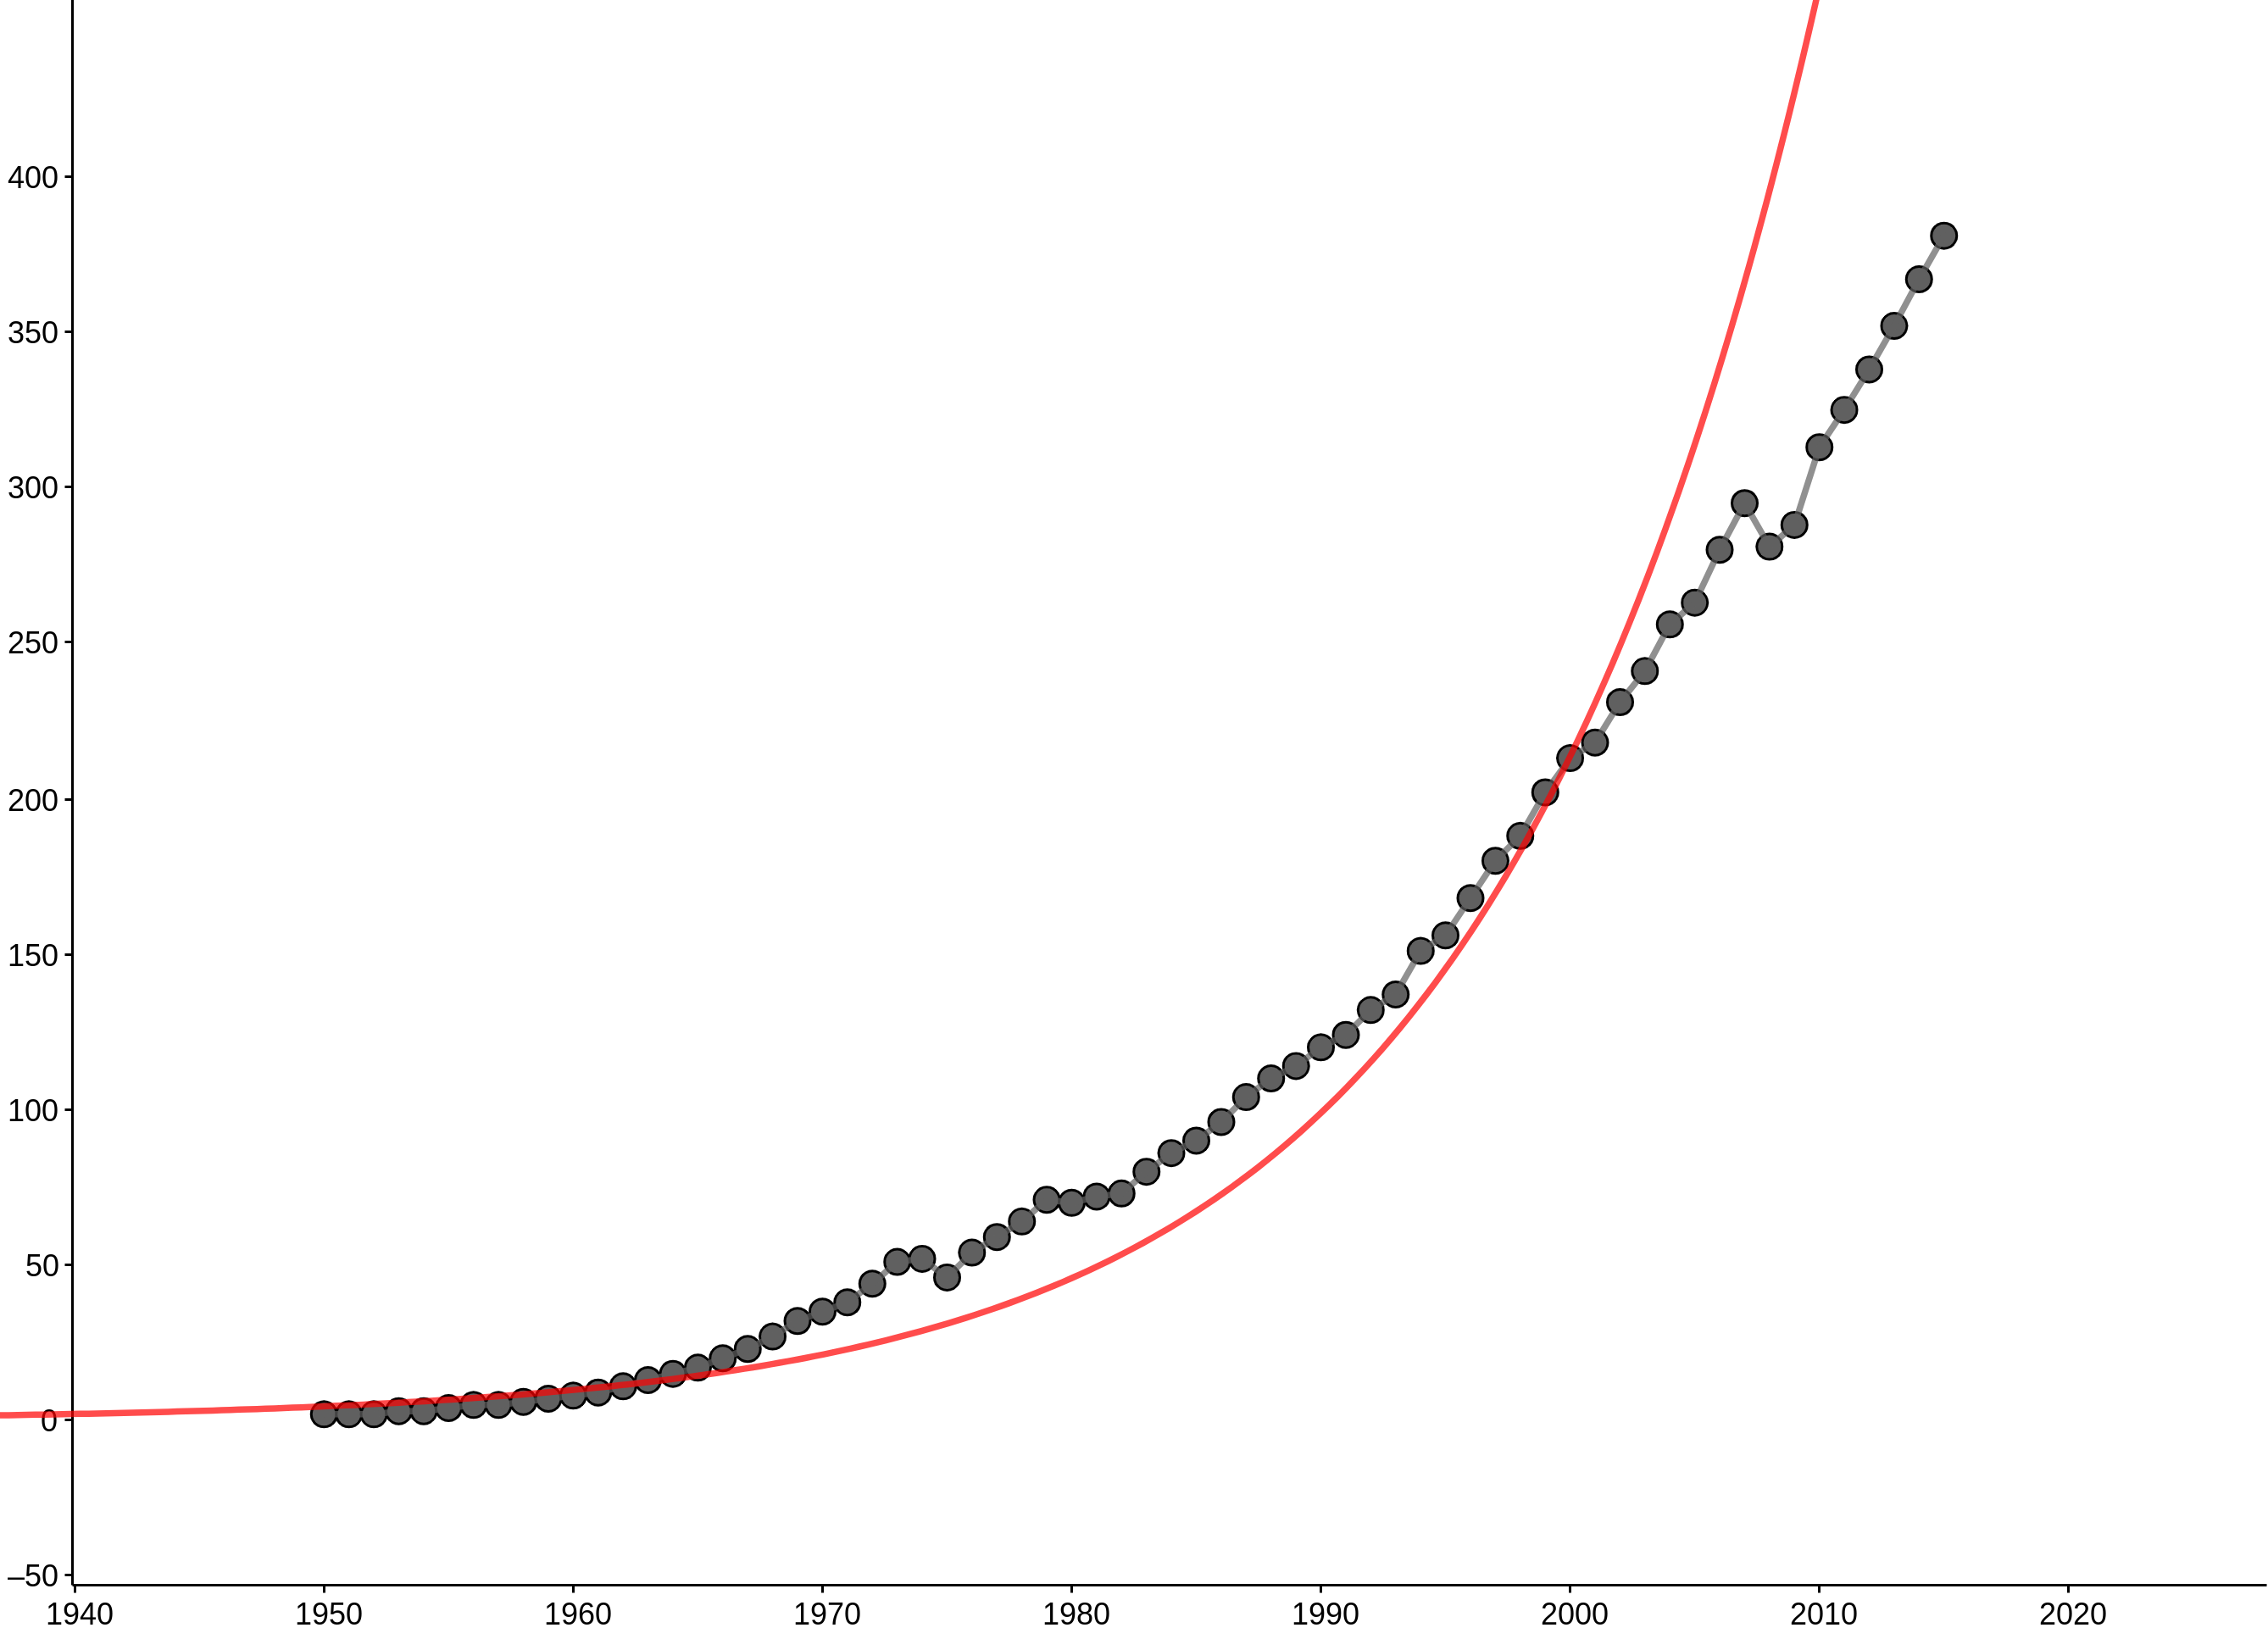
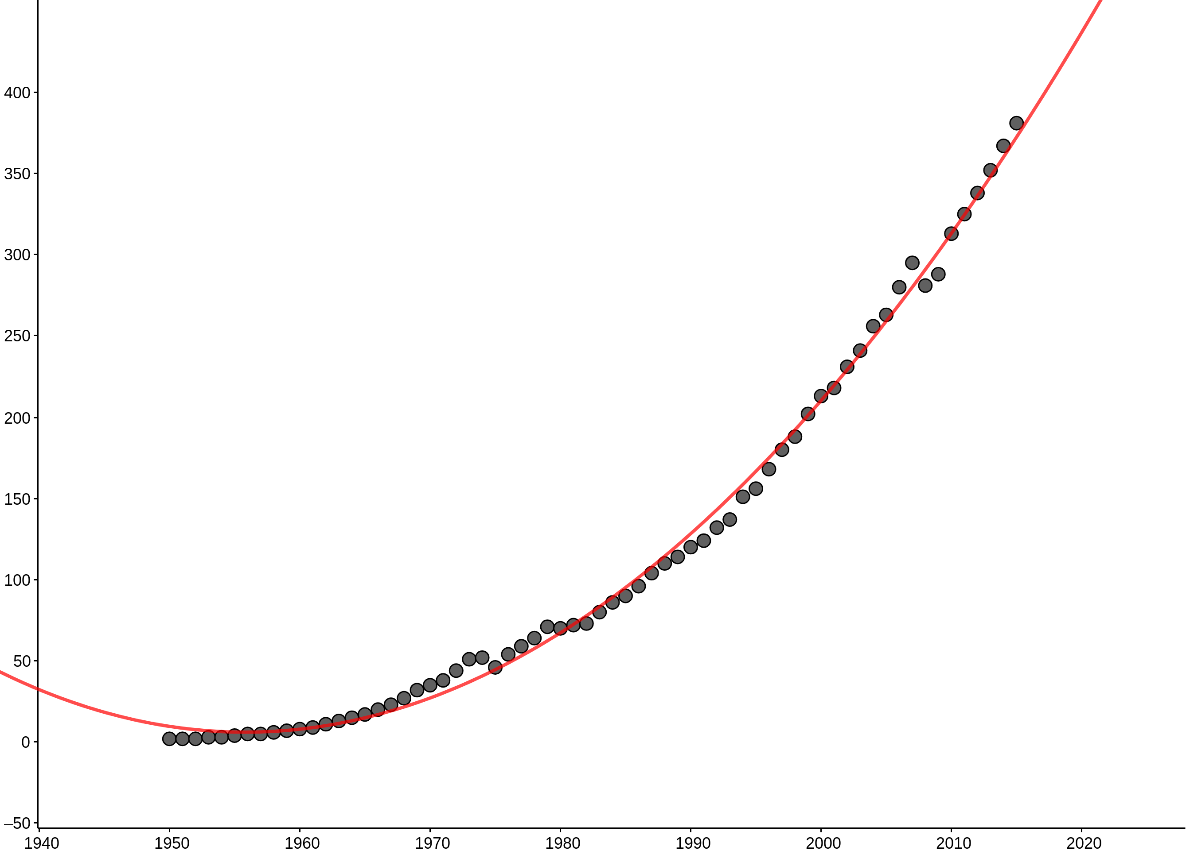
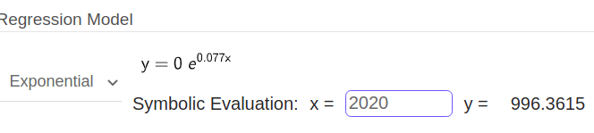
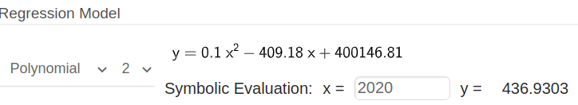
SCIE1500 | Example of expected results
Step 4: Explore effect of scaling and transformation (logs)

Slide 19
SCIE1500 | Example of expected results
Step 5: What is the story about the growth rates in plastic production?

Slide 20
SCIE1500 | References
Hannah Ritchie and Max Roser (2018) - "Plastic Pollution". Published online at OurWorldInData.org. Retrieved from: 'https://ourworldindata.org/plastic-pollution' [Online Resource]

