Slide 1
SCIE1500 Week 1 Laboratory
Analysis of Global Plastics Production Data
&
Software set up
Notes:
1

Slide 2

SCIE1500 | Objectives for the lab (Week 1)
Discuss any issues about the topic for the week: Ocean pollution and plastic pollution
Student questions?
Comments?
Discuss resources available to support teaching in the unit
Discuss software needs for the unit and set up instructions for Jupyter notebooks (Python)
Guided exercises using global plastics production using Excel
- And may be take a small step in Jupter notebooks (do one simple exercise) if time allows
Notes:
2

Slide 3
SCIE1500 | Ocean pollution: topics covered
Ocean resources and their benefits
Ocean pollution: types, including plastic pollution
How serious is plastic pollution, where does it come from, why does it happen?
And how do scientists estimate the amount of plastic pollution?
What damages does it cause?
How difficult is it to deal with (reduce plastic waste and use)?
What policies can be used? And what is happening around the world?
Notes:
3

Slide 4
SCIE1500 | Resources available
Recorded lectures
Articles and other reading materials
Online resources
Online dictionaries and math resources
Tutorials on python and notebooks
It will be assumed that you are familiar with Excel or have basic skills. If there are details that you never used but need for an exercise, then that will be explained in the lab
Notes:
4

Slide 5
SCIE1500 | Software choice
We will use programming software in our study of analytical methods
But we will start simple and gradually switch to software that requires some programming
Start with Excel exercises
Then Excel plus Jupyter Notebooks
Then mostly Jupyter Notebooks (after week 3)
Why?
Doing things in Excel is tedious – you have to work hard every time you change data, the details of a plot or tweak some other aspect of what you are doing
Benefit from a lot more tools that are not available in Excel or similar software
Invest in skills that will help you learn other languages/software easily, e.g. R which is used a lot in teaching and research
Invest in skills that we can use outside in industry or government or other area of employment. Python is one of the open-source software that you can use anywhere.
Notes:
5

Slide 6
SCIE1500 | Installing Jupyter Notebooks
These instructions have been posted in LMS
Has anyone tried to install the software?
Any issues?
Notes:
6

Slide 7
Guided Exercise

Slide 8
SCIE1500 | Guided exercises
Objective of this exercise:
Work with actual world data on plastic production (1950-2015)
Explore and plot the data
Calculate growth rates (2 ways)
Develop a mathematical model to describe plastic production
Discuss what alternative forms could be relevant
Fit the curves/models and plot them
Evaluate how good the models are for predicting future plastic production
If time allows, do some of these exercises in Notebooks as a trial
Notes:
8

Slide 9
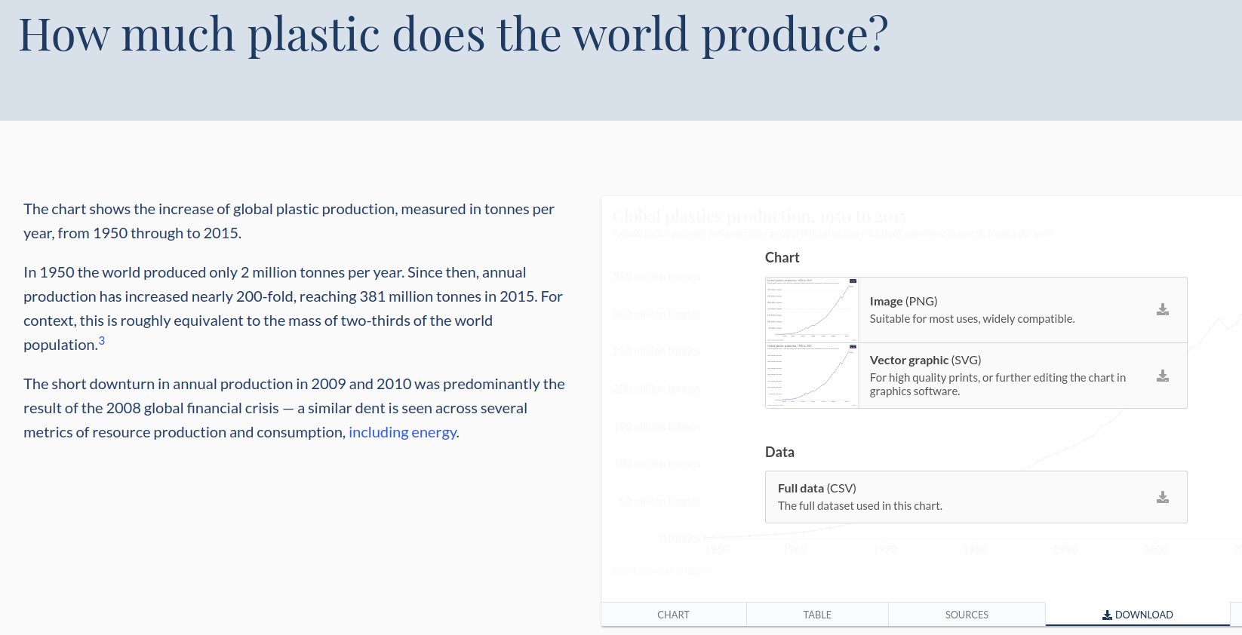
SCIE1500 | Get the data
1. Go to (QR code) https://ourworldindata.org/plastic-pollution
2. Scroll down to “How much plastic does the world produce?”
3. Select the tab “DOWNLOAD” on the right chart.
Notes:
9

Slide 10
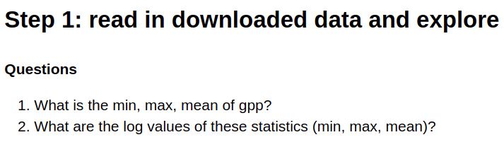
SCIE1500 | Explore data: What do you observe about the data?
Notes:
10

Slide 11
The next step is a good place to discuss what functional form would be suitable:
Linear too simple – assumes plastic production goes up by same amount every year,
Exponential – would capture the fact that the annual increase accelerated over time
GPP_{t}= A₀*exp(rt) could be better (constant growth rate better fit than constant slope)
Note: we may or may not insist that A₀= GPP_{o}?
But exponential is not necessarily the best fit. How about quadratic? We could explore that as well if we wished.
GPP_{t}= at² + bt + c
Let’s do things in steps. First, by exploring the growth rates.

Slide 12

SCIE1500 | Visualise data: What form of function would fit data?
Notes:
12

Slide 13
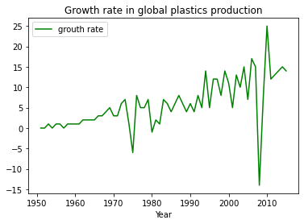
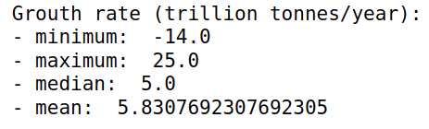
SCIE1500 | Calculate growth rate figures
Growth rate can be calculated in diferente ways.
Usual way: GrowthRate 1 = (New value – Old value)/Old value
Using log: GrowthRate 2 = log(New value/Old value)
Create columns in Excel to do both. How similar are they?
Leo, the growth rate below is diferente from what is in Excel (GR1 and GR2)
Notes:
13

Slide 14
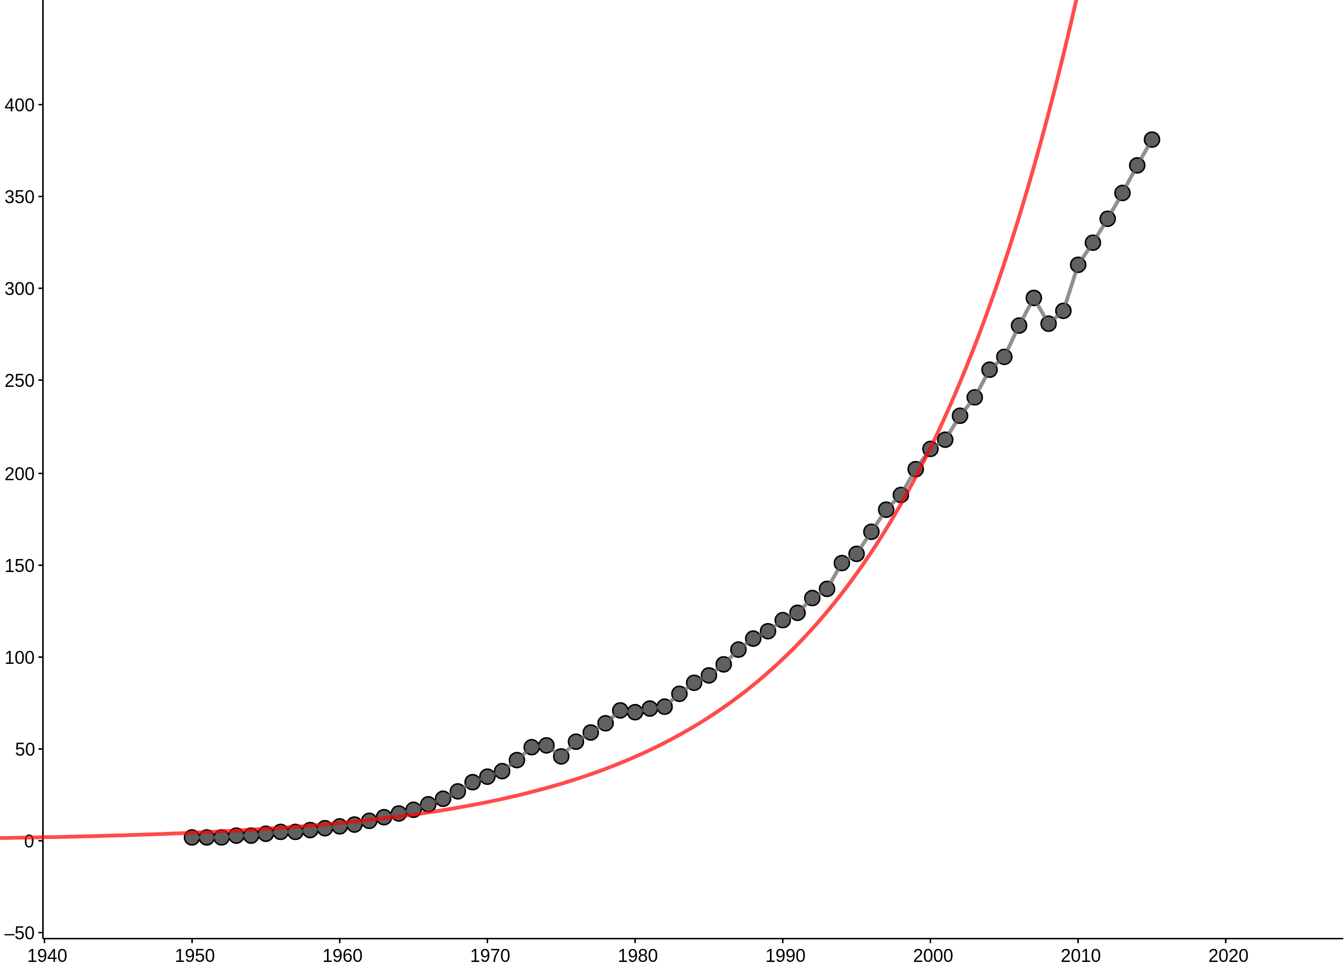
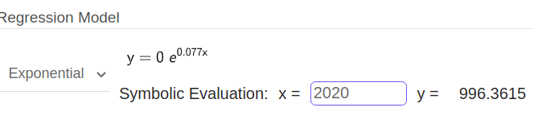
SCIE1500 | Fit a better exponential and a quadratic curve to data
Notes:
14

Slide 15
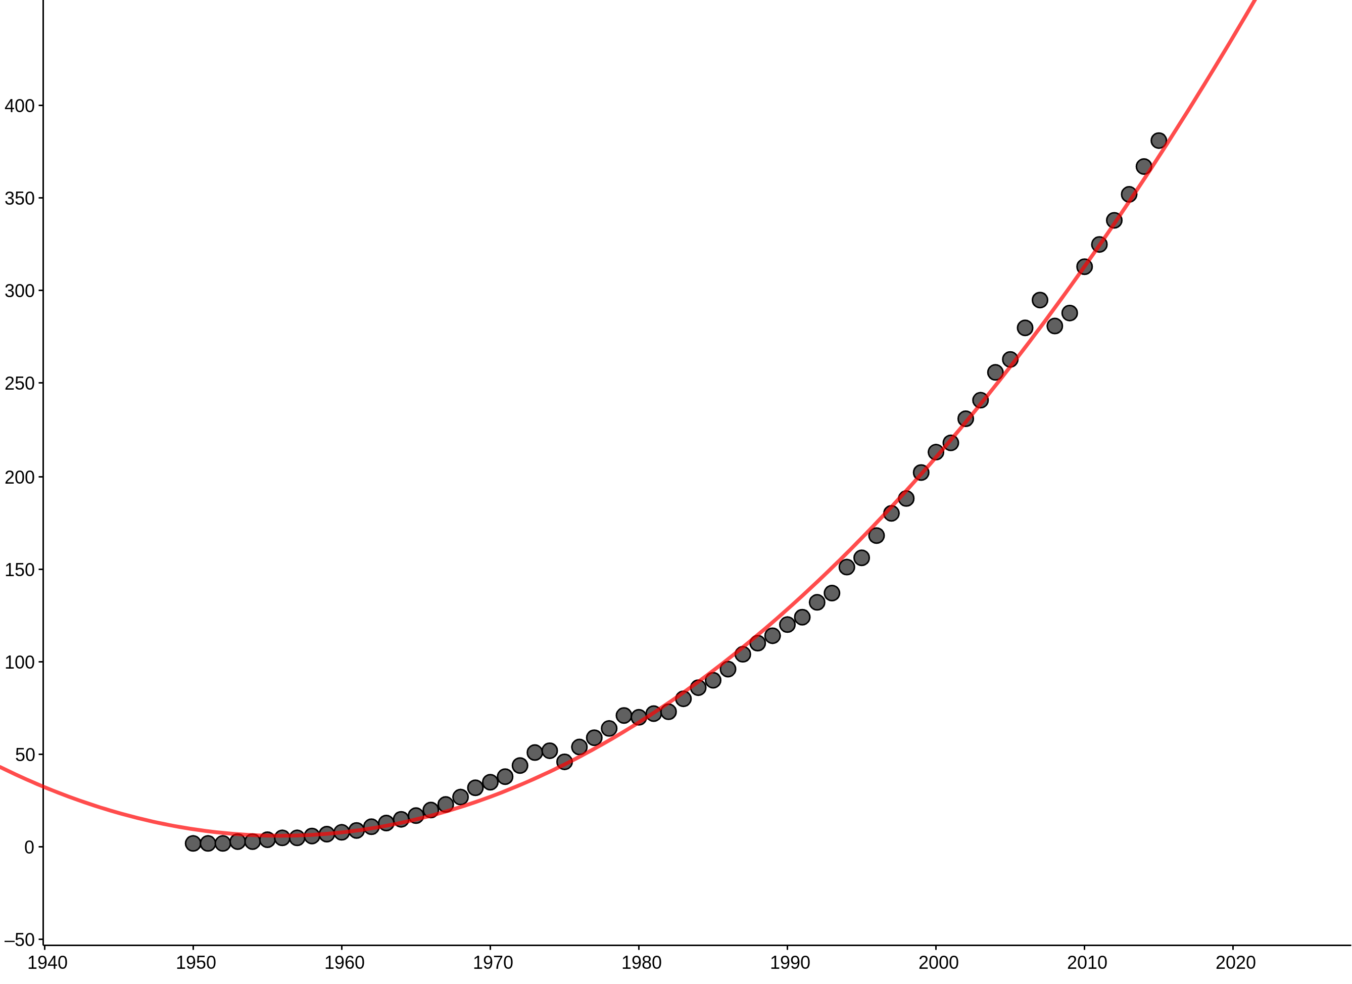
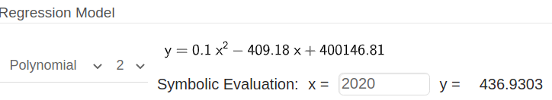
SCIE1500 | Add a quadratic curve to data
Notes:
15

Slide 16
Use a plot title that includes your name and
Upload your fitted quadratic curve as
evidence of your activity for the week in the LMS

