Slide 1
Machine Learning
Principal Authors: Piruz Alemi & Steve Li
Team members: Zhongping Yang, Mike Fonseca
Columbia University
The Fu School of Engineering and applied Science
https://bootcamp.cvn.columbia.edu/
April 18th, 2020

Slide 2
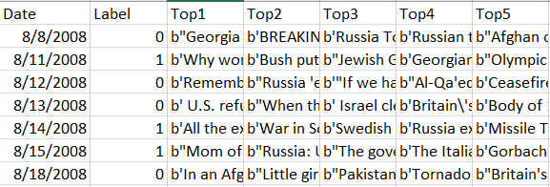
Dataset Information
Kaggle Dataset
https://www.kaggle.com/aaron7sun/stocknews
Data Structure
Date
(From 2008-8-8 to 2016-6-24)
Label (0 or 1 )
25 Articles / Day
Top Ranking Articles

Slide 3
Data Processing Steps
Step 1:
Pre-process test columns
Step 2: Split raw dataset
dNews – Daily News
Train (80%)
Test (20%)
Final_test_df – Validation
Step 3:
Mimic stock progression
0 to -1 (0 include flat and decrease)
Cumulative Score
Validation Date Selection
Supervised & Unsupervised Methods:
N-Gram, Skip-Gram
Stop Words
Non-Linear Models of Choice
K-Means Clustering

Slide 4
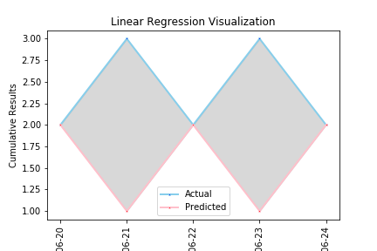
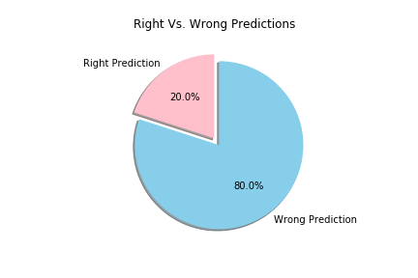
Linear Regression
Score on test dataset – 55%
Score on validation dataset – 20%

Slide 5
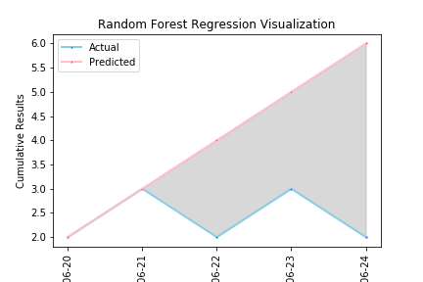
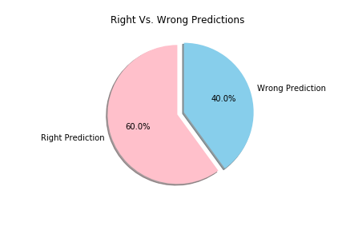
Random Forest Regression
Score on test dataset – 53.6%
Score on validation dataset – 60%

Slide 6
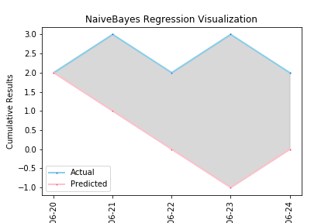
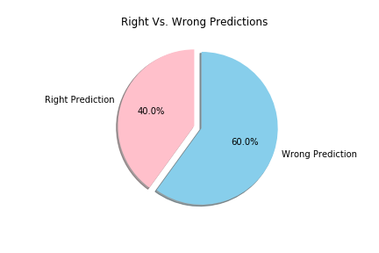
Naïve Bayes Regression
Score on test dataset – 51%
Score on validation dataset – 40%

Slide 7

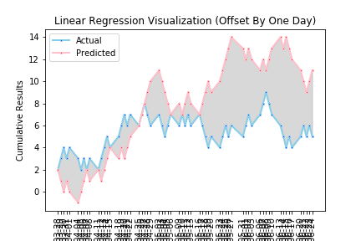
Offset by One Day

Slide 8
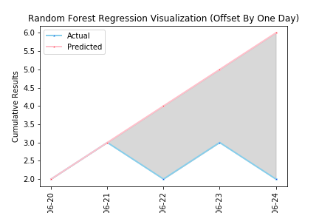

Random Forest Regression Offset By One Day
Score on test dataset – 53.6%
Score on validation dataset – 60%
Score on validation dataset offset – 60%

Slide 9
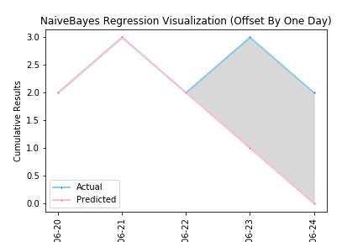
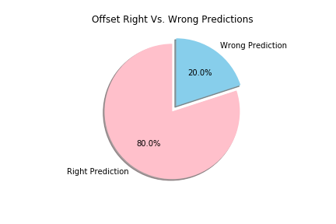
Naïve Bayes Regression Offset By One Day
Score on test dataset – 51%
Score on validation dataset – 40%
Score on validation dataset offset – 80%

Slide 10
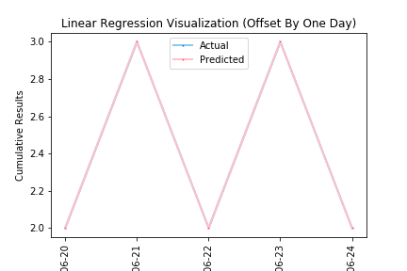
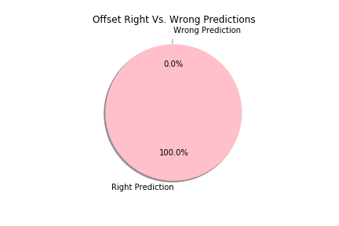
Linear Regression Offset By One Day
Score on test dataset – 55%
Score on validation dataset – 20%
Score on validation dataset offset – 100%

Slide 11
Unsupervised Learning

Slide 12
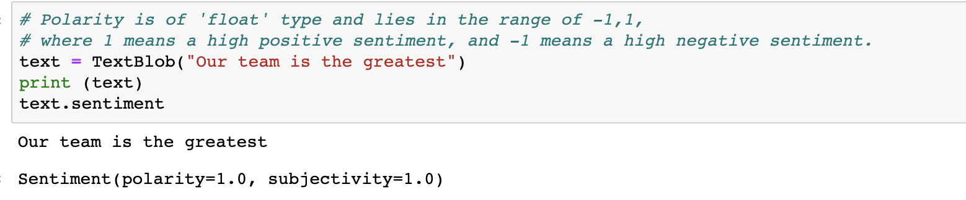
Significant in our analysis is the analysis of Text (News) by: 1. Sentiment 2. Context

Slide 13

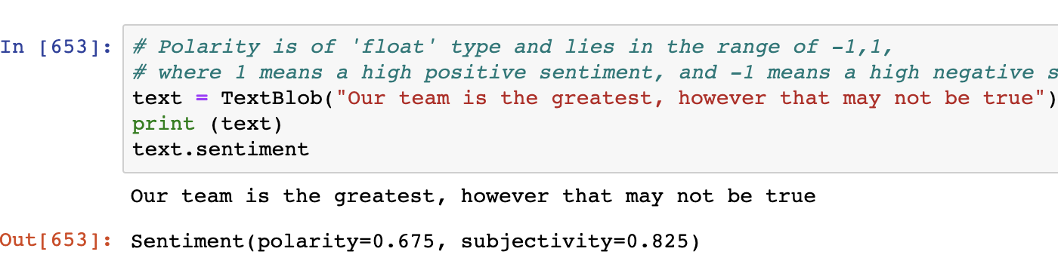
Sentiment Analysis

Slide 14
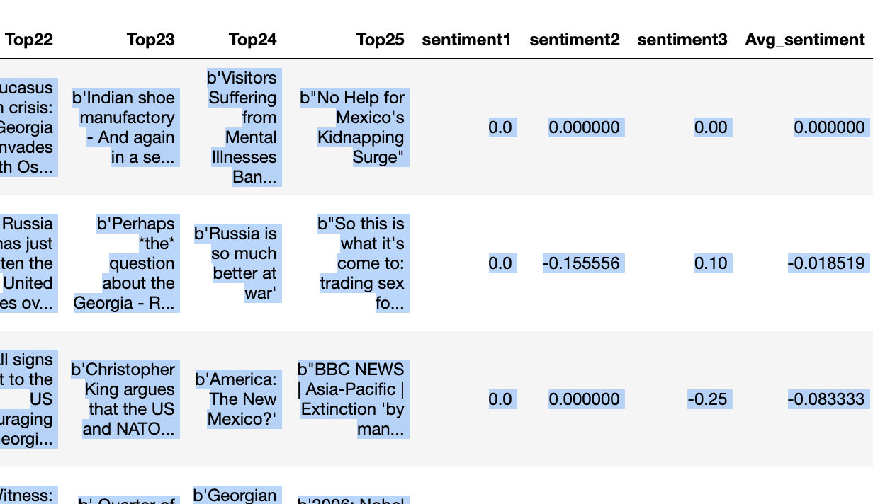
Sentiment as a column Feature

Slide 15
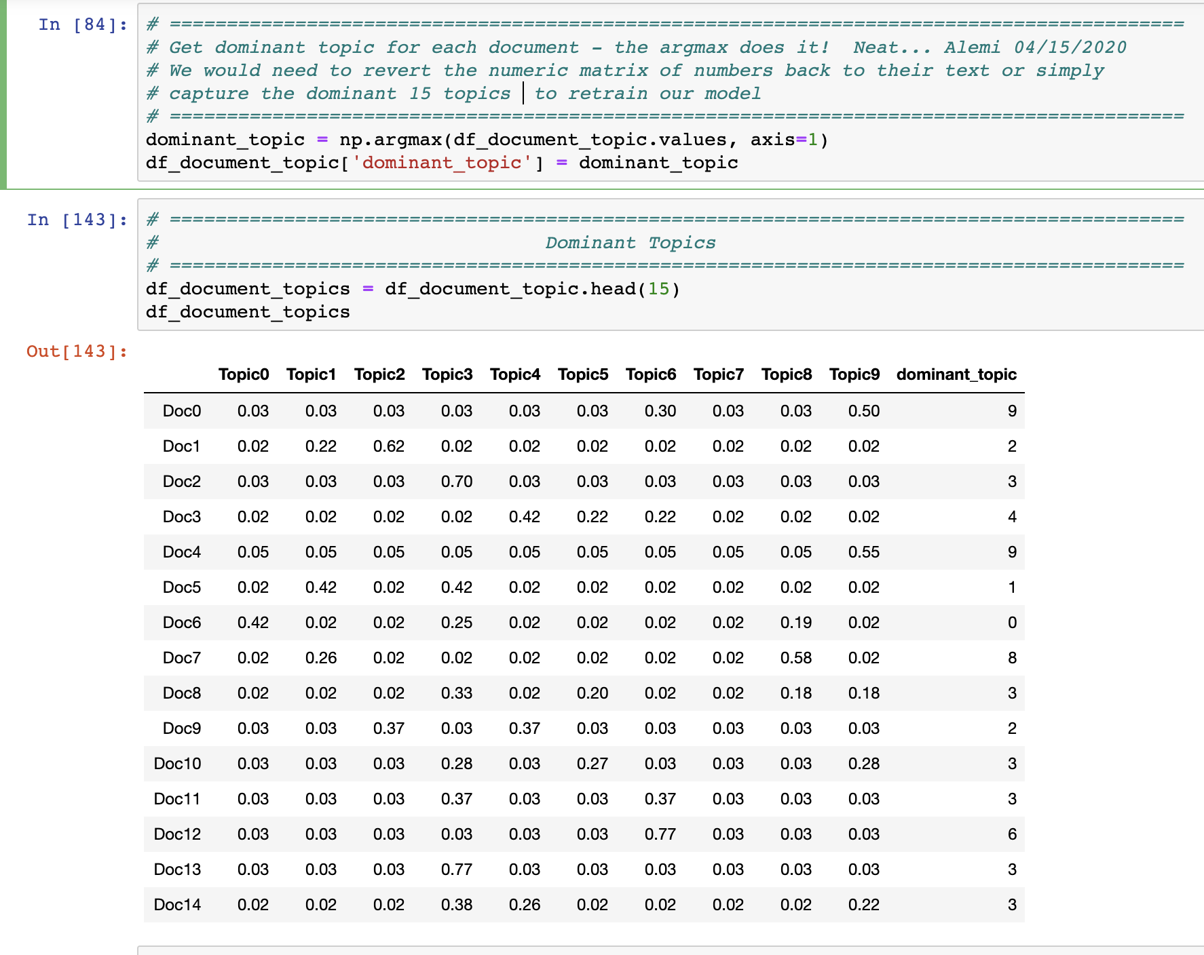
LDA*: From News to numeric bags by Topic
* Latent Dirichlet Allocation:
Model’s Score:
Log Likelihood: - 95912.04113658932
Perplexity:
225.66814792477965

Slide 16
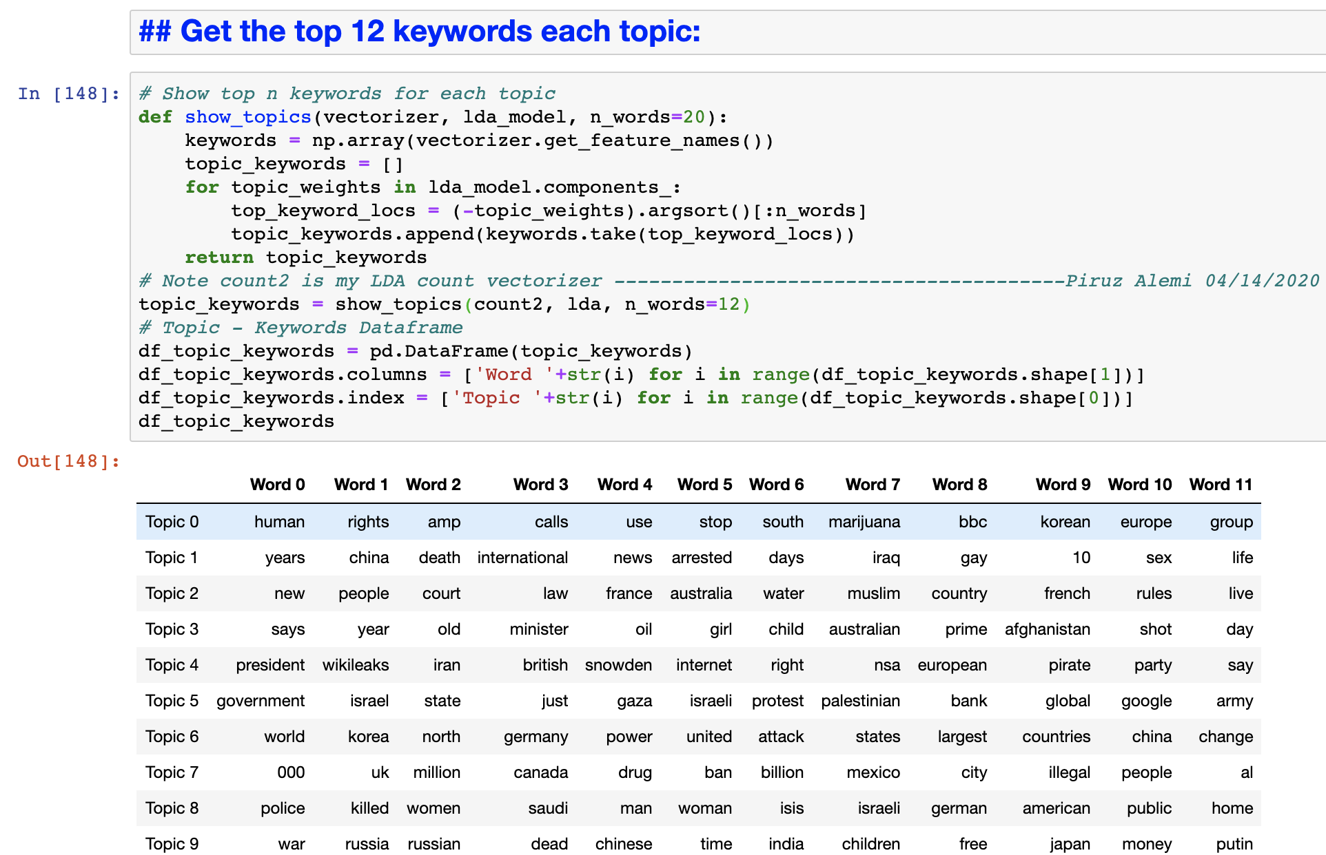
Extraction of 12 key words from numeric

Slide 17
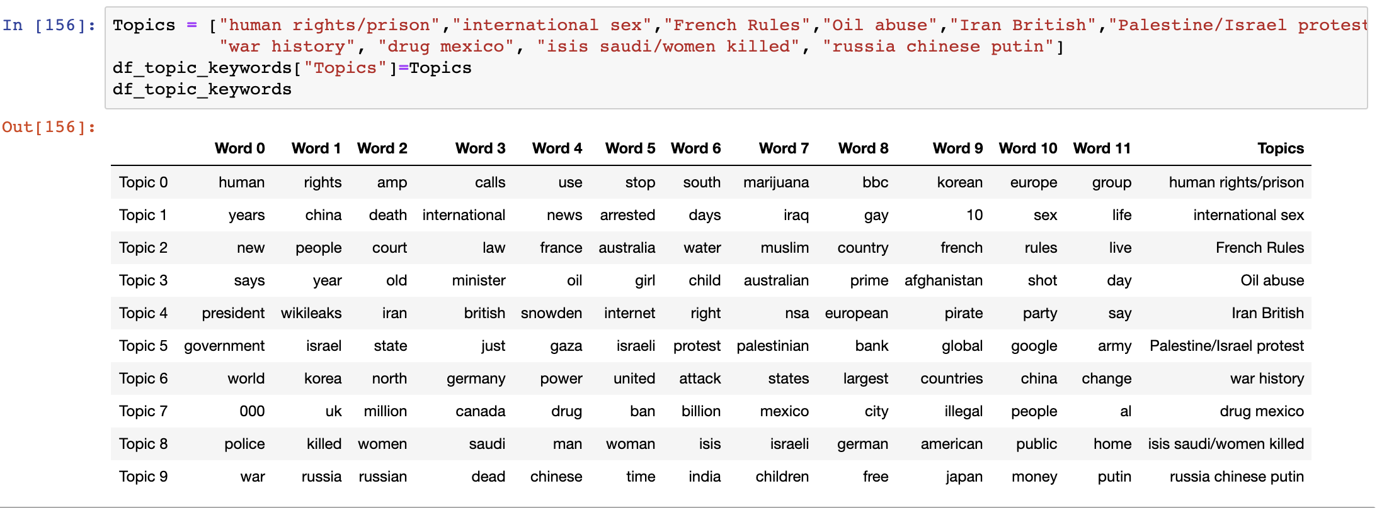
Stop! Assign your classification to the model’s classification
Check the Topics! – A remarkable feature you control!!!

Slide 18

Construct the k-means clusters

Slide 19
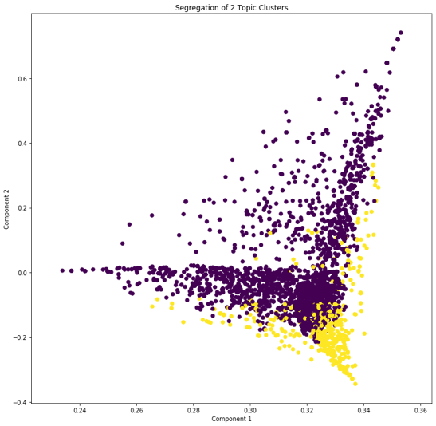
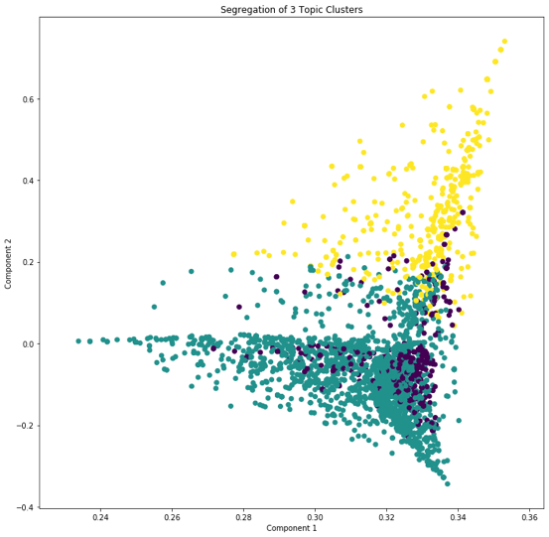
K-Means: 2 vs. 3 Topics

Slide 20
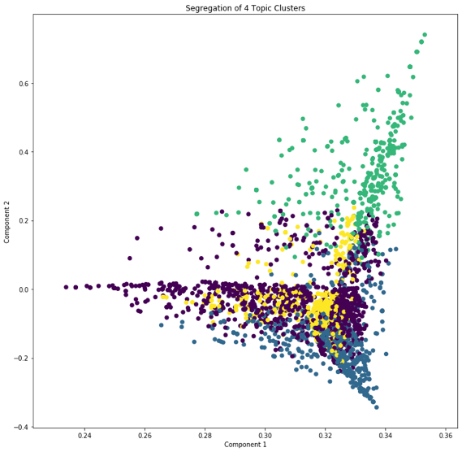
K-Means: 3 vs. 4 Topics

Slide 21
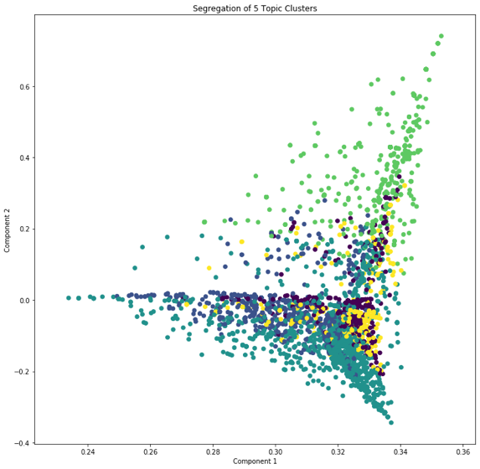
K-Means: 4 vs. 5 Topics

Slide 22
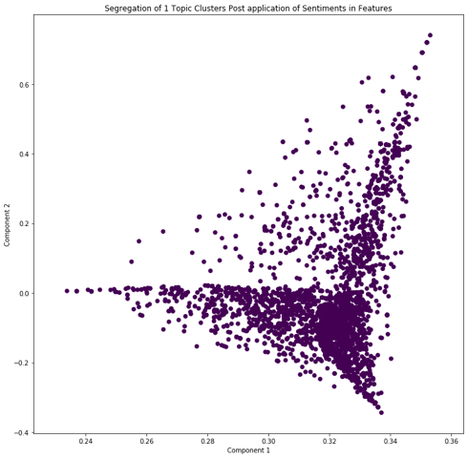
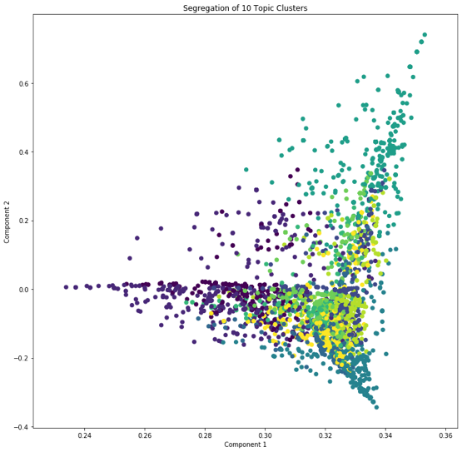
1 vs. LDA: Recommends 10 component

Slide 23
Conclusion:
We recommend the application of Alemi_Li Model in FinTech:
The model:
Is an ensemble of Supervised and Unsupervised Machine Learning
Is highly adaptive to what dominates the news.
Allows human intervention to give its features further context
Provides confidence levels for non-normal distributions.
Is being validated on U.S. Pandemic News & Stock market crash.

Slide 24
With special Thanks! to our A+ support team:
Ilya Alshteyn
Terry Huang
Jason Lin
Ju Chen
Lori Harris
Brendan Connelly
Nicholas Michaud
Isaac Mollinedo

