Slide 1

Note: The data and information in this document is reflective of a hypothetical situation and client. This document is to be used for KPMG Virtual Internship purposes only.
Sprocket Central Pty Ltd
Data analytics approach
[Division Name] - [Engagement Manager], [Senior Consultant], [Junior Consultant]

Slide 2
Note: The data and information in this document is reflective of a hypothetical situation and client. This document is to be used for KPMG Virtual Internship purposes only.
Agenda
Introduction
Data Exploration
Model Development
Interpretation

Slide 3
Note: The data and information in this document is reflective of a hypothetical situation and client. This document is to be used for KPMG Virtual Internship purposes only.
Introduction
Sprocket Central Pty Ltd - Targeting high value customers based on customer demographics and attributes
Dataset Received:
Customer Demographics
Customer Addresses
Transactions Data (2017)
Target dataset:
New Customers List with Demographics and Address information.
Target:
Use Classification Model to Predict Profit Gains for Potential Customers

Slide 4
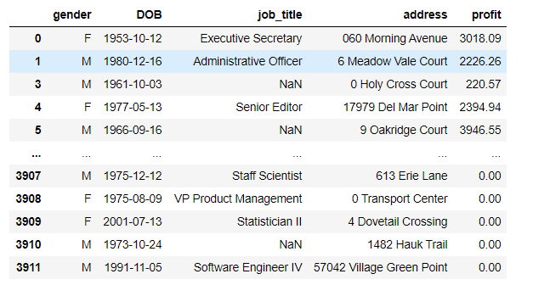
Note: The data and information in this document is reflective of a hypothetical situation and client. This document is to be used for KPMG Virtual Internship purposes only.
Data Exploration
Organize Dataset – Record At Customer Level
Reason:
The “New Customer” dataset is established at the customer level.
Our goal is to predict the profit gains at the customer level.
The “Transaction” dataset is established at the transaction level.
Approach:
Merge “Customer Demographic” and “Customer Address” dataset.
Use the “Transaction Dataset” to aggregate profit for each customer. (Only approved transactions.)
Example output

Slide 5
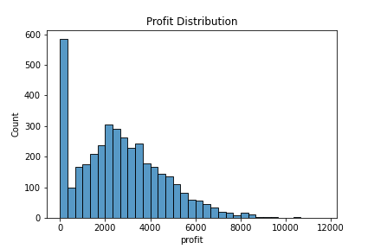
Note: The data and information in this document is reflective of a hypothetical situation and client. This document is to be used for KPMG Virtual Internship purposes only.
Data Exploration
Understanding the Distribution of Profit
Insights:
Approximate Normal distribution
Significant amount of customers result in zero profit
A small portion of customers results in a profit larger than $8000
Direction:
Cut profit data into bins for prediction. (0, less than 4000, less than 8000, and over 8000)

Slide 6
Note: The data and information in this document is reflective of a hypothetical situation and client. This document is to be used for KPMG Virtual Internship purposes only.
Data Exploration
Understanding the Distribution of Customer Information
Attributes:
Gender
Bike Related Purchases in Past 3 Years
Date of Birth
Job Title and Job Industry Category
Wealth Segment
Owns Car (Y/N)
Tenure
Address
Postcode
State
Property Valuation
Approach:
Use plots to check attributes’ own distribution
Use plots to check the correlation between attributes and profit.
Fill in missing values based on distribution.
Create categorical bins if needed.
Create clusters for customers.
Use One Hot Encoding for Categorical Data
Remove unnecessary attributes.

Slide 7
Note: The data and information in this document is reflective of a hypothetical situation and client. This document is to be used for KPMG Virtual Internship purposes only.
Data Exploration
Insights and The List of Training Attributes
Insights:
Date of Birth can be transformed to ‘Age.’ It can be further separated into ‘Age bins.’
By checking the scatterplot for Job Industry Category and profit, we grouped the categories based on the likelihood to reach higher profit.
Created bins for property Valuation
Created 16 clustering groups using hierarchical clustering (Gower distance)
Removed Job Title, Address, Postcode
Attributes:
Gender
Bike Related Purchases in Past 3 Years
Age bins
Job Industry Category (High, Mid, Low)
Wealth Segment
Owns Car (Y/N)
Tenure
State
Property Valuation
Clusters

Slide 8
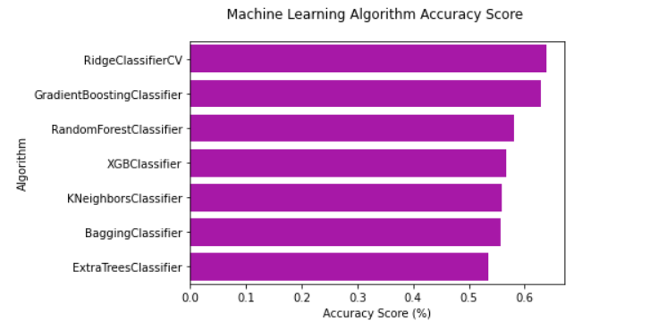
Note: The data and information in this document is reflective of a hypothetical situation and client. This document is to be used for KPMG Virtual Internship purposes only.
Model Development
Select Classification Model Based on CV Test Accuracy
Calculated the CV Test Accuracy Score for:
Ridge Classifier
Gradient Boosting Classifier
Random Forest Classifier
XGB Classifier
KNN Classifier
Bagging Classifier
Extra Trees Classifier

Slide 9
Note: The data and information in this document is reflective of a hypothetical situation and client. This document is to be used for KPMG Virtual Internship purposes only.
Model Development
Tune Model with Hyper-Parameters
Base on the CV test accuracy, we select Ridge Classifier and Gradient Boosting Classifier for further tuning.
Using the best combination of hyper-parameters, the Ridge Classifier achieves an accuracy rate of 63.99%, while Gradient Boosting Classifier achieves 63.58%.

Slide 10
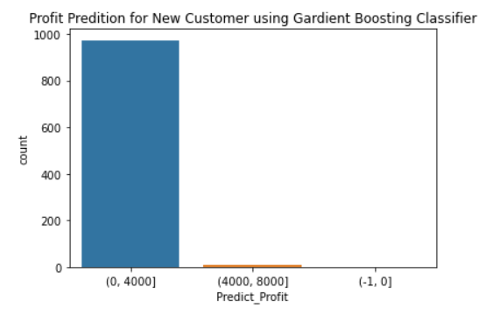
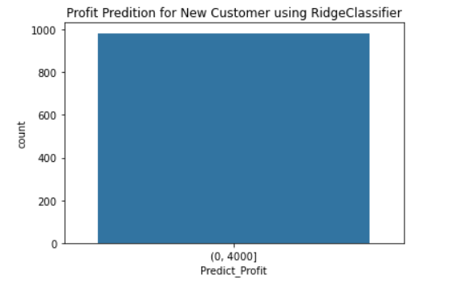
Note: The data and information in this document is reflective of a hypothetical situation and client. This document is to be used for KPMG Virtual Internship purposes only.
Interpretation
Target New Customers Based on Prediction
Although the two classifier achieves similar test accuracy, the prediction from Gradient Boosting provides more insights on marketing strategies.

Slide 11
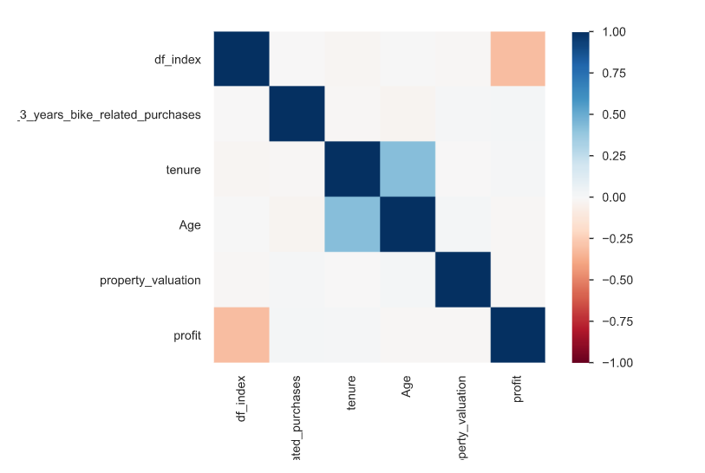
Note: The data and information in this document is reflective of a hypothetical situation and client. This document is to be used for KPMG Virtual Internship purposes only.
Interpretation
Insights and Conclusion
Using the Gradient Boosting Classifier, we can predict which profit gains classes the 1000 new customers will fall into. The marketing team can use it as a general guide to determine the target customers.
However, as shown on the correlation graph on the right, there is no significant relationship between the customer attributes and the profit gains. Therefore, additional attributes are needed for a better prediction.

Slide 12
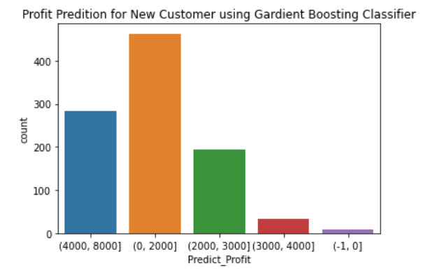
Note: The data and information in this document is reflective of a hypothetical situation and client. This document is to be used for KPMG Virtual Internship purposes only.
Interpretation
Additional: Prediction with Lower Accuracy
If we further separate the profit gains classes, the CV test accuracy goes down to 25%. However, it would provide better insights on determining the target customer groups.

Slide 13
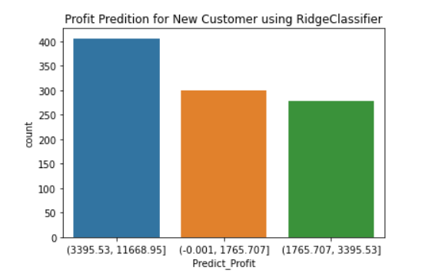
Note: The data and information in this document is reflective of a hypothetical situation and client. This document is to be used for KPMG Virtual Internship purposes only.
Interpretation
Additional: Prediction with Lower Accuracy
If we separate the profit gains classes based on quantile distribution, the CV test accuracy goes down to 32%. This would also provide insights on determining the target customers.

Slide 14
Note: The data and information in this document is reflective of a hypothetical situation and client. This document is to be used for KPMG Virtual Internship purposes only.
Appendix

Slide 15
Note: The data and information in this document is reflective of a hypothetical situation and client. This document is to be used for KPMG Virtual Internship purposes only.
Appendix
Please refer to the following materials
Detailed code (Jupyter Notebook): https://github.com/ll730/KPMG-Virtual-Internship.git
Classification Method Code Reference: https://www.kaggle.com/ldfreeman3/a-data-science-framework-to-achieve-99-accuracy

