Slide 1





Productionizing End To End Machine Learning Solutions
1

Slide 2


Hello!
I am Sparsh Dutta
Working as a Data Scientist in ZS Associates
Please download code using QR

Slide 3
Agenda For Workshop
05
Learn about model deployment
04
Deep dive into model validation and tuning
03
Deep dive into model interpretability
02
Understanding predictive modelling using Xgboost
01
Learning about ML and problem in hand

Slide 4
Our intelligence is what makes us human, and AI is an extension of that quality.
- Yann Le Cunn

Slide 5
01. Learning about ML and problem in hand

Slide 6
What is Machine Learning and AI in general?
Machine Learning
Its refers to the ability of machines to learn decision making while employing learning from past experiences.
Artificial Intelligence
Its refers to the simulation of human intelligence in machines that are programmed to think like human and mimic there actions.

Slide 7
4 Pillars of Machine Learning
Supervised Learning
Unsupervised Learning
You have input variables (X) and an output variable (Y) and you use an algorithm to learn the mapping function from the input to the output.
You have a large amount of input data (X) and only some of the data is labeled (Y). These problems sit in between both supervised and unsupervised learning.
Semi-Supervised Learning
Reinforcement Learning
It is about taking suitable action to maximize reward in a particular situation. There is no answer. In the absence of a training dataset, it is bound to learn from its experience.
You only have input data (X) and no corresponding output variables. The goal is to model the underlying structure or distribution in the data

Slide 8
Analysing the problem in hand
For the workshop we will be analysing wine quality dataset:
I have chosen “wine-quality-white” dataset.
We can use this dataset to perform both regression and classification task.
The above dataset has following features:
1 - fixed acidity 2 - volatile acidity 3 - citric acid 4 - residual sugar 5 - chlorides 6 - free sulphur dioxide 7 - total sulphur dioxide 8 - density 9 - pH 10 - sulphates 11 – alcohol
Output variable (based on sensory data):
12 - quality (score between 0 and 10)

Slide 9
Practices to follow while solving ML problems
Always begin with EDA (Exploratory Data Analysis)
While EDA try to find simple insights about the data
Always check for missing values in the data
If missing values are found then think of best imputation method by experimenting with different imputation methods.
While visualizing categorical variables:
Always think of various encoding schema used to encode the categorical feature in the data
We can use encoding techniques like:
One-hot Encoding
Label Encoding
While modelling try to normalize and standardize data

Slide 10
02. Understanding predictive modelling using Xgboost

Slide 11
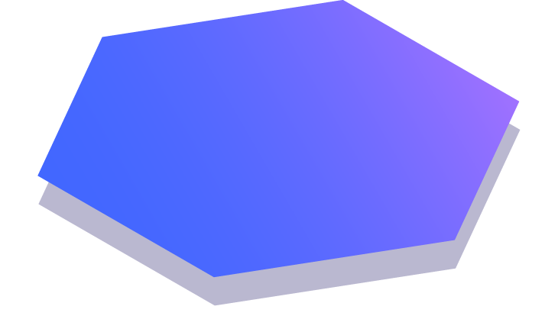
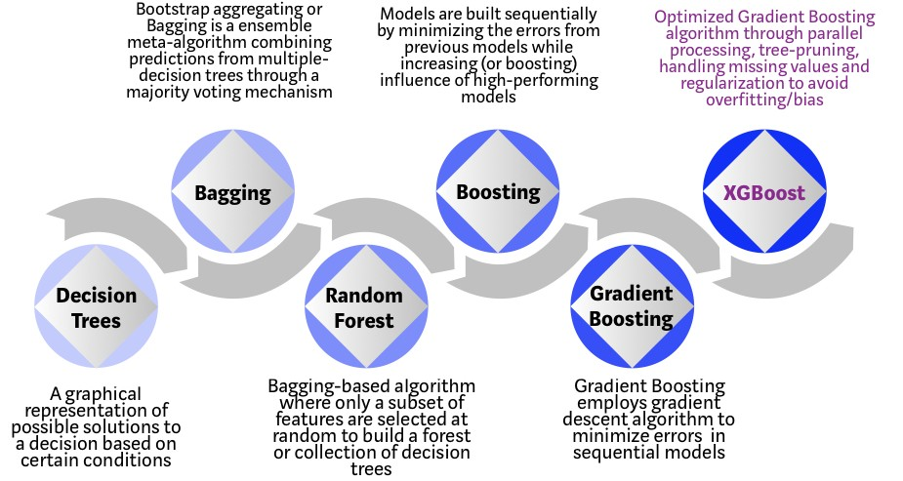
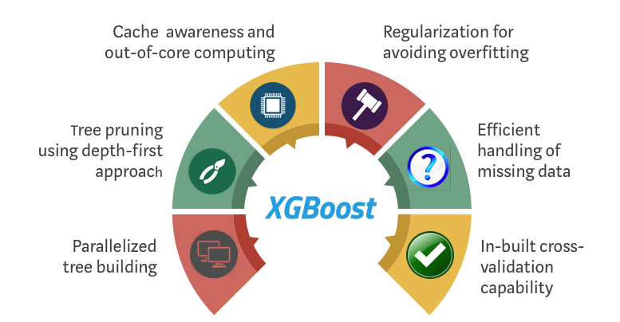
Understanding Xgboost Algorithm
Xgboost is an ensemble learning method.
It’s a boosting algorithm.
“When in doubt, use Xgboost”

Slide 12
03. Deep dive into model interpretability

Slide 13
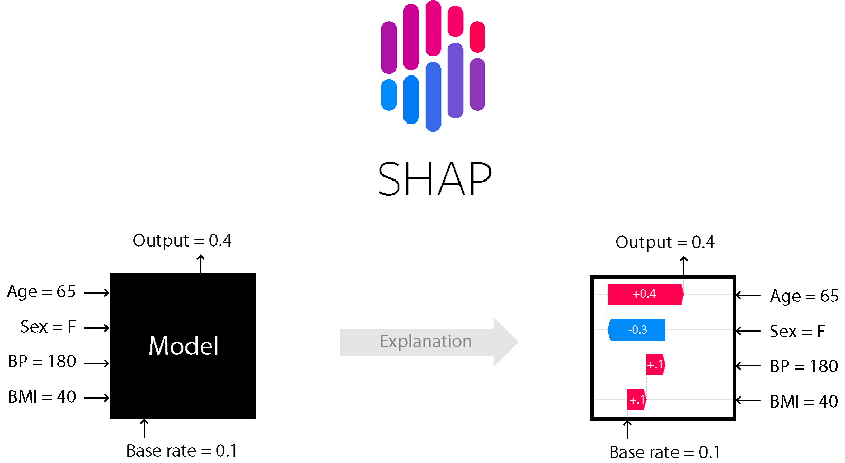
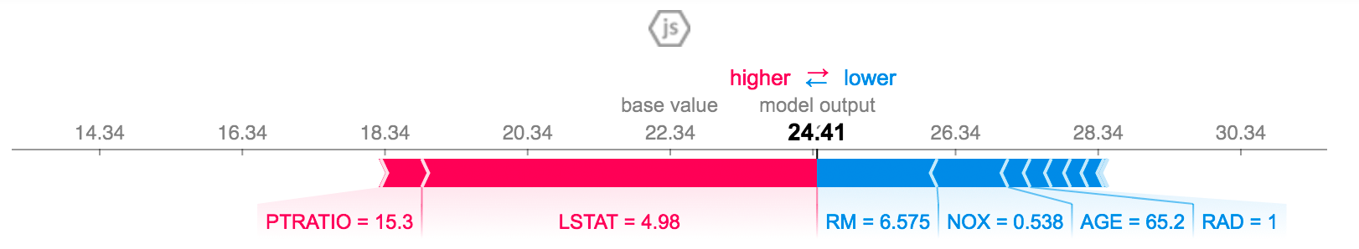
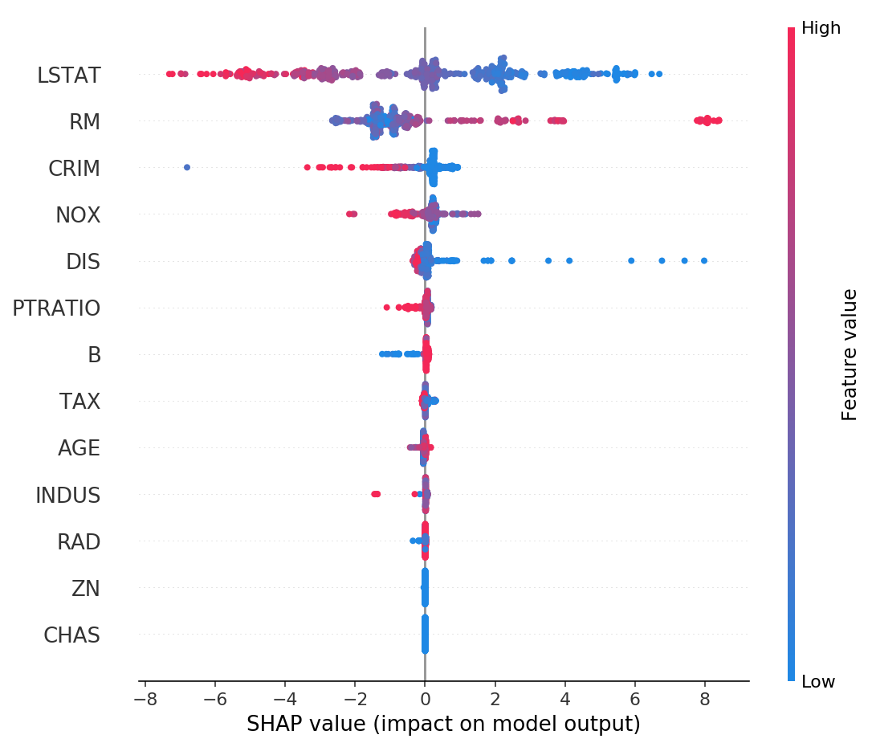
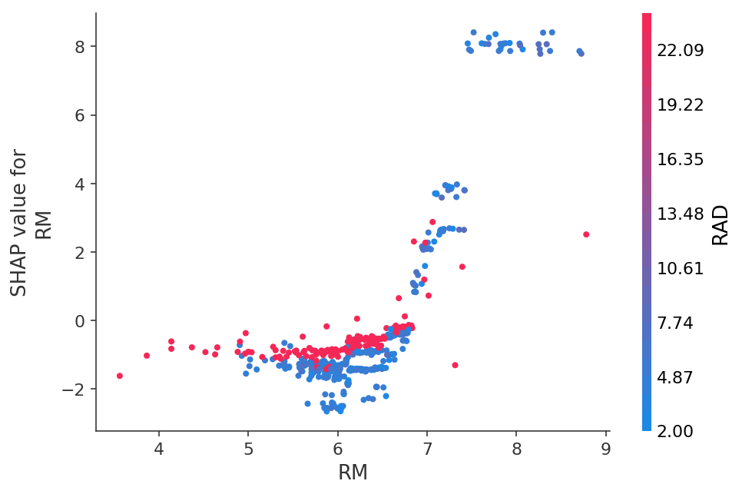
Understanding SHAP Analysis
SHAP (SHapley Additive exPlanations) is a game theoretic approach to explain the output of any machine learning model.

Slide 14
04. Deep dive into model validation and tuning

Slide 15
How to do ML model validation?
Assessing model performance is a critical part of any machine learning project, yet many data science tools make it difficult or impossible to assess the true performance of a model.
Is my model giving correct results?
As a data scientist one should always ask this question.
But how will you know that your model is performing well enough?
To answer this question you should be looking at these metrics:
Training set error
Test set error
As a data scientist one should monitor these 2 metrics very cautiously.
One can do model validation using techniques like:
K-Fold Cross Validation
Leave-one-out Cross Validation
etc.

Slide 16
What is hyperparameter tuning?
Hyperparameter tuning is choosing a set of optimal hyperparameters for a learning algorithm.
What are hyperparameters?
A hyperparameter is a parameter whose value is set before the learning process begins.
Its is done in order to stabilize the trained model and also to improve performance of the trained model.
Tuning Strategies:
Grid Search
Random Search
Bayesian Optimization
Genetic Algorithm

Slide 17

Learning about OPTUNA
An open source hyperparameter optimization framework to automate hyperparameter search
Key Features:
Easy Parallelization
Lightweight, versatile
Eager Search Spaces
Platform agnostic architecture
Efficient Optimization Algorithms
Eliminating unfavourable experiments

Slide 18
05. Learn about model deployment

Slide 19









Learning about FastAPI
FastAPI is a modern, fast (high-performance), web framework for building APIs with Python 3.6+ based on standard Python type hints.
Key Features:
Fast: Very high performance
Fast to code
Fewer bugs
Intuitive
Robust
Standards-based

Slide 20


Thanks!
Any questions?
You can find me at:
sparsh.dtt@gmail.com
github.com/llFireHawkll

