Slide 1

VOYAGERBOT: SMART LUGGAGE BAG
Presented By
22BEM10025- NAHAL
22BEM10020 – ARYAN WAGH
22BEM10042 – AAYUSH SINGHAL
22BEM10033 – HUSSEIN ALIMSON
22BEM10054 – ABDULRAHMAN SADDAM
Under the supervision of
Inderpreet Singh
Under the supervision of
Dr. Gurmeet Singh
H.O.D
CHANDIGARH UNIVERSITY
Department of Mechatronics Engineering

Slide 2
CONTENT
Project description
Objectives
Initial Design Process and Methodology
Tasks Division
Revised Design Approach
Voyager-Bot Features
What’s in the bag
Method of Operation
Project timeline
Challenges
In Progress
Cost
Department of Mechatronics Engineering

Slide 3
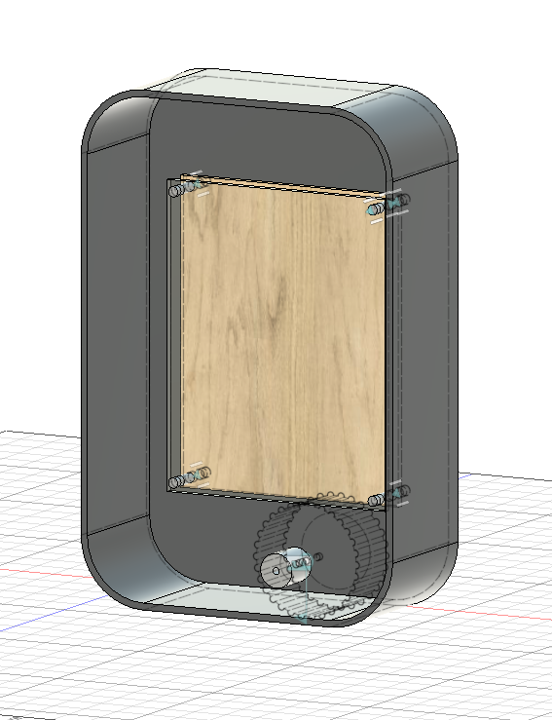


PROJECT DESCRIPTION
VOYAGER BOT
This project focuses on developing a smart travel bag that enhances security, convenience, and user interaction through advanced technologies
The bag features an autonomous follow-me mechanism to track and move with its owner, an anti-theft system with real-time alerts, and an AI-powered chat companion for personalized assistance. Additionally, it integrates live location tracking, SMS notifications for status updates, and a web application that allows users to monitor, configure, and calibrate its functions seamlessly
Department of Mechatronics Engineering

Slide 4
OBJECTIVES
Follow-Me Mechanism The bag will autonomously follow its owner, ensuring it only responds to the rightful user.
Anti-Theft System Equipped with a siren or buzzer that activate to get the bags whereabout.
Live Location Tracking Real-time location updates of the bag will be sent directly to the owner.
SMS Alerts Owners will receive instant updates about the bag’s status and condition via SMS.
Application A dedicated web app to monitor, configure, and calibrate all bag functions.
Chat Companion An integrated AI assistant designed to accompany and interact with the owner
Department of Mechatronics Engineering

Slide 5
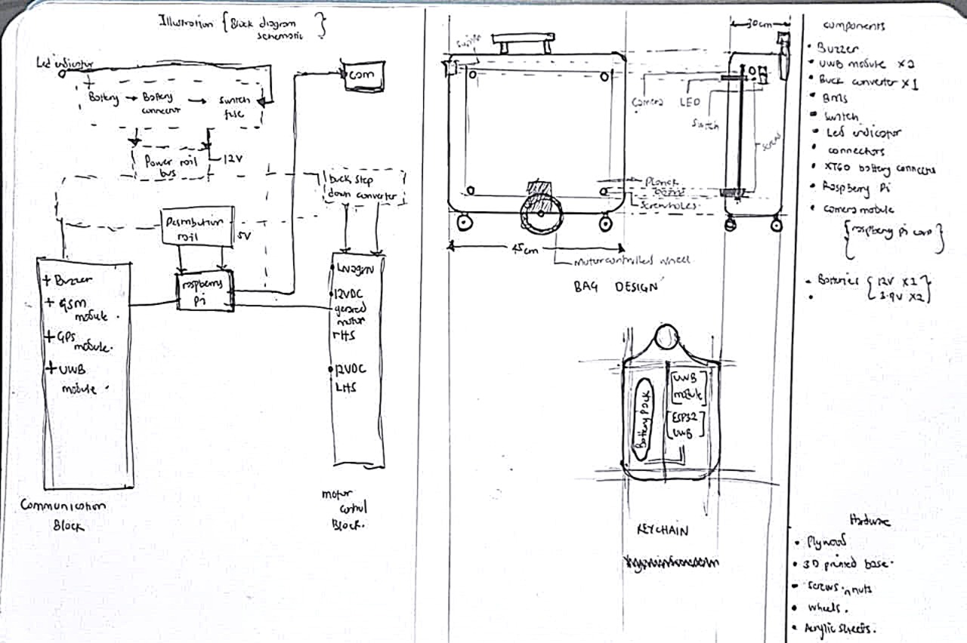
DESIGN PROCESS

Slide 6
INITIAL CONCEPT DESIGN
The project follows a structured approach combining electronic system integration, mechanical design, and smart control logic to develop the autonomous travel bag.
System Architecture The design begins with a block diagram schematic outlining the main subsystems:
Power Supply Unit: A 12V battery connected through a switch, step-down converters, and distribution rails to provide both 12V and 5V power for different modules.
Communication Block: Includes the Raspberry Pi as the central controller interfacing with the buzzer, GSM module, GPS module, and UWB modules for tracking and connectivity.
Motor Control Block: Consists of L298N and 12V DC geared motors, managed by the Raspberry Pi, to drive the bag’s autonomous movement.
Bag Design The bag layout incorporates compartments for the Raspberry Pi, sensors, motorized wheels, and power supply. The mechanical frame is dimensioned (approx. 45 cm × 30 cm) with space for the wheel system and additional sensors such as a camera and LED indicators.
Department of Mechatronics Engineering

Slide 7
DESIGN PROCESS AND METHODOLOGY
Keychain Module A portable keychain device integrates UWB modules and an ESP32 to act as the reference point for the follow-me mechanism, ensuring the bag tracks only its owner.
Component Selection Core components include Raspberry Pi, UWB modules, GSM/GPS modules, buzzer, LED indicators, converters, and a 12V battery system. The structure will be built using plywood, acrylic sheets, screws/nuts, and custom 3D-printed parts for durability and modularity.
Methodology
Develop the power distribution system to ensure stable operation of all modules.
Program the Raspberry Pi to integrate communication modules and motor control.
Build and test the keychain for accurate distance tracking.
Assemble the bag structure with controlled wheels and integrate sensors.
Calibrate and refine the follow-me, anti-theft, and live tracking features.
Department of Mechatronics Engineering

Slide 8
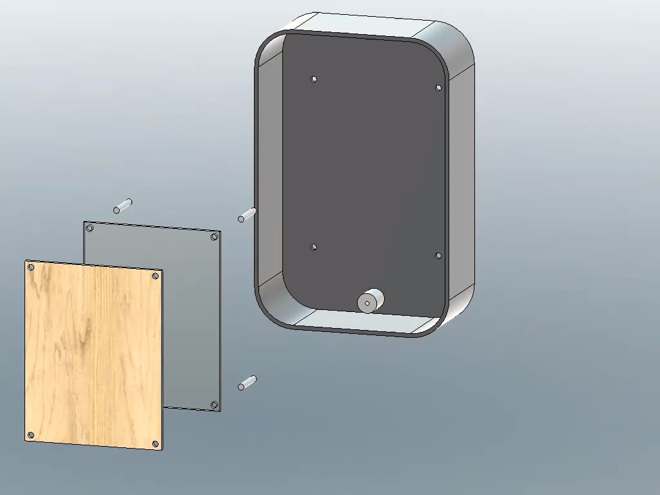
ASSEMBLY SIMULATION
Department of Mechatronics Engineering

Slide 9
TASKS DIVISION
TASKS | ARYAN WAGH | AYUUSH SINGHAL | ABDUL RAHMAN | HUSSEIN ALIMSON | NAHAL
PRODUCT DESIGN AND RESEARCH |  |  |  | ✔️ | ✔️
ELECTRONIC COMPONENTS ACQUISITION |  | ✔️ | ✔️
HARDWARE ACQUSITION | ✔️ |  |  | ✔️
PROGRAMMING |  |  | ✔️ |  | ✔️
PROTOTYPING AND TESTING | ✔️ | ✔️ | ✔️ | ✔️ | ✔️
Department of Mechatronics Engineering

Slide 10
REVISED DESIGN APPROACH
Vision-Based Tracking (Color Locking)
The system now uses onboard camera vision to detect and follow the owner.
The algorithm identifies and locks onto the color of the owner’s clothing (e.g., trousers.).
Continuously tracks the selected color region to maintain distance and movement alignment.
Powered by Raspberry Pi 5 with onboard camera for real-time image processing.
Provides a cost-effective and accessible alternative to UWB tracking.
Advantages:
No external sensors or beacons required.
Easier calibration and deployment.
Works in indoor and outdoor lighting with basic color contrast.
Limitation:
Accuracy may reduce in low-light or color-similar environments.
Department of Mechatronics Engineering

Slide 11
REVISED DESIGN APPROACH
A real-time "follow-me" mechanism using the Raspberry Pi.
Method: Computer vision to lock onto and track a specific, user- selected color.
Works On: Raspberry Pi (via Serial API)
How It Works:
SELECT COLOR :User chooses a color from a preset array on the dashboard (e.g., Red, Green, Blue, Yellow).
2. LOCK TARGET The Pi Camera streams a live video feed. The system processes the video to find the largest object matching the selected color.
3. FOLLOW The system calculates the target's position in the frame. It sends real-time commands to keep the target centered in the camera's view. This tracking is continuous, allowing the bot to follow the target smoothly, even around turns.
Department of Mechatronics Engineering

Slide 12
REVISED DESIGN APPROACH
🔐 Remote Alarm Activation - Call to trigger alarm from anywhere
📍 GPS Geofencing - Virtual safe zone protection
📱 Multi-Interface Control - SMS, Bluetooth, Serial
🌐 Real-Time GPS Tracking - Automatic location updates
🔔 Smart Trigger System - Whitelist-based access control
🔊 120dB Siren - High-decibel alarm deterrent
🤖 Raspberry Pi Ready - API for advanced integrations
colour tracking follow mechanism
AI companion
Department of Mechatronics Engineering

Slide 13
VOYAGER-BOT FEATURES
GPS Geofencing:
How it Works:
Set: Park your vehicle and send an SMS (e.g., f set 100) to create a 100-meter safe zone.
Monitor: The system checks its location every 60 seconds.
Alert: If the vehicle moves outside this zone, it instantly triggers the 120dB alarm.
Notify: You immediately receive an SMS alert with:
A violation warning
The new GPS coordinates
A Google Maps link to the new location
Remote Alarm & Smart Triggers
How it Works:
Whitelist: You add trusted numbers (family, friends) to the system's "Trigger List."
Trigger: A trusted number calls the system.
Action:
The system auto-answers the call.
The 120dB siren activates immediately.
The alarm sounds for 30 seconds, then the call auto-disconnects.
Security:
Calls from any unknown number are silently rejected. This prevents false alarms.
Department of Mechatronics Engineering

Slide 14
VOYAGER-BOT FEATURES
Multi-Interface Control
You have complete control, no matter where you are:
SMS (Global):
Works from anywhere, no internet needed.
Use commands like g (Get GPS) or n (Change Owner).
Bluetooth (Local):
Use a Bluetooth serial app on your phone.
Perfect for setup, debugging, or when you're near the vehicle (no SMS cost).
Raspberry Pi (Advanced):
Web control , Ai and App control Interface
System Logic: Incoming Call
Path 1: Trusted Number
Incoming Call → Number is on Whitelist? → YES
Auto-Answer Call
Activate 120dB Alarm (30s)
Auto-Hangup Call
Path 2: Unknown Number
Incoming Call → Number is on Whitelist? → NO
Silently Reject Call
(No Alarm, No Alert)
This is done to prevent false alarm
Department of Mechatronics Engineering

Slide 15
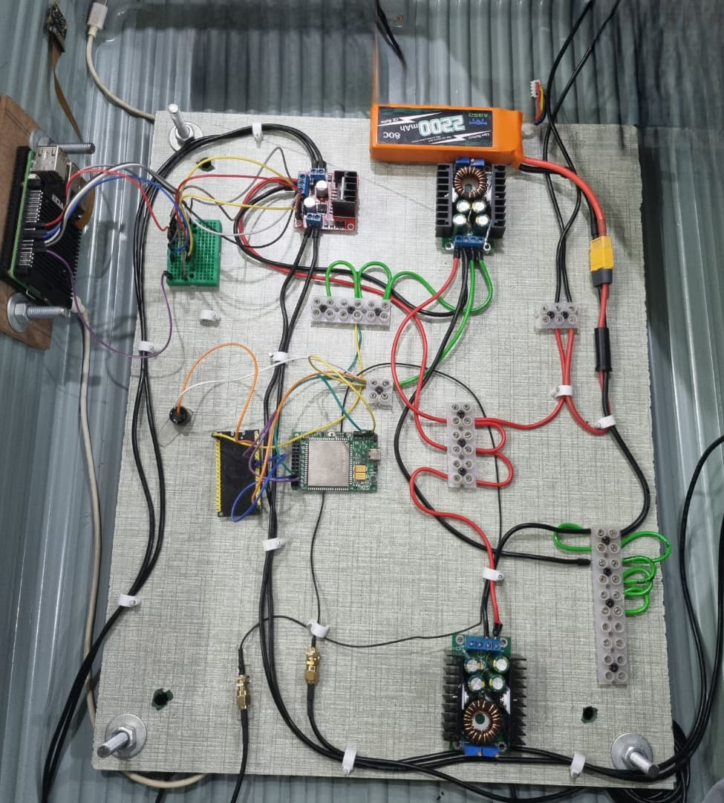
WHAT’S IN THE BAG
Department of Mechatronics Engineering

Slide 16
WHAT’S IN THE BAG:
ELECTRICAL COMPONENTS WIRING
1. 12V 2200mAh Battery Pack
Primary power source for the entire system.
Supplies 12V to motors, converters, and control modules.
2. Adjustable Buck Converter
Steps down voltage from 12V to 5V and 3.3V for logic circuits.
Provides stable, regulated power for sensitive electronics.
3. 5V Power Line
Distributes regulated 5V supply to the Raspberry Pi, ESP32, and GSM module.
4. 12V Power Line
Delivers direct 12V output to high-power components such as motors and driver boards.
5. Ground Bus
Common grounding rail ensuring electrical stability and reducing noise across all modules.
6. GPS Cable
Connects the GSM/GPS module to its external GPS antenna for accurate satellite tracking.
8
12
1
2
11
3
4
10
9
5
6
7
Department of Mechatronics Engineering

Slide 17
WHAT’S IN THE BAG:
7. GSM Antenna Cable
Provides reliable cellular signal reception for GSM-based communication and SMS control.
8. Raspberry Pi Camera Module 3 (NoIR)
Captures live video for color-based tracking of the suitcase owner.
NoIR sensor enhances low-light performance and visual clarity.
9. Quectel EC200U-CN GSM/GPS Module
Handles SMS communication and real-time GPS location reporting.
Interfaced with ESP32 for command processing.
10. ESP32 Microcontroller
Manages Bluetooth communication, GSM control, and GPS data relay.
Acts as the communication hub between user and system.
11. Raspberry Pi 5
Core processing unit executing the vision algorithm and movement logic.
Interfaces with camera, ESP32, and motor driver for coordinated operation.
12. Motor Driver
Controls the 12V DC motors for differential movement.
Receives motion commands from Raspberry Pi to drive the suitcase autonomously.
8
12
1
2
11
3
4
10
9
5
6
7
Department of Mechatronics Engineering

Slide 18
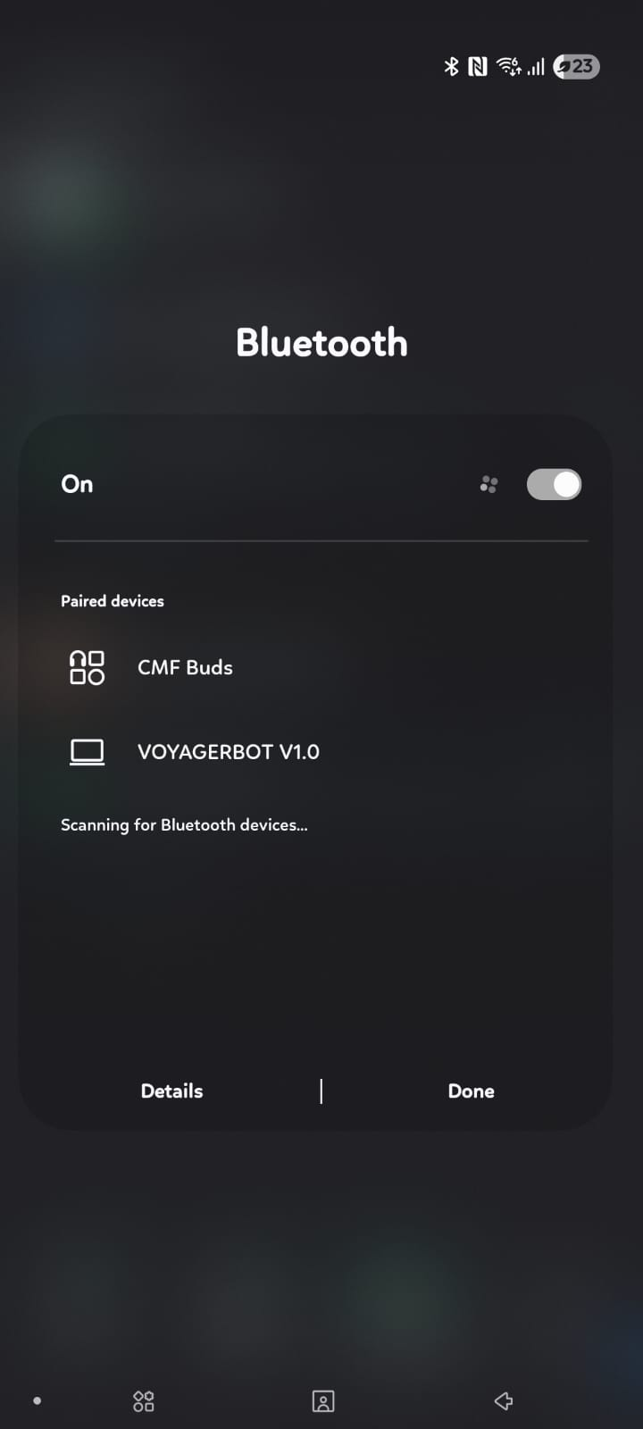
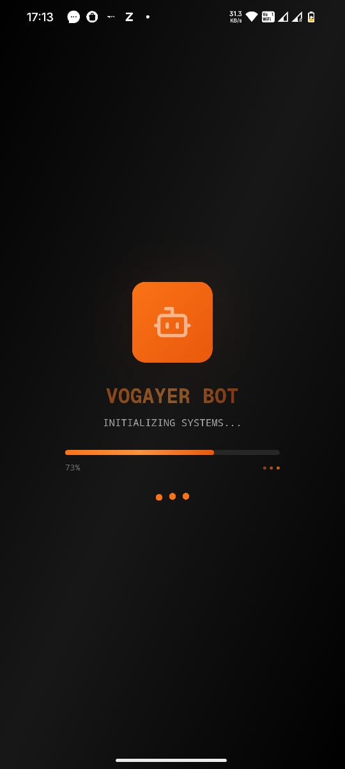
METHOD OF OPERATION Voyager-Bot Communication
The bag is connected to owner via Bluetooth and SMS, this ensures the suitcase remains accessible, trackable, and controllable — whether nearby via Bluetooth or remotely via GSM/SMS.
ESP32 handles:
Bluetooth serial communication (for local control & debugging).
GSM module (Quectel EC200U-CN) for SMS and GPS operations.
Bluetooth Terminal App (on mobile) used to connect wirelessly to ESP32.
SMS Commands allow control when Bluetooth range is exceeded.
App : Created an app where we integrated AI companion w live camera feed and motion control for voyager-bot
Department of Mechatronics Engineering

Slide 19
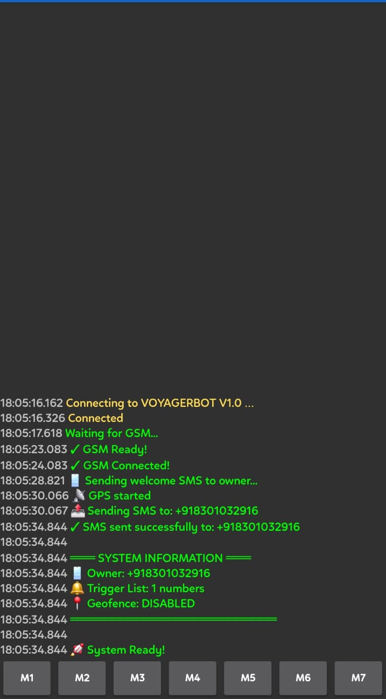
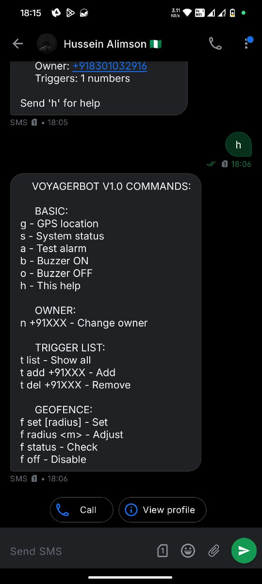
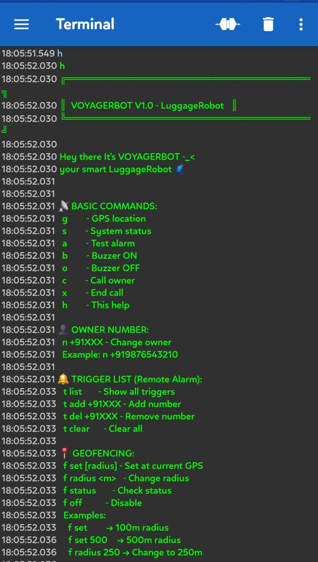
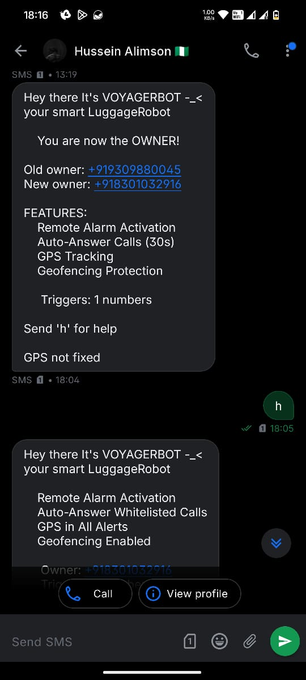
VOYAGER-BOT COMMUNICATION
BLE terminal showing initialization info
SMS showing command features
BLE terminal showing command features
SMS Welcome message

Slide 20
COMMANDS
BASIC COMMANDS
Command | Function | Response
g | Get GPS location | GPS coordinates + Google Maps link
s | System status | Complete system info with GPS location
a | Test alarm | 3 short beeps + confirmation + GPS
b | Buzzer ON (continuous) | Confirmation + GPS location
o | Buzzer OFF | Confirmation + GPS location
h | Help message | Complete command list
c | Make call to owner | "Calling..."
x | Hang up current call | "Call ended"
TRIGGER LIST COMMANDS
t list | Show all whitelisted numbers | Numbered list of all triggers
t add +91XXX | Add number to trigger list (max 10) | Confirmation message
t del +91XXX | Remove number from trigger list | Confirmation message
t clear | Clear all triggers (keeps owner) | Confirmation (owner kept)
Department of Mechatronics Engineering

Slide 21
COMMANDS
GEOFENCING COMMANDS
f set | Set geofence at current GPS (100m) | Confirmation with center coordinates
f set <radius> | Set geofence with custom radius (Range: 10-5000m) | Confirmation with radius
f radius <m> | Change radius (center unchanged, Range: 10-5000m) | Updated radius confirmation
f status | Check geofence settings | Enabled status, center, radius
f off | Disable geofencing | Confirmation
OWNER COMMANDS
n +91XXXXXXXXXX | Change owner number | Welcome message to new owner + Confirmation + GPS location
Department of Mechatronics Engineering

Slide 22
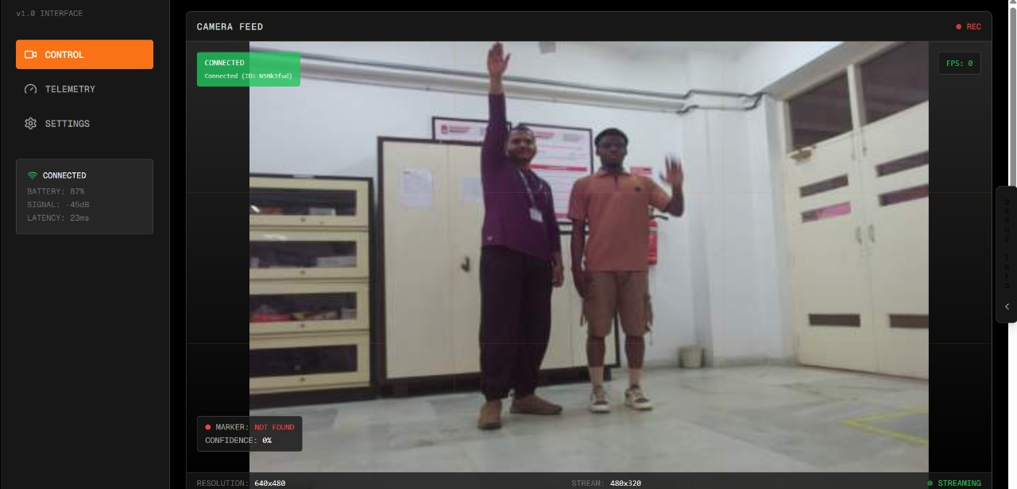
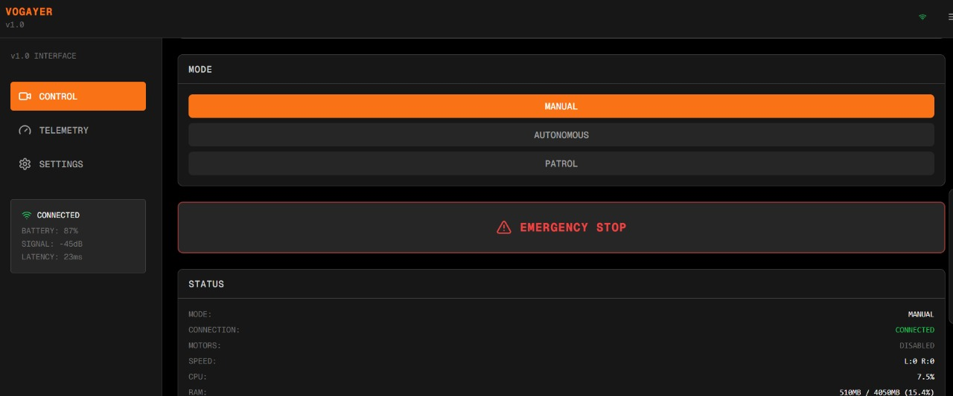
RPI CONTROL DASHBOARD
Department of Mechatronics Engineering

Slide 23
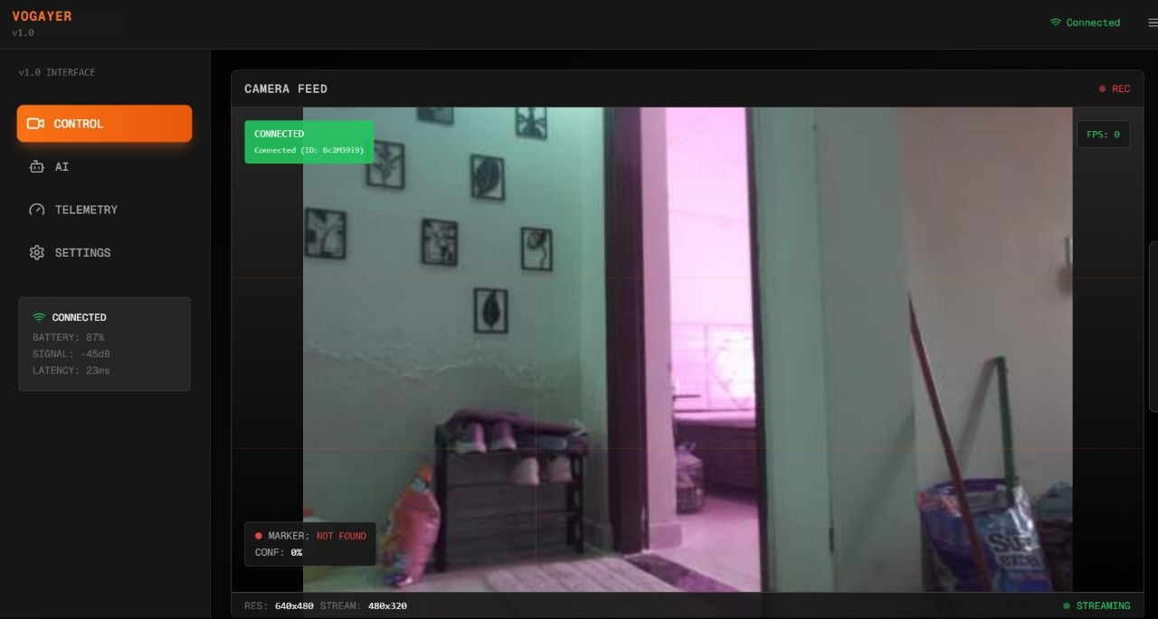
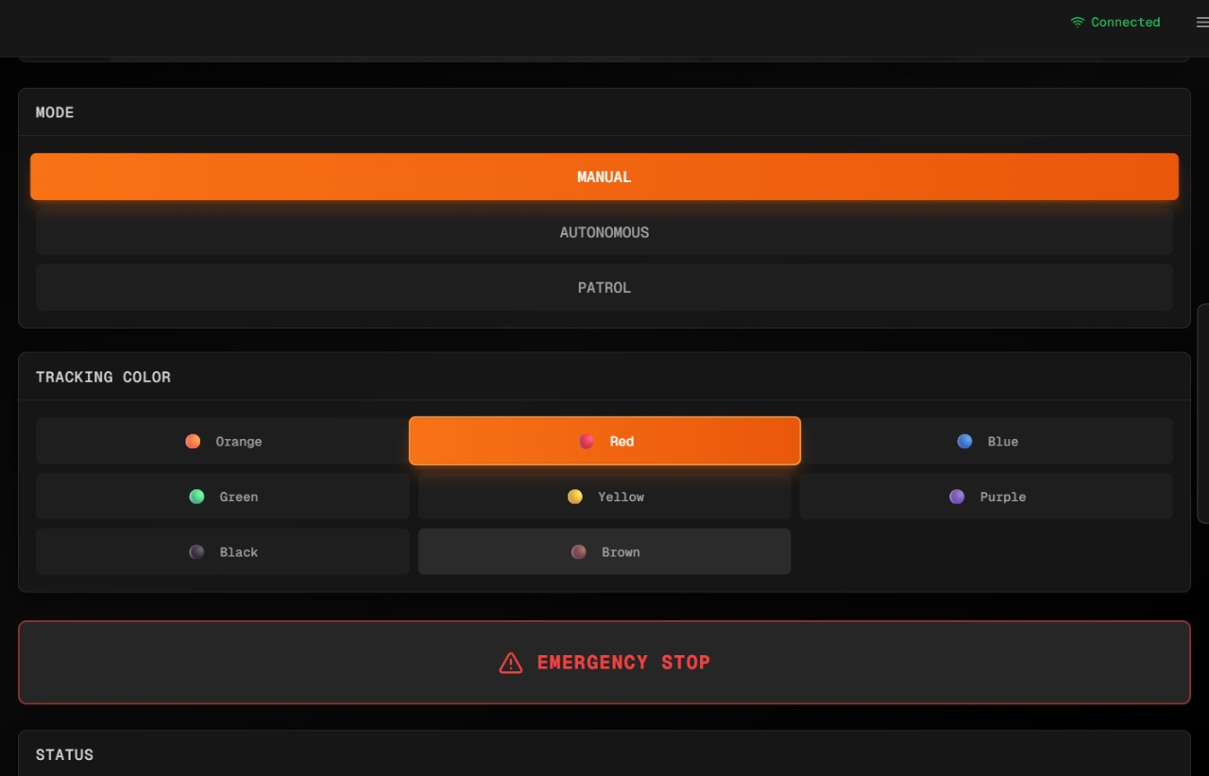
RPI CONTROL DASHBOARD
1.Live Camera Feed
Real-time video stream from the Pi Camera for object detection and tracking.
Displays tracking confidence level and marker detection status.
2.Control Panel
Includes an Emergency Stop for instant motor shutdown.
Colour selection Panel for following mechanism.
Provides joystick for directional control and speed adjustment.
3.Telemetry Dashboard
Displays CPU usage, RAM usage, FPS, and connection status.
Monitors motor activity, temperature, and system health in real-time.
Graphs for CPU and memory history ensure stable performance monitoring.
4.Settings & Network Configuration
Manages backend and network URLs for remote connectivity.
Provides camera configuration controls (resolution, frame rate, etc.).
Displays signal strength, battery level, and latency statistics.
Department of Mechatronics Engineering

Slide 24
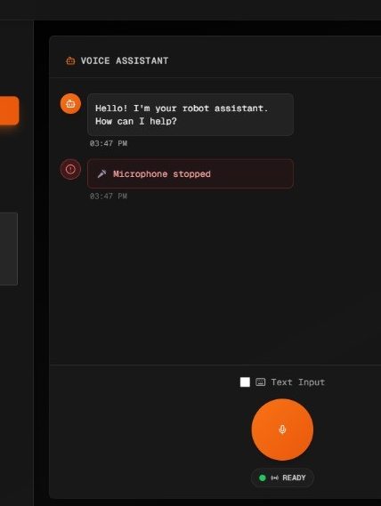
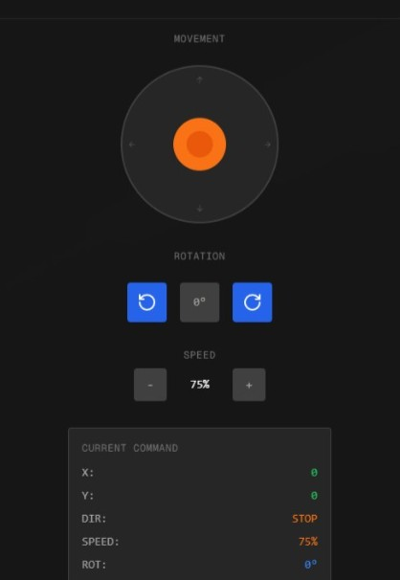
RPI CONTROL DASHBOARD
AI Companion
For voice control commands to move the Voyager-Bot
Companion to chat with during Travels
Department of Mechatronics Engineering

Slide 25
CHALLENGES
1. UWB Module Acquisition Issues
The initial design required two UWB modules for precise distance tracking between suitcase and owner.
Unavailability and sourcing delays forced a change in tracking method.
Led to a major redesign of the system’s core tracking concept.
2. Camera Placement Limitation
Mounting the camera on a low position (front of suitcase) reduced its field of view (FOV).
The camera often captured lower-body or ground-level frames, making consistent tracking difficult.
Required experimentation with angle adjustment and color detection sensitivity.
3. System Integration & Power Management
Combining Raspberry Pi, ESP32, GSM, GPS, and motor control created power stability challenges.
Required careful voltage regulation and wiring optimization to prevent brownouts.
Department of Mechatronics Engineering

Slide 26
THANK YOU
Department of Mechatronics Engineering

