Slide 1
IBM University Engagement Project Submission
Exploring the Power of Agentic AI with IBM Granite and LangFlow
Project
AI-Powered Personalized Learning & Teacher Assistant Platform
Domain: Education
Core Agent
Personalized Learning Recommendation Agent
Student-specific learning paths, adaptive difficulty and actionable teacher insights.
Student Name: Sujal Talaviya | University: Sarvajanik University

Slide 2

Project Overview
Domain: Education
Project Title: AI-Powered Personalized Learning & Teacher Assistant Platform
Primary focus: Personalized Learning Recommendation Agent
Target users: Students, teachers and school administrators
Target context: Government and rural schools in Gujarat
Goal: improve personalized learning while reducing repetitive teacher workload

Slide 3
Problem Statement
Why personalized learning is difficult in many government and rural schools
1. Diverse learning levels
Students in the same class may have very different mastery levels.
2. Limited resources
Teachers have limited time and access to individualized learning materials.
3. Administrative load
Assessment, feedback and repetitive planning consume teacher time.
4. Weak progress visibility
Teachers need timely topic-wise insights to identify students needing support.
5. One-size-fits-all learning
A fixed sequence may be too easy for some students and too difficult for others.
Core challenge: turn assessment evidence into practical, explainable, personalized next steps.

Slide 4
Proposed Solution
Create an AI-assisted platform that builds a learning profile for each student.
Analyze assessment results and estimate mastery for each topic.
Detect weak, developing, proficient and strong areas.
Select the next learning action: foundation, guided practice, independent practice or challenge.
Recommend curriculum-aligned learning resources at an appropriate difficulty.
Provide teachers with students-needing-support lists and topic-wise performance insights.
Use a human-in-the-loop approach: teachers can review and adapt recommendations.

Slide 5
Technology Used
Python
Core application and recommendation logic
Streamlit
Lightweight student + teacher dashboard
FastAPI
Optional REST API layer
SQLite + SQLAlchemy
Local structured storage for the MVP
scikit-learn
Optional ML/ranking layer for later experimentation
IBM Granite + LangFlow
Planned/next-stage LLM and agent orchestration layer
RAG
Future curriculum-content retrieval layer using approved school material
Vector Database
Future semantic retrieval for curriculum resources

Slide 6
LangFlow / Agent Components
Chat/Input component — receives student or teacher questions and learning context.
Agent component — coordinates reasoning and chooses the next learning action.
IBM Granite model — planned for natural-language reasoning, explanation and content generation.
Retriever / Vector Store — future component for curriculum-aligned RAG.
File / Data components — ingest approved lesson plans, worksheets and resource metadata.
Output component — returns a personalized recommendation with an explanation.

Slide 7
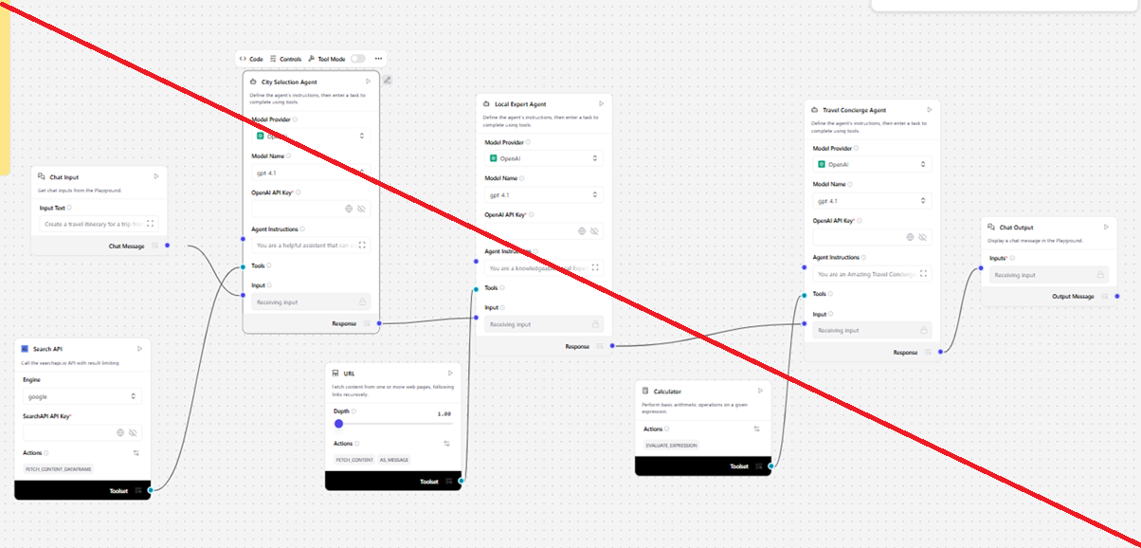
Personalized Learning Workflow
Student
Profile
Assessment
Results
Mastery
Estimation
Weak Topic
Detection
Action & Resource
Selection
Personalized
Recommendation
New learning activity
Re-assessment
Feedback loop: every new assessment updates the student's mastery profile.

Slide 8
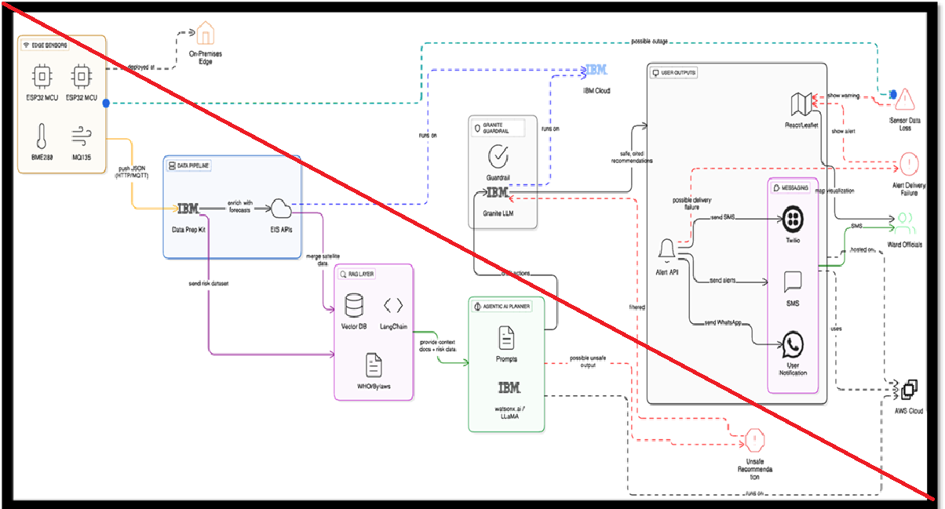
Architecture Blueprint
STUDENT / TEACHER INTERFACE • Streamlit
PERSONALIZED LEARNING AGENT • Observe → Analyze → Decide → Recommend
Student Profile
Assessments
Mastery Service
Recommendation Service
SQLite + SQLAlchemy • Students • Topics • Assessments • Resources
Future: IBM Granite + LangFlow + RAG + Vector Database

Slide 9

Role of Agentic AI in the Solution
Observe: collect student profile, assessment history and topic performance.
Reason: estimate mastery and identify the most important learning gap.
Plan: select an appropriate learning action and difficulty.
Act: recommend a specific learning resource or teacher-approved activity.
Adapt: use the next assessment to update the recommendation.
Explain: provide a reason that a teacher can understand and review.
Human oversight: teachers remain responsible for final educational decisions.

Slide 10


Token Usage & Prompt Design
Before Prompt
Student: Grade 8
Topic: Fractions
Recent score: 35%
History: repeated mistakes
After Prompt / Agent Output
Action: Foundation Lesson
Difficulty: Easy
Reason: mastery below 40%
Next step: short re-assessment
Keep prompts structured: student context → evidence → constraints → required output.
Avoid sending unnecessary student history to reduce cost and improve consistency.
For the first MVP, deterministic rules handle core recommendations; LLMs are best added for explanation/content generation.

Slide 11
Novelty and Uniqueness
Student-level personalization instead of one-size-fits-all recommendations.
Explainable recommendations: every action is tied to observed performance.
Closed feedback loop: assessment → recommendation → activity → re-assessment.
Teacher-in-the-loop design for safer and more practical school adoption.
Gujarat-focused opportunity: future Gujarati + English learning support.
Rural-school friendly architecture: lightweight first deployment with a path to cloud/LLM/RAG.
Modular agent architecture can later support assessment, lesson planning and teacher-assistant agents.

Slide 12
Implementation & Demo
Student Dashboard
View mastery by topic and receive personalized recommendations.
Teacher Dashboard
See students needing support and inspect topic-wise performance.
Agent API
FastAPI endpoint exposes student recommendations for future integrations.
Demo data includes Mathematics, Science and English topics.
Example decisions: <40% → Foundation; 40–59% → Guided Practice; 60–79% → Independent Practice; ≥80% → Challenge.
The repository includes database models, services, agent logic, UI, API and a basic automated test.

Slide 13
Future Scope
Teacher Assistant Agent — lesson plans, worksheets, activity ideas and differentiated content.
Assessment Agent — generate quizzes, evaluate answers and produce feedback.
Curriculum RAG — retrieve only approved Gujarat/state curriculum material.
Gujarati + English support — improve accessibility for local classrooms.
Student Knowledge Graph — model concepts, prerequisites and mastery relationships.
Early Support Detection — identify persistent learning gaps and alert teachers.
Voice interface — support students and teachers with limited typing ability.
Cloud deployment + PostgreSQL — support multiple schools and larger datasets.
Evaluation framework — measure recommendation accuracy, learning gains and teacher time saved.

Slide 14
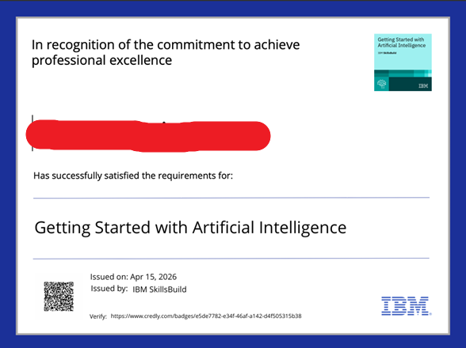
GitHub Repository
Recommended repository name: ai-powered-personalized-learning-platform
Include: app.py, agents/, services/, database/, api/, ui/, scripts/, data/, tests/
Include README.md with setup, architecture, screenshots and demo instructions.
Add the project presentation and problem statement PDF.
Add a clear .gitignore and requirements.txt.
Before submission: test the complete setup on a clean virtual environment.
GitHub: https://github.com/Sujal2812 (replace with the final project repository URL)

Slide 15

Certificates / IBM Engagement
Add the relevant IBM / Credly certificate after completion.
Add IBM BOB certificate if issued for the engagement.
Keep certificates as supporting evidence; the main presentation should focus on the working solution.

Slide 16

Conclusion
What the project delivers
An explainable, adaptive learning recommendation system that converts assessment evidence into the next best learning action for each student.
Student impact
More relevant practice, appropriate difficulty and continuous feedback.
Teacher impact
Faster identification of learning gaps and actionable topic-level insights.
Next milestone: add curriculum RAG + IBM Granite/LangFlow orchestration after the core MVP is validated.

