Slide 1
Ratan Lal Bunkar || System Enginner
Electrical Engineering Fundamentals
Reliable Engineering Solutions
System V&V
Validation Platforms
Cross-Domain Debugging

Slide 2
Electrical Engineering Journey
Strong foundation in control systems, signal processing, and digital electronics.
IIT Ropar Electrical Engineering
1
Practical application of embedded systems and control concepts.
IIT Ropar Embedded Systems
2
Deepened knowledge in signal processing and system modeling.
3
NTUT Signal Processing
Strengthened experimental and measurement- driven engineering approach.
NTUT Experimental Engineering
4
Applied electrical engineering to electromechanical systems.
SHL Medical Electrical Engineering
5

Slide 3
My Core Roles in System Development and Reliability
System Architecture & Integration
Requirements-driven system definition and seamless HW/FW/ME integration.
Automated Test Platforms
Custom fixtures, SBC-based ATE, and repeatable validation workflows.
Data-Driven Troubleshooting
Structured log, signal, and test-data analysis to isolate performance issues.
End-to-End System Readiness
Verification & Validation
End-to-end traceability, protocol execution, and compliant test evidence.
Root Cause Analysis
Structured approach to identify and resolve underlying issues.
Cross-Domain Debugging
Fast resolution across hardware, firmware, mechanics, and communication interfaces.

Slide 4
Engineering Skills
Hardware Design
Systems Engineering
System integration, requirements engineering, system definition, requirements-to-test traceability, system architecture support, V&V, test planning/protocols, IQ/OQ/PQ, TMV, DFMEA/risk support.
Altium Designer, schematic capture, PDN & power sequencing, component selection, BOM management, SysML / UML.
Tools & Skills
Data & Quality
Python, Pyshark, Minitab, Matlab, Jira, Confluence, Teamcenter, Polarion, stakeholder communication, technical documentation, concise reporting.
SPC, ANOVA, GRR, reliability testing, signal timing analysis, power behavior
analysis, log/packet analysis, test
data organization, ISO 13485,
ISO 14971, ISO 9001, IEC 60601,
IEC 62304, ISO 11608 awareness.
Validation & Debugging
Interfaces & Protocols
PCBA bring-up, design verification (EVT / DVT),
Python-based test automation, SBC/Raspberry Pi custom ATE, , oscilloscope, cross-domain debugging (HW/FW/ME), structured RCA.
Ethernet MAC/PHY, CAN-FD, USB, BLE, SPI / I2C / UART, RS-232 / RS-422 / RS-485, TCP/IP, RFID testing, firmware/interface validation, protocol analysis.

Slide 5
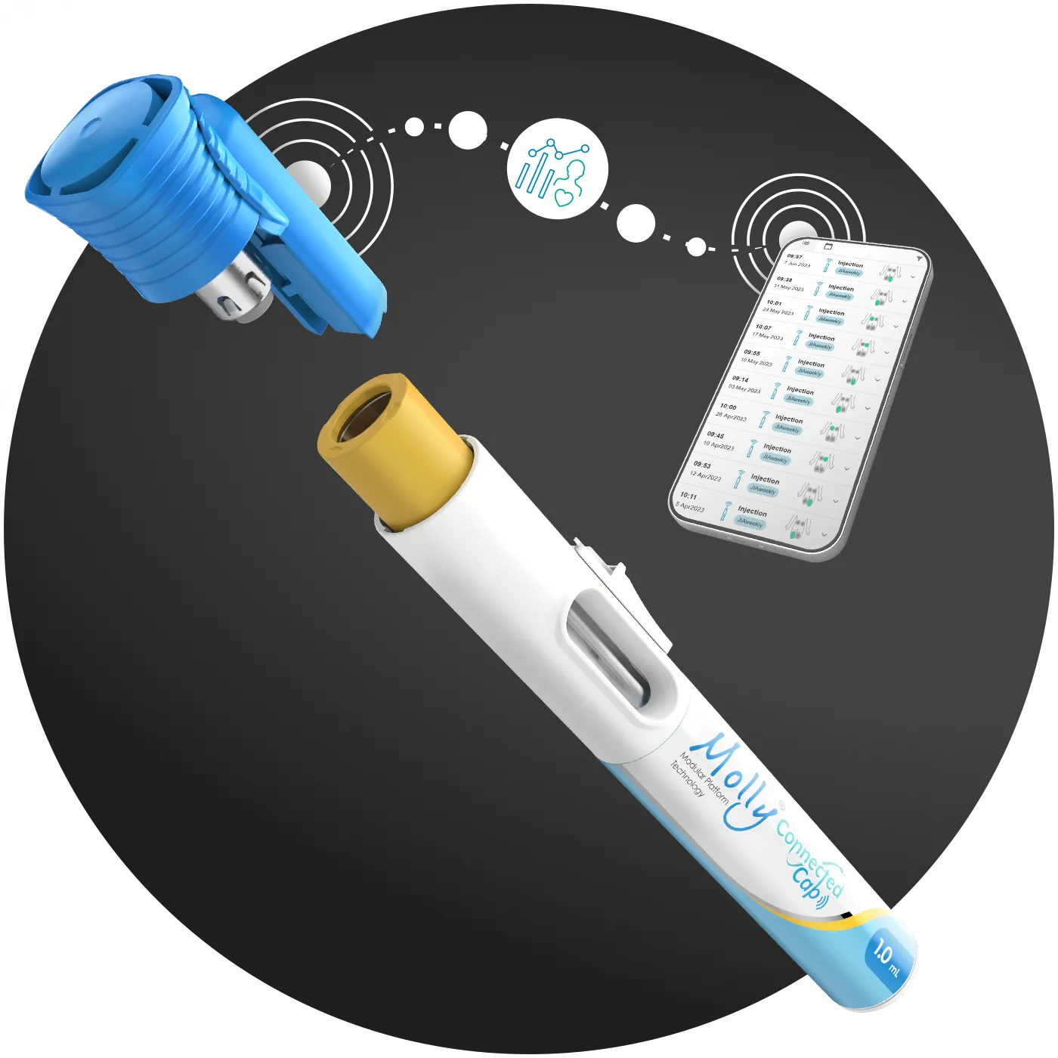
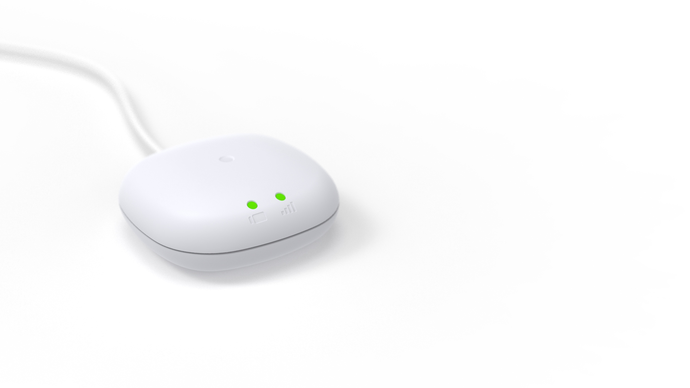
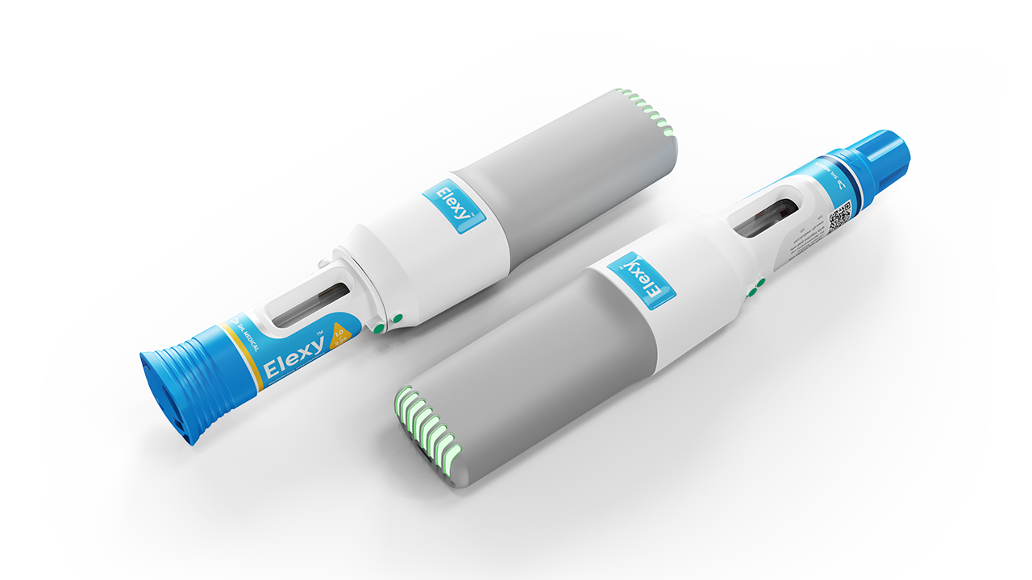
Project Descriptions
SmartHub
Communication interface validation, protocol/log analysis, system-level testing, data-driven troubleshooting, cross- domain debugging across HW/FW.
Elexy Platform
Molly cCap
System integration, V&V execution, automated validation, interface debugging, DOE-based characterization, RCA for actuator performance and timing stability.
Validation support, test method development, fixture-based testing, requirements traceability, verification documentation in regulated environment.

Slide 6
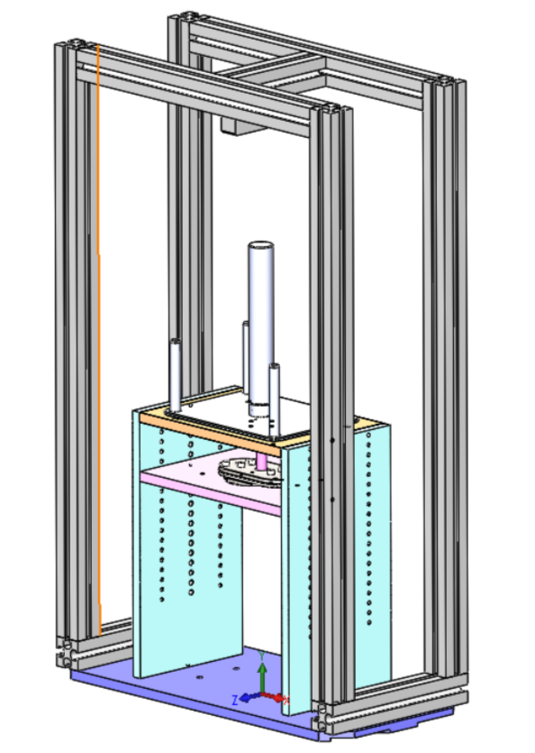
Power Unit Reliability Test Bench
Independent electromechanical validation of the Elexy Power Unit
Dedicated Validation System
Integrate Sensors
Controlled Experimentation
Simulate Injection Scenarios
Synchronized Data Acquisition

Slide 7
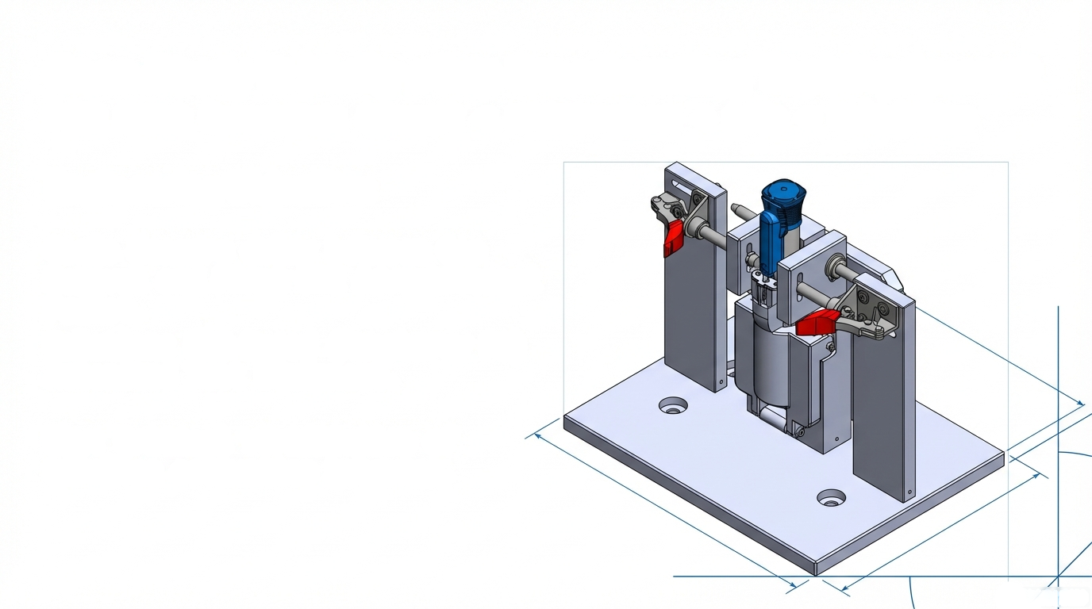
Molly cCap Broadcasting Test Equipment
BLE Communication
Core function of the test
User Interaction
Trigger for BLE events
Mechanical Trigger
Simulates device activation
SBC-Based System
Captures BLE packets
Software Tools
Analyzes communication data

Slide 8
Failure Analysis and Resolution Process
Recurrence Prevention
Reproduce the Issue
Evidence Collection
Root Cause Confirmation
Update tests, design margins, and documentation to prevent future occurrence
Stabilize & Contain
Recreate failure under controlled conditions
Gather time- correlated data to build causal understanding
Ensure cause reproduces issue, fix removes it, and explains behavior
Stop operation, isolate system, preserve data
Boundary Isolation
Corrective Action & Validation
Define Failure Clearly
Isolate problem across electrical, firmware, mechanical, or environmental domains
Hypothesis Testing
Describe issue using condition, deviation, measurement, frequency
Implement fix and verify through regression, stress, and interface testing
Form data-driven hypotheses and validate using controlled experiments

