Slide 1
Introduction to the Research Question
RESEARCH QUESTION : Is there statistically significant relationship between country's women population and its Gross Domestic Product?
H0: There is no statistically significant relationship between country's women population and its Gross Domestic Product.
H1: There is statistically significant relationship between country's women population and its Gross Domestic Product.
Assumptions:
Normality
Homoscedasticity
No Extreme Outliers
Linear Relationship
Random Sample
Ratio or Interval variable
Sample:
The data contains semi-structured data on GDP, Total Population, Female Population Percentage and Country to Region Mapping for various countries between 2015 - 2017 and the source of data is World Bank. The World Bank data set is a subset of data extracted from the primary World Bank collection of development indicators, compiled from officially-recognized international sources.
GDP: Includes GDP data for countries from 2015 to 2017.
Total Population: Includes Total population data for countries from 2015 to 2017.
Female Population Percentage: Includes female population percentage data for countries from 2015 to 2017.
Countries: Includes country mapping data.

Slide 2
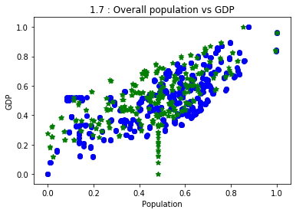
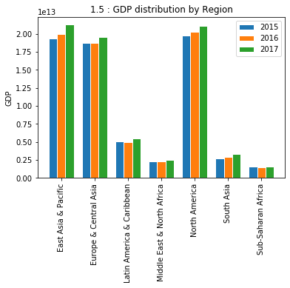
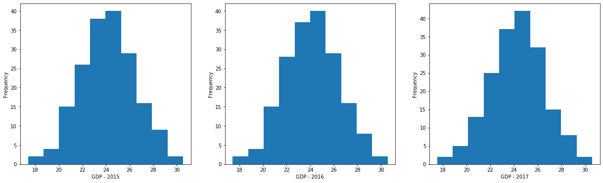
Analysis Result
As we can see data is having ratio and interval data and represent random sample.
The Shapiro–Wilk test is a test of normality, and our result are in favour of null hypothesis i.e. data is from normal distribution.
As we can see that there is strong statically significant relationship between country's women population and its Gross Domestic Product rvalue = 0.64 pvalue = 1.58
There is no extreme outliers and shows homoscedasticity.
GDP for all the regions is in incremental way (i.e. GDP-2017 > GDP-2016 > GDP-2015).
GDP of North America and Asian Region is much higher compares with other regions; This is because North America is having The United States and Asian Region is having China which is contributing in the result.

Slide 3
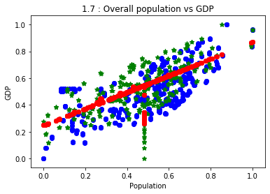
Result and Conclusion
A zero order correlation was used to evaluate the null hypothesis that there There is no statistically significant relationship between country’s women population and its Gross Domestic Product where N=181. Result of Pearson's analysis yielded that there is strong positive correlation between country's women population and its Gross Domestic Product by rvalue = 0.64 and pvalue = 1.58.
Research Conclusion : The analysis provide evidence in favour of alternative hypothesis
Our model shows a promising result, although further evaluation and tuning is still required.
Choice of the model is due to the fact that as per graph 1.7 : Overall population vs GDP we can see linear pattern in the data.

