Slide 1

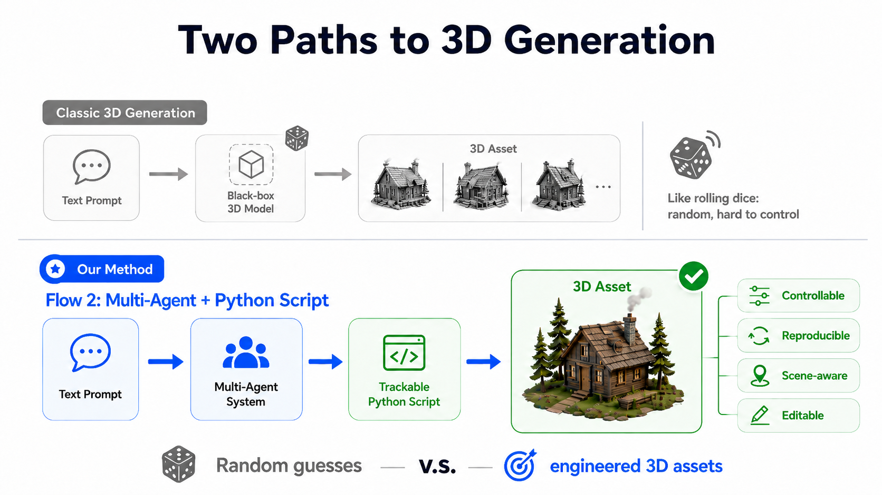
SCRIPT3D
Script-backed, controllable, reproducible 3D asset generation in Blender
Core thesis
Treat every generated 3D asset as a reproducible object: code + metadata + scene context, not a one-off mesh.
Hackathon presentation | Key highlights only
GOSIM 2026 Paris Hackathon

Slide 2
PROBLEM
Text-to-3D is useful, but weak for real workflows
A black-box mesh can look good once, then fail when the scene needs iteration.
No provenance
No stable handle
No scene memory
prompt
-> generated mesh
-> hard to edit later
Which factory, seed, script, or prompt produced this asset?
“The apple” becomes ambiguous after multiple objects exist.
Size, support surface, pose, and relation are easy to lose.
User asks later:
“make the desk marble”
“replace the apple with a green one”
“put the lamp on the side table”
These are not just visual edits. They require asset identity, generation history, and spatial consistency.
GOSIM 2026 Paris Hackathon

Slide 3
SOLUTION
SCRIPT3D makes generated assets inspectable and repeatable
The asset is not only geometry. It carries the procedure and scene facts needed to regenerate or edit it.
Python generation script
Scene index JSON
Blender object group
Visual feedback
Factory path, category, seed, source prompt, edit prompt, scale, and location.
Stable object_id, semantic category, dimensions, materials, and relations.
Root object and children are tagged, moved, replaced, rendered, and saved coherently.
Verifier and camera agents check intent, visibility, placement, and scene plausibility.
prompt -> plan -> structured tools -> Blender execution -> metadata -> render -> verify -> correct
GOSIM 2026 Paris Hackathon

Slide 4
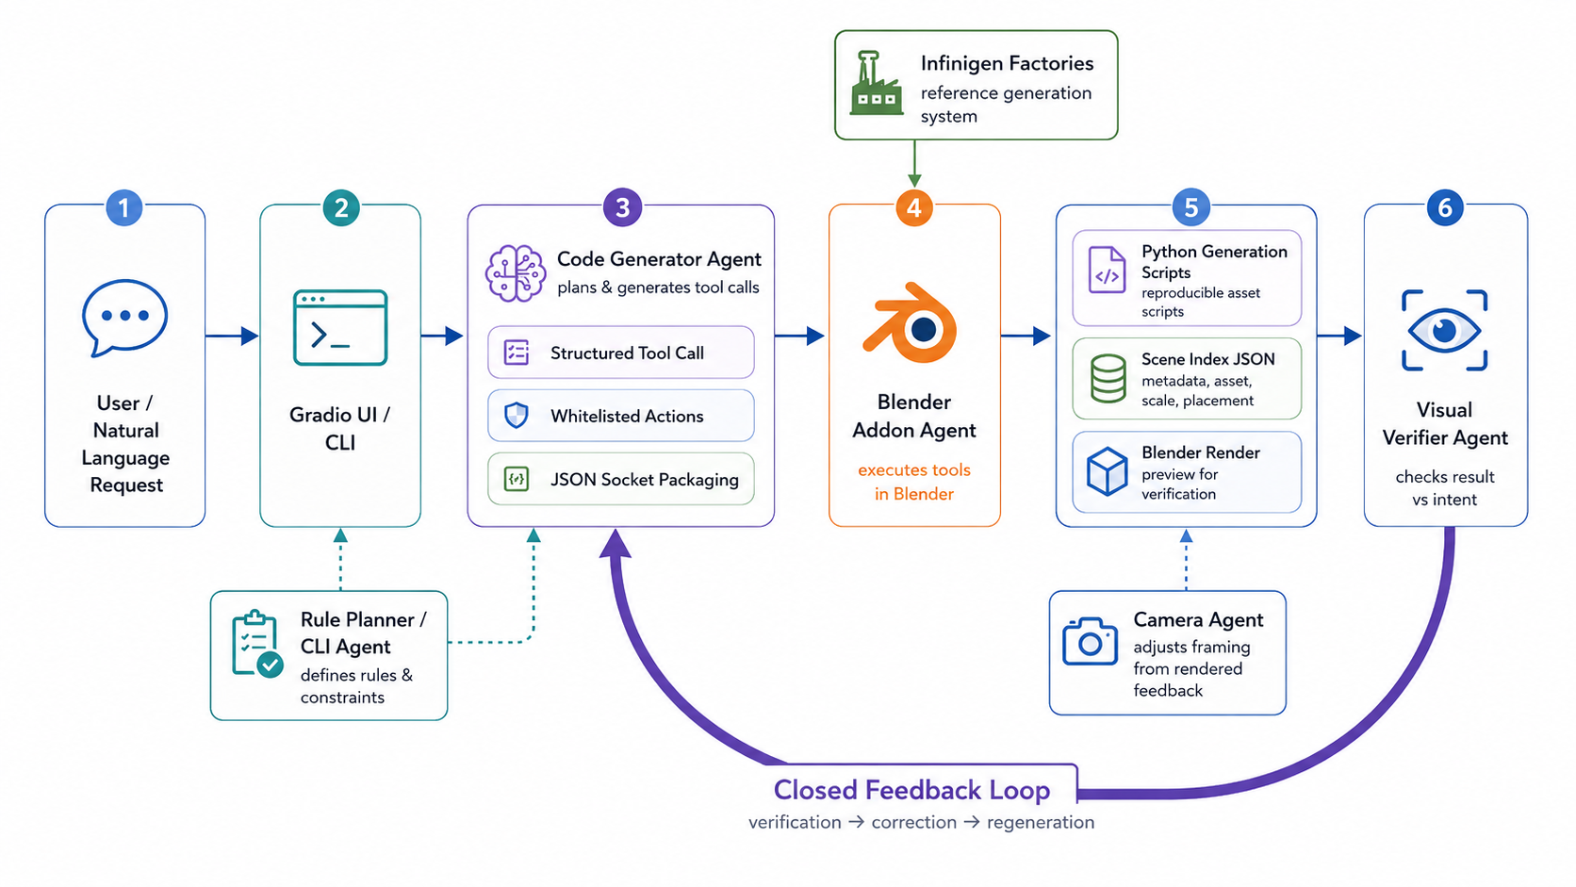
ARCHITECTURE
Multi-agent architecture with a narrow execution surface
Flexible natural-language planning, but Blender only receives structured, whitelisted JSON commands.
GOSIM 2026 Paris Hackathon

Slide 5
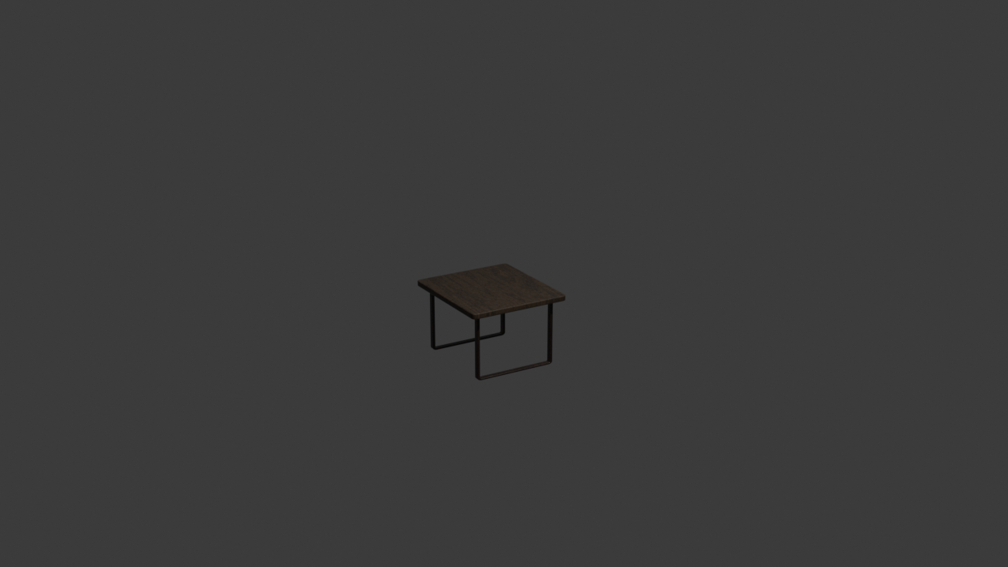
DEMO FLOW
End-to-end demo: from prompt to editable scene asset
“add a desk and put a desk lamp on it”
1
2
3
4
5
Resolve categories
Generate assets
Place with rules
Write records
Render & verify
desk + desk_lamp
Infinigen factories
lamp on desk surface
scripts + scene_index.json
camera + visual verifier
Later edit:
\editing make the desk marble
SCRIPT3D resolves the desk record, respawns a compatible asset, preserves the old bounding box, updates metadata, and renders again.
GOSIM 2026 Paris Hackathon

Slide 6
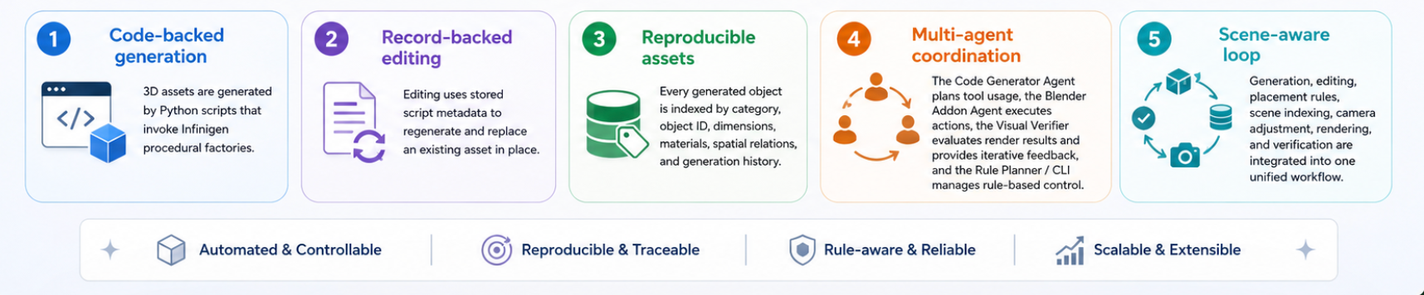
TECHNICAL DEPTH
What is technically different
Structured tool calls
Record-backed editing
No arbitrary bpy code is sent to Blender; actions are auditable.
Edits use stored factory, seed, script path, and bounding box.
Scene-aware placement
Verification loop
place_on, place_near, wall placement, physics cleanup, scale sanity.
Render-based checks produce targeted correction instructions.
GOSIM 2026 Paris Hackathon

Slide 7
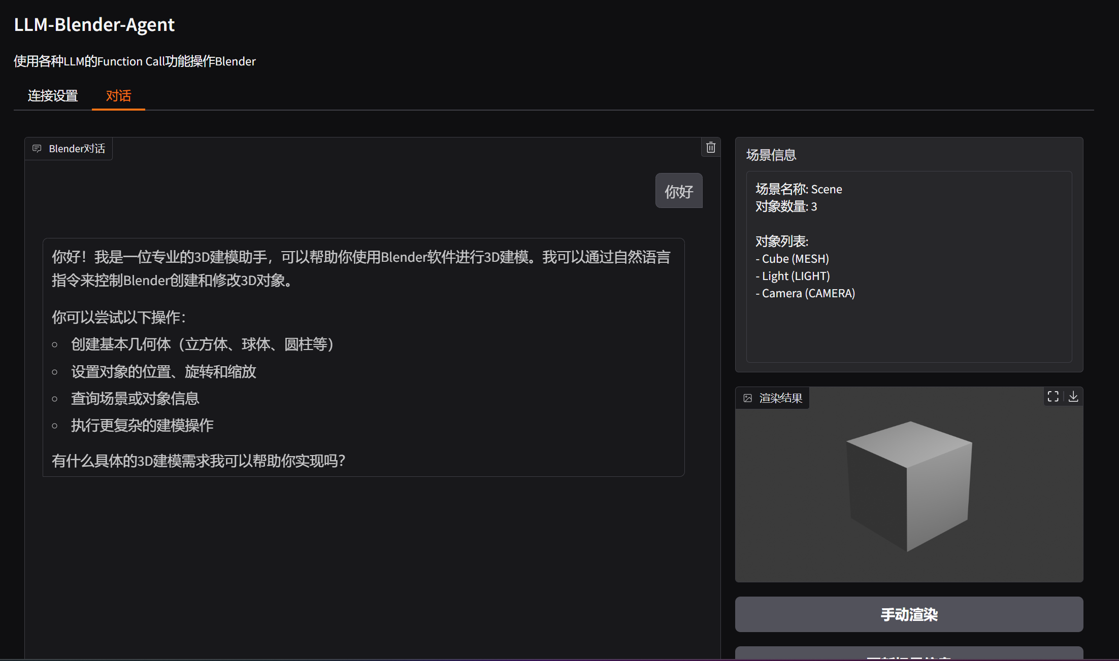
USER WORKFLOW
Built for hackathon demos and real iteration loops
Two planning paths share the same Blender command surface
LLM function-calling path
Used by Gradio UI for flexible natural-language workflows and streamed progress.
Deterministic rule planner
Useful for offline demos, repeatable tests, and environments without LLM access.
CLI + UI support
Open, inspect, generate, edit, place, render, save, and verify in both modes.
Demo safety: if remote planning fails, the system still has deterministic fallback control.
GOSIM 2026 Paris Hackathon

Slide 8
SCRIPT3D
From random guesses to engineered 3D assets
Judge the project by whether assets can be regenerated, edited, placed, inspected, and verified after the first generation.
Demo now
Next
Why it matters
Natural language -> Blender -> metadata -> render
Broader factories, richer edit parameters, stronger verifier
3D creation becomes iterative, reproducible, and controllable
GOSIM 2026 Paris Hackathon

