Slide 1

IST 687 Hyatt Hotel Dataset Analysis
Team 4
[ELIZABETH SCHAUB, Daniel Pearl, Travis tRan, Laura Lamoureux]

Slide 2
Introduction
We set out to understand what impacts our guest’s likelihood to recommend our hotel(s) and ultimately compels them to become a promoter of our hotels.
Our aim was to arrive at recommendations based on what we discovered from our analysis.

Slide 3
Our Process
Started with Variable Glossary document
Hypothesized a variety of variables (including dates, countries, room types, etc.) that could potentially have impact on Net Promoter Score
Later learned that some variables mentioned in the Glossary were not included in the data set
Some questions were not able to be answered due to low frequency of responses in certain categories
Divided questions to be answered among the group members
We utilized a group space on 2SU for sharing of documents & files
Each member independently
Cleaned and analyzed the data for their assigned questions
Did any necessary data transformations and/or creation of new variables needed for analysis
Group met weekly to discuss report progress and discuss any changes from the initial approach

Slide 4
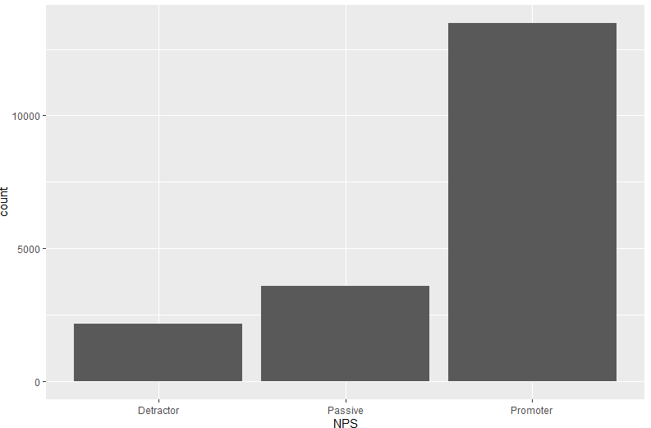
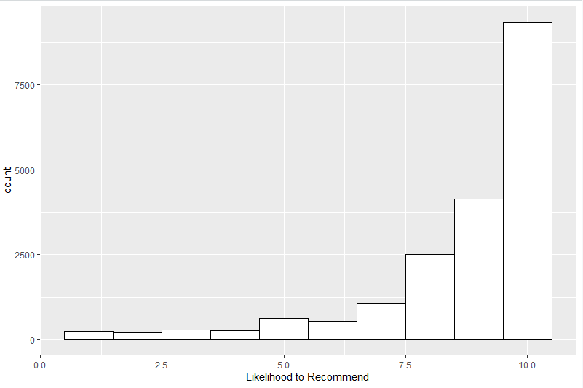
Data Exploration
Most hotel guests are classified as “Promoters” who would be Likely to Recommend Hyatt Hotels:
Net Promoter Classification
Likelihood to Recommend

Slide 5
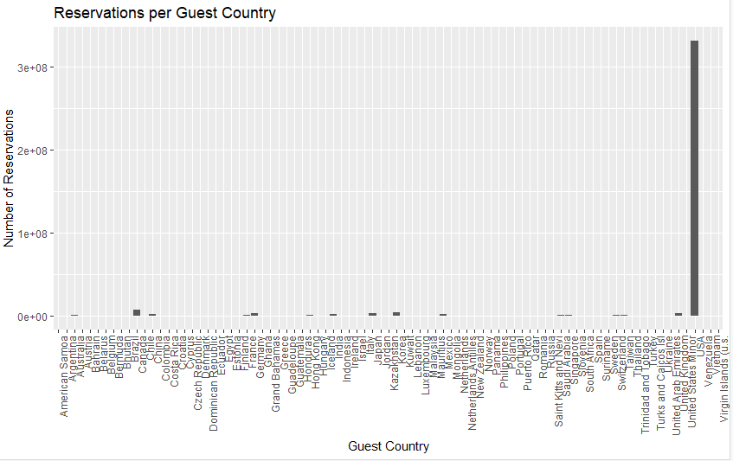
Data Exploration
Most guests in this data set were from the United States:

Slide 6
Data Exploration
Most reservations in this data set were from 2014, and most of those were from February:
Year Number of Stays 2013 1 2014 19218 | Month Number of Stays Jan 6 Feb 19192 Mar 21

Slide 7
Discussion of Results
Which survey data questions might help us to understand and predict NPS?
We created a multiple regression model that included each of the survey variables. Then we created a model, stepwise, adding in each significant variable until we reached an equivalent adjusted R^2 value.
Likelihood to Recommend = -1.95 + 0.38(Customer Service) + 0.32(Guest Room)
+ 0.21(Hotel Condition) + 0.15(Staff Cared) + 0.13(Tranquility)
Conclusion: We found that a combination of Customer Service, Guest Room Satisfaction, Condition of Hotel, Staff Cared and Tranquility explains 66% of Likelihood to Recommend, which is directly related to Net Promoter Score.
Indicated Actions:
TLC training for all staff to improve both Customer Service and Staff Cared ratings
Capital Expenditures for Hotel and Room Renovations to improve Hotel Condition and Guest Room ratings

Slide 8
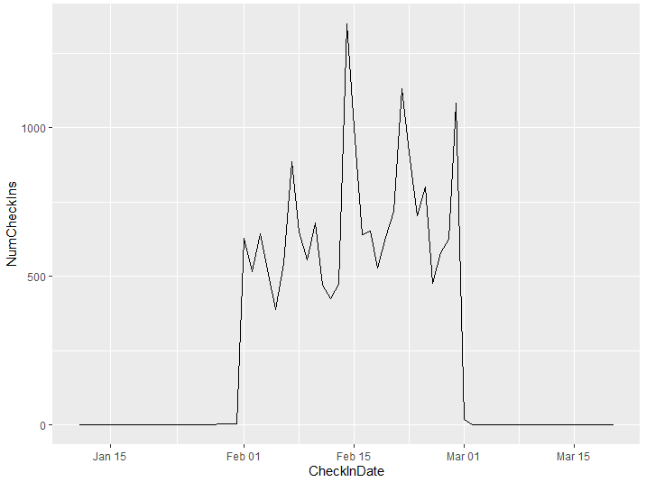
Discussion of Results
During which time is NPS the highest?
Conclusion: Recalling the earlier data shown in our Initial Observations, since we found that the majority of stays were during February 2014, we could not answer this question based on seasonality or month of the year.
That said, we did look at Check-Ins Per day in JFM 2014 and noted a spike in Check-Ins on February 14 (Valentine’s Day).
Indicated Action:
Valentine’s Day discounts and/or promotions

Slide 9
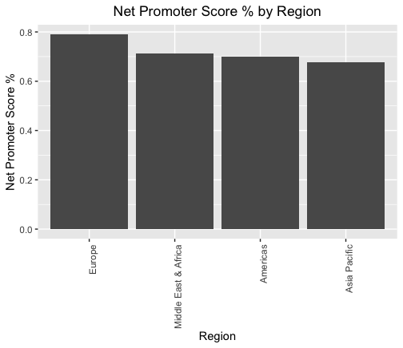
Europe 0.790
Middle East & Africa 0.713
Americas 0.701
Asia Pacific 0.677
Which regions have the highest NPS?
Further analysis would have to be conducted to determine what cultural factors are contributing to the differences in these scores
It is recommended that cross training of managers occurs.

Slide 10
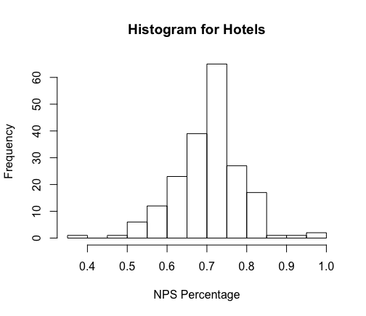
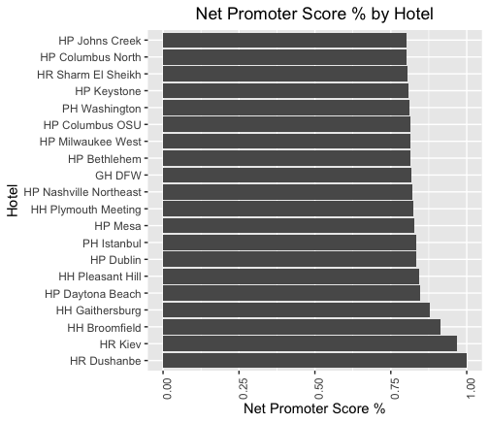
Which hotels have the worst NPS Percentage?
More successful hotels can be emulated and used as a model for these low scoring hotels.
Recommended that cross-training occurs between managers of varying hotels
We will hopefully see the histogram shift to the right after implementation.

Slide 11
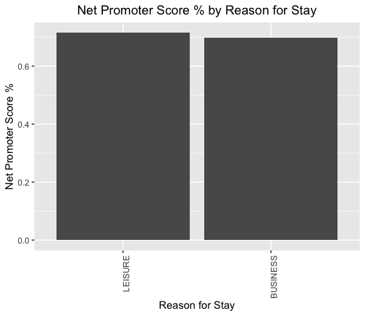
How does reason for stay impact the NPS?
LEISURE 0.715
BUSINESS 0.698
Adjusted R-squared: 1.971e-05
p-value: 0.2399
Regression analysis shows that reason for stay does not have a significant impact on NPS
The difference in percentage between guest staying for business and leisure is 0.017 which is a very minimal difference between these two groups.

Slide 12
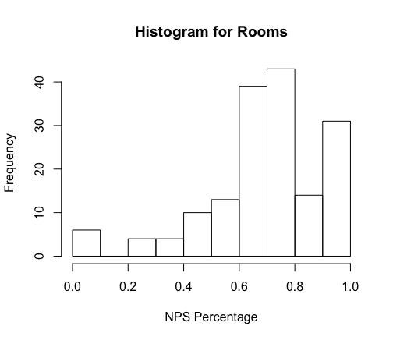
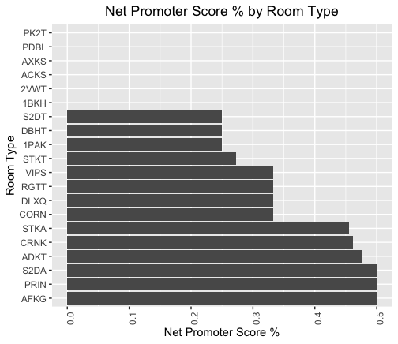
Which rooms have the lowest net promoter score?
Perhaps the lowest ranking rooms can be altered and fixed up to raise the overall NPS
Further analysis will have to be conducted to determine the difference between the high and low rated rooms

Slide 13
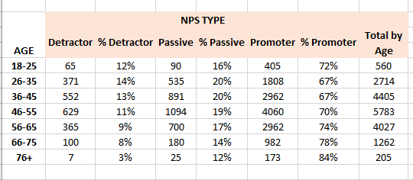
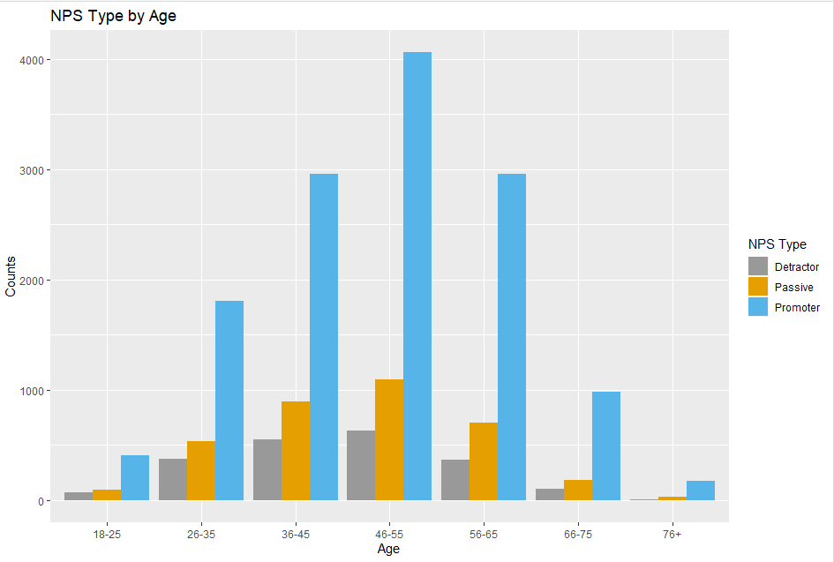
Which age groups have the highest NPS?
Conclusion:
Promoter scores increased with age of the survey taker. Detractor scores were higher among younger survey takers.
Indicated Action:
Age-specific marketing campaigns to address deficiencies for younger hotel guests and continue appealing to older hotel guests.

Slide 14
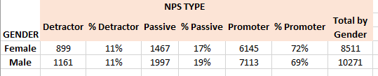
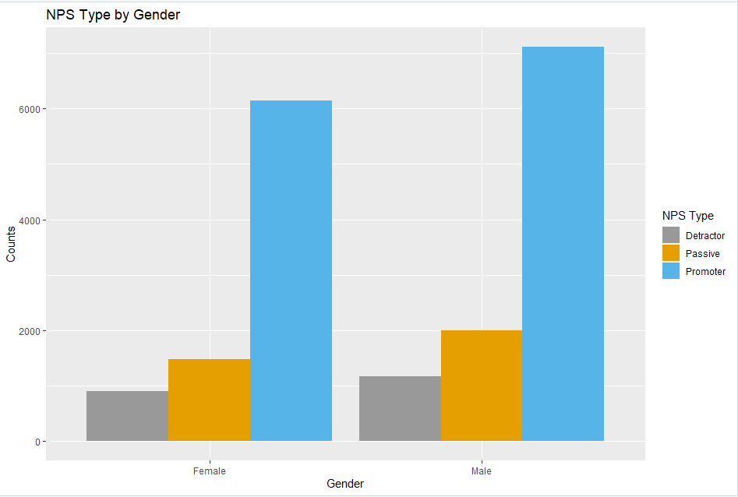
Which gender has the highest NPS?
Conclusion:
While more males than females took the survey, females were slightly more likely to be “Promoters”. Both genders were equally likely to be detractors.
Indicated Actions:
No action recommended. Today, it would not be culturally sensitive to market towards a specific gender.

Slide 15
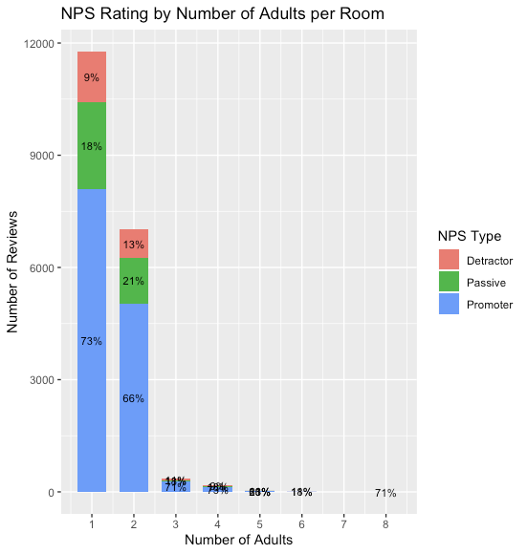
Discussion of Results
Does number of adults in the room
Impact NPS?
Conclusion: One adult in the room is more likely to be a promoter than 2 or more adults in the room.
Indicated Actions:
Offer promotions or incentives for business travelers who recommend hotel to colleagues as they are more likely to be traveling alone

Slide 16
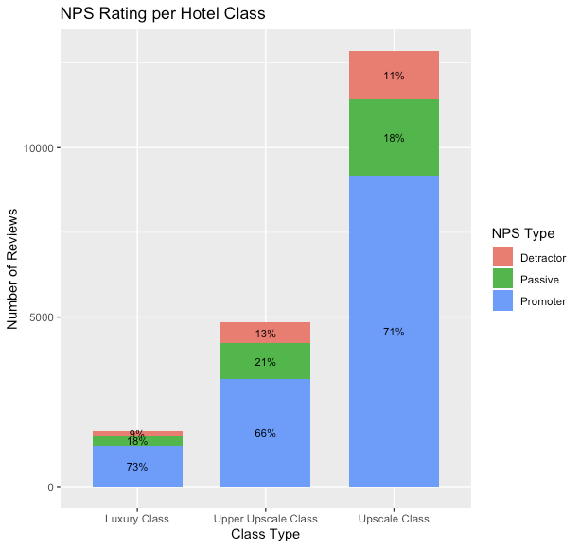
Discussion of Results
Does the class of the hotel impact the NPS?
From highest class to lowest class:
Luxury
Upper Upscale
Upscale
Indicated Actions:
Improve value of the Upper Upscale hotel guests experiences by offering them a chance to stay in a Luxury hotel.
Conclusion: The value for the Upper Upscale class need to be addressed in order to improve the NPS.

Slide 17
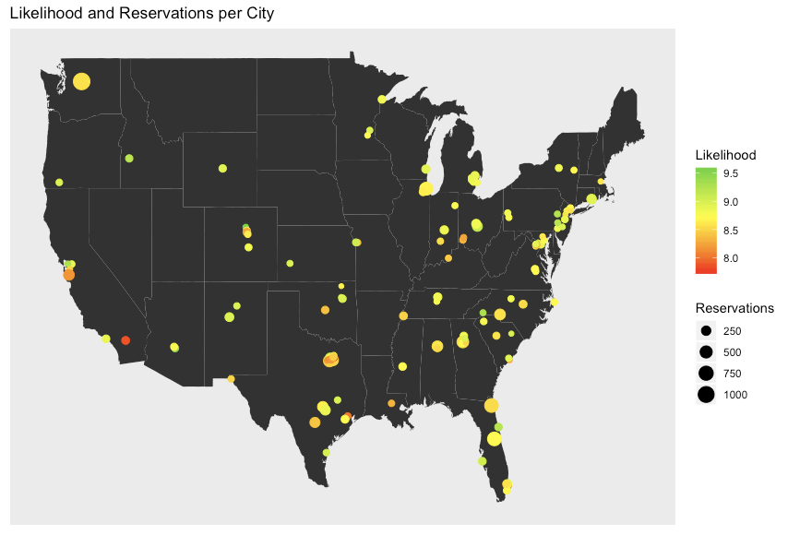
Discussion of Results
Visualization of Likelihood to Recommend and # of Reservations by US City
Indicated Actions:
Consider adding additional hotel(s) in the Northwest
Consider utilizing skilled managers in high rated hotels to train those in lower rated hotels

Slide 18
Recommendations for Hyatt Hotels
General ideas
Reapply what is working at the highly rated hotels to the lower rated hotels
Reapply what is working for highly rated room types to the lower rated room types
Expand into Northwest Region of the United States
Develop marketing strategies targeting adults aged 26-35
Allocate resources to fund capital expenditures renovations to hotel general areas and guest rooms
Staff Training Ideas
Develop a cross-training program in which managers/staff from highly rated hotels or regions are temporarily assigned to managerial positions at lower-rated hotels or regions to teach/influence staff there
Create in-service opportunities in which managers/staff from lower rated hotels/regions are temporarily assigned to work at higher rated hotels/regions to learn how things are done there
TLC training for all Staff
Promotion Ideas
Valentine’s Day discounts or offers
Offers or incentives to business travelers who recommend the hotel to their colleagues
Offering guests who stayed in an Upper Upscale hotel who were not promoters, a chance to stay in a Luxury hotel.

Slide 19
Appendix A: Business Questions We Set Out To Answer
* questions we are discussing today are in bolded green
Does short vs. long length of stay relate to higher NPS?
Does whether guest stay was a walk-in or a reservation relate to higher NPS?
Is this impacted by how far in advance the reservation was made?
Does guest country of origin impact NPS?
During which time(s) is NPS the highest?
How does whether travel is free Independent vs. group travel impact NPS?
Which region’s hotels have the highest NPS?
Which specific hotels have the highest NPS?
How does member/rewards status impact NPS?
Is NPS impacted by whether or not guest’s preferred language = language survey was taken in?
Does reason for stay (business vs. pleasure) impact NPS?
Does the type of room in which the guest stayed impact the NPS?
Does the room rate the guest paid stayed impact the NPS?
Does size of hotel (number of rooms &/or number of floors) impact the NPS?
Does whether or not the guest was offered a promotion impact the NPS?
Which age groups give the highest NPS?
Does gender of survey taker affect NPS?
Do guests who stayed on the ground floor give a different NPS than those who stayed on upper floors?
Does the class of the hotel (luxury, etc.) impact the NPS?
Does the presence or use of hotel amenities (golf, pool, fitness center, spa, club lounge, restaurant, internet) impact NPS?
Is this related to length of stay?
Does having transportation services (Shuttle Service/Valet/Self-Park) impact the NPS?
Does having one vs. multiple adults impact the NPS?
Which survey data helps to predict a “likelihood-to-recommend” score?

