Slide 1
Read Any Good Books Lately?
Book Data Analysis
IST 652 Project
Laura Lamoureux

Slide 2
What is GoodReads?
Goodreads is a social-cataloging/media platform for readers, authors, anyone interested in books
Join communities
Track books to read, books read, books currently
Shelve books on shelves of your choosing
Fiction, non-fiction, young-adult-with-royalty theme
Notes:
Goodreads is a social media website that was launched back in 2006. It joins readers together from across the globe. In 2013, Amazon purchased Goodreads, tying together Amazon’s book selling including their Kindle ebooks; with a social media presence that caters to readers. That presence runs over 50 million users.

Slide 3
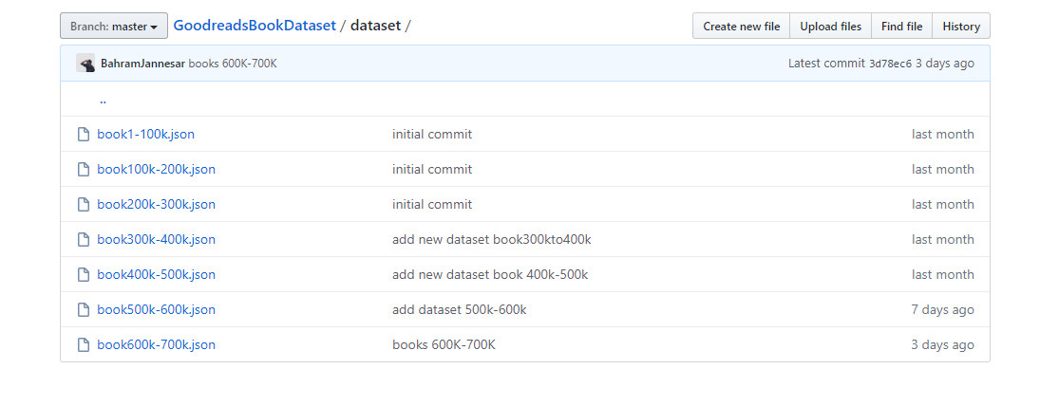
Goodreads Data File
JSON data file found on GitHub: https://github.com/BahramJannesar/GoodreadsBookDataset/ tree/master/dataset
Notes:
Initially, I found a dataset on Kaggle that appeared promising but after some initial looking through the dataset, I realized it was not going to help me answer all of the questions I wished to have answered. I found a dataset on Github that had been recently curated and it seemed to have the data I was hoping for. As you can see the folks that are curating the data from Goodreads are doing so in chunks of 100,000 books at a time every so many days. I decided to work with the 1 – 100K JSON file.

Slide 4
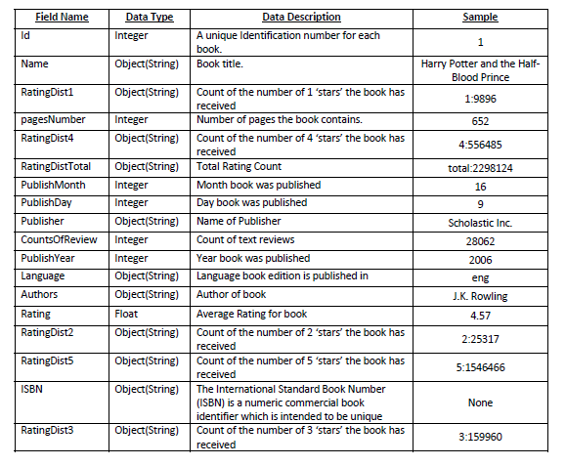
Data Available
Notes:
The initial JSON file contained 58,292 rows and 18 columns. The data available included book title, author, date published broken down into 3 categories: day, month, year; number of reviews, average rating, language, etc. The data types included integer, object (string) and on float datatype. As you can see here, there would need to be some pre-processing tasks that needed to happen in order to make the data useful for what was being asked.

Slide 5
Preprocessing
Limit range of books to those with an ‘eng’ language tag
Number of rows = 15,988
Number of columns = 18
Count of ratings format #:####
PublishMonth was PublishDay data
Columns removed; data types converted

Slide 6
Data questions to be answered
How many 1 to 5 star ratings were there compared to the total number of ratings?
What does the rating distribution look like?
Most rated top 20 books?
Page count affect ratings?
#book data – retweet counts

Slide 7
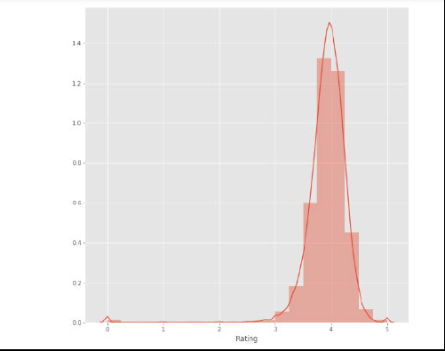

Ratings data

Slide 8
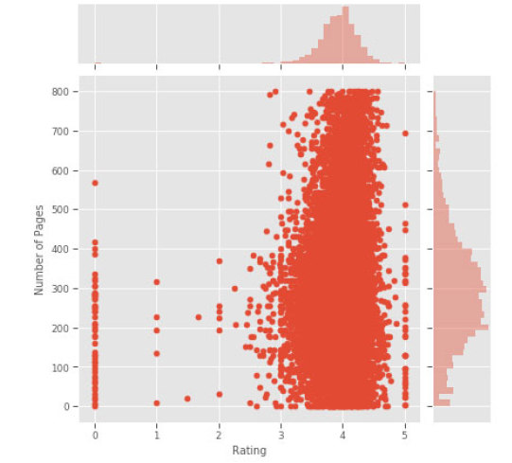

Page # vs Average Rating

Slide 9
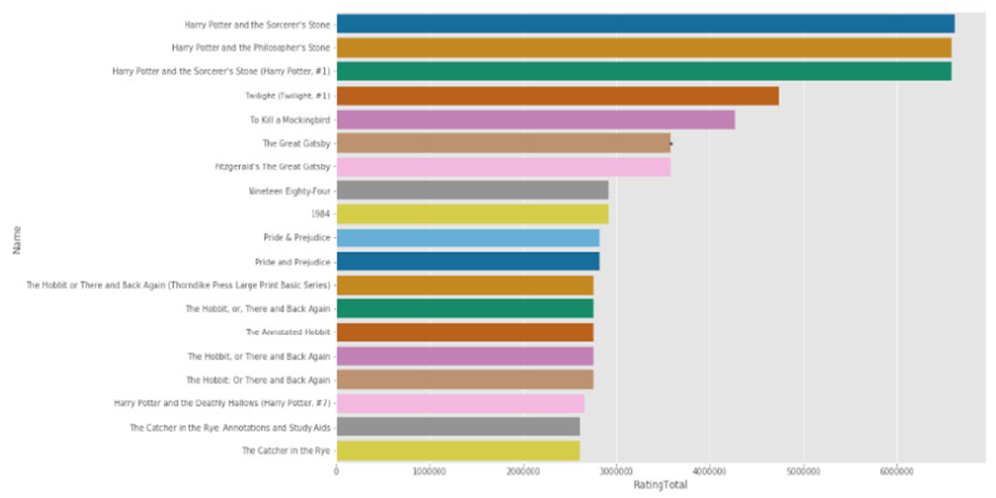
20 Most Popular Books

Slide 10
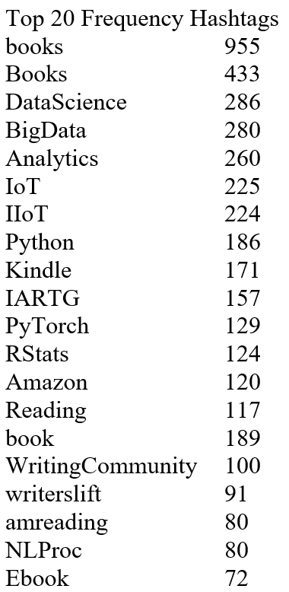

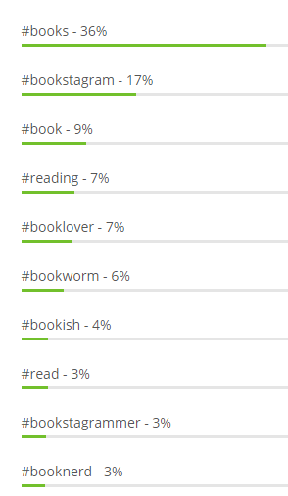
# Frequencies
Notice … the DataScience, BigData and Python frequency numbers.
Retweets

Slide 11

Any Questions?

