Slide 1
MyMenu Project
Ghalia Alshanbari, Lamya Alzahrani, Basil alGhamdi, Mohammed Asiri

Slide 2
Problem definition and objective/ Work Breakdown
1-For our project, we made an automated menu system for 10 restaurants in the Boston Area.
2-Our project allows customers to optimize their ordering experience without worrying about dietary, religious, or health restrictions.
3-Our project’s objective is to make the food ordering process simpler for customers in the Boston area with food restrictions from food allergies to dietary preferences while also easing their minds while ordering and making sure the food they order doesn’t contain any food they are allergic to or food they choose not to consume such as Halal food.

Slide 3
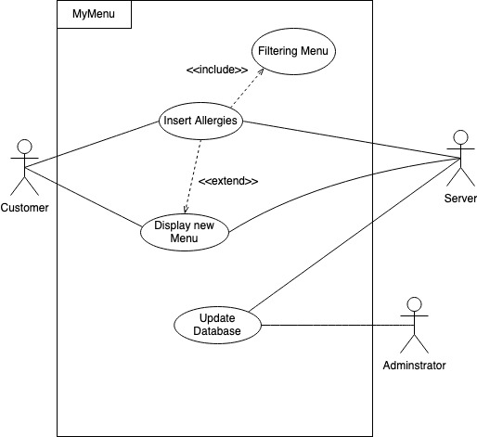
Use Case
Notes:
The customer can request a menu, and they can optionally inserts any allergies or constraint to the program; however, if a constraint or an allergy is selected the program needs to filter the menu accordingly. The new menu is then displayed to the customer. Other scenario

Slide 4
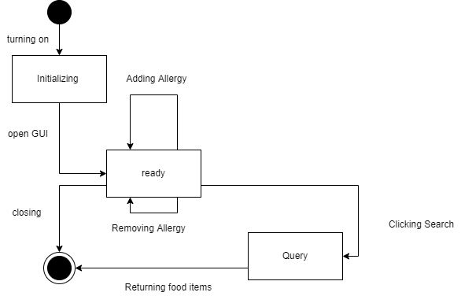
Application State Structure
Notes:
It starts with turning on the program which then initializes the state. After, the program is initialized a GUi opens and the program enters a ready state. In this state, the customer adds and delete allergies, and it won’t affect the state of application. whenever the search button is clicked the application enters the query state after which it return a new menu according to the constraints.
. Then, if the customer is adding an allergy it goes into the ready state where they can add a new allergy or remove the allergy. However, if removing the allergy makes it that there are no allergies left that are selected it goes back to the idle state. When getting to this stage the customer can exit the program or click the search button. After clicking the search button, the program query’s, the database and filters the menu according to the allergies. The updated menu is returned to the customer and the program is terminated

Slide 5
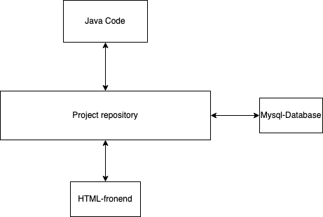
System Architecture
1-MyMenu Program uses the Repository Architecture because it consists of a database that is our central data structure that contains each restaurant and their menus with the ingredients of each item on the menu respectively.
2- Each restaurants menu can be seen as a collection of independent components that answer to the central database that serves each of these restaurants and their menus.
3-The repository is used here because this system contains a large amount of information that must be stored in an efficient way.

Slide 6
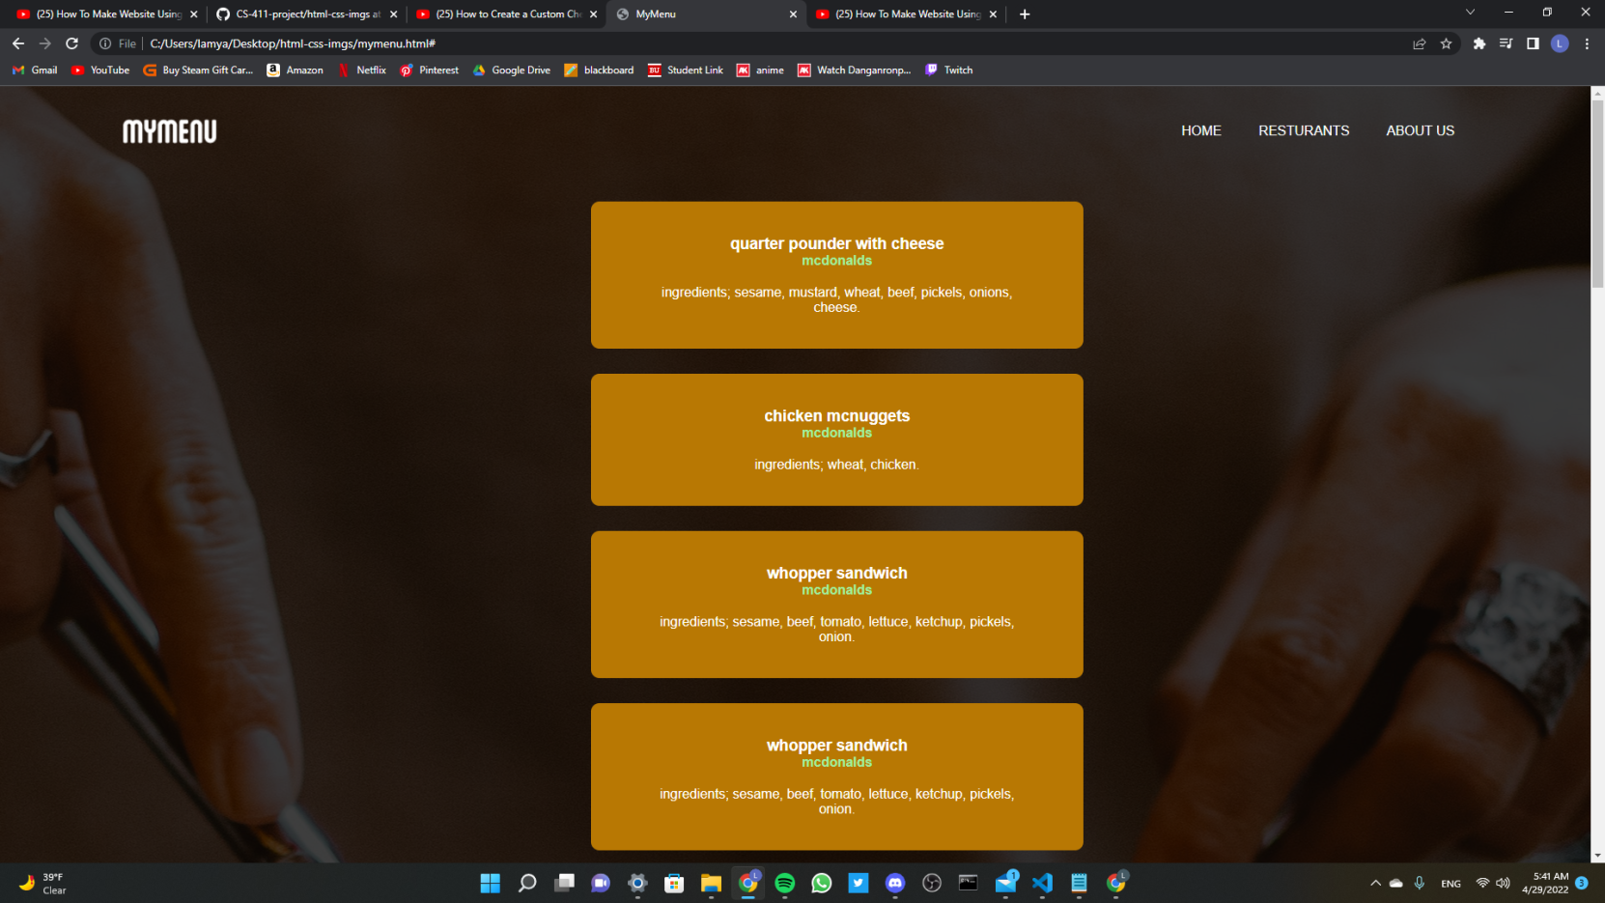
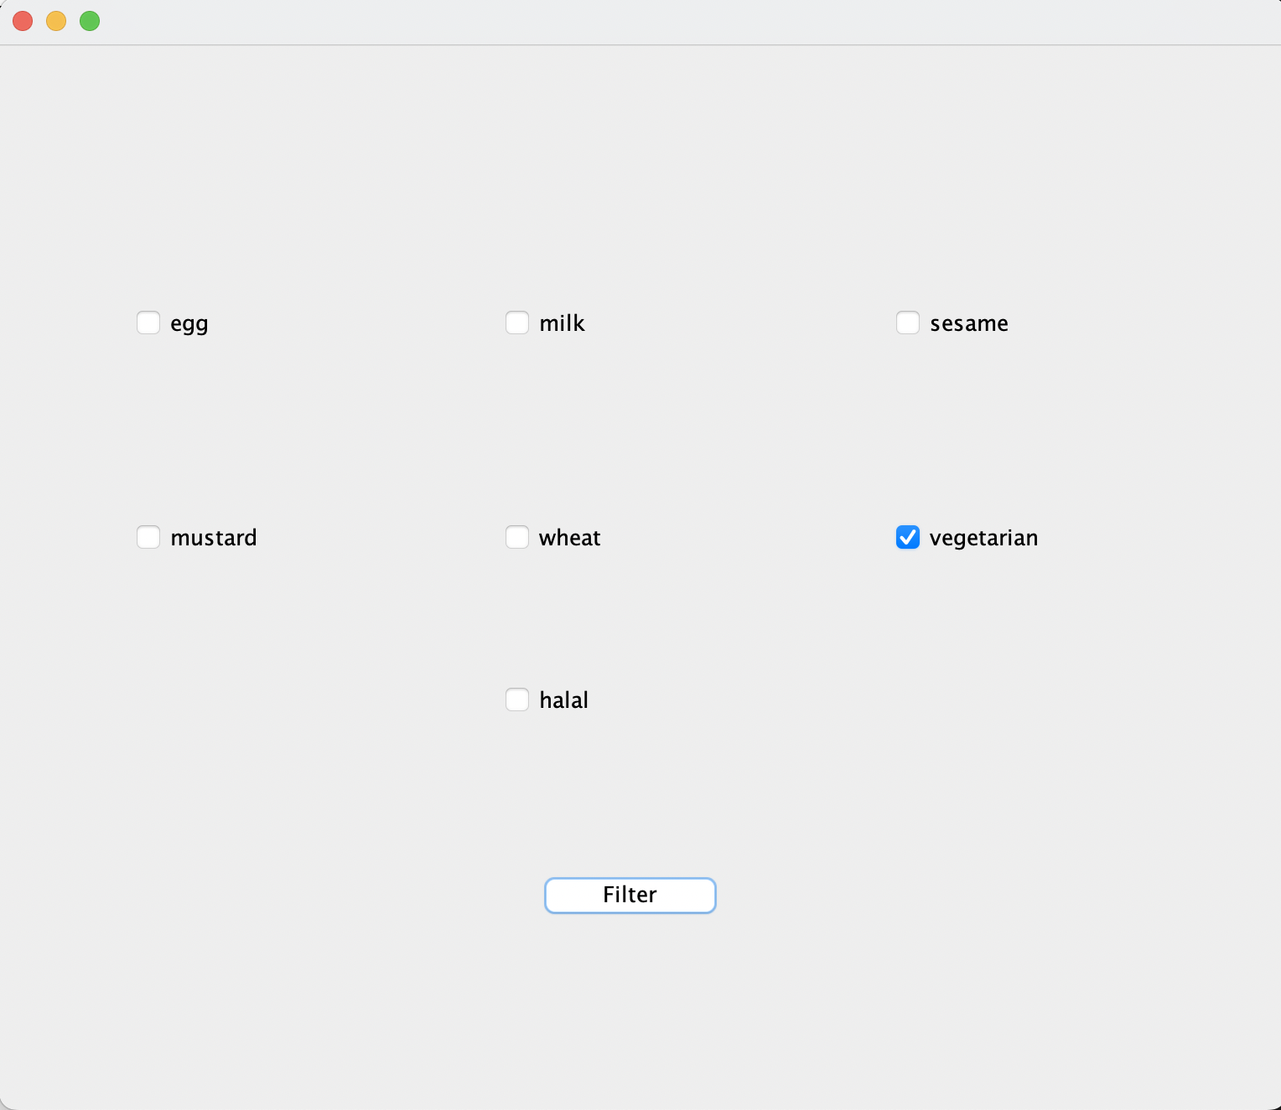
Program Demo

Slide 7
Conclusion and Lesson Learned
The MyMenu project has been a very informative journey for our software engineering experience. This was most of our first times dealing with databases and creating a program. We learnt how to structure our program in an efficient way as well as time management and making sure everyone had a part in everything. This has helped us overall to gain experience and know our strengths and our weaknesses.

