Slide 1
Threads
COEN 346 Tutorial

Slide 2
Outline
General Context
Threads Creation: Runnables
Threads Creation: Callables
Threads Control
Shared Resource Access Control
Useful Links

Slide 3
Threads
The smallest execution unit
Shared Memory
Used for parallel programming
They can
Execute a process (sometimes even periodically)
Return values
Challenges
Communication (synchronous Vs asynchronous)
Scheduling
Control access to shared data

Slide 4
Multithreading in C++
It used to have problems such as the portability (pthreads work only in Linux while windows has some specific libraries)
Now, after the release of the STL (Standard Thread Library), the same code can run on both platforms

Slide 5
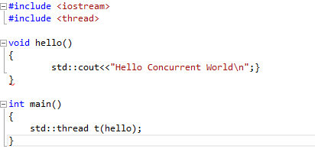
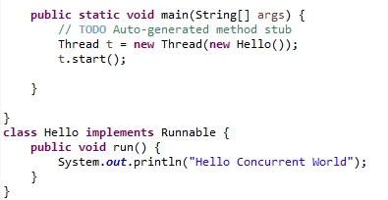
Threads Creation: Runnables
C++
JAVA

Slide 6
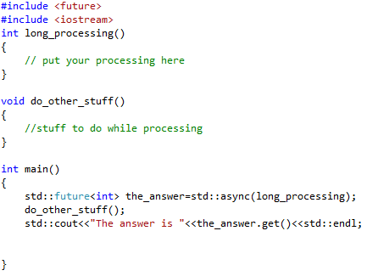
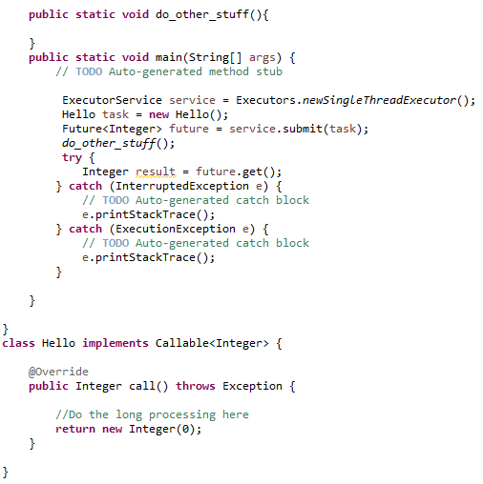
Threads Creation: Callables
C++
JAVA

Slide 7
Threads Control
join(): a method used both in JAVA and C++ to make a thread wait for another one to finish (Rendez-vous)
detach(): used in C++ to tell a thread that it does not have to wait for another one

Slide 8
Shared Resources Access Control
Why?
To prevent data from being altered simultaneously
To make sure all threads access the right data (variable holding the right variable)
Multiple solutions exist in C++, they differ only in the way they insure thread safety and complexity of usage

Slide 9
Mutexes
Include <mutex>
use methods such as: lock or try_lock to make sure only one thread accesses the block of code
Use the method unlock to release it after the thread is finished

Slide 10
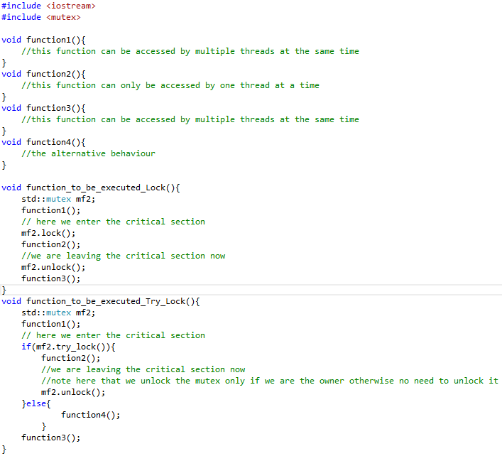
Code Sample (Skeleton)

Slide 11
Useful Links
Posix threads: http://www.tutorialspoint.com/cplusplus/cpp_multithreading.htm
C++11 threads: https://solarianprogrammer.com/2011/12/16/cpp-11-thread-tutorial/
Mutex tutorial: http://www.cplusplus.com/reference/mutex/mutex/lock/
Lock_guard tutorial: http://www.cplusplus.com/reference/mutex/lock_guard/
Unique_lock tutorial: http://www.cplusplus.com/reference/mutex/unique_lock/

