Slide 1
GridSight
Member Addition

Slide 2
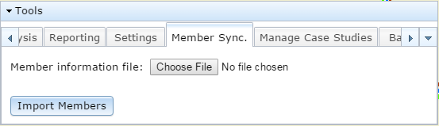
Add/Update Members
In order to add or update the members in the model, take the following steps:
Go to Tools>Member Sync.
Click on Choose File and open the Member information file.
The member import file is a zip file that contains three csv files:
Daffron customer info file, which should be called “epelocinfo.csv”
Daffron transformer info file, which should be called “epexfmers.csv”
Meter info from Landis+Gyr Command Center, which should be called “report.csv”
Note that the first one is mandatory and the last two are optional. Also note that the file names should be exactly as noted.
1
2

Slide 3
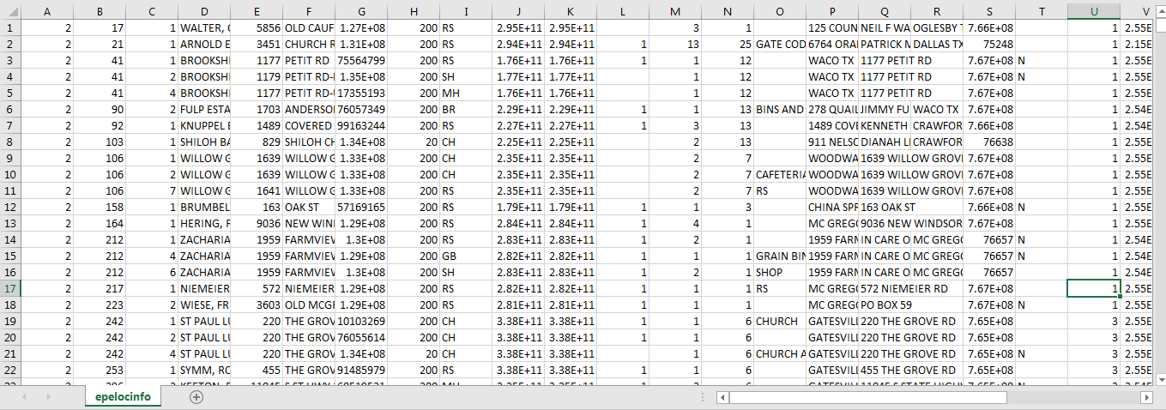
epelocinfo.csv

Slide 4
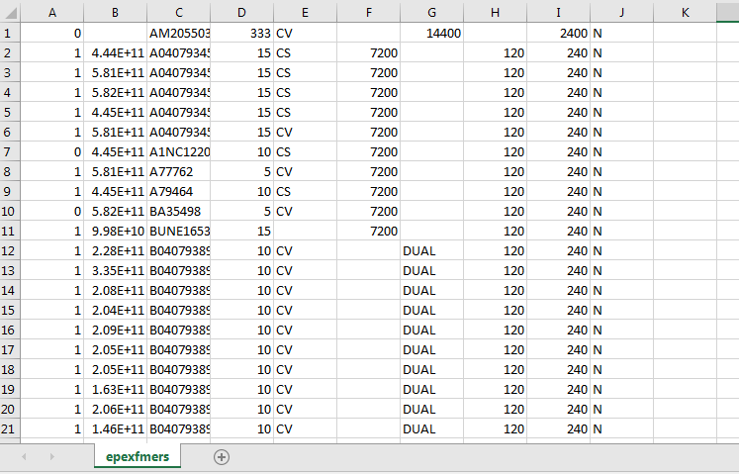
epexfmers.csv

Slide 5
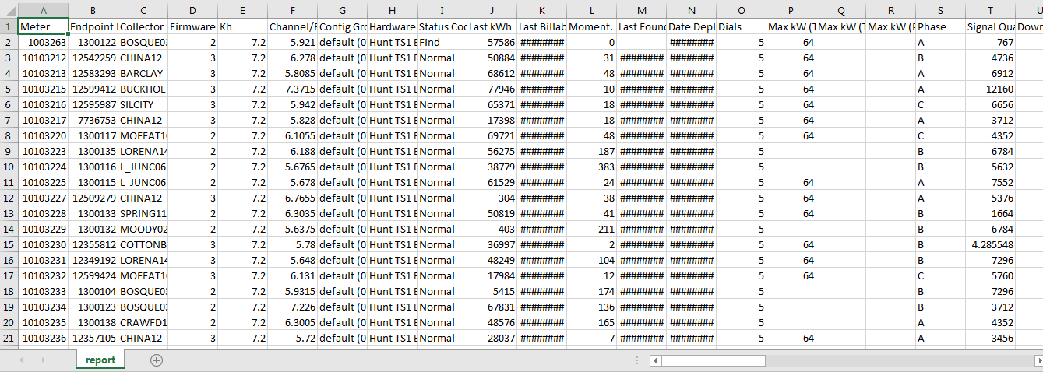
report.csv

Slide 6
Fields in report.csv
Meter
Endpoint
ID Collector
Firmware Version
Kh
Channel/Freq
Config Group
Hardware Model
Status Code
Last kWh
Last Billable Read
Moment. Interr. Count
Last Found
Date Deployed
Dials
Max kW (TS1)
Max kW (TS2)
Max kW (PLX)
Phase
Signal Quality
Downstream % (TS2)
Usage Violation (in days)
Billing Cycle
Cust ID
EA Loc
Serv Loc
Acct #
Feeder
Revenue
Class
Mom. Event Int. Count (TS2)
Sust. Interr. Count (TS2)
Mom. Event Int. Count (PLX)
Sust. Interr. Count (PLX)
Latitude
Longitude
Pole #
Meter Position
Custom1
Custom2
Layer
Address
City
State
Zip
Installation Date
Status Groups
Zigbee Firmware Version
Initial Installation Date
Time Zone
Seal Number 1
Seal Number 2
Multiplier
Demand Multiplier
Line Section
Grid Location
Cust Last Name
Form
Base
Class
WAN Address
DCW Version
Meter Firmware Version
Last Status Changed
Security Status Code
Highspeed
Reactive Capable
Reactive Enabled
Reactive Mode
RowNo
Meter Program Id

Slide 7
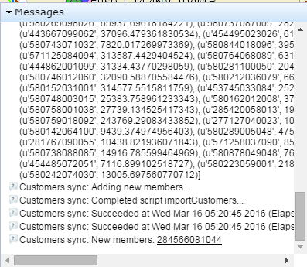
Add/Update Members-cont’d
Click on Import Members
Check messages for successful import and for new
members added
4
3

Slide 8
New Construction
New members that are staked can be added into GridSight even before being assigned a meter.
Once assigned a meter and the member is being supplied power, the meter data can be synced from L+G in order to be assigned a load based on consumption.

