Slide 1
Food Analysis System
Prepared By: Lawrencia Archer

Slide 2
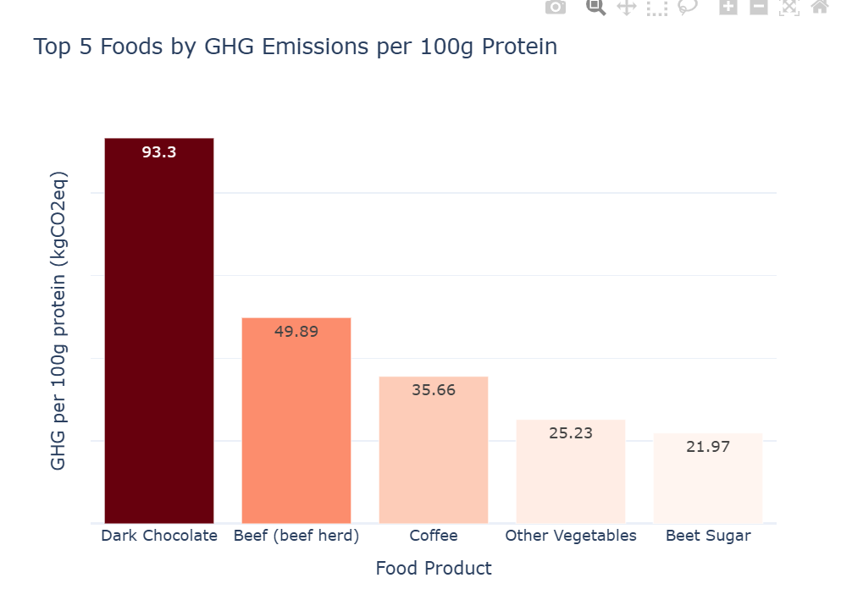
Q1: Top Five Foods with the Highest Greenhouse Gas Emissions Per 100g of Protein
Conclusion:
Dark chocolate and Beef (beef herd) have a disproportionately high environmental footprint

Slide 3
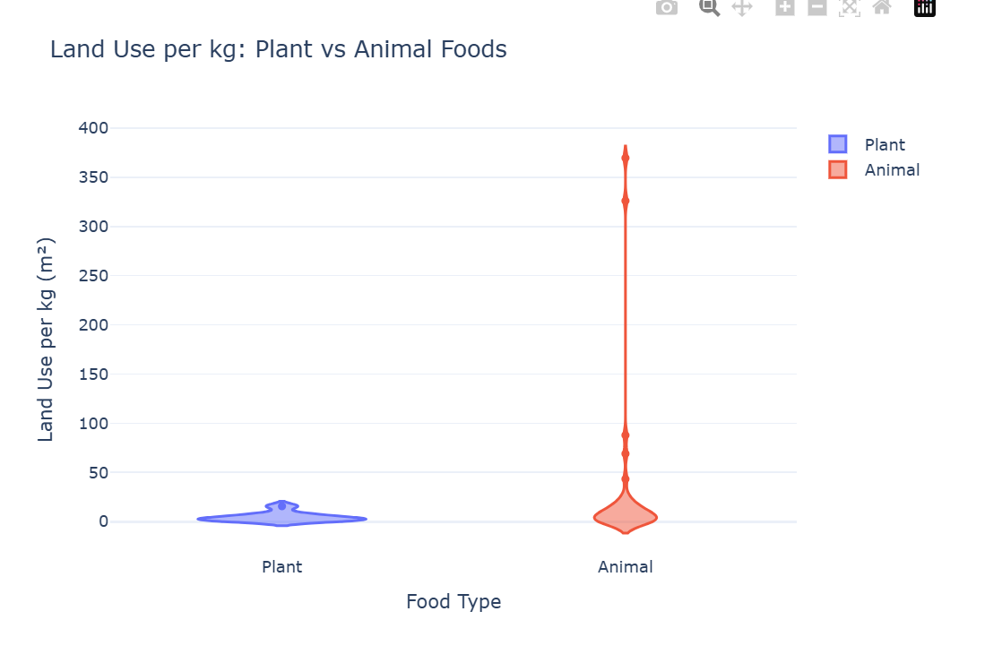
Q2.Land Use Between Plant-based and Animal-based foods
Conclusion:
Animal agriculture requires more land per kilogram of food produced.
Plant-based foods’ land use is minimal.

Slide 4
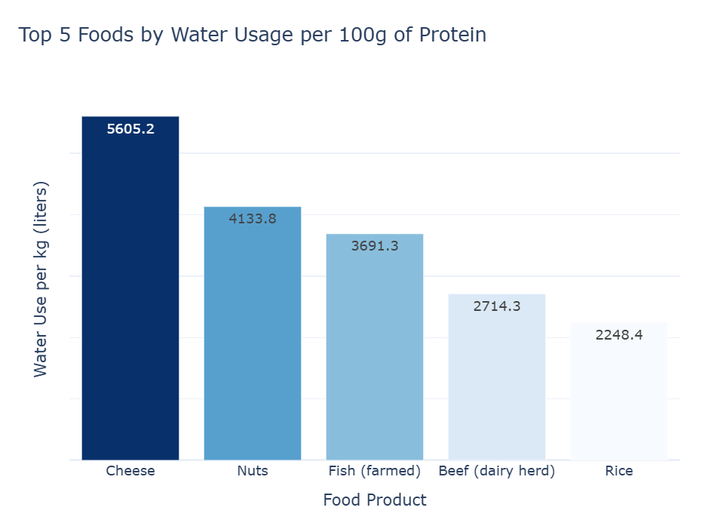
Q3. Top Five Foods with the Highest Water Usage
Conclusion
- Cheese and nuts require thousands of liters of water per 100g of protein.

Slide 5
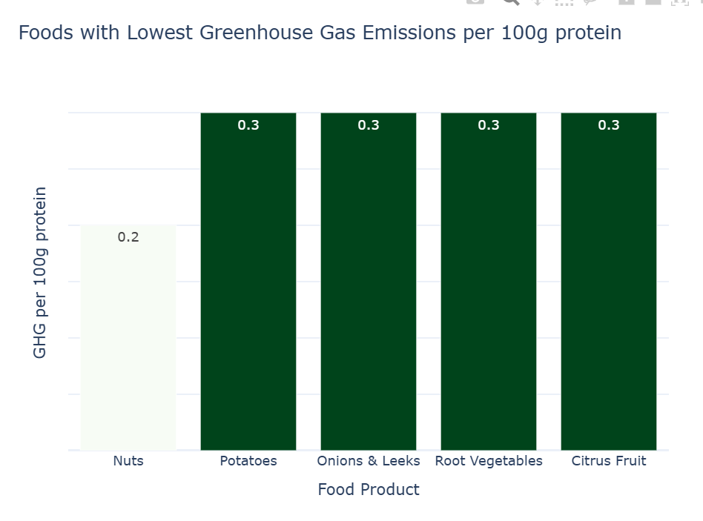
Q4. The five least foods with Greenhouse gas emissions.
Conclusion
- Nuts have the lowest Greenhouse Gas emissions, followed by potatoes, onions, and leeks.

Slide 6
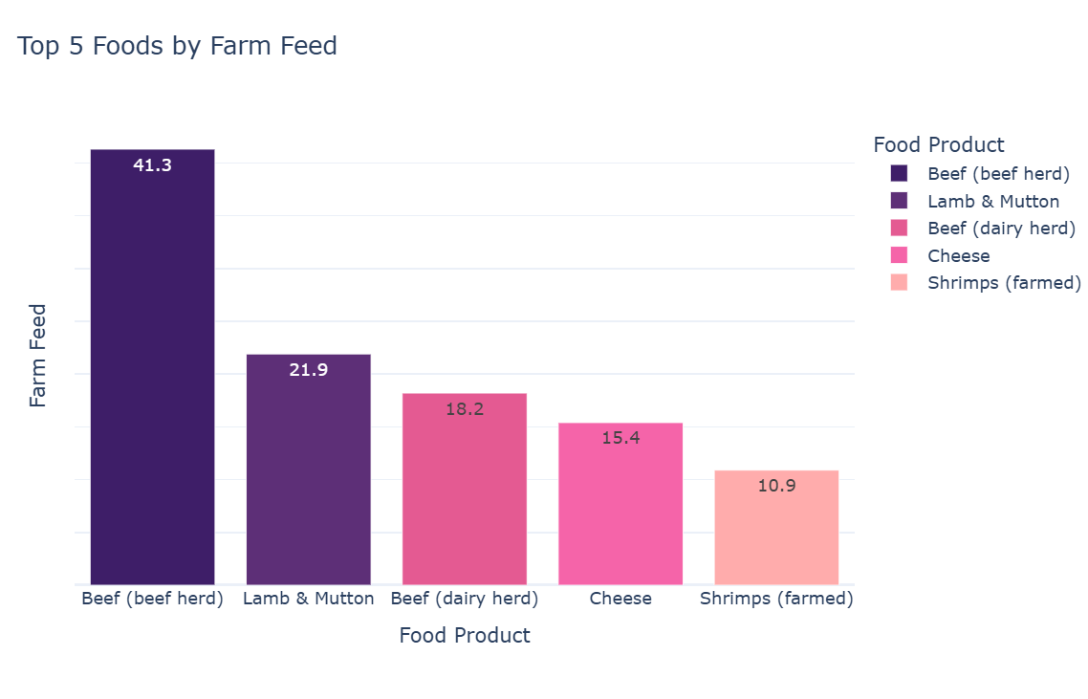
Q5.Top Five foods with the highest total from farm and animal feed.
Conclusion

Slide 7
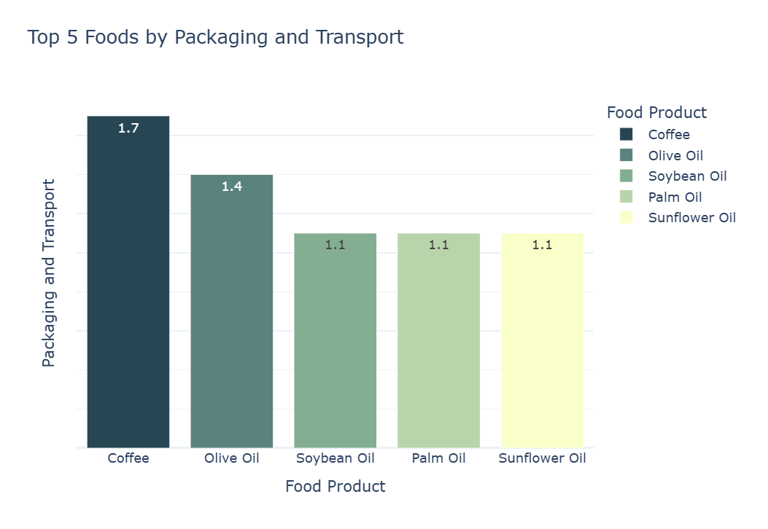
Q6. .Top Five Foods with the Highest total from Packaging and Transport.
Conclusion

Slide 8
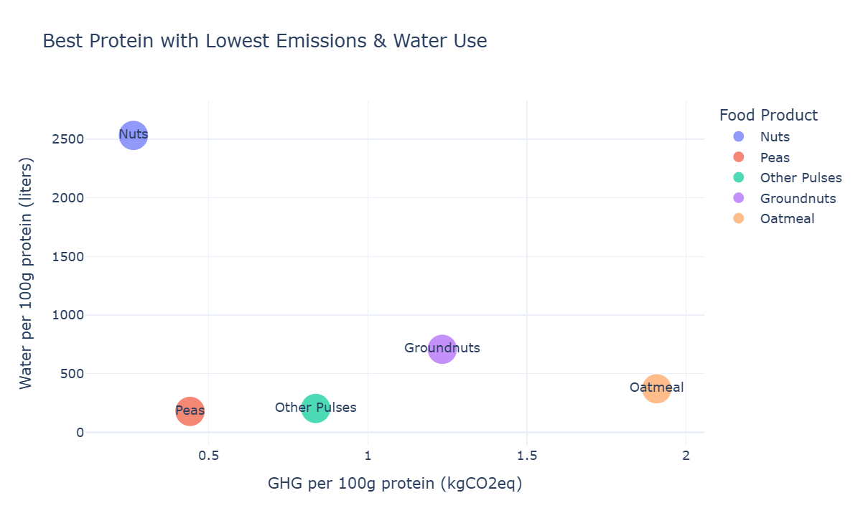
Q7. Top Five foods that .
Conclusion

Slide 9
Final insight
Environment Footprint:
Choosing some specific food items can have a much greater impact on personal carbon footprint than many other factors.
Water scarcity goes beyond dietary changes and also focuses on improving irrigation efficiency and sustainable farming practices for water-intensive crops
Property Interactions:
Certain properties and items dominate interactions, highlighting key products or features that attract more visitors
Monitoring low-interaction items could help identify opportunities for promotion and optimization.
Item Interaction:
Seasonal trends are evident, which could inform marketing strategies or inventory management.

Slide 10
Overview of Methods Used
1. Data Loading And Preprocessing.
Tools Used: (Pandas, Sklearn)
Steps:
- changing long column names
- filling null values using KNN imputation.
- replacing spaces in column names with underscore (_)
- replacing longer names with shorter ones for easier analysis
3. Exploratory Data Analysis and Visualization.
Tools Used: (Plotly)
Visualization Created:
Bar chats
Violin and swan
Scatter plot
Link to GitHub: https://github.com/llawlaw23/Food_Production_Analysis

