Slide 1
BTS Trade Data Analysis (2020–2024)
Prepared By: Lawrencia Archer

Slide 2
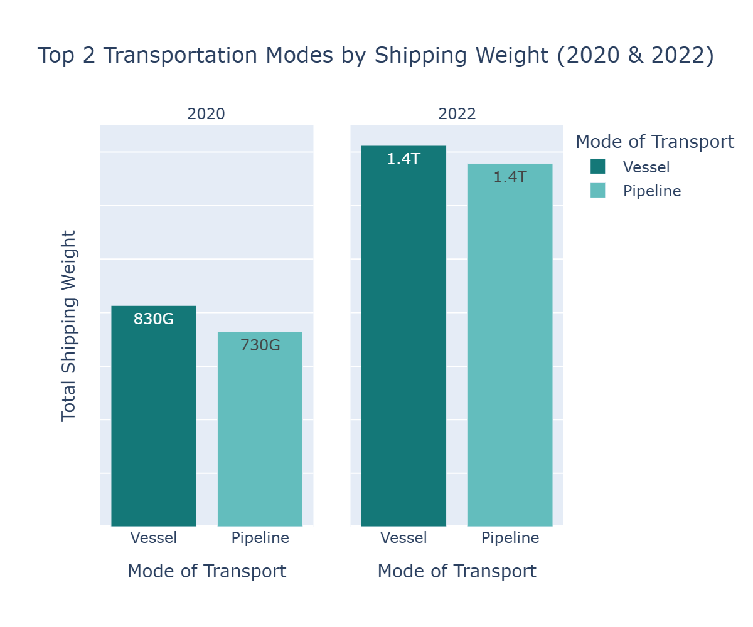
Q1: Dominant Transportation Modes by Weight and Value
Conclusion:
- Vessel and pipeline mode of transport was the most used in the year 2020 and 2022 by shipping weight
- There was a Significant increase in shipping weight by Transportation between the year 2020 and 2022.

Slide 3
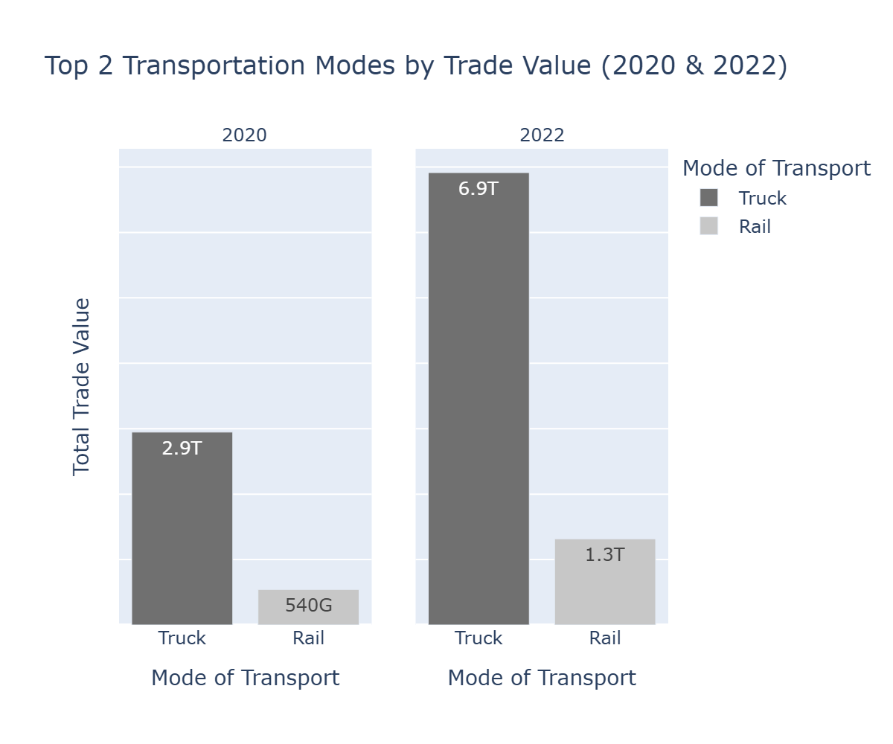
Q1: Dominant Transportation Modes by Value Cont.
Conclusion:
- Truck and rail mode of transport were the most used in the year 2020 and 2022 by Trade value.
- There was a Significant increase in Trade Value by Transportation between the year 2020 and 2022.

Slide 4
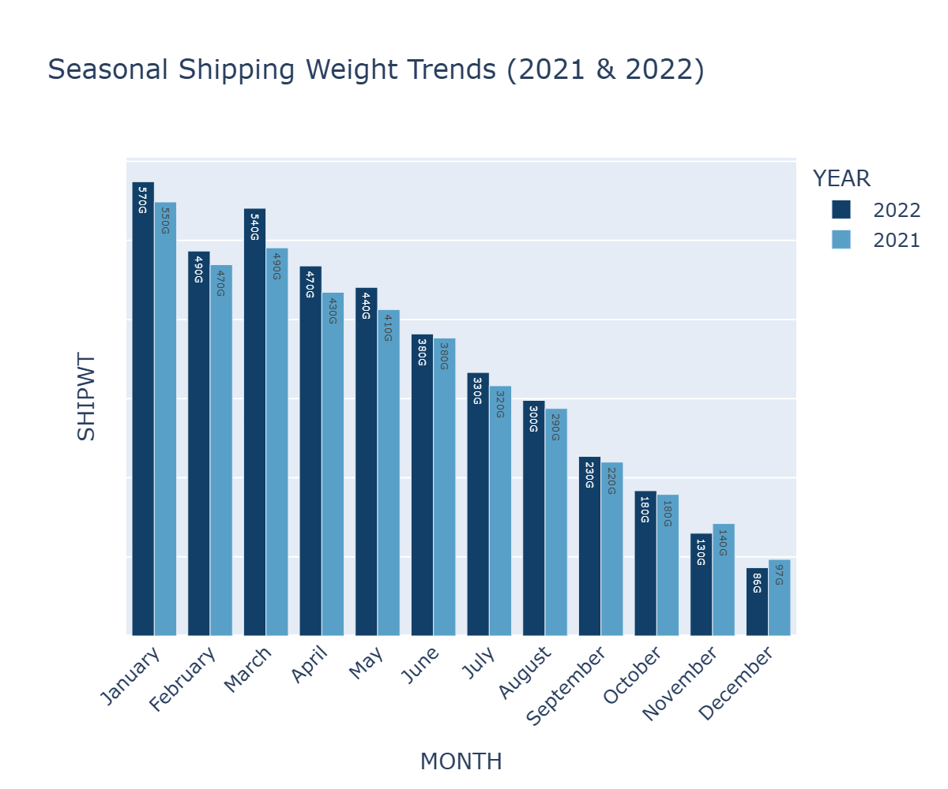
Q2.Seasonal Variation in Shipping Weight (2021 & 2022)
Conclusion
- Trade value and shipping were relatively high in January but declined as the months progressed to December
- Patterns were consistent across year 2021 and 2022, indicating regular business cycles and seasonal demand fluctuations.

Slide 5
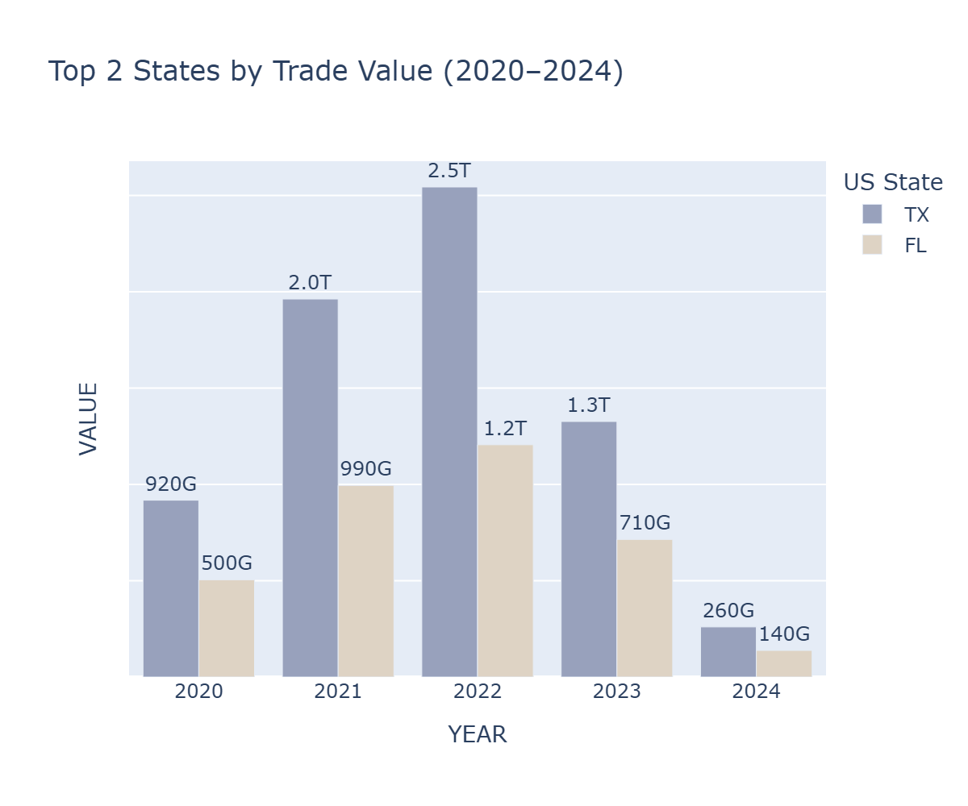
Q3.Contribution by U.S. States
Conclusion
- Texas contributed most to trade volume and value from 2020 to 2024 and started declining after.
- Texas trade value skyrocketed in 2021 and 2022 as compared to the years.

Slide 6
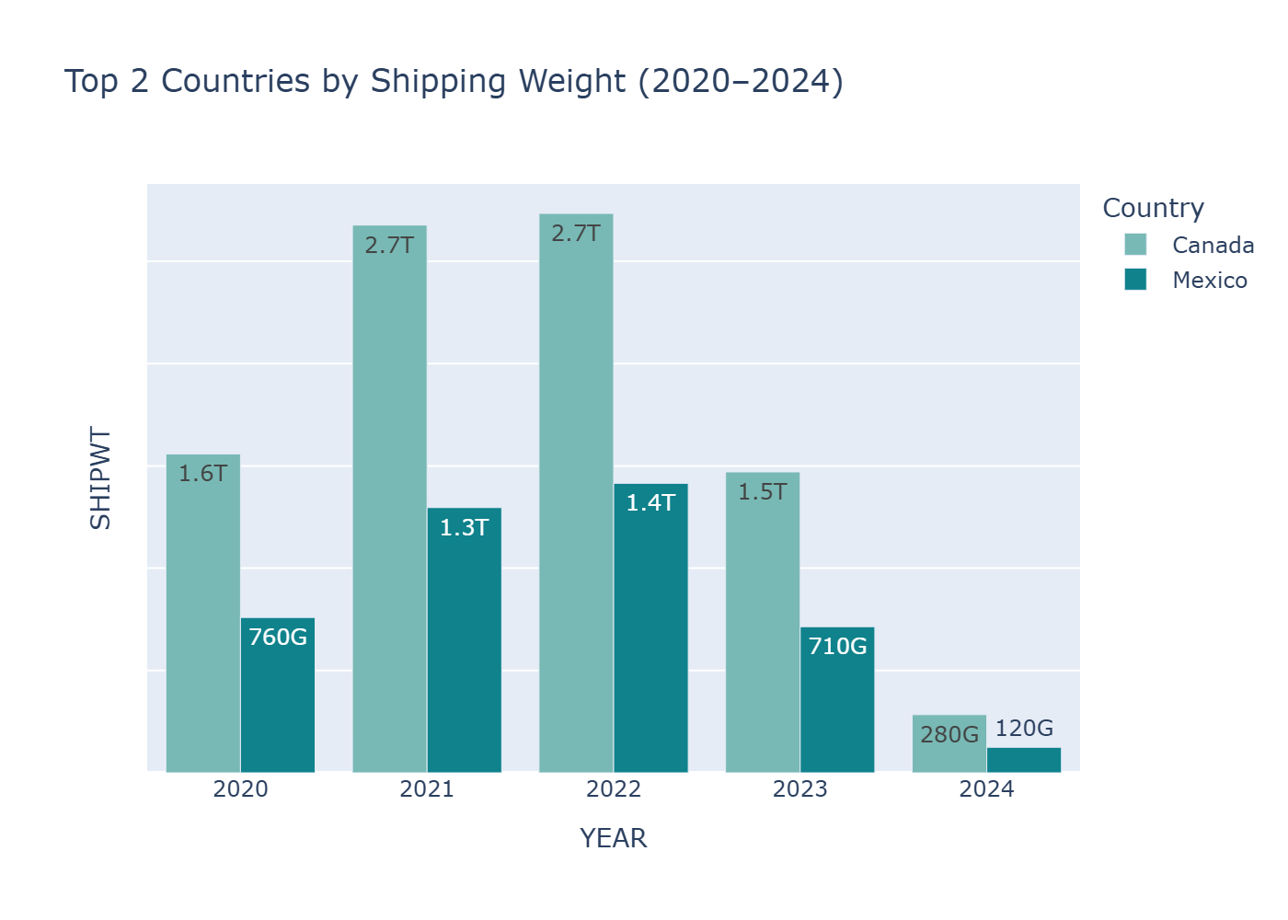
Q4.Contribution by Countries
Conclusion
- Internationally, trade was almost exclusively with Canada and Mexico, reflecting strong land-border commerce ties.
- With Canada topping every other year.

Slide 7
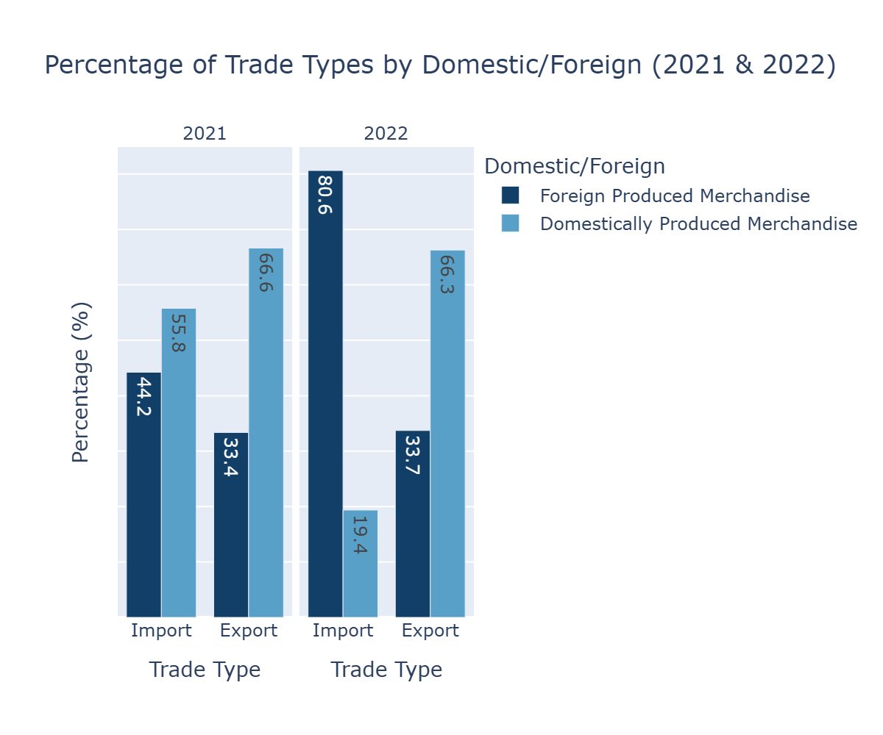
Q5.Percentage distribution Of Trade Types by
Conclusion
- Imports and exports showed distinct patterns in 2021 and 2022, with domestic shipments dominating trade types.
- In the year 2022 foreign produced merchandise import was relatively high as compared to the other years.

Slide 8
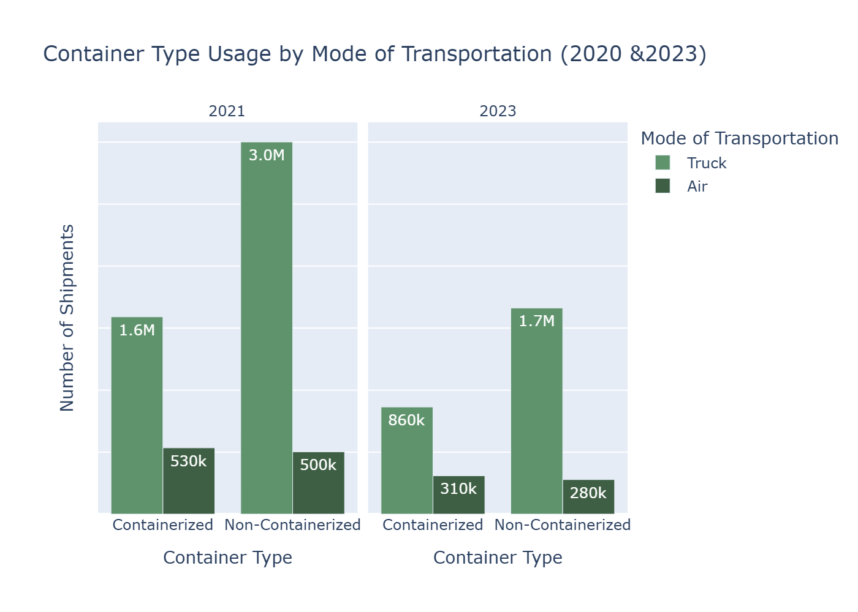
Q6.Container Type Usage By Transportation Mode
Conclusion
- Truck and air mode of transport used a diverse range of container types.
- Truck transport showed concentrated use of both container types.
- There was a visibly differences in container usage between 2021 and 2023

Slide 9
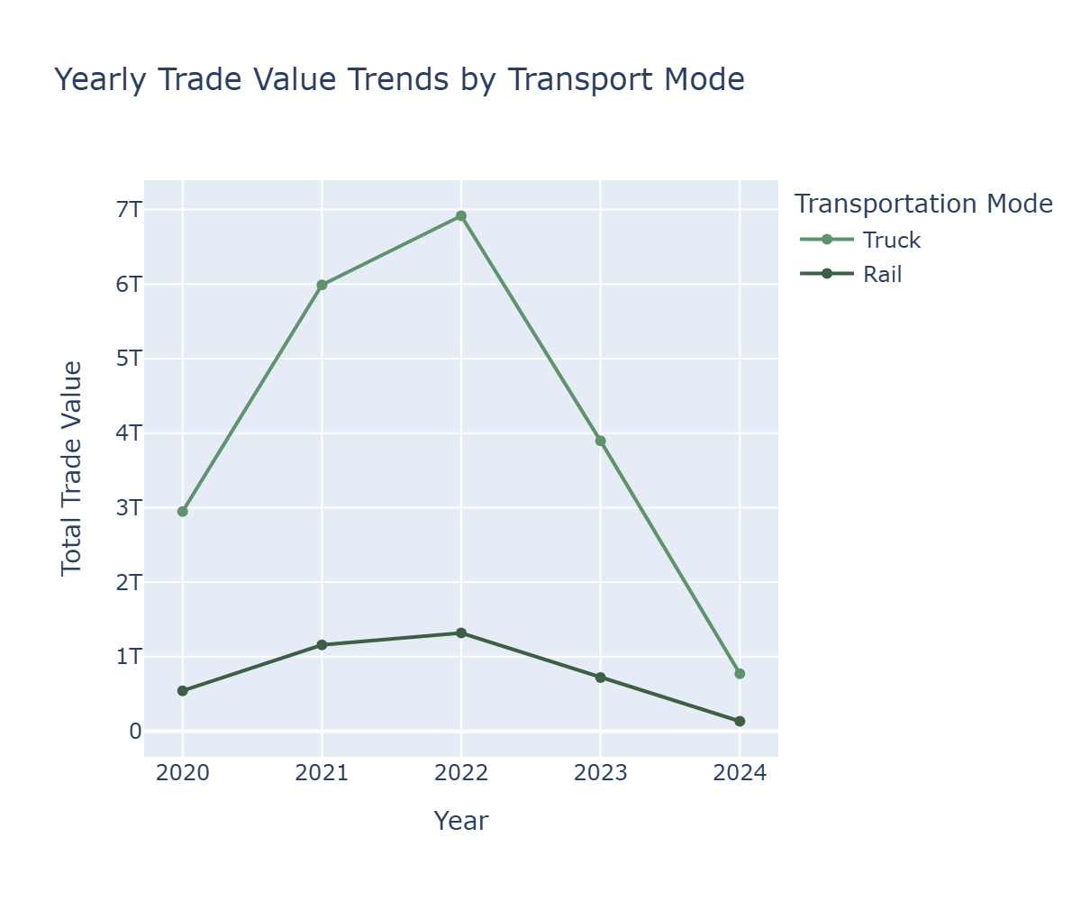
Q7.Yearly Value Trends by Transportation Mode
Conclusion
- Trade value was relatively low, as a result of the pandemic in the year of 2020.
- Truck mode of transport increased massively after the pandemic while the increase in rail was not massive.
- The year 2022 recorded the most trade value as compared the the other years.

Slide 10
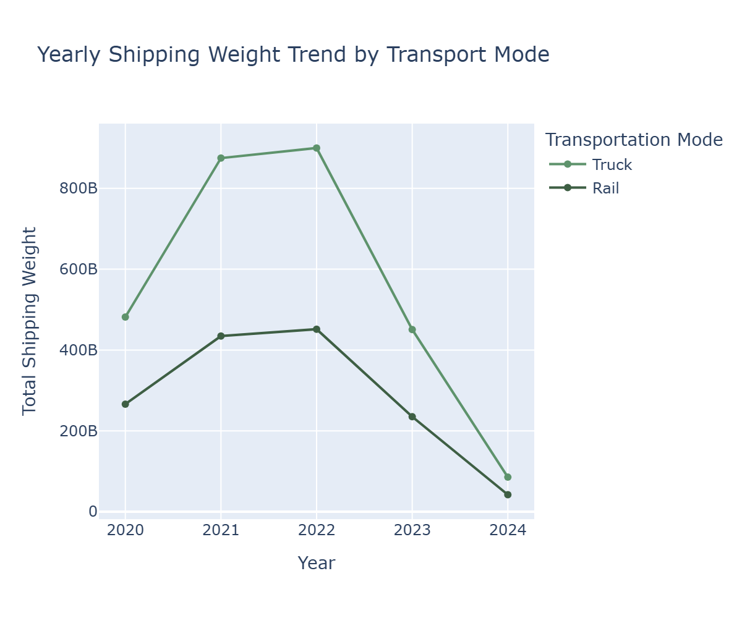
Q7.Yearly Value Trends by Transportation Mode Cont.
Conclusion
- shipping weight was relatively low, as a result of the pandemic in the year of 2020.
- Truck mode of transport increased massively after the pandemic as compared to the increase in rail
- Shipping weight was relatively low in 2024 as compared to the other years.

Slide 11
Final insight
Recovery post-pandemic (2020 – 2022):
Shipping weight and trade values sharply increased after a noticeable dip in 2020, due to the pandemic.
Dominant Transportation modes by category:
Vessel and pipeline led in shipping weight, while truck and rail dominated in the trade value
Seasonality and Patterns:
A clear seasonal trend was observed with a high trad activity in the early months (especially January), tapering off towards December.
Geographic contributions:
Texas was the top contributing state, especially in 2021 and 2022, before experiencing slight decline.
Canada and Mexico were consistently top international trade partners, reaffirming strong NAFTA/USMCA trade ties.
Trade Type and Container Use:
Domestic trade types dominated, but foreign produced imports surged notably in 2022.
Container usage varied across modes.

Slide 12
Overview of Methods Used
1. Data Loading And Preprocessing.
Tools Used: (Pandas, Dask, Numpy, Os)
Steps:
Loaded and read data with Os and Pandas, the data was saved in parquets in another folder and used garbage collection and reclaim memory used
- Cleaned missing values and standardized categorical entries.
2. Data Transformation.
Grouped and aggregated data by:
Year, mode of transportation, container type, and trade type
Computed metrics:
Shipment counts, total shipping weight, trade type distribution (domestic and foreign).

Slide 13
Overview of Methods Used Cont.
3. Exploratory Data Analysis and Visualization.
Tools Used: (Plotly, Matplotlib, and seaborn)
Year, mode of transportation, container type, and trade type
Visualization Created:
Bar chats comparing container usage by transportation mode across the years.
Trade type distribution
Shipping weight trends by transport type.
Highlighted top 2 modes per year using grouped rankings.

