Slide 1
BTS Trade Data Analysis (2020–2024)
Prepared By: Lawrencia Archer

Slide 2
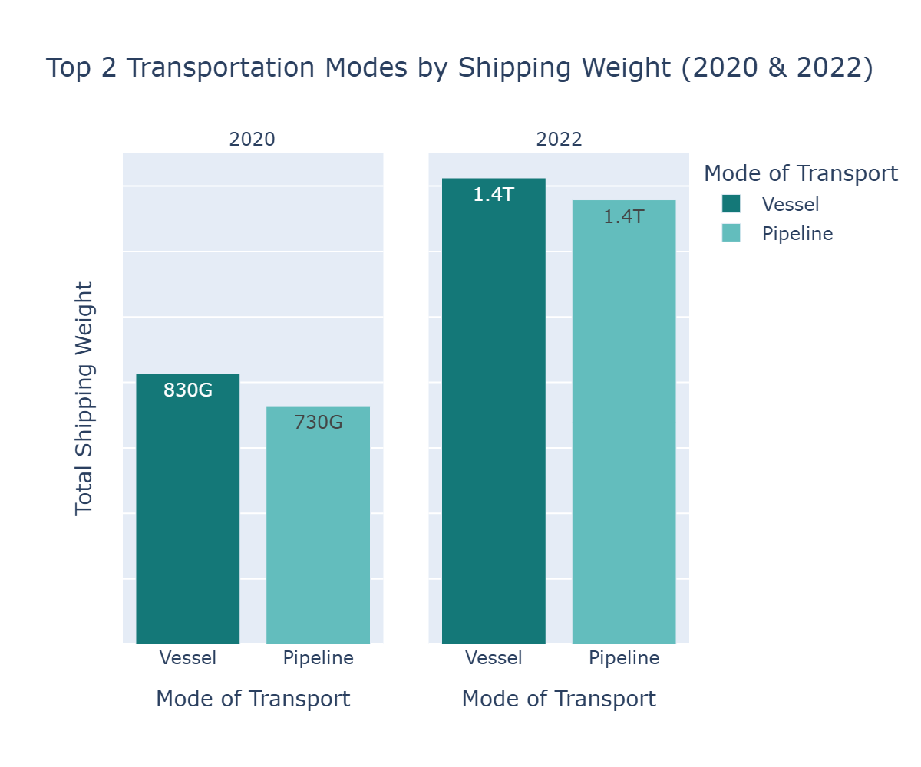
Q1: Dominant Transportation Modes by Weight and Value
Conclusion:
- Vessel and pipeline mode of transport was the most used in the year 2020 and 2022 by shipping weight
- There was a Significant increase in shipping weight by Transportation between the year 2020 and 2022.

Slide 3
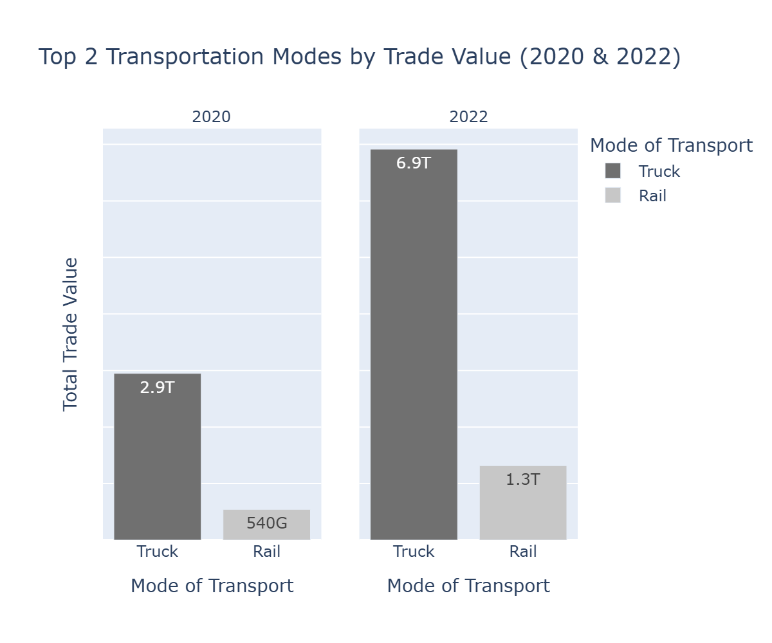
Q1: Dominant Transportation Modes by Value
Conclusion:
- Truck and rail mode of transport were the most used in the year 2020 and 2022 by Trade value.
- There was a Significant increase in Trade Value by Transportation between the year 2020 and 2022.

Slide 4
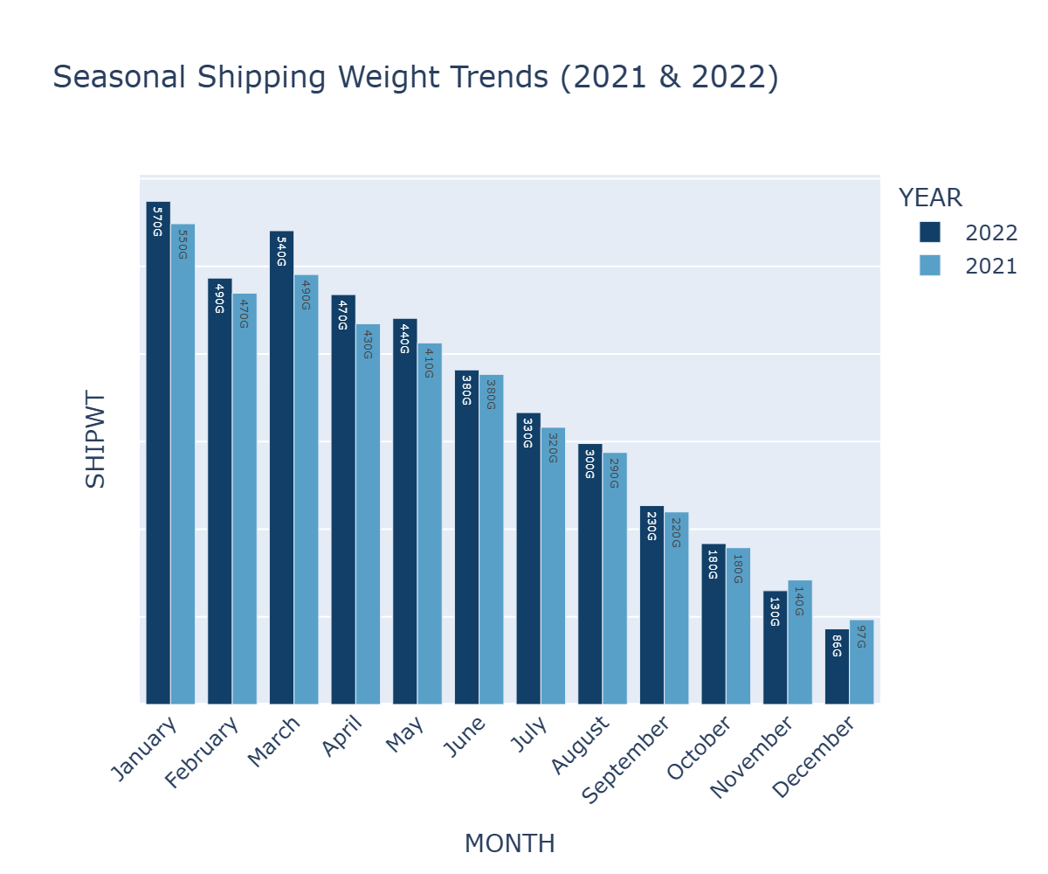
Q2.Seasonal Variation in Shipping Weight (2021 & 2022)
Conclusion
- Trade value and shipping were relatively high in January but declined as the months progressed to December
- Patterns were consistent across year 2021 and 2022, indicating regular business cycles and seasonal demand fluctuations.

Slide 5
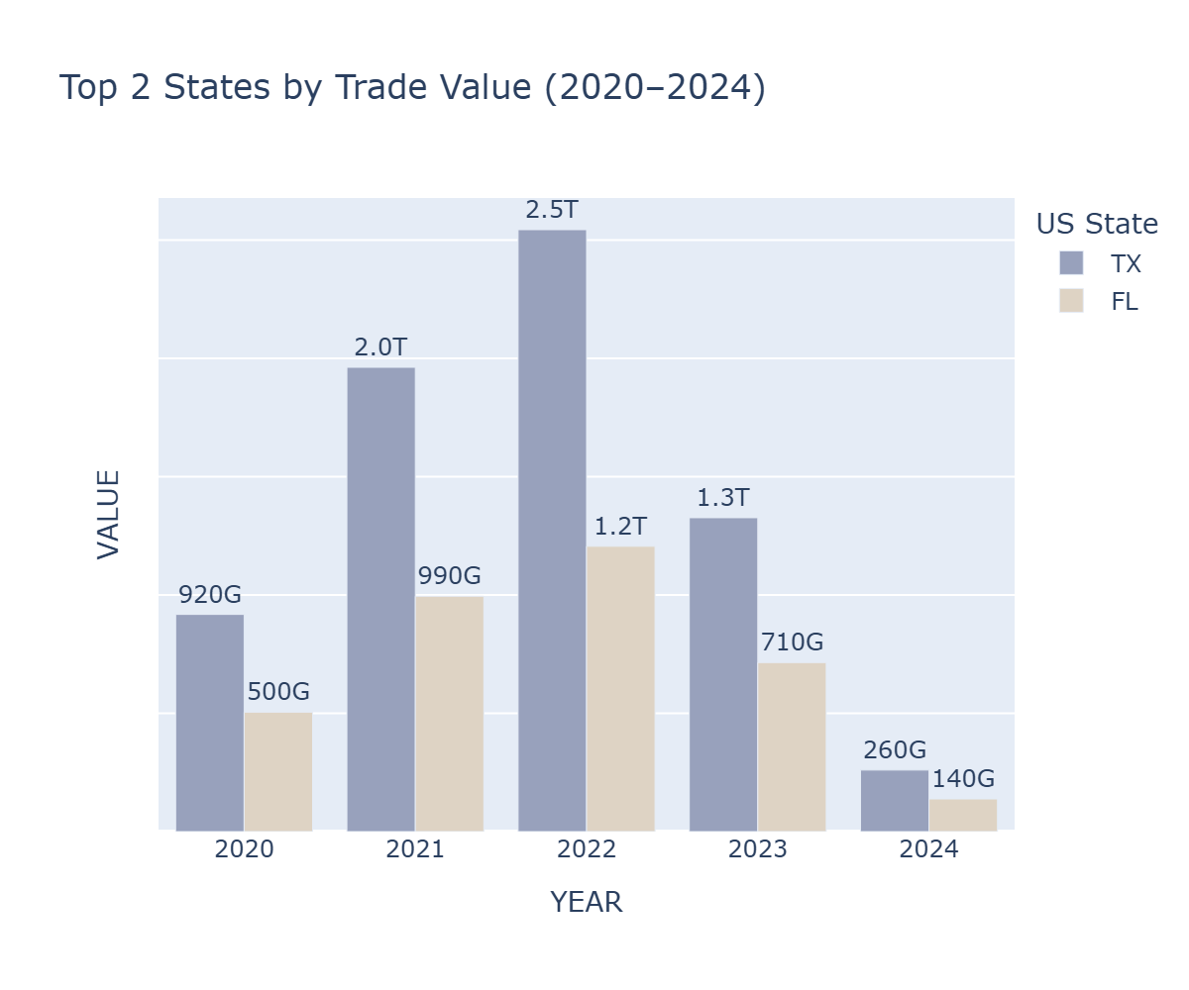
Q3.Contribution by U.S. States
Conclusion
- Texas contributed most to trade volume and value from 2020 to 2024 and started declining after.
- Texas trade value skyrocketed in 2021 and 2022 as compared to the years.

Slide 6
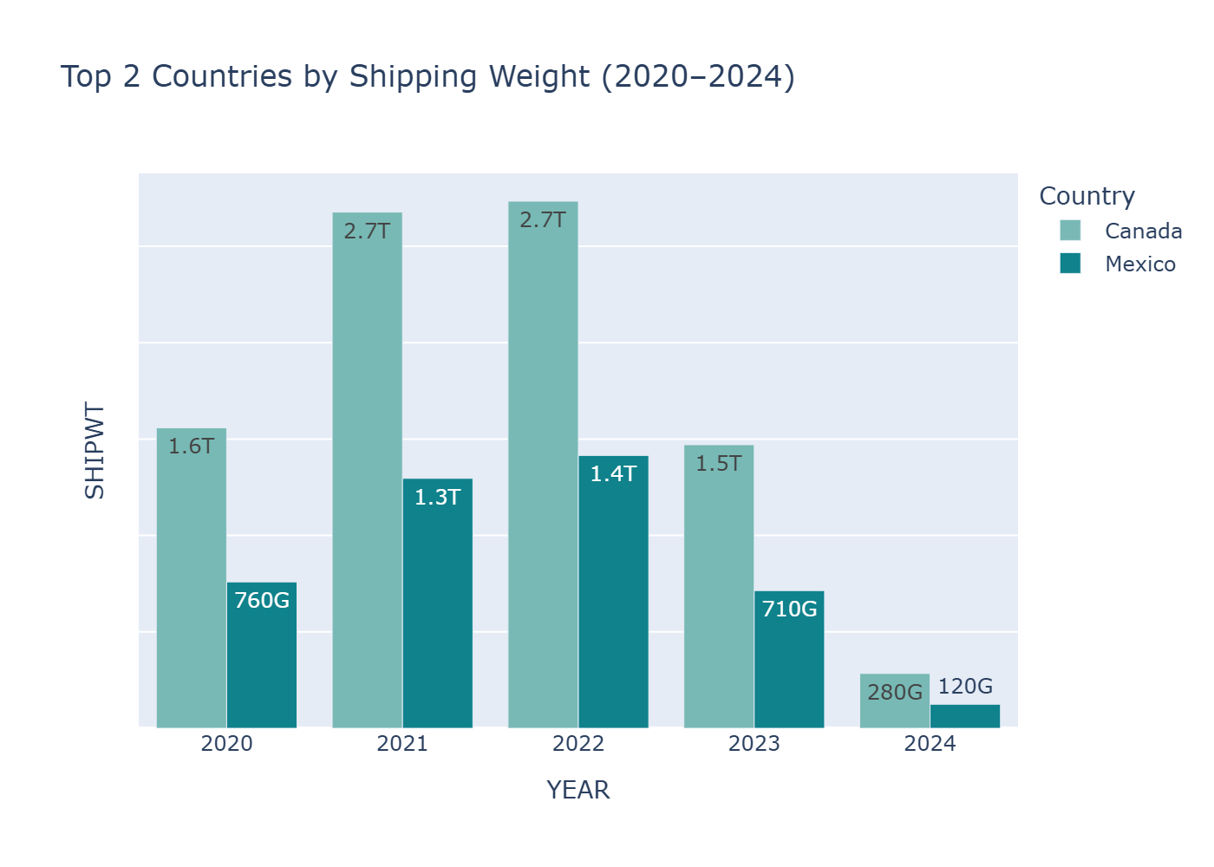
Q4.Contribution by Countries
Conclusion
- Internationally, trade was almost exclusively with Canada and Mexico, reflecting strong land-border commerce ties.
- With Canada topping every other year.

Slide 7
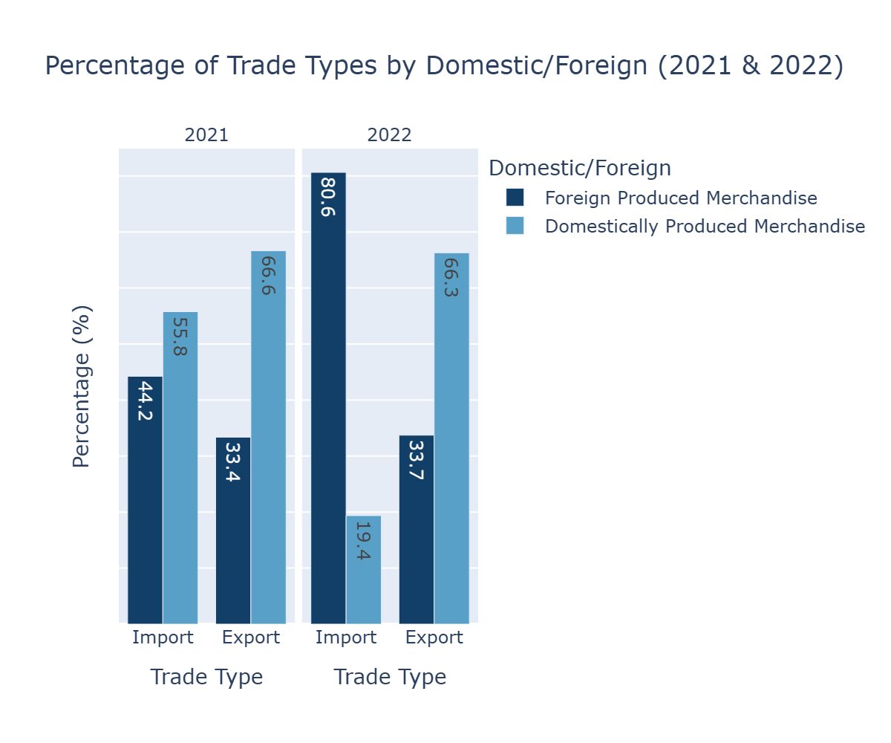
Q5.Percentage distribution Of Trade Types by
Conclusion
- Imports and exports showed distinct patterns in 2021 and 2022, with domestic shipments dominating trade types.
- In the year 2022 foreign produced merchandise import was relatively high as compared to the other years.

Slide 8
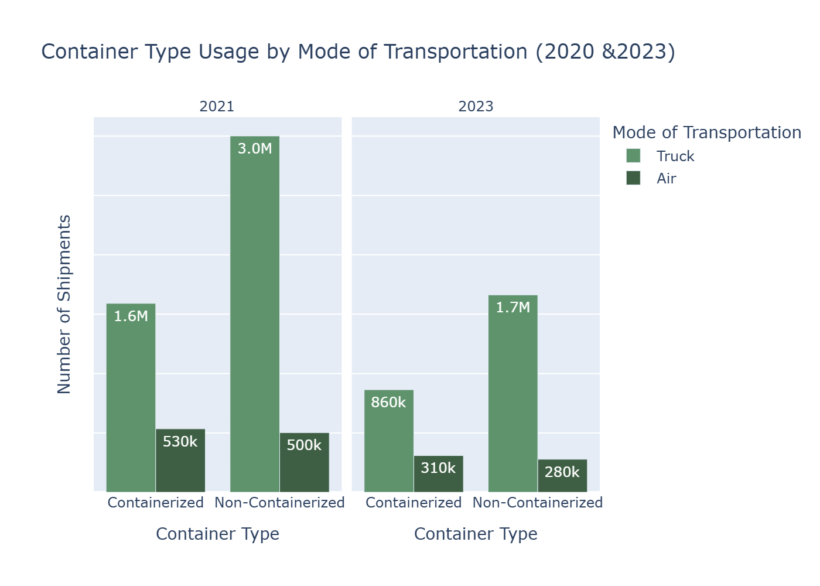
Q6.Container Type Usage By Transportation Mode
Conclusion
- Truck and air mode of transport used a diverse range of container types.
- Truck transport showed concentrated use of both container types.
- There was a visibly differences in container usage between 2021 and 2023

Slide 9
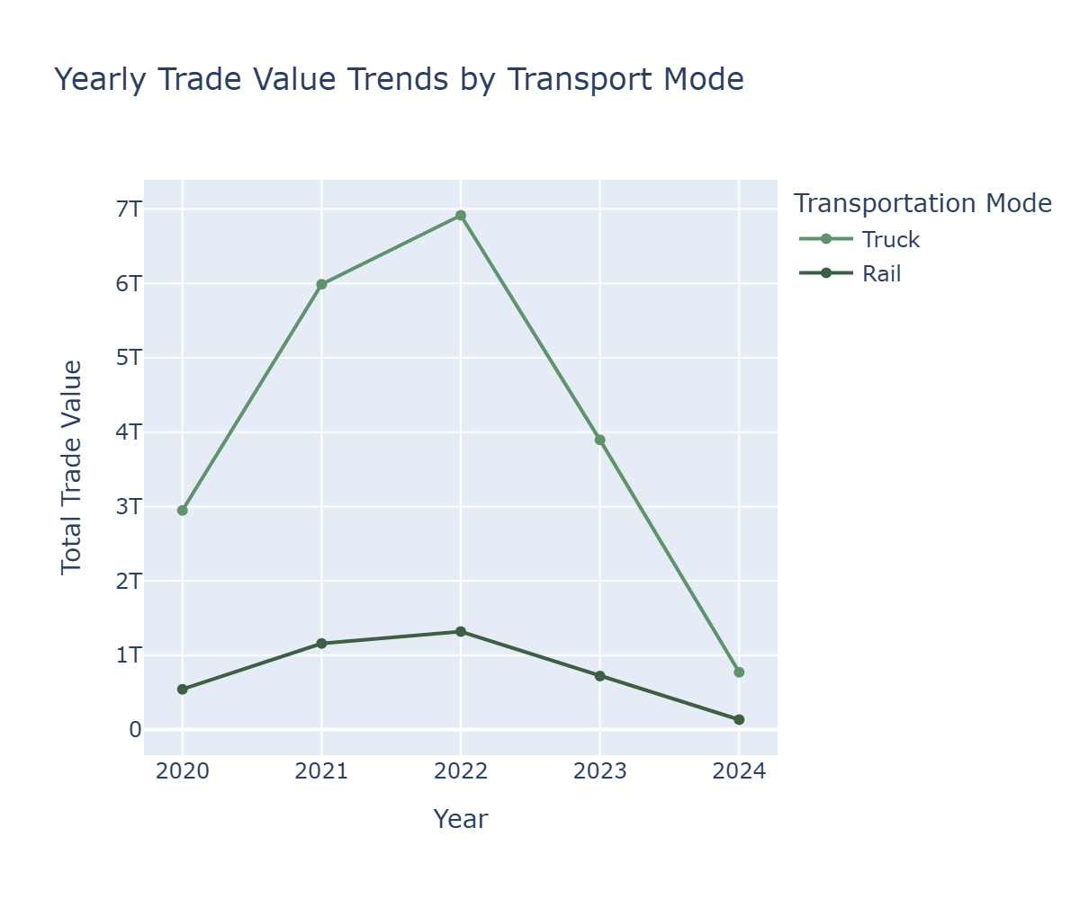
Q7.Yearly Value Trends by Transportation Mode
Conclusion
- Trade value was relatively low, as a result of the pandemic in the year of 2020.
- Truck mode of transport increased massively after the pandemic while the increase in rail was not massive.
- The year 2022 recorded the most trade value as compared the the other years.

Slide 10
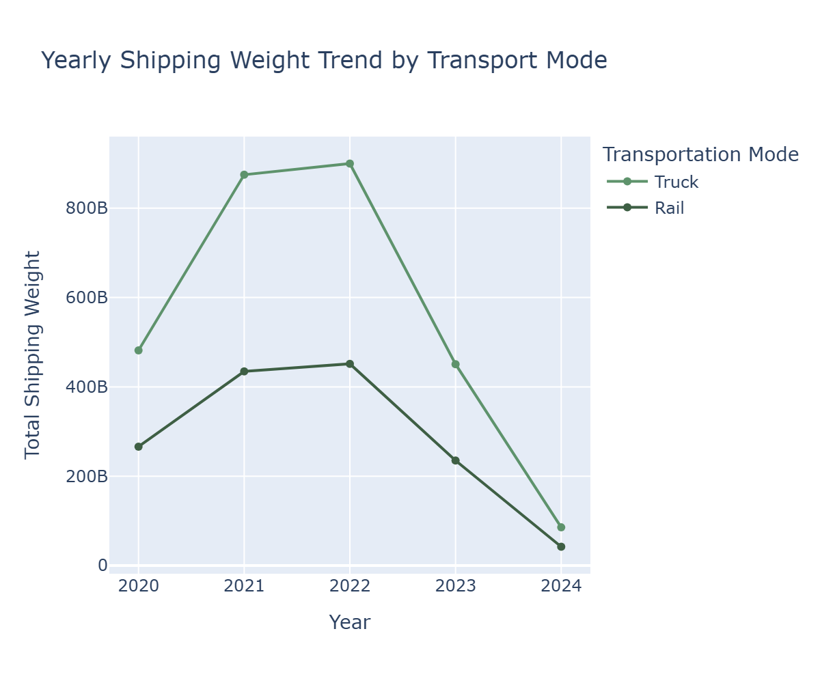
Q7.Yearly Value Trends by Transportation Mode
Conclusion
- shipping weight was relatively low, as a result of the pandemic in the year of 2020.
- Truck mode of transport increased massively after the pandemic as compared to the increase in rail
- Shipping weight was relatively low in 2024 as compared to the other years.

