Slide 1

Chatbot for Complementarity Assessment Framework (COMPASS)
DSI 39
Lin Li Cheng

Slide 2
Table of contents
01
02
03
04
05
06
Background
Objective
Workflow
Findings
Evaluation of chatbot
Demonstration
07
Next steps

Slide 3
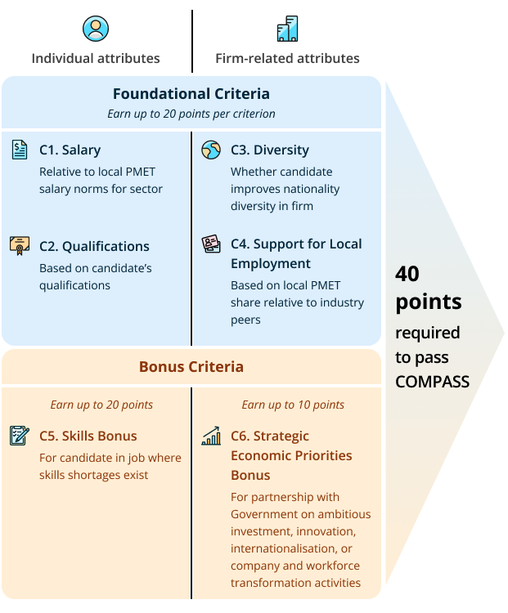
What is Complementarity Assessment Framework (COMPASS)?
COMPASS is a new points-based framework that was announced in Mar 2022 for Employment Pass (EP) approvals
COMPASS considers both individual and firm-related attributes to holistically evaluate an EP applicant’s complementarity
To qualify for EP:
applicants must meet the minimum EP qualifying salary; and
score at least 40 points under COMPASS
Sources:
https://www.straitstimes.com/singapore/from-the-gallerynew-points-system-a-compass-for-better-workforce-complementarity
https://www.mom.gov.sg/newsroom/speeches/2022/0304-speech-by-minister-for-manpower-dr-tan-see-leng-at-committee-of-supply-2022

Slide 4
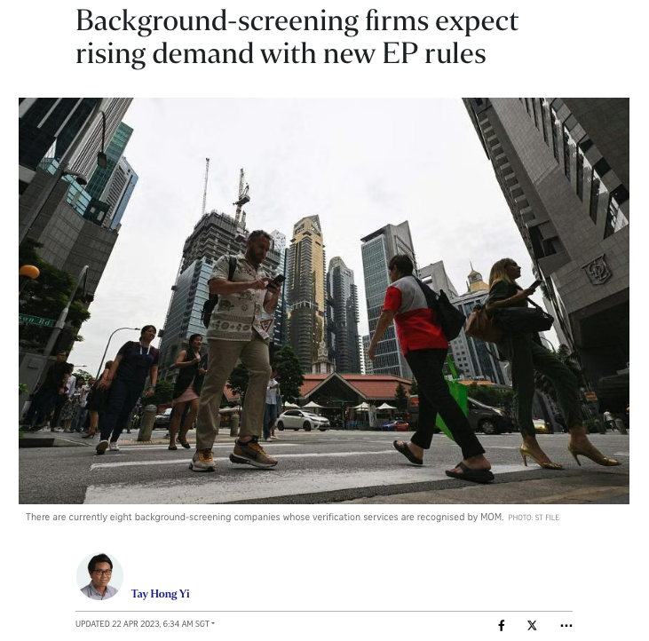
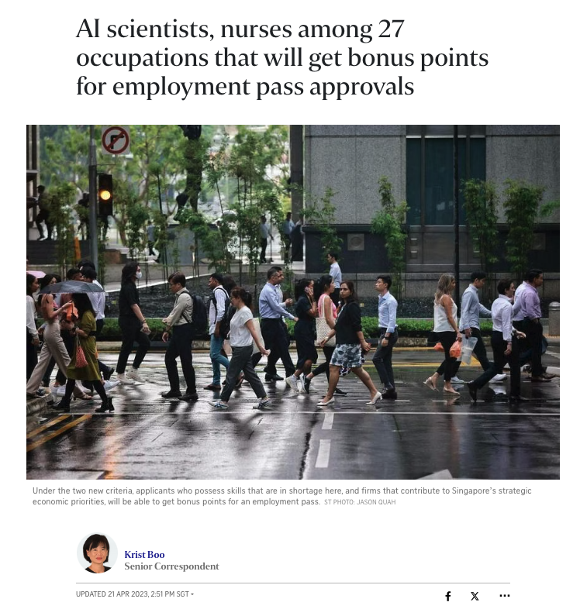
Ongoing updates and media coverage on COMPASS to prepare businesses for the new requirement
“Demand for background-screening services, especially to verify educational qualifications, is likely to see a jump when new rules for Employment Pass (EP) applicants take effect in September, industry players said.” – UPDATED 22 APR 2023, 6:34 AM SGT
“Two new bonus criteria were announced on Friday… The two criteria allow applicants who possess skills that are in shortage here, and firms that contribute to Singapore’s strategic economic priorities, to earn bonus points to help secure an EP. – UPDATED 21 APR 2023, 2:51 PM SGT
Sources:
https://www.straitstimes.com/business/background-screening-companies-expect-rising-demand-for-services-with-new-ep-rules
https://www.straitstimes.com/business/27-job-types-get-bonus-points-for-employment-pass-approvals

Slide 5
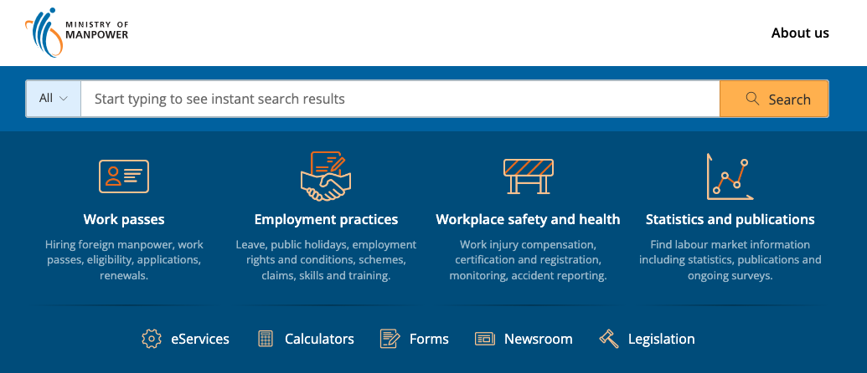
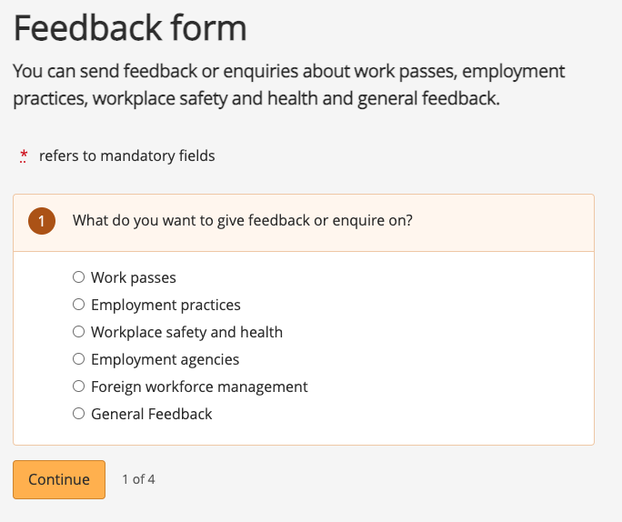
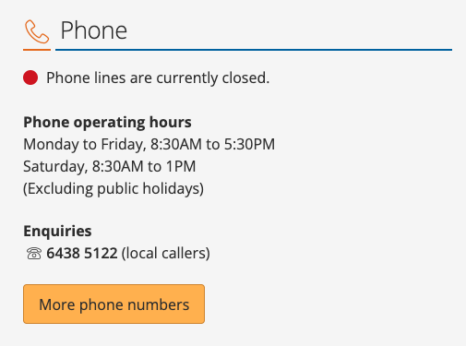
Existing channels to get information about COMPASS have their limitations
Website
Pro: Contains updated information
Con: Requires user to navigate around to find the content
Hotline
Pro: Immediate assistance
Con: Operating hours are not 24/7
Feedback form
Pro: Information is comprehensive
Con: Not real-time

Slide 6
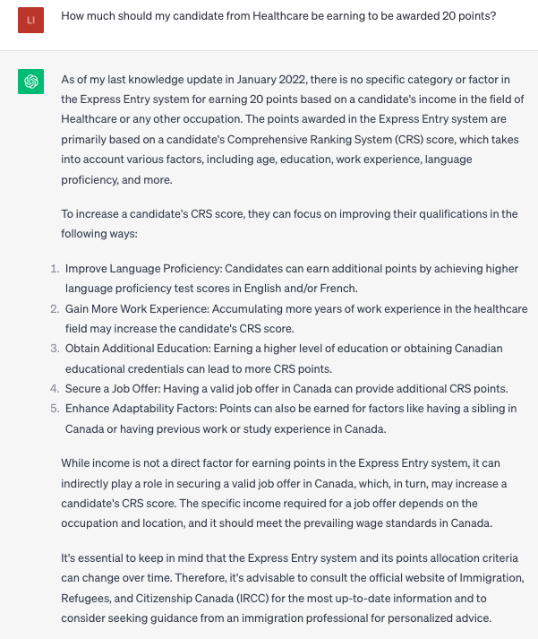
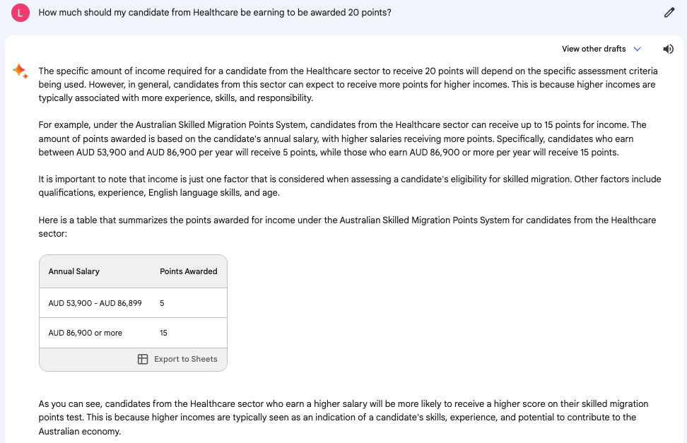
Readily available chatbots are not so helpful
Without including more context or providing the chatbot with a specific knowledge base, the answers generated would typically be based off some assumed context, which is incorrect
Issue: Wrong context
Provided information about Australia’s Skilled Migration Points System
Issue: Wrong context
Provided information about Canada’s Express Entry system
Bard
ChatGPT 3.5

Slide 7
Objective: To create a customised chatbot that addresses queries from businesses about COMPASS, which is user-friendly and offers 24/7 support

Slide 8
Workflow of building a customised chatbot
Data collection
Deployment
Chatbot creation
Scraping relevant URLs from MOM website
Storing relevant HTMLs and PDFs
Customising chatbot’s responses with collected data
Deploying the customised chatbot for businesses

Slide 9
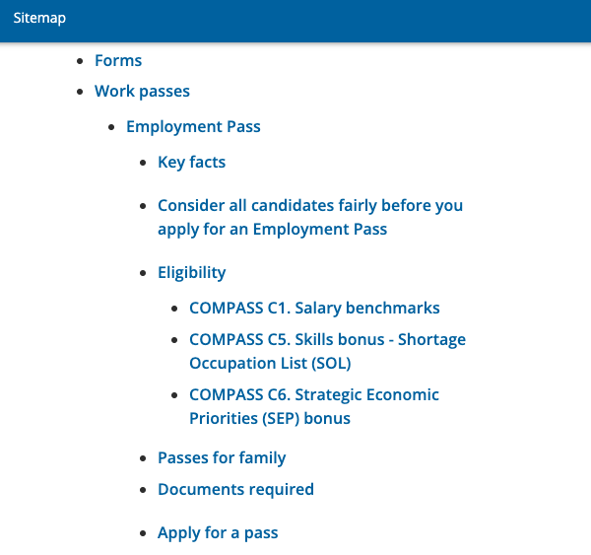
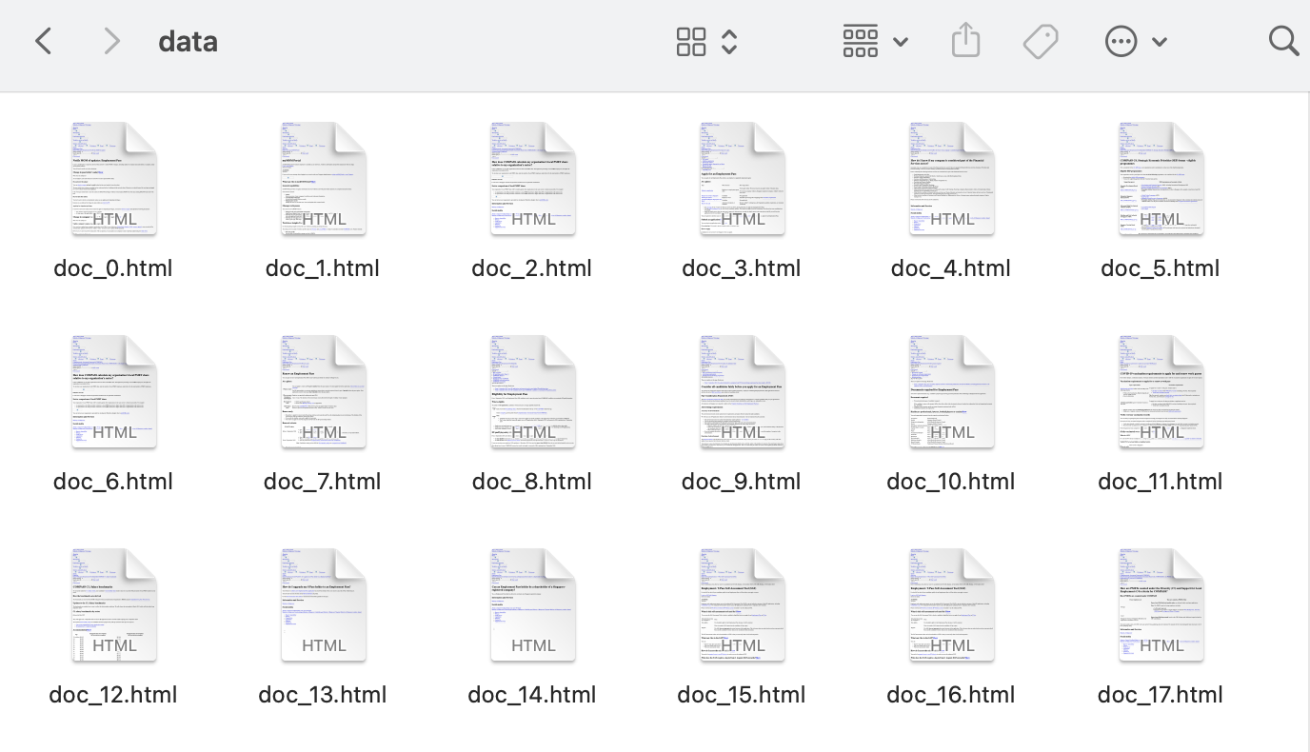
Scraped data from the main URLs and all relevant URLs present in the main URLs as our knowledge base
The sitemap of MOM website shows a hierarchy of content available
We narrowed down to the Eligibility segment which included the COMPASS criteria
Using python package and libraries, we extract all the relevant URLs, and subsequently store these documents into a folder as our knowledge base for the chatbot

Slide 10
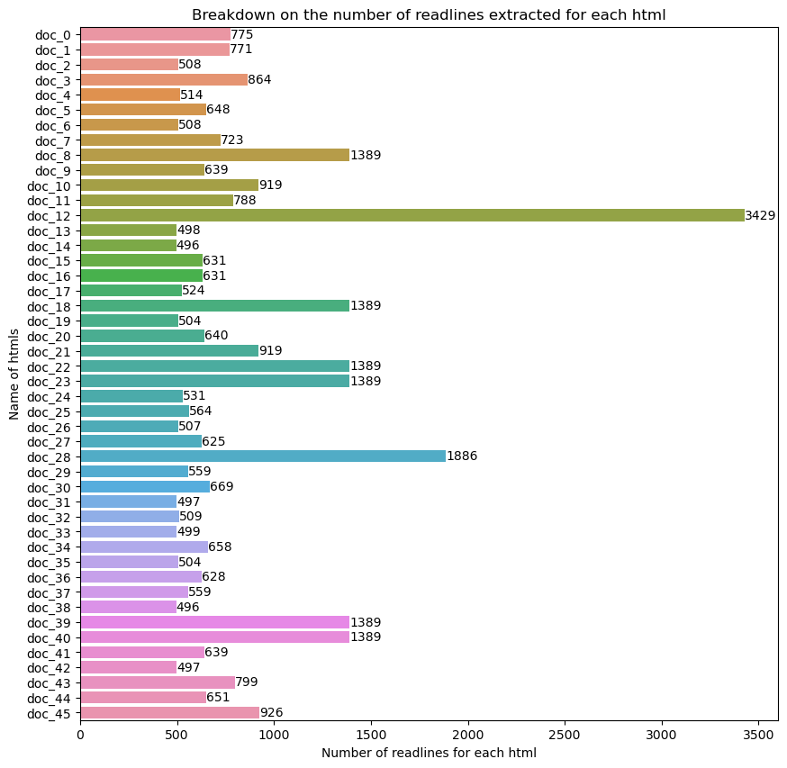
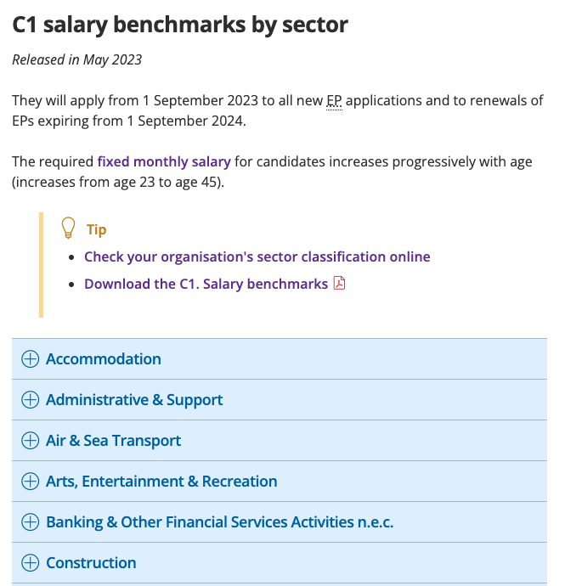
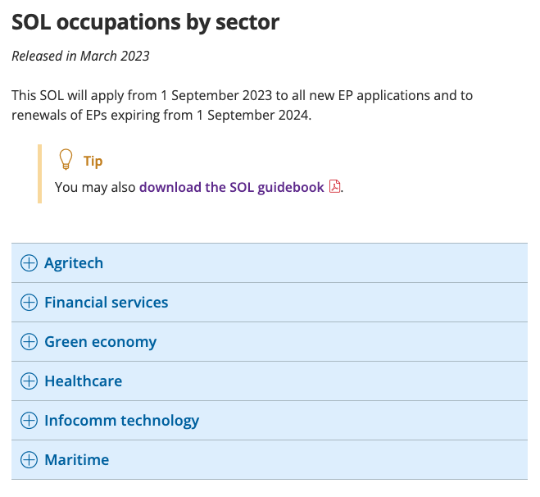
HTMLs files covering sectorial information for C1. Salary and C5. Skills Bonus were significantly longer
COMPASS criteria for salary and skills bonus could be overwhelming for readers
Reference table on COMPASS

Slide 11
Overview of creating a customised chatbot
1
Generate an OpenAI API key
2
Read in the documents that forms the knowledge base for the chatbot
Indicate the Large Language model (e.g., gpt-3.5-turbo) to use, the type of embedding model (e.g., text-embedding-ada-002), and any specific instructions for the chatbot (i.e., system prompt)
3
4
Start your query and refine step 3 to get the desired responses

Slide 12

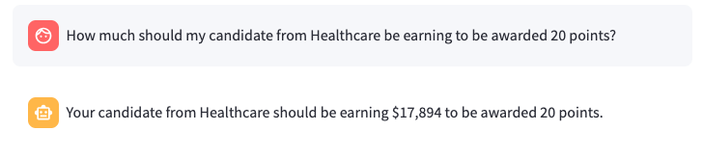
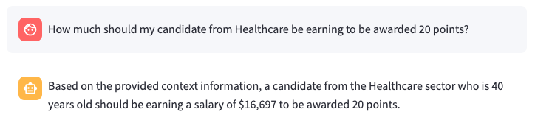
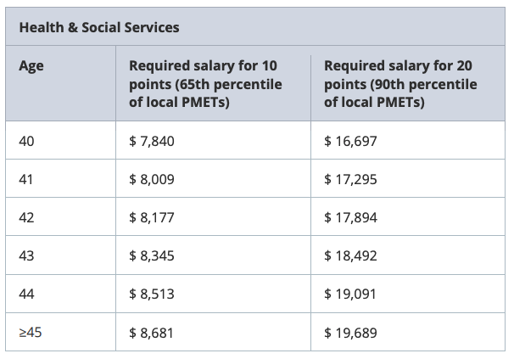
The chatbot with system prompt provides more context in its responses and is preferred
1
Original (GPT-3.5-Turbo)
2
Improved with system prompt (GPT-3.5-Turbo)
Query engine | RAGAS Score | Answer Relevancy | Faithfulness
Original (GPT-3.5-Turbo) | 08767 | 0.9227 | 0.8350
Improved with system prompt (GPT-3.5.Turbo) | 0.8310 | 0.9606 | 0.7322
For all the metrics, the closer the value to 1, the better the performance.

Slide 13
Persona for demo
Meet Tom
HR representative of a manufacturing firm, i.e, The Colony Pte. Ltd
Replacement staff of an ex-employee who left without notice
Unfamiliar of the requirements for employment pass holders

Slide 14
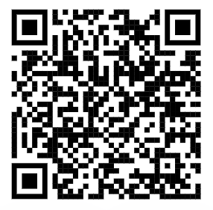
Questions Tom would like to find out
I have a candidate from Fudan University, will she earn 20 points under the qualification criterion?
I have another candidate from Flinders University, will he earn 20 points under the qualification criterion?
My candidate is 35 years old and we are from manufacturing sector, what is the minimum salary to get 20 points?
What is support for local employment about?
Where can I find information about my company’s local PMET share relative to the sector?
https://chatbot-compass.streamlit.app

Slide 15
Summary
Problem:
While there are various channels that businesses can rely on to get information about COMPASS, there has not been any that could provide 24/7 support and immediate assistance for the queries that businesses might have when planning for the applications and/or renewals of Employment Passes.
Deliverable:
To create a customised chatbot that addresses queries from businesses about COMPASS, which is user-friendly and offers 24/7 support

Slide 16
Next steps
Phase 1
Phase 2
Phase 3
Improvise the chatbot to achieve RAGAS score > 0.9
Iterating the system prompts, exploring various LLMs and embedding models
Piloting the improvised chatbot to gather feedback from users and refine accordingly
Using MOM’s official Telegram channel (/sgministryofmanpower) to reach out to a smaller pool of users
Deploy the refined chatbot on MOM website for any users to enquire about COMPASS
Expanding the use of the refined chatbot to reach out to all visitors of MOM website

Slide 17
Thank you
CREDITS: This presentation template was created by Slidesgo, including icons by Flaticon, infographics & images by Freepik

