Slide 1
Does Singapore’s weather affect the number of Typhoid cases?
Lin Li Cheng
DSI 39

Slide 2
Background of Singapore’s weather
Singapore is an island city-state surrounded by water, situated near the equator and has a tropical climate.
Our geographical location makes us susceptible to infectious diseases caused by bacteria, viruses, fungi or even parasites due to the high humidity and rainfall.
The project aims to study the relationship between the climate in Singapore and the number of locally reported Typhoid cases to develop effective public health interventions.

Slide 3
Total rainfall
of 2207.2 mm
in 2022
There is much higher rainfall accompanied with slight changes in relative humidity and mean air temperature in recent years from 2018 to 2022
78.6% of
relative humidity
in 2022
Mean air temperature of 27.87℃
of 499 mm compared to 2018
of 0.98% compared to 2018
of 0.02℃ compared to 2018
With the changing weather climate in Singapore,
would it affect our immunisation against infectious disease like Typhoid?

Slide 4
69 Typhoid cases in 2022
There has been an increase in Typhoid cases in 2022 compared to 2018, and Typhoid cases are not easy to identify and cure
Dangers of Typhoid include:
Hard to detect during the earlier stages of infection which usually shows up as common fever which could last for up to two weeks
Carriers of this disease who displayed no symptoms remained contagious
Resistance to antibiotics would potentially make it harder to treat for relapsed patients
of 26 cases compared to 2018

Slide 5
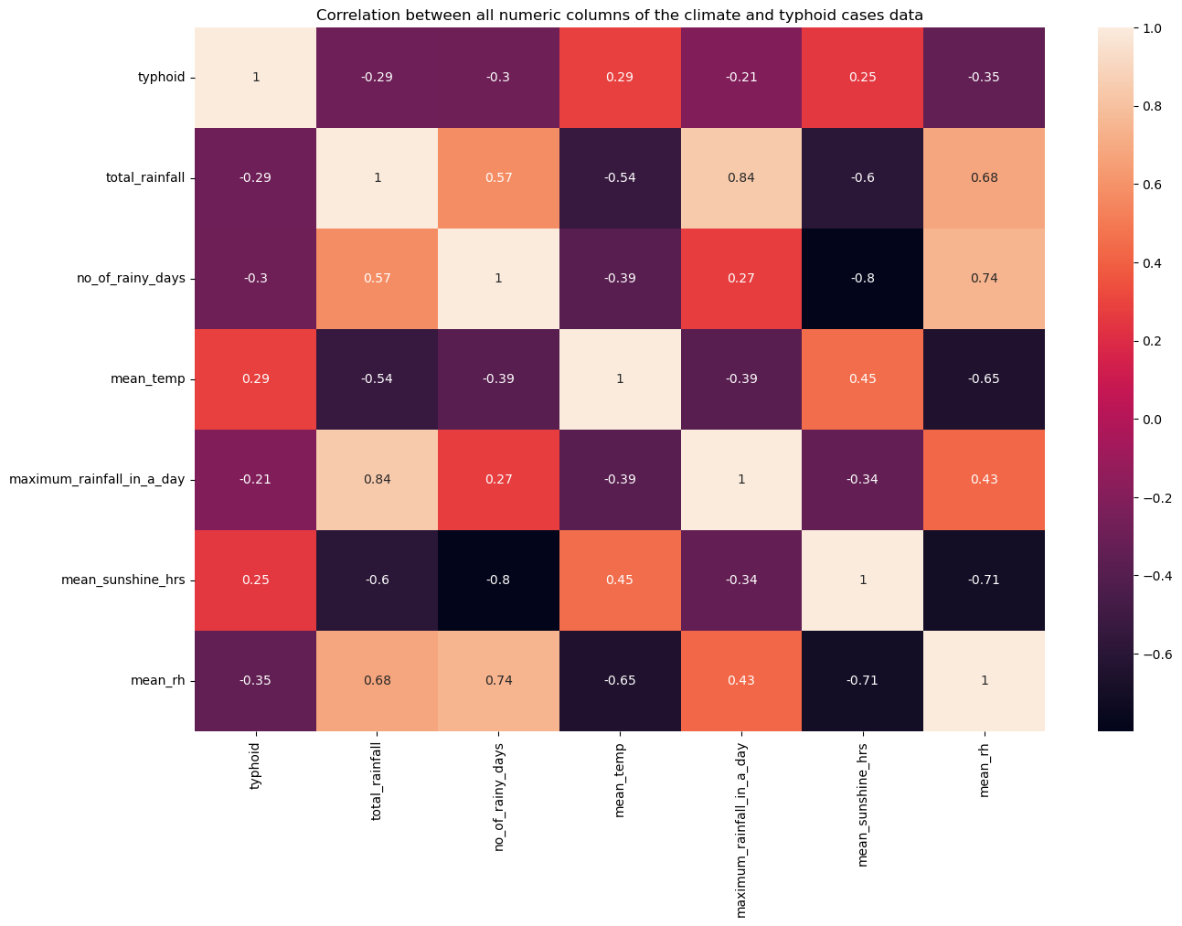
Using the data we have, we wanted to identify whether there are any correlations between the number of Typhoid cases we have against the various climate metrics that could help us better target and develop effective interventions for Typhoid immunisation.
Our initial heatmap did not show any particular climate metrics having moderate to strong correlation with the number of Typhoid cases, there were only slight negative correlation for average relative humidity.

Slide 6
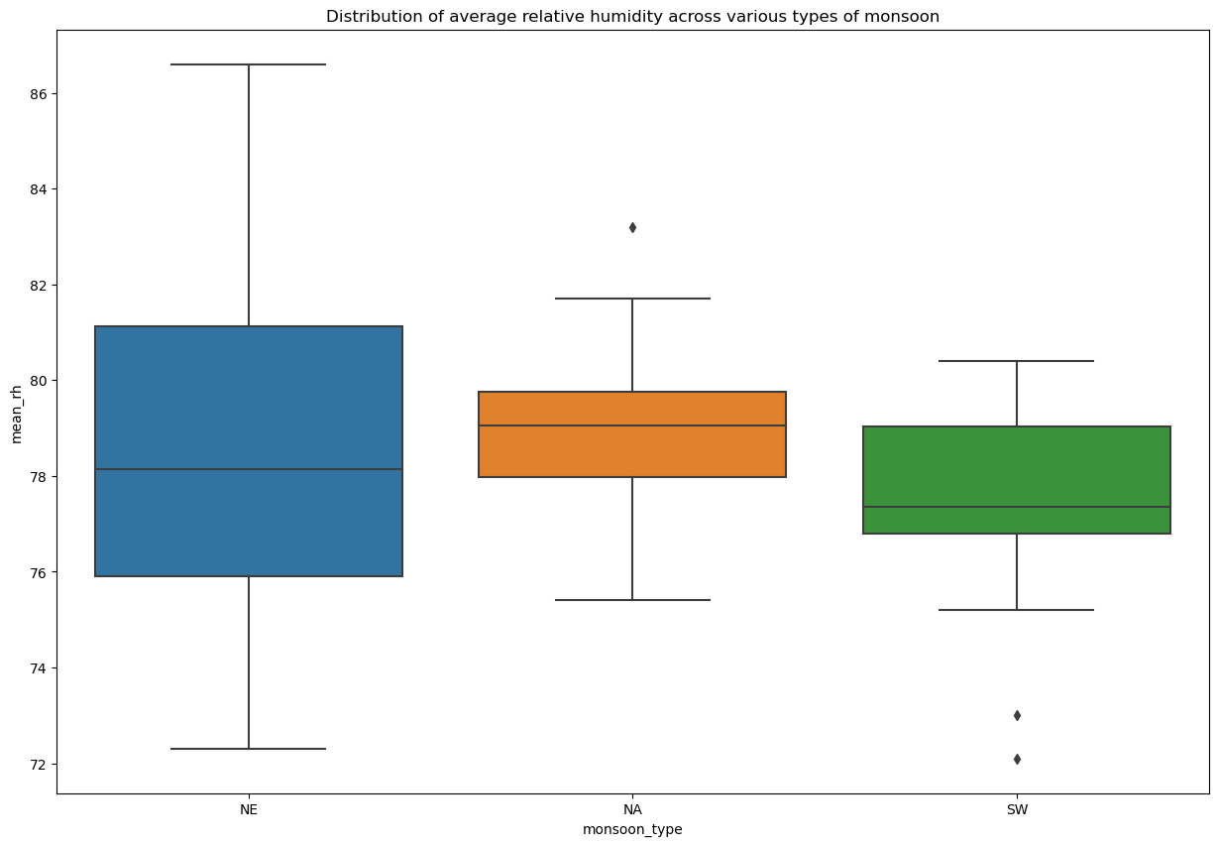
By splitting the data on average relative humidity by the various types of monsoon in Singapore (i.e. Northeast, Southwest, Non-Monsoon period),
we can see that the median of the average relative humidity for the Southwest monsoon period is lower than the other two groups.
Lower median compared to the other two groups

Slide 7
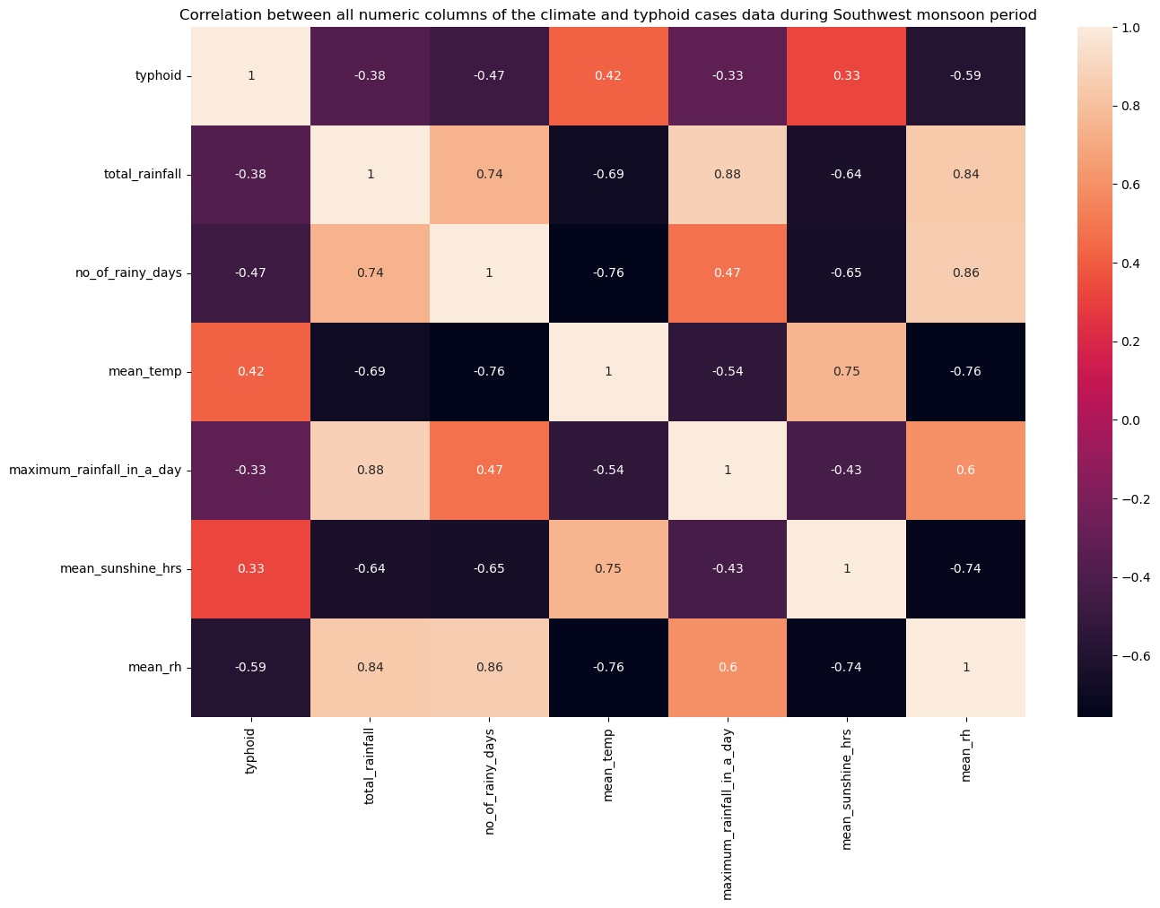
By plotting the heatmap for southwest monsoon period, we can observe the following:
The lower the average relative humidity, the higher the number of Typhoid cases
The lower the number of rainy days, the higher the number of Typhoid cases

Slide 8
Recommendations
Engage
We should encourage the public to undergo Typhoid vaccine especially during the Southwest monsoon period, where we see a stronger negative correlation between the average relative humidity during the Southwest monsoon period and the number of typhoid cases reported in Singapore.
Possible ways to engage the public could include having infographics or short animation videos on various social media platforms regarding Typhoid disease and preventive measures.
Review
We should consider revising the list of subsidised vaccinations to include Typhoid vaccine under the subsidised list for the general public, especially during the Southwest monsoon period. This could help nudge the public to take on the Typhoid vaccine to protect themselves.

Slide 9
Limitations
The study did not consider whether COVID-19 could have affected the number of typhoid cases recorded
The study did not run statistic tests to find out whether there are significant differences between the different monsoon seasons to implement a more targeted intervention
Plans for improvement
To include data on tourist visits to rural areas by citizens to enhance the dataset for a more comprehensive understanding on the Typhoid cases in Singapore

Slide 10
Credits
https://eresources.nlb.gov.sg/infopedia/articles/SIP_2022-08-19_132436.html#:~:text=Subsequently%20from%201990%20to%202009,had%20no%20recent%20travel%20history.
https://my.clevelandclinic.org/health/diseases/17730-typhoid-fever
https://www.nhgp.com.sg/our-services/other-services/Pages/Vaccination-Clinic.aspx
https://www.gavi.org/vaccineswork/global-response-needed-typhoid-evades-antibiotics
https://www.ncbi.nlm.nih.gov/pmc/articles/PMC3554574/

Slide 11
Thank you!
This template provided by SlidesCarnival is free to use under Creative Commons Attribution license.

