Slide 1


Refresher & practical UoN HPC “Ada” session
LIFE4137 – individual research projects
(also useful for LIFE4136 group projects)
Laura Dean

Slide 2
Learning Objectives
Remind ourselves what the HPC is and how to use it
Practice submitting a job submission script
Practice running an interactive job
Practice accessing software modules on the HPC
Install and practice using Conda on the HPC
Practice copying files between the HPC and your local machine
Know where to go for further support

Slide 3

What is a HPC?
HPC = high performance computer (sometimes called cluster, server, super-computer)
Connect to it remotely from your terminal using ssh (secure shell)
Login nodes = less powerful than your phone! (used only for logging in, submitting jobs and very quick tasks e.g. viewing output files)
Compute nodes = EXTREME POWER!

Slide 4

Exploration tier (your accounts semesters 1 & 2)
This tier gives you a ‘sandpit’ where you can develop your HPC skills.
The Exploration tier gives the exploration user:
simultaneous use of up to 96 CPU cores
360 GB memory (RAM)
Job lengths of up to 2 days.
1TB of storage (disk space) by default.
Exploration tier users that need extra resource will be advised to apply for the ‘production’ tier.

Slide 5

Production tier (your accounts semester 3)
The Production tier is for university projects, where you and your project team have existing HPC user experience.
Production tier gives the production user:
Simultaneous use of up to 600 CPU cores
3000 GB memory (RAM).
Job lengths of up to 7 days
1TB of storage (disk space) by default.
Production users can also apply for larger limits on CPU cores, memory (RAM), and storage, and all requests will be considered.

Slide 6
UoN HPC – Ada – partitions:
Partition name | Type of node
defq | Standard compute nodes with 96 cores and 384 GB (361 GB usable) memory. There are 63 nodes in this partition. The maximum job walltime allowed is 7 days (168 hours).
shortq | Standard compute nodes with 96 cores and 384 GB (361 GB usable) memory. There are 6 nodes in this partition. The maximum job walltime allowed is 12 hours.
devq | Standard compute nodes with 96 cores and 384 GB (361 GB usable) memory. This queue shares the nodes with 'defq' partition, but limits total number of cores per user to 96, and number of jobs to 4. The maximum job walltime allowed is 1 hour.
hmemq | High memory compute node with 96 cores and 1536 GB (1495 GB usable) memory. There are 10 nodes in this partition. The maximum job walltime allowed is 7 days (168 hours).
ampereq | GPGPU (ampere) compute node with 96 cores and 768 GB (747 GB usable) memory, and 8 Nvidia A100 GPUs There are 2 nodes in this partition. The maximum job walltime allowed is 7 days (168 hours).
ampere-devq | GPGPU (ampere) compute node with 96 cores and 768 GB (747 GB usable) memory, and 8 Nvidia A100 GPUs This queue shares the nodes with 'ampereq' partition, but limits total number of cores per user to 12, number of GPUs per user to 1, and number of jobs to 4. The maximum job walltime allowed is 1 hour
ampere-mq | GPGPU (ampere) compute node with 96 cores and 768 GB (747 GB usable) memory, and 8 Nvidia A100 GPUs, each A100 split into 7x 'MIG' instances There are 2 nodes in this partition. The maximum job walltime allowed is 7 days (168 hours).
ampere-m-devq | GPGPU (ampere) compute node with 96 cores and 768 GB (747 GB usable) memory, and 8 Nvidia A100 GPUs, each A100 split into 7x 'MIG' instances This queue shares the nodes with 'ampere-mq' partition, but limits total number of cores per user to 12, number of GPUs per user to 1, and number of jobs to 4. The maximum job walltime allowed is 1 hour.
normal jobs
quick jobs
testing
high memory
GPU (graphics processing unit)
GPU - testing
Notes:
Defq is the one for accessing normal HPC nodes. This is probably the main queue you will want to use
If you need to run jobs with more than 361 GB memory e.g. genome assemblies you would use hmemq
If you want access to GPU nodes use ampere
GPU – graphics processing Unit

Slide 7

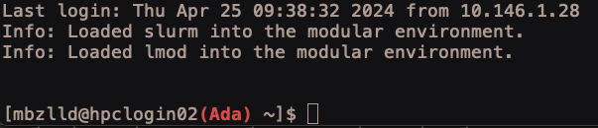
Connecting to the UoN HPC – Ada
Always connect to the VPN before login (even on campus)
ssh – secure shell basic command:
ssh username@hpclogin01.ada.nottingham.ac.uk
Your username for Ada is your university username e.g. mine is mbzlld
Your password for Ada is your university password
To logout use the command:
exit
This is the message you should see when you have logged in successfully:
Ada Lovelace
Notes:
Ada Lovelace – considered the world’s first computer programmer!
If you have not connected to the VPN first your SSH command will just hang and eventually time out and give you an error.

Slide 8

Password-less login with ssh keys
ssh keys link your device to the HPC and remove the need for a password when logging in
Open Ubuntu (windows) or terminal (mac)
Check you are in your home directory:
cd ~
Generate an ssh key pair using the following command:
(when it suggests a default name / location for the keys, press enter to accept this, press enter each time it asks for client secret to leave the password for the keys blank)
ssh-keygen
This will create a private and public key pair, usually called id_rsa and id_rsa.pub in the hidden directory ~/.ssh
Notes:
Ada Lovelace – considered the world’s first computer programmer!
If you have not connected to the VPN first your SSH command will just hang and eventually time out and give you an error.

Slide 9
Password-less login with ssh keys
Copy the public key to Ada using the following command:
(you will be prompted to enter your password for Ada to copy the key)
ssh-copy-id username@hpclogin01.ada.nottingham.ac.uk
Now try login again and you should be able to get in without typing your password:
ssh username@hpclogin01.ada.nottingham.ac.uk
Notes:
Ada Lovelace – considered the world’s first computer programmer!
If you have not connected to the VPN first your SSH command will just hang and eventually time out and give you an error.

Slide 10

Setting up a config file
An ssh config file specifies information about the different hosts you connect to
The config file is located here: ~/.ssh/config
Example config file: (note the spaces, indentation and capitalization, it all matters!)
Host ada
Hostname hpclogin01.ada.nottingham.ac.uk
User username
After you have created a config file you can login using the command:
ssh ada

Slide 11
Your config file can contain info for many HPCs
Example config file with multiple hosts:
Host ada
Hostname hpclogin01.ada.nottingham.ac.uk
User mbzlld
Host cyclecloud
Hostname 10.102.161.12
User mbzlld
Host archer2
Hostname 193.62.216.43
User LauraDean

Slide 12
How to use Ada
ssh to login to a login node
submit jobs to compute nodes
OR
srun for interactive job on compute node
OR
OpenOnDemand – vnc session: super useful if you want to use a GUI (graphical user interface)
1
Major bonus, you can logout of Ada and your job is still running
2
3

Slide 13

SLURM commands for job submission & monitoring:
sbatch - to submit a job
squeue - to list jobs, and show status
scancel - to delete jobs
sinfo - to show status of nodes and partitions
sacct - to output resource information on jobs
srun – to request an interactive session on a compute node

Slide 14
Every job needs a job submission script:
Example job submission script:
#!/bin/bash
#SBATCH --partition=defq
#SBATCH --nodes=1
#SBATCH --ntasks=1
#SBATCH --cpus-per-task=8
#SBATCH --mem=5g
#SBATCH --time=00:10:00
#SBATCH --job-name=my_job
#SBATCH --output=/gpfs01/home/mbzlld/slurm-%x-%j.out
#SBATCH --error=/gpfs01/home/mbzlld/slurm-%x-%j.err
#SBATCH --mail-type=ALL
#SBATCH --mail-user=mbzlld@exmail.nottingham.ac.uk
# Write out a test file to check our job ran
echo “hello world” > ~/our_test_output.txt
NOTE: My username is mbzlld – where you see this in the scripts you will need to replace it with your own university username

Slide 15
Every job needs a job submission script:
Example job submission script:
#!/bin/bash
#SBATCH --partition=defq
#SBATCH --nodes=1
#SBATCH --ntasks=1
#SBATCH --cpus-per-task=8
#SBATCH --mem=5g
#SBATCH --time=00:10:00
#SBATCH --job-name=my_job
#SBATCH --output=/gpfs01/home/mbzlld/slurm-%x-%j.out
#SBATCH --error=/gpfs01/home/mbzlld/slurm-%x-%j.err
#SBATCH --mail-type=ALL
#SBATCH --mail-user=mbzlld@exmail.nottingham.ac.uk
# Write out a test file to check our job ran
echo “hello world” > ~/our_test_output.txt
#!/bin/bash
The shebang – tells the operating system which interpreter to use to when executing the script
NOTE: My username is mbzlld – where you see this in the scripts you will need to replace it with your own university username

Slide 16
Every job needs a job submission script:
Example job submission script:
#!/bin/bash
#SBATCH --partition=defq
#SBATCH --nodes=1
#SBATCH --ntasks=1
#SBATCH --cpus-per-task=8
#SBATCH --mem=5g
#SBATCH --time=00:10:00
#SBATCH --job-name=my_job
#SBATCH --output=/gpfs01/home/mbzlld/slurm-%x-%j.out
#SBATCH --error=/gpfs01/home/mbzlld/slurm-%x-%j.err
#SBATCH --mail-type=ALL
#SBATCH --mail-user=mbzlld@exmail.nottingham.ac.uk
# Write out a test file to check our job ran
echo “hello world” > ~/our_test_output.txt
--partition=
Select the type of compute node you want to use (we will talk about the different partitions that are available to you later)
NOTE: My username is mbzlld – where you see this in the scripts you will need to replace it with your own university username

Slide 17
Every job needs a job submission script:
Example job submission script:
#!/bin/bash
#SBATCH --partition=defq
#SBATCH --nodes=1
#SBATCH --ntasks=1
#SBATCH --cpus-per-task=8
#SBATCH --mem=5g
#SBATCH --time=00:10:00
#SBATCH --job-name=my_job
#SBATCH --output=/gpfs01/home/mbzlld/slurm-%x-%j.out
#SBATCH --error=/gpfs01/home/mbzlld/slurm-%x-%j.err
#SBATCH --mail-type=ALL
#SBATCH --mail-user=mbzlld@exmail.nottingham.ac.uk
# Write out a test file to check our job ran
echo “hello world” > ~/our_test_output.txt
--nodes=
Select how many compute nodes you want to use (almost always this will be 1)
NOTE: My username is mbzlld – where you see this in the scripts you will need to replace it with your own university username

Slide 18
Every job needs a job submission script:
Example job submission script:
#!/bin/bash
#SBATCH --partition=defq
#SBATCH --nodes=1
#SBATCH --ntasks=1
#SBATCH --cpus-per-task=8
#SBATCH --mem=5g
#SBATCH --time=00:10:00
#SBATCH --job-name=my_job
#SBATCH --output=/gpfs01/home/mbzlld/slurm-%x-%j.out
#SBATCH --error=/gpfs01/home/mbzlld/slurm-%x-%j.err
#SBATCH --mail-type=ALL
#SBATCH --mail-user=mbzlld@exmail.nottingham.ac.uk
# Write out a test file to check our job ran
echo “hello world” > ~/our_test_output.txt
--ntasks=
Select how many separate tasks you want your job to be split across (for most jobs this will also be 1)
NOTE: My username is mbzlld – where you see this in the scripts you will need to replace it with your own university username

Slide 19
Every job needs a job submission script:
Example job submission script:
#!/bin/bash
#SBATCH --partition=defq
#SBATCH --nodes=1
#SBATCH --ntasks=1
#SBATCH --cpus-per-task=8
#SBATCH --mem=5g
#SBATCH --time=00:10:00
#SBATCH --job-name=my_job
#SBATCH --output=/gpfs01/home/mbzlld/slurm-%x-%j.out
#SBATCH --error=/gpfs01/home/mbzlld/slurm-%x-%j.err
#SBATCH --mail-type=ALL
#SBATCH --mail-user=mbzlld@exmail.nottingham.ac.uk
# Write out a test file to check our job ran
echo “hello world” > ~/our_test_output.txt
--cpus-per-task=
Select how many cores you want your job to use. This is where you can make a lot of things much faster by requesting more cores.
NOTE: you cannot request more than the maximum number of cores in the node or nodes you have requested.
NOTE: My username is mbzlld – where you see this in the scripts you will need to replace it with your own university username

Slide 20
Every job needs a job submission script:
Example job submission script:
#!/bin/bash
#SBATCH --partition=defq
#SBATCH --nodes=1
#SBATCH --ntasks=1
#SBATCH --cpus-per-task=8
#SBATCH --mem=5g
#SBATCH --time=00:10:00
#SBATCH --job-name=my_job
#SBATCH --output=/gpfs01/home/mbzlld/slurm-%x-%j.out
#SBATCH --error=/gpfs01/home/mbzlld/slurm-%x-%j.err
#SBATCH --mail-type=ALL
#SBATCH --mail-user=mbzlld@exmail.nottingham.ac.uk
# Write out a test file to check our job ran
echo “hello world” > ~/our_test_output.txt
--mem=
Select how much RAM to allocate to your job. This allows you to use far more memory than you would usually be able to access on a standard computer.
Units:
g = gb – gigabytes
m = mb – megabytes
NOTE: My username is mbzlld – where you see this in the scripts you will need to replace it with your own university username

Slide 21
Every job needs a job submission script:
Example job submission script:
#!/bin/bash
#SBATCH --partition=defq
#SBATCH --nodes=1
#SBATCH --ntasks=1
#SBATCH --cpus-per-task=8
#SBATCH --mem=5g
#SBATCH --time=00:10:00
#SBATCH --job-name=my_job
#SBATCH --output=/gpfs01/home/mbzlld/slurm-%x-%j.out
#SBATCH --error=/gpfs01/home/mbzlld/slurm-%x-%j.err
#SBATCH --mail-type=ALL
#SBATCH --mail-user=mbzlld@exmail.nottingham.ac.uk
# Write out a test file to check our job ran
echo “hello world” > ~/our_test_output.txt
--time=
Select the maximum amount of time your job can run for.
Units:
hh:mm:ss
NOTE: the different nodes have different maximum job times. No one can request more than 7 days (168 hours) on any node.
NOTE: My username is mbzlld – where you see this in the scripts you will need to replace it with your own university username

Slide 22
Every job needs a job submission script:
Example job submission script:
#!/bin/bash
#SBATCH --partition=defq
#SBATCH --nodes=1
#SBATCH --ntasks=1
#SBATCH --cpus-per-task=8
#SBATCH --mem=5g
#SBATCH --time=00:10:00
#SBATCH --job-name=my_job
#SBATCH --output=/gpfs01/home/mbzlld/slurm-%x-%j.out
#SBATCH --error=/gpfs01/home/mbzlld/slurm-%x-%j.err
#SBATCH --mail-type=ALL
#SBATCH --mail-user=mbzlld@exmail.nottingham.ac.uk
# Write out a test file to check our job ran
echo “hello world” > ~/our_test_output.txt
--job-name=
Short useful name for you to identify your job (no spaces allowed!)
NOTE: My username is mbzlld – where you see this in the scripts you will need to replace it with your own university username

Slide 23
Every job needs a job submission script:
Example job submission script:
--output=
Name and location of output file (all output that would be printed to the screen if you ran your script directly in the terminal will be stored here)
If you do not specify a separate error file, errors will also be written to your output file.
%x = Job name (taken from --job-name=)
%j = Job ID (allocated upon submission)
Note: you cannot use ~ as shorthand for your home directory here
#!/bin/bash
#SBATCH --partition=defq
#SBATCH --nodes=1
#SBATCH --ntasks=1
#SBATCH --cpus-per-task=8
#SBATCH --mem=5g
#SBATCH --time=00:10:00
#SBATCH --job-name=my_job
#SBATCH --output=/gpfs01/home/mbzlld/slurm-%x-%j.out
#SBATCH --error=/gpfs01/home/mbzlld/slurm-%x-%j.err
#SBATCH --mail-type=ALL
#SBATCH --mail-user=mbzlld@exmail.nottingham.ac.uk
# Write out a test file to check our job ran
echo “hello world” > ~/our_test_output.txt
NOTE: My username is mbzlld – where you see this in the scripts you will need to replace it with your own university username

Slide 24
Every job needs a job submission script:
Example job submission script:
--error=
OPTIONAL: Name and location of error file (any errors that would be printed to the screen if you ran your script directly in the terminal will be stored here)
If you do not specify a separate error file, errors will be written to your output file.
%x = Job name (taken from --job-name=)
%j = Job ID (allocated upon submission)
Note: you cannot use ~ as shorthand for your home directory here
#!/bin/bash
#SBATCH --partition=defq
#SBATCH --nodes=1
#SBATCH --ntasks=1
#SBATCH --cpus-per-task=8
#SBATCH --mem=5g
#SBATCH --time=00:10:00
#SBATCH --job-name=my_job
#SBATCH --output=/gpfs01/home/mbzlld/slurm-%x-%j.out
#SBATCH --error=/gpfs01/home/mbzlld/slurm-%x-%j.err
#SBATCH --mail-type=ALL
#SBATCH --mail-user=mbzlld@exmail.nottingham.ac.uk
# Write out a test file to check our job ran
echo “hello world” > ~/our_test_output.txt
NOTE: My username is mbzlld – where you see this in the scripts you will need to replace it with your own university username

Slide 25
Every job needs a job submission script:
Example job submission script:
#!/bin/bash
#SBATCH --partition=defq
#SBATCH --nodes=1
#SBATCH --ntasks=1
#SBATCH --cpus-per-task=8
#SBATCH --mem=5g
#SBATCH --time=00:10:00
#SBATCH --job-name=my_job
#SBATCH --output=/gpfs01/home/mbzlld/slurm-%x-%j.out
#SBATCH --error=/gpfs01/home/mbzlld/slurm-%x-%j.err
#SBATCH --mail-type=ALL
#SBATCH --mail-user=mbzlld@exmail.nottingham.ac.uk
# Write out a test file to check our job ran
echo “hello world” > ~/our_test_output.txt
--mail-type=ALL
--mail-user=
OPTIONAL: include both these lines and replace my username with yours if you want the system to send you an email when your job starts running and when it completes.
NOTE: My username is mbzlld – where you see this in the scripts you will need to replace it with your own university username

Slide 26
Every job needs a job submission script:
Example job submission script:
#!/bin/bash
#SBATCH --partition=defq
#SBATCH --nodes=1
#SBATCH --ntasks=1
#SBATCH --cpus-per-task=8
#SBATCH --mem=5g
#SBATCH --time=00:10:00
#SBATCH --job-name=my_job
#SBATCH --output=/gpfs01/home/mbzlld/slurm-%x-%j.out
#SBATCH --error=/gpfs01/home/mbzlld/slurm-%x-%j.err
#SBATCH --mail-type=ALL
#SBATCH --mail-user=mbzlld@exmail.nottingham.ac.uk
# Write out a test file to check our job ran
echo “hello world” > ~/our_test_output.txt
The main body of your script – the bit where you write what you want the script to do.
NOTE: My username is mbzlld – where you see this in the scripts you will need to replace it with your own university username

Slide 27
Practical job submission
1. Connect to the VPN
2. Open a terminal (Mac) or Ubuntu (Windows) and login to Ada:
ssh ada
3. Clone the following repo:
git clone https://github.com/lldean18/LIFE4137-HPC_practice
4. Move into the repo you cloned, have a look what is in it:
cd ~/LIFE4137-HPC_practice
ls -lh
5. Edit the file job_submission_script.bash and substitute USERNAME for your username, read through the script and have a look at what it is doing:
nano job_submission_script.bash

Slide 28
Practical job submission
6. Submit the job submission script:
sbatch job_submission_script.bash
7. Check your job in the queue (replace USERNAME with your actual username!):
squeue –l –u USERNAME
8. Check some info about how your job ran after it has completed:
sacct --format="JobID,JobName,AllocCPUS,State,time,Elapsed,CPUTime,ReqMem,MaxRSS,ExitCode"
Key things to notice from the output of the sacct command:
time limit vs. elapsed time (how long you gave it vs. how long it actually took)
CPUTime is time multiplied by number of allocated CPUS (AllocCPUS)
requested memory (ReqMem) vs. actual memory used (MaxRss)
exit code is 0:0 if the job completed successfully (as far as slurm is concerned)
9. Look at the new files that have been created by running your job, inspect the slurm output script:
ls

Slide 29
How to use Ada
ssh to login to a login node
submit jobs to compute nodes
OR
srun for interactive job on compute node
OR
OpenOnDemand – vnc session: super useful if you want to use a GUI (graphical user interface)
1
2
3

Slide 30
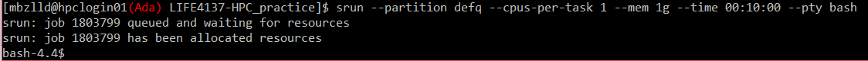
Using srun for an interactive session
(Options mostly similar to the sbatch command) NOTE: syntax difference, no = between flag and input
srun --partition defq --cpus-per-task 1 --mem 1g --time 00:10:00 --pty bash
Partition you would like to use
Number of cores you are requesting for your job
Amount of memory you are requesting for your job
Maximum runtime for your job
Type of shell to run your job in
Example srun usage:

Slide 31
Practical use of srun for an interactive session
1. Use this srun command to enter an interactive session:
srun --partition defq --cpus-per-task 2 --mem 10g --time 00:20:00 --pty bash
2. Move into the repo you cloned earlier:
cd ~/LIFE4137-HPC_practice
3. Load software modules we will use:
module load samtools-uoneasy/1.18-GCC-12.3.0
module load gnuplot/5.4.8-GCCcore-12.3.0
4. Plot the coverage of data in your bam file:
samtools coverage --histogram ~/LIFE4137-HPC_practice/stickleback.bam
5. Create some plots of stats for your bam file:
samtools stats stickleback.bam > stickleback_stats.txt
plot-bamstats stickleback_stats.txt

Slide 32
How to use Ada
ssh to login to a login node
submit jobs to compute nodes
OR
srun for interactive job on compute node
OR
OpenOnDemand – vnc session: super useful if you want to use a GUI (graphical user interface)
1
2
3

Slide 33
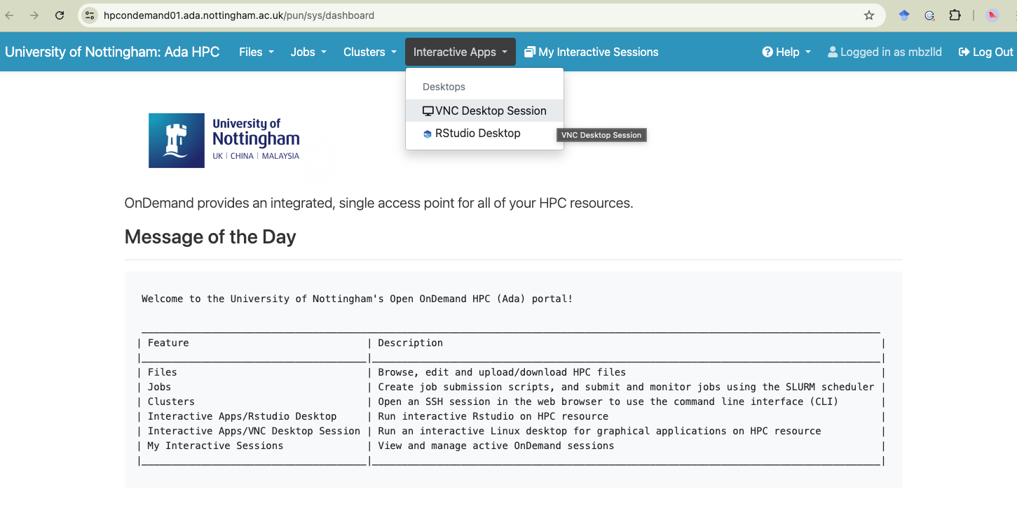
OpenOnDemand
https://hpcondemand01.ada.nottingham.ac.uk

Slide 34
Practical use of Open on Demand
1. Follow this link and login when prompted:
https://hpcondemand01.ada.nottingham.ac.uk
2. Click on interactive apps at the top and VNC Desktop session. Change the default memory to 5, leave everything else as the default settings and click Launch at the bottom of the page
3. Once resources have been allocated to your job, click Launch VNC Desktop Session
4. Click on the little black box in the panel at the bottom of the screen to open a terminal
5. Navigate to your working folder:
cd LIFE4137-HPC_practice
6. Open the images in a web page using the html file:
firefox bamstats.html
7. Move your cursor over the images to view them

Slide 35

Accessing software on Ada
Pre-installed software available to you as modules
Software you install yourself with Conda
Software containers (singularity, docker) – we will not cover software containers in this module but you should be aware that they exist and you can use them on Ada

Slide 36
Practical: search for, load and unload software modules
1. List all available software modules:
module avail
2. Search for a software module using a keyword:
module avail vcftools
3. Load the module you found from your search e.g.:
module load vcftools-uoneasy/0.1.16-GCC-12.3.0
4. Print the help message or open the manual page for the software to check you have loaded it:
vcftools --help
man vcftools
5. Unload the module e.g.:
module load vcftools-uoneasy/0.1.16-GCC-12.3.0
6. Repeat the above steps with a different module – try e.g. bcftools, bedtools, hifiasm, python

Slide 37
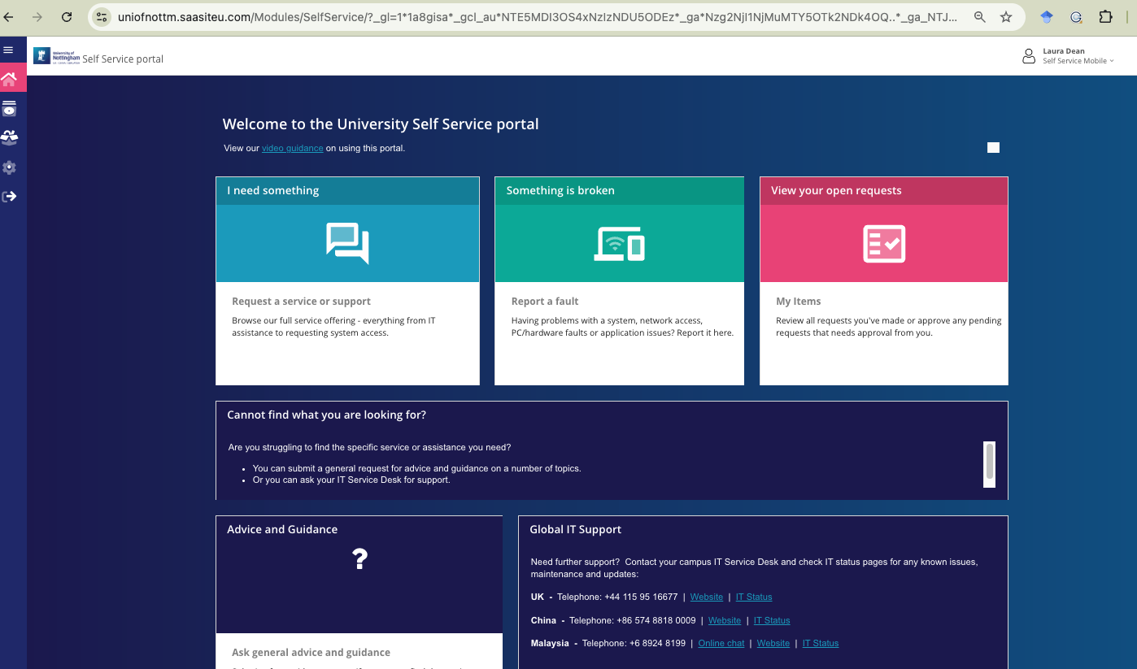
requesting new software modules
Use the IT self-service portal, like we did to request access to Ada
https://www.nottingham.ac.uk/dts/help/self-service-portal/self-service-portal.aspx
Notes:
Software on Ada must be loaded from environment modules
To search for a specific software use module avail software_name
To load modules use module load module_name
To unload use module unload module_name

Slide 38
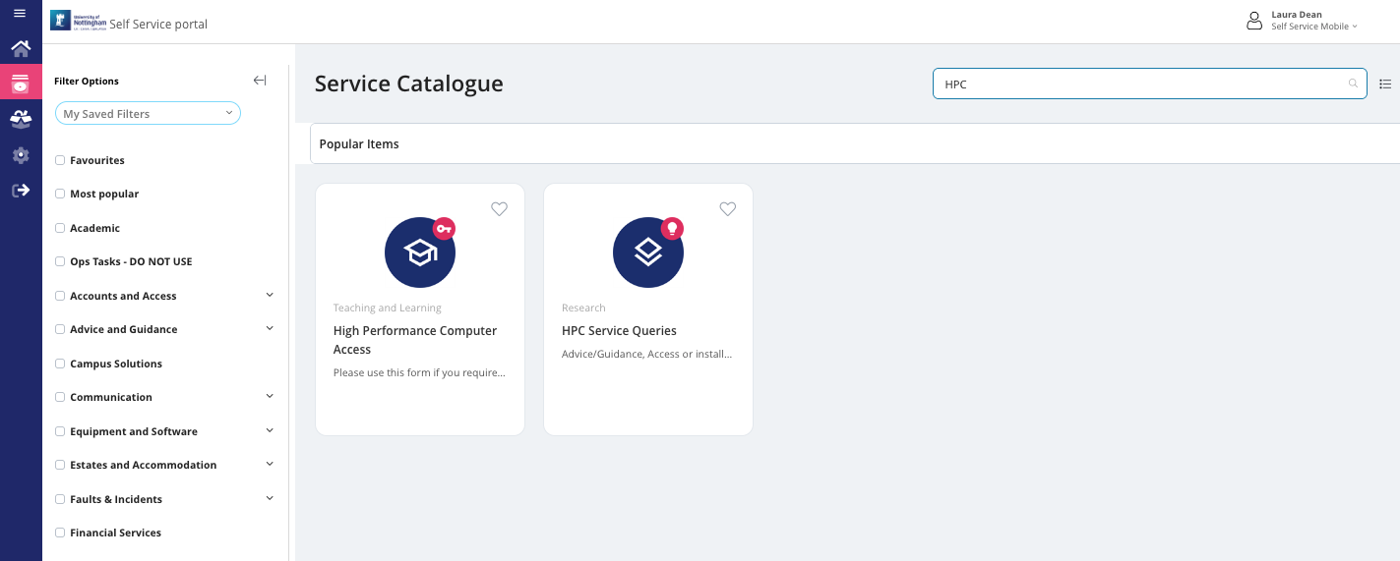
requesting new software modules
Search HPC and use the HPC Service Queries option
Notes:
Software on Ada must be loaded from environment modules
To search for a specific software use module avail software_name
To load modules use module load module_name
To unload use module unload module_name

Slide 39

Practical: install and use Conda
Download conda:
wget https://repo.anaconda.com/miniconda/Miniconda3-latest-Linux-x86_64.sh
Run through the install:
bash Miniconda3-latest-Linux-x86_64.sh
Say yes to everything it asks you during the install process
Log out of Ada and back in again:
exit
ssh ada
Then run the following commands:
conda config --set auto_activate_base false
conda config --append channels conda-forge
conda config --append channels bioconda
conda deactivate
Create a test conda environment, activate it and check the software is available, then deactivate it:
conda create --name nanoplot nanoplot
conda activate nanoplot
NanoPlot -h
conda deactivate

Slide 40
EXAMPLE: using conda in a job submission script
#!/bin/bash
#SBATCH --partition=defq
#SBATCH --nodes=1
#SBATCH --ntasks=1
#SBATCH --cpus-per-task=1
#SBATCH --mem=1g
#SBATCH --time=00:05:00
#SBATCH --job-name=my_job
#SBATCH --output=/gpfs01/home/mbzlld/slurm-%x-%j.out
#SBATCH --error=/gpfs01/home/mbzlld/slurm-%x-%j.err
#SBATCH --mail-type=ALL
#SBATCH --mail-user=mbzlld@exmail.nottingham.ac.uk
# source your bash profile so you can use conda
source $HOME/.bash_profile
# activate conda environment
conda activate environment_name
# do some tasks within conda environment
# deactivate conda environment
conda deactivate
Conda will not work unless you source your bash profile before you use it

Slide 41
Practical: copying files to and from Ada with scp
Logout of Ada (scp is always run from your laptop terminal not from Ada):
exit
Copy a file from the LIFE4137-HPC_practical folder on Ada to your laptop:
scp ada:~/LIFE4137-HPC_practice/job_submission_script.bash ./
Check the file is now there on your laptop:
ls
Copy a file from your laptop to the LIFE4137-HPC_practical folder on Ada:
touch test_file.txt
scp test_file.txt ada:~/LIFE4137-HPC_practice/
Log back into Ada and check your test_file.txt is there:
ssh ada
cd ~/LIFE4137-HPC_practice
ls

Slide 42


UoN HPC – Ada – support & information
Slurm manual pages:
https://slurm.schedmd.com/documentation.html
The sharepoint site:
Commands, partitions and resources:
https://uniofnottm.sharepoint.com/sites/DigitalResearch/SitePages/Ada-Commands-Partitions-and-Resources.aspx
Software modules:
https://uniofnottm.sharepoint.com/sites/DigitalResearch/SitePages/Ada-Compute-software.aspx
The IT helpdesk: (if you need something that requires admin rights, this is your only option!)
https://www.nottingham.ac.uk/dts/help/self-service-portal/self-service-portal.aspx
Me! : laura.dean@nottingham.ac.uk or teams chat

Slide 43
UoN HPC – Ada – SLURM commands:
Check your storage:
mmlsquota -u username --block-size G dss2fs01:HOME

