Slide 1
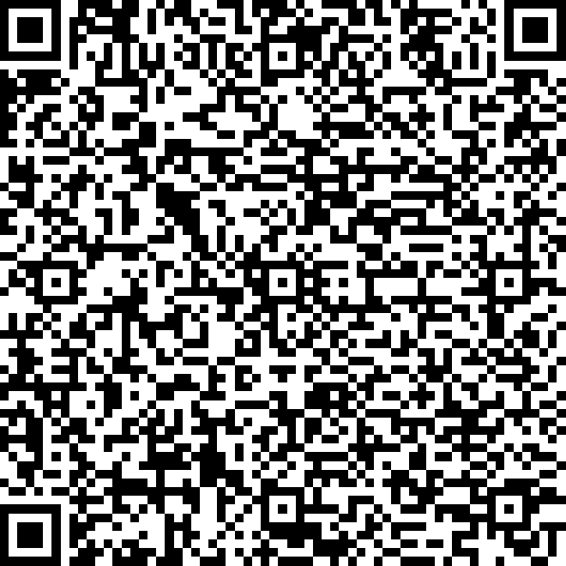
LIFE4138 Coursework

Slide 2
LIFE4138 Coursework
Part 1
10 questions to be answered in both R and Python
Part 2
2 Scripting challenges, one to be completed in R, one in Python. You choose which.
Coursework submission deadline: 4pm, Tuesday 28th January 2025
Total weighting:
Part 1 & Part 2 R = 37.5% of module mark
Part 1 & Part 2 Python = 37.5% of module mark
(remaining 25% of module mark comes from the Linux exam you have already completed)

Slide 3
Coursework - Part 1
The questions for part 1 will be provided for you as two jupyter notebooks, one for you to complete in R and one in Python.
You must complete all of the questions in both notebooks and save them with your answers.
The notebooks can be downloaded from the R github repository, access them by cloning the repository:
git clone https://github.com/lldean18/LIFE4138-R
Or by typing git pull inside the repository if you already have it on your laptop
conda install r r-tidyverse r-irkernel ipykernel

Slide 4
To access your homework…
Open a terminal
Activate your lectures conda environment:
conda activate lectures
Install r into your lectures conda environment (if you don’t have it already):
conda install r r-tidyverse r-irkernel ipykernel
If you don’t have the LIFE4138-R folder download it using:
git clone https://github.com/lldean18/LIFE4138-R
Run jupyter lab from your terminal
jupyter lab
Find the coursework inside the LIFE4138-R folder in jupyter lab. Complete the answers in the empty cells. MAKE SURE YOU PRESS SAVE (the floppy disk button in the top left hand corner)

