Slide 1

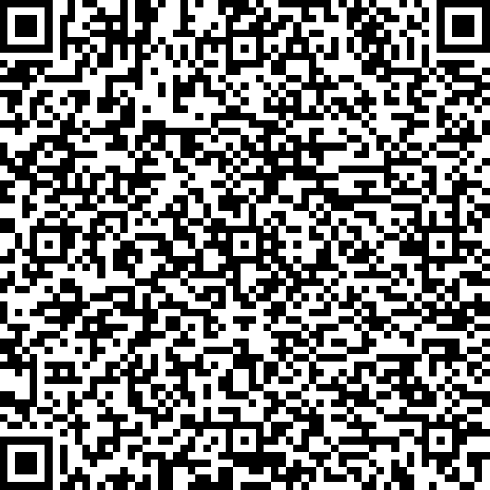
An Introduction to R
Workshop 3
Please record your attendance:
Laura Dean
LIFE4138
laura.dean@nottingham.ac.uk

Slide 2

Homework recap
Let’s go through the answers to the homework from last session

Slide 3
Learning objectives and outcomes
Learning about control flow in R:
for, if, else, ifelse
Writing functions in R
Lists in R
Understanding the apply family of functions:
apply, lapply, sapply
Scripting best practices in R

Slide 4
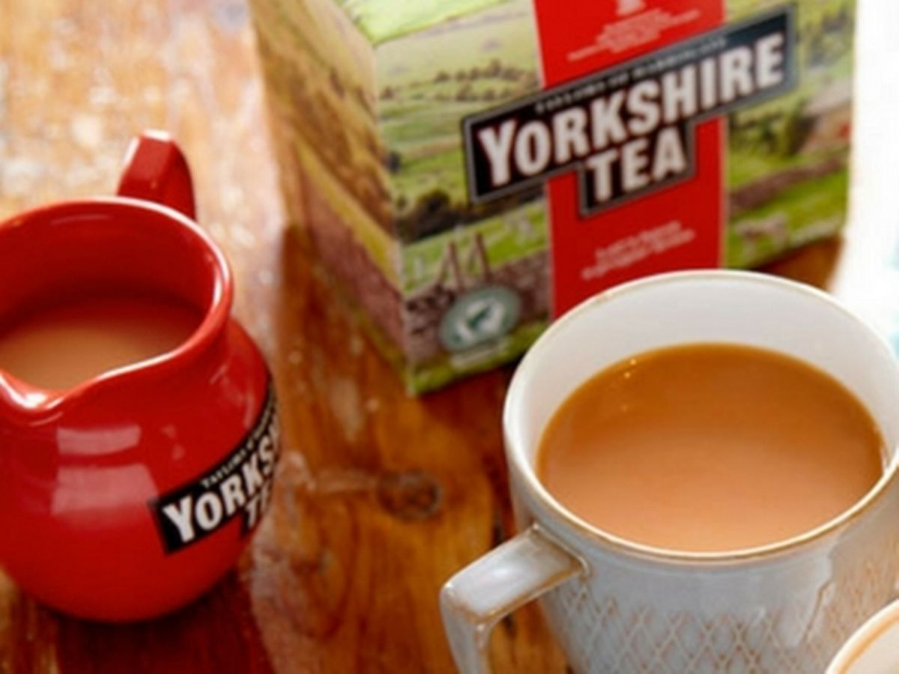
Control flow
Kettle on
A real world example: boiling a kettle
demonstrates the principle
Is water boiling?
NO
Continue to heat
YES
Stop heating
Kettle off

Slide 5
Conditional statements
Perform different tasks depending on conditions
Syntax:
Example:
if
if (conditional statement){
do some things if true
}
if (z < 10){
print(“z is less than 10”)
}
if (conditional statement){
do some things if true
} else {
do some things if false
}
if (z < 10){
print(“z is less than 10”)
} else {
print(“z is more than 10”)
}
else
Notes:
* `for` - we start with the `for` statement. If you are using an IDE, you might notice that this statment changes colour to denote that it is one of R's protected control statements.
* `x in 1:10` - we know that 1:10 produces a vector of all of the numbers in sequence from 1 to 10. the `x in` bit just means "for every value in the vector of". The x could be anything you want it to be. e.g. `for numbers in 1:10` would yeild the name result. Note here that different programming languages follow different conventions- in python you'll often see `for` loops written as `for i in 1:10`.
* `{}` - the curly brackets contain the body of the loop. What that means is that all of the values we have just specified above will have the contents of the `{}` performed on them. Here, we've used the `print()` function, which just prints our values to the console.
So, this loop assigns x a value of 1 - 10 in a sequence, and prints it to the console.
This is an example of a super simple and straightforward control statement. We could replace the 1:10 with anything we liked, and the loop would cycle through the values presented it in turn until it reached the final one.

Slide 6
Conditional statements
Perform different tasks depending on conditions
Syntax:
ifelse(conditional statement, task if true, task if false)
ifelse
Example:
ifelse(z < 10, print(“z is small”), print(“z is large”))
Notes:
* `for` - we start with the `for` statement. If you are using an IDE, you might notice that this statment changes colour to denote that it is one of R's protected control statements.
* `x in 1:10` - we know that 1:10 produces a vector of all of the numbers in sequence from 1 to 10. the `x in` bit just means "for every value in the vector of". The x could be anything you want it to be. e.g. `for numbers in 1:10` would yeild the name result. Note here that different programming languages follow different conventions- in python you'll often see `for` loops written as `for i in 1:10`.
* `{}` - the curly brackets contain the body of the loop. What that means is that all of the values we have just specified above will have the contents of the `{}` performed on them. Here, we've used the `print()` function, which just prints our values to the console.
So, this loop assigns x a value of 1 - 10 in a sequence, and prints it to the console.
This is an example of a super simple and straightforward control statement. We could replace the 1:10 with anything we liked, and the loop would cycle through the values presented it in turn until it reached the final one.

Slide 7
For loops
Automate repetitive tasks
Do many iterations of the same thing
Syntax:
Example:
for (variable in sequence){
do some things
}
for (i in 1:10){
print(i + 5)
}

Slide 8
A note on brackets
So far we have seen different uses for brackets in R:
Standard brackets/parentheses - i.e. () – for functions
Square brackets – i.e. [] - for indexes/subsetting
Curly brackets – i.e. {} – for defining blocks of code in functions or statements
Notes:
`()` - rounded brackets are used exclusively to perform functions, or denote the order of mathematical calculations
`[]` - square brackets are used for indexing and subsetting
`{}` - curly brackets are used to define blocks of code in functions and statements. What I mean by this will become increasingly apparent as we work through the below.

Slide 9
Writing your own functions
Often you will need to write your own functions in R
Keeps code simpler and more readable
Reduces duplication
Very simple to do
Notes:
Writing your own functions is an important part of programming. It keeps code simple and readable, and allows you to perform a set of tasks multiple times without loads of duplication in your code. If you wanted to develop your own package, custom function creation would be a huge part of this - a package is essentially just a collection of functions!

Slide 10
The anatomy of a function
function(x) – declares function and the arguments it requires
{} defines code block
Note here – y is only defined within the function
return() tells R what output to send out from function at end
add_ten <- function(x){
y <- x + 10
return(y)
}
Notes:
* `add_ten` - first, we have to give our new function a name. I've imaginatively called this one add_ten.
* Then, we assign the rest of the code to the new function name with our assignment arrow `<-`
* Next up, we have the `function` function. This tells R that we want to turn our function name into a new function
* `function(x)` - this tells R that we are creating a function with a single argument (or input), x.
* `{}` this denotes the body of the function - whatever code is in here is what will be applied to an input
* `y <- x + 10` - this bits obvious - add 10 to our input of x and assign it a new name, `y`.
* `return(y)` - give us an output! Without this, R wouldn't automatically tell us what the output of whatever we've just asked it to do is!
Notice here that the new `y` object is treated a little differently in functions than loops. If we remove `y` from our environment and run the function again, you'll notice that it does not re-appear. Whatever objects you create within the body of the function exist only within that function - they are not callable to the wider R environment.
Let's quickly recap the anatomy of how a function works
`function(x)` declares a function. It creates the function within the R environment, and defines the arguments that the function requires. In our example above, whenever you run `add_ten`, you *must* have an x argument, otherwise the function will not run.
`{}` define the block of code within which the work that the function does takes place. Here, `y` is only defined within the function.
`return(y)` tells R to give us an output, and display what the function has done.

Slide 11
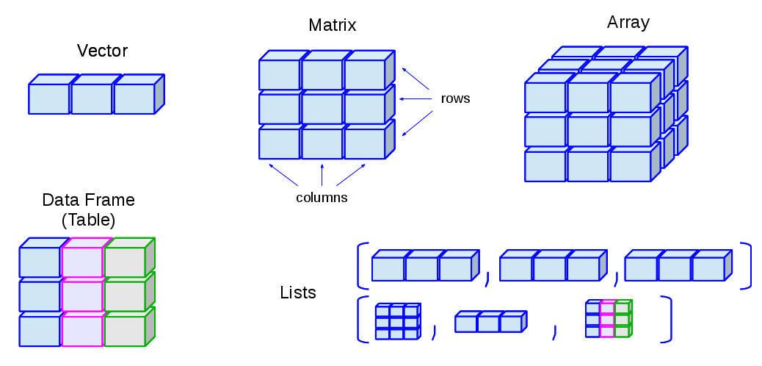
Data structures in R - lists
Data types:
numeric, character, logical
Notes:
Different colours in this figure represent different data types.

Slide 12
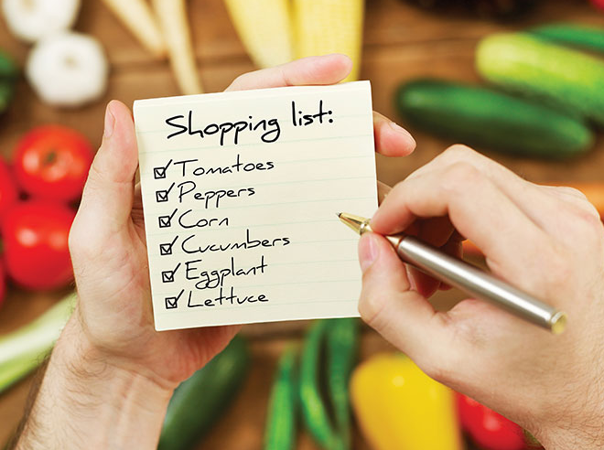
Why lists are important
Useful to know in order to improve your R programming, can be extremely powerful
Particularly helpful for storing multiple data.frames or tibbles
Very useful in combination with the apply functions

Slide 13
Apply family of functions
Apply functions are an alternative to for loops that allow you to apply a function to a data structure
Essentially built to avoid loops and usually (but not always) much faster
Nonetheless, quite complex and not well explained
Takes time to get used to but certainly worth doing so!

Slide 14
Apply family of functions
Today we will focus on three core functions
apply() – works on matrices or dataframes
lapply() – works with lists and outputs lists
sapply() – similar to lapply but simplifies the output
NB: Other functions are available but understanding these will expand your R toolkit considerably

Slide 15
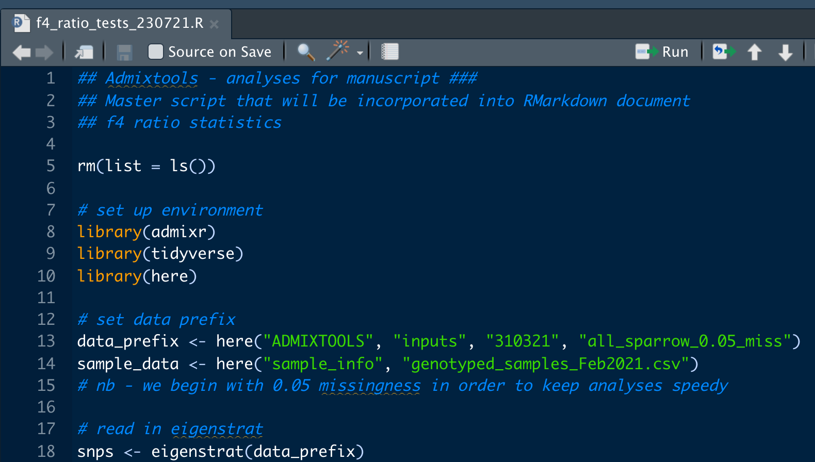
Writing useable and shareable R scripts
Somewhat different to other languages – i.e. not just simply a program you write and run
An annotated guide to your code – what you did and how you did it
Making effort to put together a logical and well-designed script is useful for you and people you share it with

Slide 16
R Scripts – a guide
my_rscript.R
# my script to analyse
# height and mass data
Start off with an explanation of what the script is
Date/author info is a good idea

Slide 17
R Scripts – a guide
my_rscript.R
# my script to analyse
# height and mass data
rm(list = ls())
Clear the R environment
rm(list = ls()) will remove all objects from a library
Controversial!
Advantages: clears environment and prevents any conflicts
Disadvantage: will also remove objects for anyone you share it with
Alternative? Restart R each time

Slide 18
R Scripts – a guide
my_rscript.R
# my script to analyse
# height and mass data
# clear environ
rm(list = ls())
# set up environ
library(dplyr)
library(ggplot2)
Load all the libraries and packages you need for the script

Slide 19
R Scripts – a guide
my_rscript.R
# my script to analyse
# height and mass data
# clear environ
rm(list = ls())
# set up environ
library(dplyr)
library(ggplot2)
# declare objects and paths
data_path <- “./starwars_data.csv”
starwars <- read_csv(data_path)
Declare all objects and paths you will need within the script
Also declare working directory if this is how you prefer to manage R

Slide 20
R Scripts – a guide
my_rscript.R
# my script to analyse
# height and mass data
# clear environ
rm(list = ls())
# set up environ
library(dplyr)
library(ggplot2)
# declare objects and paths
data_path <- “./starwars_data.csv”
starwars <- read_csv(data_path)
# count species
starwars %>% count(species)
Annotate the working parts properly with comments

Slide 21
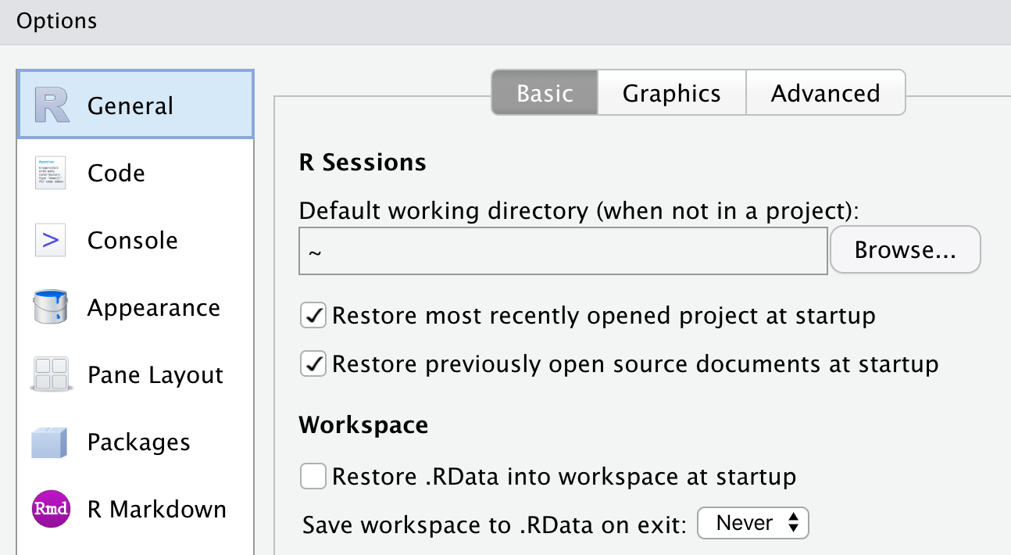
R Scripts – other tips
Set up R so that it does NOT save your workspace each time you exit.
To do this: RStudio>Preferences>Workspace

Slide 22
Practical time…
Open R studio and we will work through some examples together

Slide 23
Try it yourself tasks:
Write a for loop to iterate over numbers 1 to 100, multiply each one by 5 and print the output
Write an if statement to multiply a number by 100 only if it is less than 100
Write an ifelse() statement to output "X is big" if x is greater than or equal to 20 and "X is small" if x is less than 20
Write a function to divide one input by another and return the output
modify your function from question 4 to have a default value for both inputs
Write a function to add 50 to an input variable only if the input is less than or equal to 10
BONUS: Use nested ifelse() statements to add a new factor variable to the airquality data set that says early if the day is 10 or under, middle if the day is 11-20 and late if the day is 21 or greater.

Slide 24
Try it yourself tasks:
Create a new list with 5 named elements, make sure you include logical, character and numeric elements and at least one data frame
Using its number, access the second element in your list and return it as a list
Using its number, access the second element in your list and return it as a vector or data frame (whichever it would be outside of the list)
Using its name, access the 5th element in your list.
Using the apply() function, find the total sums of each column in the airquality dataset (note: you'll need to reload the dataset to remove the column we added earlier)
Using the lapply() function, print the classes of the items in the list you made in question 1.
BONUS: Using the sapply() function, paired with your own custom function output the class of each item in the list you created in question 1

Slide 25
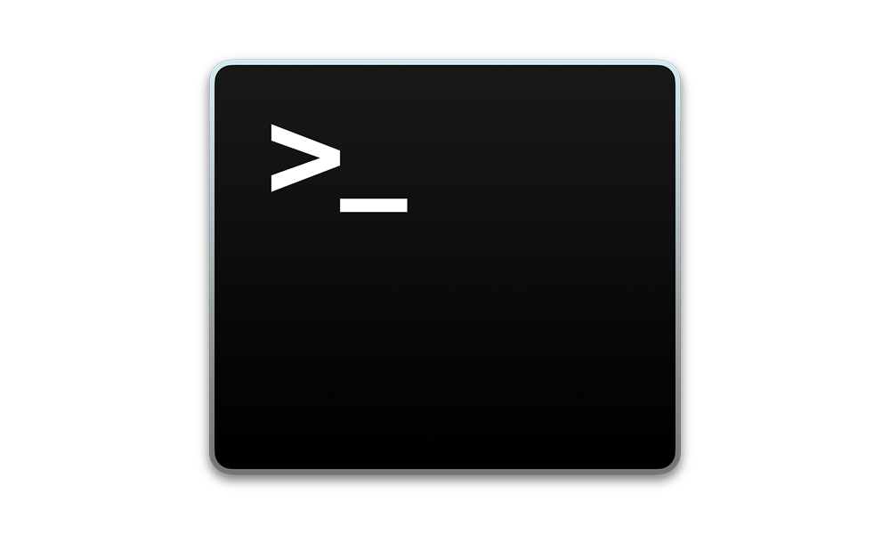
Up next
Reading in and manipulating VCF files in R
Principal components analysis (PCA) in R
Running R scripts from the terminal

Slide 26

Homework!
Homework for this workshop is provided as a jupyter notebook on Moodle
Please complete the homework for next session
Please record your attendance:

