Slide 1
















SPECIALIZED PROJECTS
BUILDING A PROGRAM WHO IS A MILLIONAIRE CLIENT-SERVER MODEL

Slide 2
Introduce Group
Instructors | MS. Le Viet Truong
Students perform | Nguyen Manh Hieu – 20IT367 Le Lam Duy Khanh – 20IT054
Da Nang, May 2023

Slide 3
Content
01
02
Overview
Theoretical Basis
03
04
Data Structure
Program Implementation

Slide 4
OVERVIEWOF THE TOPIC
01

Slide 5

WHO WANTS TO BE A MILLIONAIRE!
This is a game genre that plays on your own understanding of all issues from ancient times to needles, many areas of life with the form of answering objective multiple-choice questions with 4 options with 3 rights to help:
50/50
Call relatives
Ask the audience in the studio.
And the right to stop the game at any milestone to preserve the number of bonus points available.

Slide 6
I. Introduce
1. Reasons for choosing the topic
In today's life, it is not difficult to find a game that can entertain us, help us relieve stress after a long time of work or meet friends and chat through in-game applications. . And to be able to meet that need of people, today the development of network technology is no stranger to everyone.
Games sprang up like mushrooms, all genres, all forms to be able to attract people. Some people often have a tendency to stigmatize games, when mentioning the word game, they immediately think of useless games, wasting time in it. But they only think about the harms without thinking about other benefits, we can for example be the game "Who wants to be a millionaire?" a game for phones that is extremely intellectual and useful.
A completely new playground for everyone, because to play well and win you must be a person with a lot of knowledge. In the game "Who wants to be a millionaire" there will be countless questions in all areas of life such as sports, history, economic information, social life, music...you must be a person who understands Knowing extremely deeply can conquer everything in the game.
Too many things that we need to consider about an issue does not necessarily mean that it is completely evil, but also depends on the perception of each person. Game Who Wants to Be a Millionaire will help you learn things that you never knew through the program's questions, helping you to add missing knowledge in your life.

Slide 7
I. Introduce
2. The goal of creating the topic
Systematize the basic knowledge as the basis for the implementation of the topic.
Briefly present some related topics that have been done before in different formats.
Apply the properties of Object Oriented Programming.
Swing's application in building the game Who Wants to Be a Millionaire.
3. Scope of the subject
Research subjects: Build game software Who wants to be a millionaire?
Research scope: The scope revolves around game companies, fully ensuring the main functions of the software and exploiting new functions related to building software to make the software more useful.

Slide 8
THEORETICAL BASIS
02

Slide 9



THEORETICAL BASIS
HTML
DATABASE
JAVASCRIPT
FIREBASE

Slide 10
DATA STRUCTURE
03

Slide 11
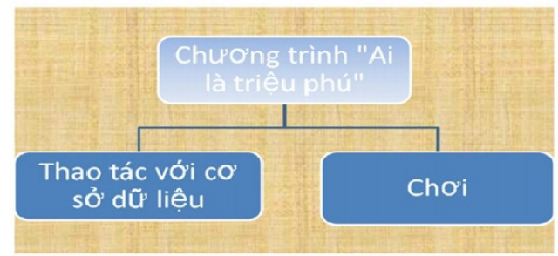
GENERAL MODULE SUMMARY

Slide 12
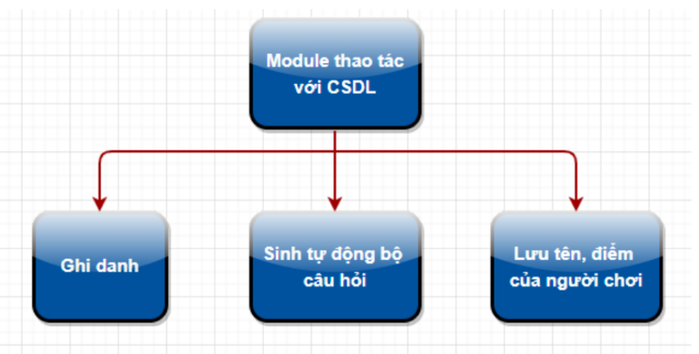
DATABASE MANAGEMENT MODULE
Includes main functions:
Registration function.
Answer selection function.
Answer check function.
Help function.

Slide 13
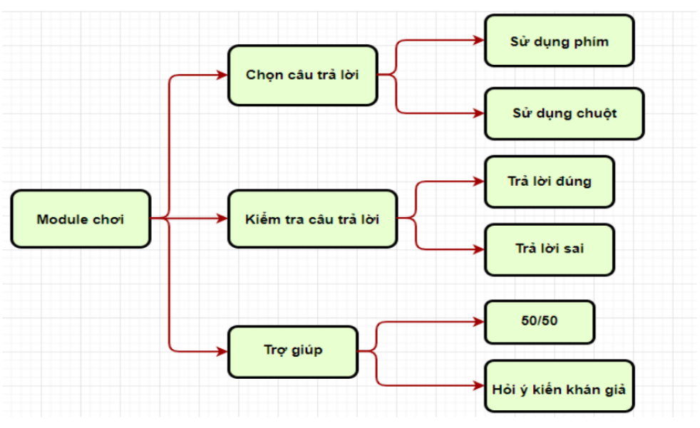
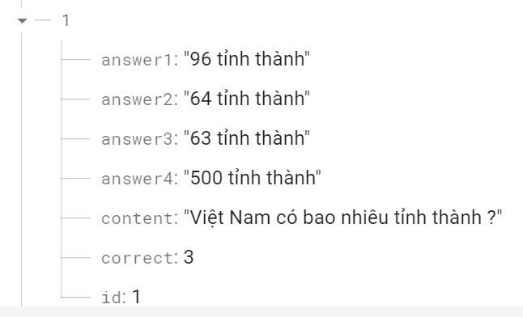
SOME PICTURES OF GAME MODULE

Slide 14
PROGRAM IMPLEMENTATION
04

Slide 15
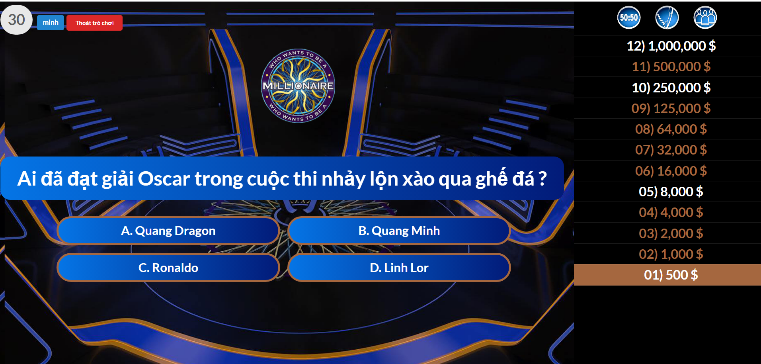
MAIN INTERFACE

Slide 16
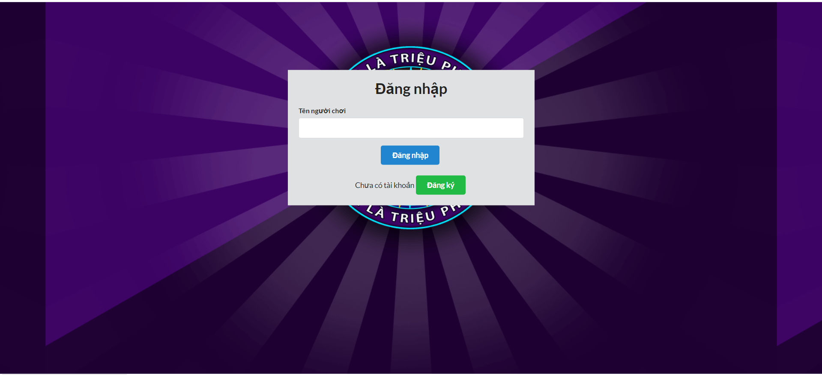
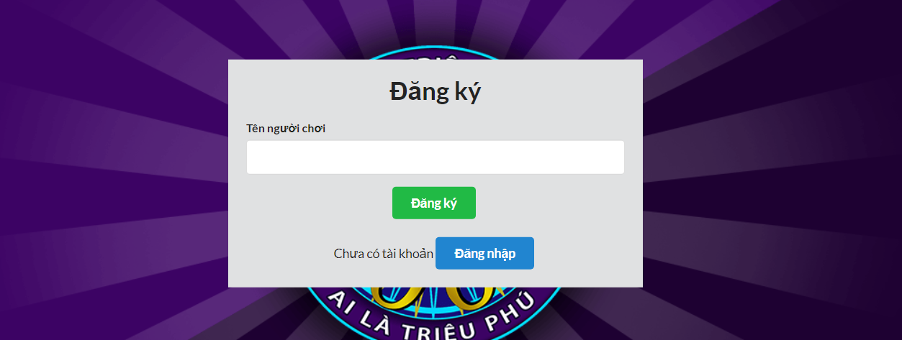
LOGIN AND REGISTRATION INTERFACE
LOGIN
REGISTRATION

Slide 17



SUPPORT RIGHTS
50/50
CALL RELATIVES
ASK THE AUDIENCE IN THE STUDIO
When a contestant uses this help, any two incorrect answers will be deleted, leaving one incorrect answer and one correct answer, thus giving the contestant a 50% chance of answering the question correctly or incorrect.
Used if a contestant is stuck on a particular question and needs help by calling a friend or relative.
The player's companion will join in answering the current question with the main player.

Slide 18
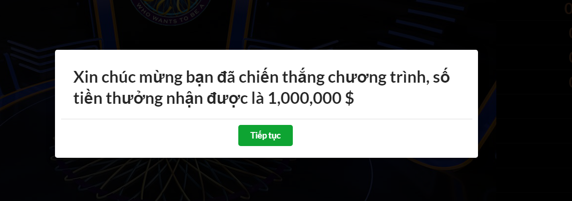
HIGHEST REWARD IMAGES

Slide 19

THANK YOU
Do you have any questions?

