Slide 1
MERIDIAN TECHNOLOGIES
People Risk & Workforce Health
Board Presentation · April 2026 · Chief People Officer
CONFIDENTIAL
n = 2,500 employees · 36-month panel · Apr 2023 – Mar 2026

Slide 2
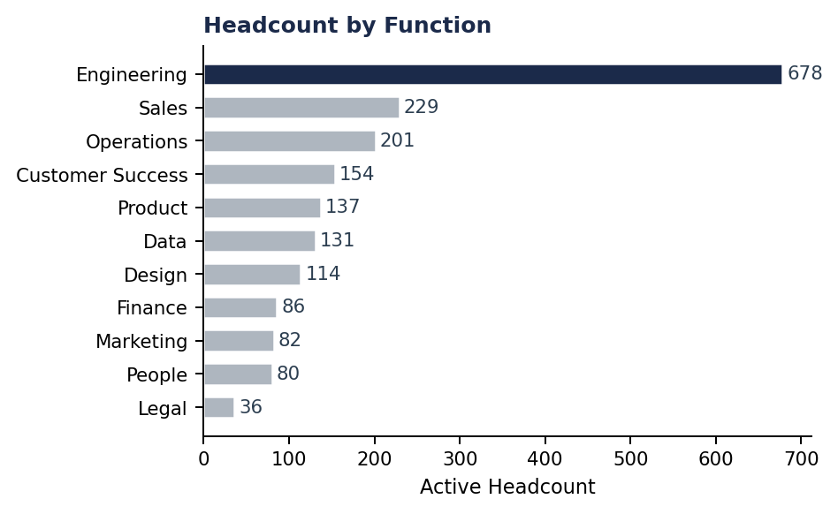
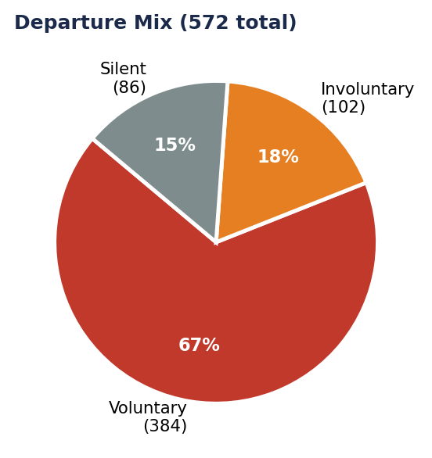
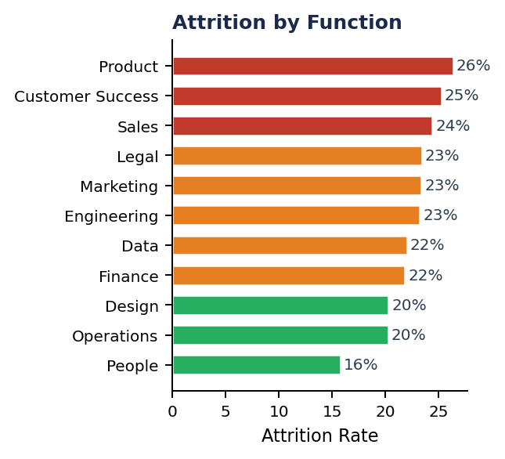
01 | STATE OF THE WORKFORCE
April 2026
1,928
23%
67%
7.07
Active Employees
36-Month Attrition
Voluntary Exits
Avg Engagement
as of Mar 2026
572 departures
384 of 572 leavers
scale 1–10

Slide 3
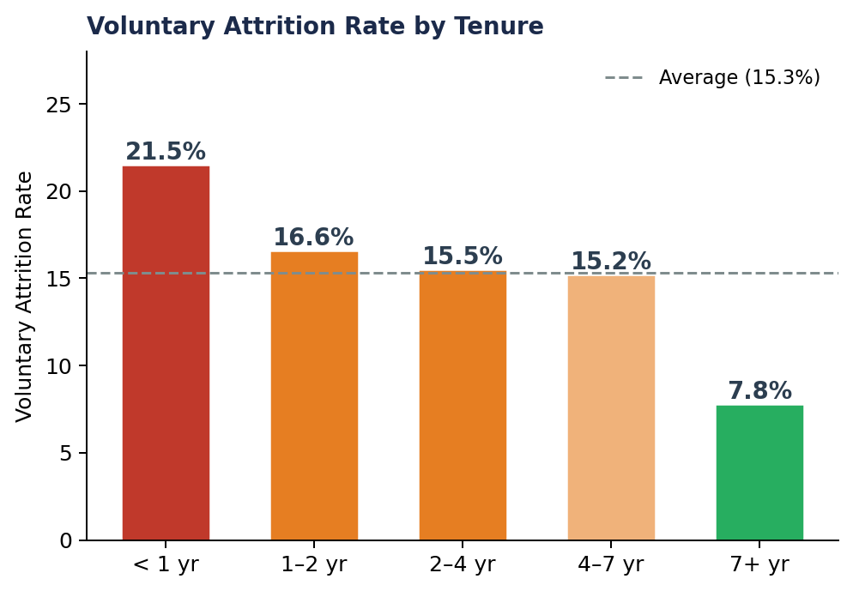
02 | RISK 1: PEOPLE ARE LEAVING BEFORE THEY RAMP
21%
KEY IMPLICATIONS
› Year-one leavers represent a ~$4–8M annual recruiting & lost-productivity cost
of new hires leave within their first year
› Pattern points to an expectation gap at hiring, not a compensation problem
7.8%
attrition for 7+ year employees — 3× lower
› Proposed action: structured 30/60/90 day check-ins + manager accountability

Slide 4
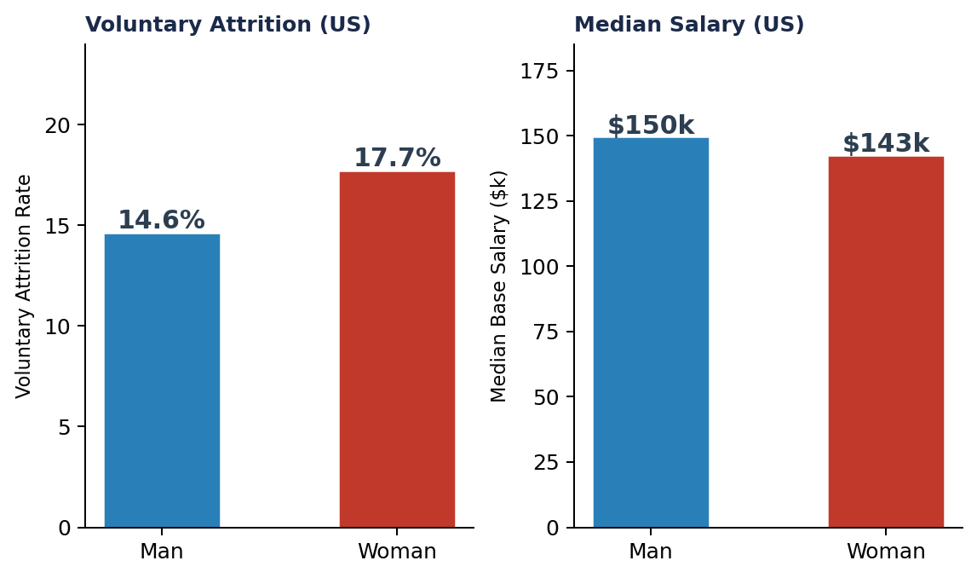
03 | RISK 2: WOMEN ARE LEAVING MORE AND EARNING LESS
+3.1pp
KEY IMPLICATIONS
› Pay gap likely contributes directly to the attrition differential
higher voluntary attrition for women vs. men (US)
› Fairness risk: visible in Glassdoor data before it reaches the board
–$7.2k
median salary gap, women vs. men (US)
› Proposed action: comp equity audit (US first) completed by Q3 2026
14.6% → 17.7%
Men vs. Women voluntary attrition rate (US)

Slide 5
04 | WHAT'S WORKING
M&A Integration Succeeded
Performance Management Is Functioning
Referrals Retain Best
79.5%
3.4×
81.4%
of acquired employees still active
over-represented among leavers (rating 1)
referral hire retention rate
The ~2022 acquisition cohort retained at a higher rate than direct hires (79.5% vs 74.4%) and voluntary attrition is 3pp below company average. Engagement is on par with the rest of the workforce. The integration playbook worked.
Low performers (rating 1) leave at 3.4× their share of the active headcount. High performers (rating 4–5) make up 45% of actives but only 30% of voluntary leavers. The org is naturally selecting toward talent.
Referral hires retain at 81.4% — 7pp above direct hires (74.4%) and 5pp above agency hires. With direct hires making up 1,201 of 2,500 employees, even a modest shift toward referrals would meaningfully reduce attrition and cost.
› Playbook to reuse for future M&A
› Invest in calibration to protect this signal
› Scale referral programme in Eng, Product & CS

Slide 6
05 | WHAT WE'RE ASKING FOR
01
Compensation Equity Review
Q3 2026
Mandate a US-wide pay equity audit with external benchmarking. Prioritise women in Engineering and Product where the gap is largest. Board to receive findings before year-end.
02
Early-Tenure Intervention Programme
Q2 2026
Structured 30/60/90 day manager check-ins for all new hires. Tie manager performance ratings to first-year retention. Pilot in Product and Customer Success first.
03
Scale the Referral Engine
Q2 2026
Referral hires retain 7pp above direct hires. Increase referral bonus budget and set a target of 30% referral hires in Engineering, Product, and Customer Success by year-end.
Data source: Meridian HRIS snapshot (synthetic) · Prepared by CPO Office · April 2026

Slide 7
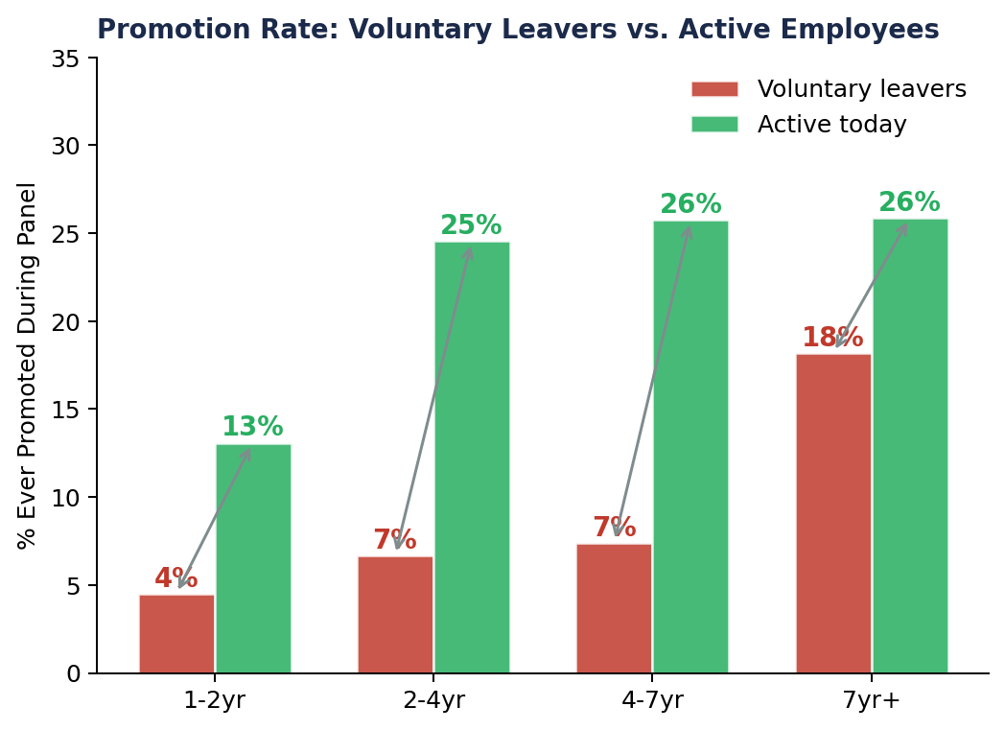
06 | DEEP DIVE: PROMOTION IS THE MISSING LEVER
3.5×
KEY IMPLICATIONS
› Career stagnation — not pay — is the primary voluntary exit trigger
higher promotion rate for active vs. leavers (2–4 yr tenure band)
› Fixing promo velocity in Product & CS would directly cut 24–26% attrition
7.3%
of voluntary leavers ever promoted (vs 20% of active staff)
› Proposed action: bi-annual promo windows with manager accountability metrics
All tenures
Promotion gap holds at every tenure band — it's systemic, not a new-hire problem

Slide 8
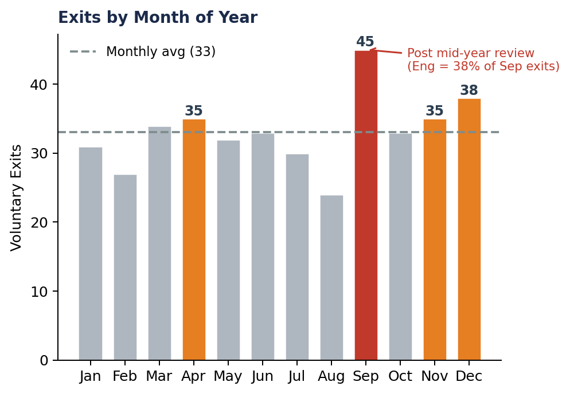
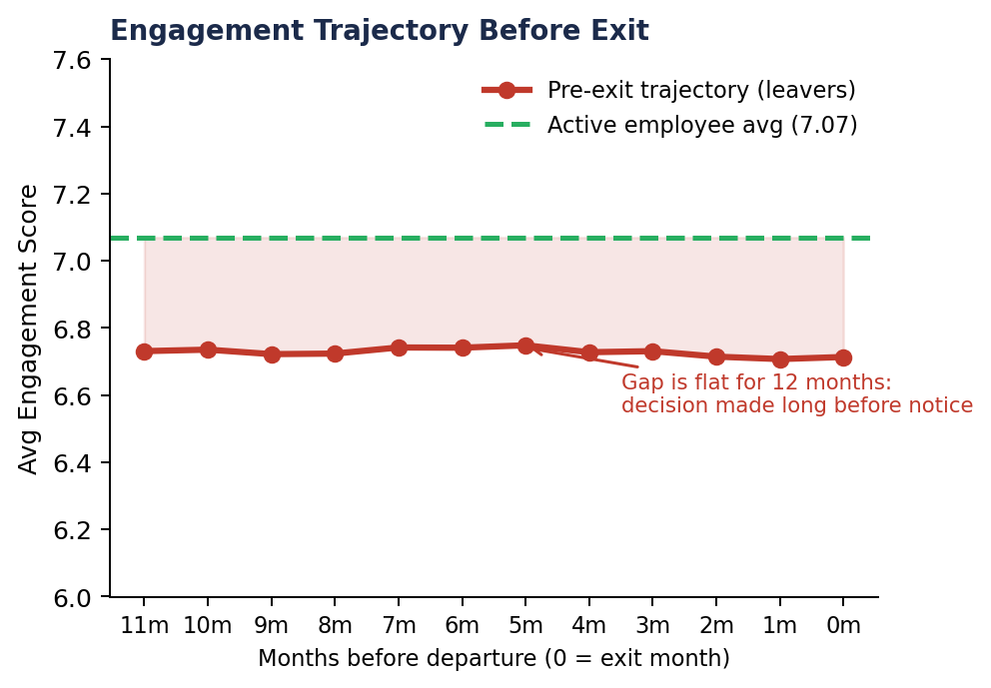
07 | DEEP DIVE: WHEN AND HOW PEOPLE DISENGAGE
› September has 45 exits — 40% above monthly average. Engineering alone accounts for 38%. Timing is consistent with mid-year review outcomes triggering resignation decisions.
› Leavers sit 0.35 points below active employees for the entire year before they exit. Exit interviews are too late — pulse scores at 12 months out are the real early-warning signal.

Slide 9
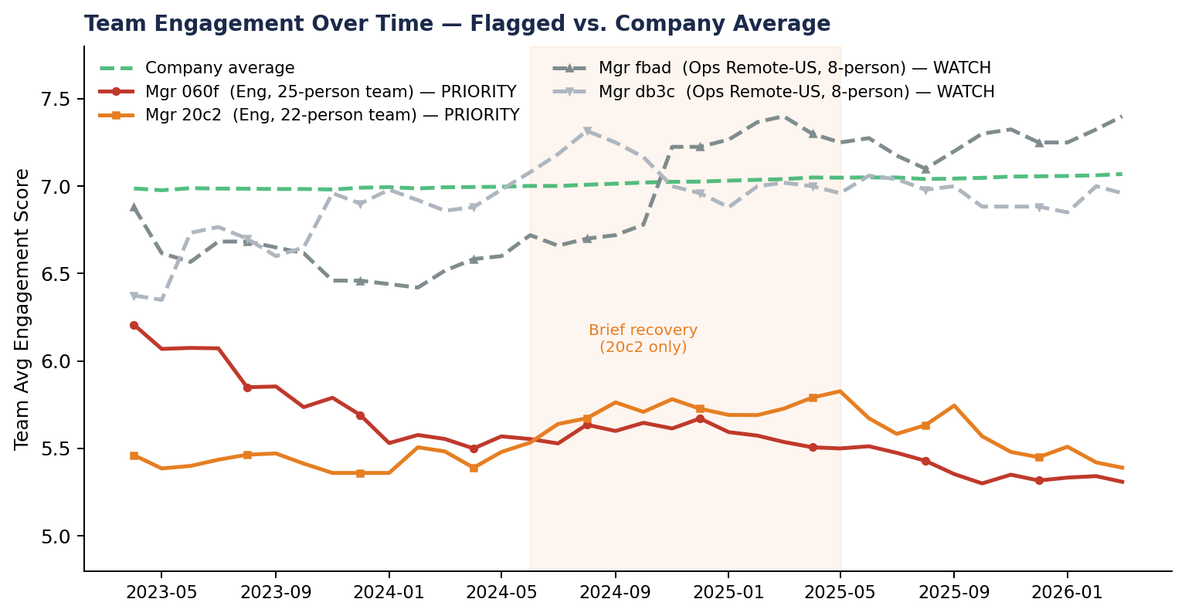
08 | DEEP DIVE: MANAGER WATCH-LIST — 3-YEAR ENGAGEMENT TREND
Manager
Fn / Loc
Team
Attr%
Eng
Signal
Status
060f8cec
Eng / SF
25
56%
5.3 ↓
3 yrs declining
PRIORITY
20c21d2b
Eng / SF
22
55%
5.4 ↓
Recovery reversed
PRIORITY
fbad34d8
Ops / Remote
8
50%
6.9
Low eng, decent mgr
WATCH
db3ccea8
Ops / Remote
8
38%
6.8
Early exits (3mo)
WATCH
bc48283a
Ops / Remote
8
38%
6.9
Early exits (3mo)
WATCH
Action: structured skip-level conversations for both PRIORITY managers within 30 days. Use existing manager-effectiveness scores as the evidence base — the data is already there.

