Slide 1
Share OneDrive files and folders
You can use OneDrive to share photos, Microsoft Office documents, other files, and entire folders with people. The files and folders you store in OneDrive are private until you decide to share them and you can see who a OneDrive file is shared with or stop sharing at any time.
How do you want to share?
Option 1: Copy a link and paste in a message
Choose this option to share items with lots of people you might not know personally. For example, you can use these to share in email or IM. Anyone who gets the link can view or edit the item, depending on the permission you set. Users with the link cannot upload new items. Keep in mind that the link can also be forwarded and sign-in is not required.
Go to the OneDrive website and sign in with your Microsoft account or your work or school account.
Pick the file or folder you want to share by selecting the circle in the upper corner of the item. You can also pick multiple items to share them together.

Slide 2
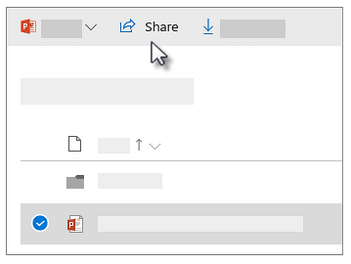
Share OneDrive files and folders
Select Share at the top of the page.
Select Anyone with the link can edit to customize the link options.
Set the options you want on your link, then select Apply when you're done.
Allow editing - When you share items with this type of link, people can edit files, and can add or delete files in a shared folder. Recipients can forward the link, change the list of people sharing the files or folder, and change permissions for recipients. If you're sharing a folder, people with Edit permissions can copy, move, edit, rename, share, and delete anything in the folder.
Unchecking this box means that people can view, copy or download your items without signing in. They can also forward the link to other people. However, they cannot make change to the version on your OneDrive.

Slide 3
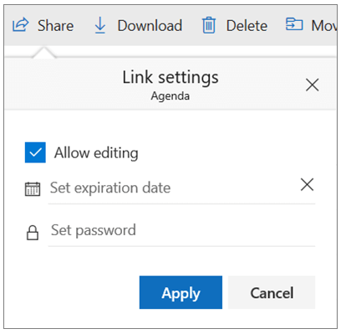
Share OneDrive files and folders
Set expiration date - The link will only work until the date you set. After that, the link will be invalid, and you will need to create a new link for users requiring access to your file or folder.
Set password - When a user clicks the link, they will be prompted to enter a password before they can access the file. You'll need to provide this password separately to users.

Slide 4
Share OneDrive files and folders
OneDrive for Business additional options
OneDrive for Business users also have the option to restrict the level of access (anyone with the link, only people within your organization, only people with existing access to the file, or only individuals you specify). Also, if you opt to disable editing, you can also opt to prevent viewers from downloading the file.
Anyone gives access to anyone who receives this link, whether they receive it directly from you or forwarded from someone else. This may include people outside of your organization.
People in <Your Organization> gives anyone in your organization who has the link access to the file, whether they receive it directly from you or forwarded from someone else.
People with existing access can be used by people who already have access to the document or folder. It does not change the permissions on the item. Use this if you just want to send a link to somebody who already has access.
Specific people gives access only to the people you specify, although other people may already have access. If people forward the sharing invitation, only people who already have access to the item will be able to use the link.
By default, Allow editing is turned on. If you want people to only view your files, uncheck the check box. This can be further restricted by selecting the option to Block download, which means they cannot save a local copy. For Word files, you can also select Open in review mode only to limit people to leaving comments and making suggestions in the file.

Slide 5
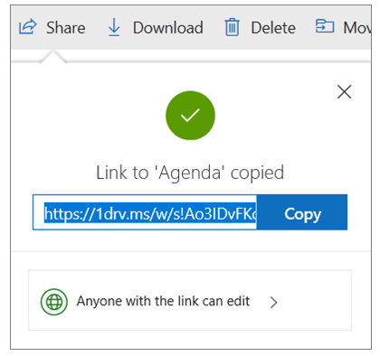
Share OneDrive files and folders
6. Once you're back at the main Share box, select Copy Link to copy the link to your clipboard.
Paste the link in an email message or wherever else you’re sharing the link.

Slide 6
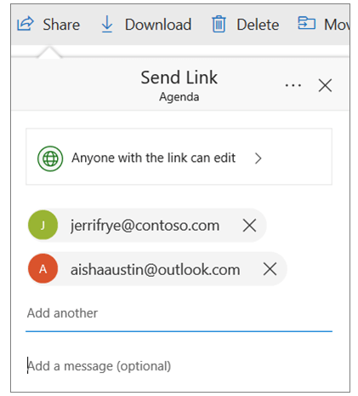
Share OneDrive files and folders
Option 2: Send link in Email
Choose this option if you want to send an email invitation to people or groups and keep track of who you invited. This lets you also remove permission for specific individuals or groups later if you need to.
In the Enter a name or email address field, start typing the email addresses or contact names of people you want to share with. When you begin to enter info in the box, you can also choose a contact from the list that appears.

Slide 7
Share OneDrive files and folders
2. Add a note to recipients if you want.
3. To change the permission level, select Anyone with the link can edit.
Set the options you want on your link, then select Apply when you're done.
Allow editing - When you share items with this type of link, people can edit files, and can add or delete files in a shared folder. Recipients can forward the link, change the list of people sharing the files or folder, and change permissions for recipients. If you're sharing a folder, people with Edit permissions can copy, move, edit, rename, share, and delete anything in the folder.
Unchecking this box means that people can view, copy or download your items without signing in. They can also forward the link to other people. However, they cannot make change to the version on your OneDrive.
Set expiration date - The link will only work until the date you set. After that, the link will be invalid, and you will need to create a new link for users requiring access to your file or folder.
Set password - When a user clicks the link, they will be prompted to enter a password before they can access the file. You'll need to provide this password separately to users.

Slide 8
Share OneDrive files and folders
Sharing folders
When you share folders with Edit permissions, people you share with can add the shared folders to their own OneDrive. This lets them keep the folder alongside their own folders and items, easily move items between folders, and more easily work on it offline. Any updates they make sync with the shared folder, so everyone with access to the folder is up to date.
Tip: The recipient can add shared folders to their OneDrive, not individual files. If you want the recipient to add files to their OneDrive, put the files in a folder first, and then share the folder.

Slide 9
User Authentication for OneDrive
Secure Access:
Before sharing files or folders in OneDrive, ensure users are authenticated to maintain security and control over shared content.
Authentication Methods:
Microsoft Account - Users must sign in with their Microsoft account (personal, work, or school) to access shared files.
Multi-Factor Authentication (MFA) - Enhances security by requiring a second form of verification, such as a code sent to the user's phone, in addition to their password.
Conditional Access - Set policies based on conditions like user location, device compliance, and risk level to control access to OneDrive resources.
Single Sign-On (SSO) - Integrates with organizational SSO solutions, allowing users to access OneDrive with their existing corporate credentials without needing to sign in again.
Best Practices:
Always require users to authenticate before accessing sensitive information.
Enable MFA to add an extra layer of security.
Regularly review and update access permissions.

