Slide 1
SICP Midterm Exam
Jiacai Cui

Slide 2
Exam Overview

Slide 3
Score Distribution
Maximum: 96
Average: 63.41
Median: 66

Slide 4
Score on Each Problem
 | P1 | P2 | P3 | P4 | P5 | P6 | Bonus
Average | 9.08 | 7.56 | 12.40 | 6.56 | 16.48 | 10.67 | 0.67
Total | 14 | 14 | 22 | 12 | 23 | 15 | 3
Rate | 64.88% | 53.99% | 56.36% | 54.66% | 71.63% | 71.13% | 22.30%

Slide 5
P1: WWPD
(14pts)

Slide 6
Print & None
>>> print(print('Hello'), 'SICP')
Hello None SICP
https://sicp.pascal-lab.net/2024/files/03-Control.pptx

Slide 7
Boolean Expressions
>>> print(False) and 1 / 0
False
https://sicp.pascal-lab.net/2024/files/03-Control.pptx

Slide 8
Mutable Values
>>> lst1 = [1, 2, 3, 4]
>>> lst2 = lst1 + [5]
>>> lst1.append(5)
>>> lst1 == lst2
True
>>> lst1 is lst2
False
https://sicp.pascal-lab.net/2024/files/
11-Mutable_Values_full.pdf
https://sicp.pascal-lab.net/2024/
labs/lab04/2_5.html

Slide 9
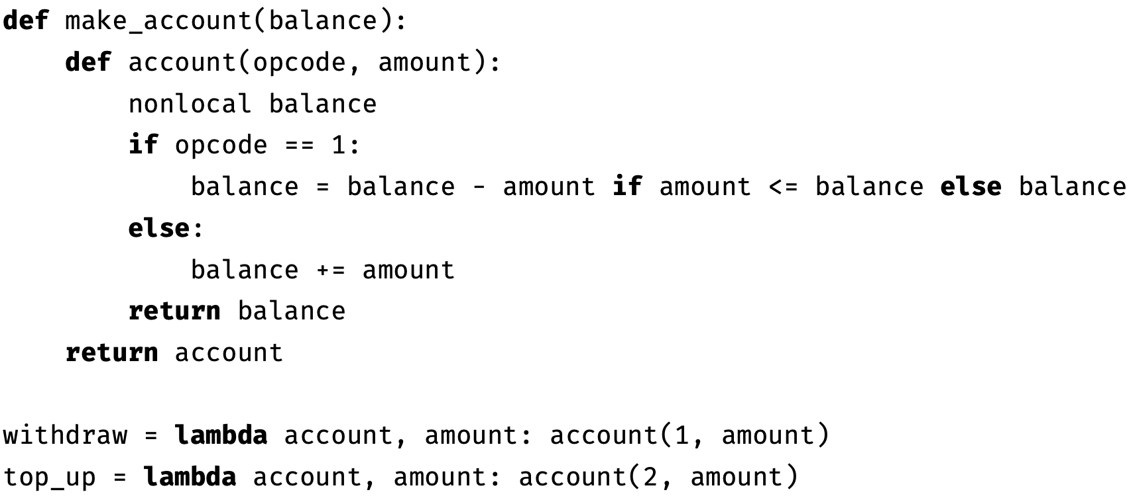
Mutable Functions
https://sicp.pascal-lab.net/2024/
files/12-Mutable-Functions-n-Growth.pptx

Slide 10
Mutable Functions
>>> alice_account = make_account(10)
>>> bob_account = make_account(10)
>>> withdraw(alice_account, 20)
10
>>> top_up(alice_account, 10)
20
>>> top_up(bob_account, 10)
20
>>> withdraw(bob_account, 20)
0
https://sicp.pascal-lab.net/2024/
files/12-Mutable-Functions-n-Growth.pptx

Slide 11
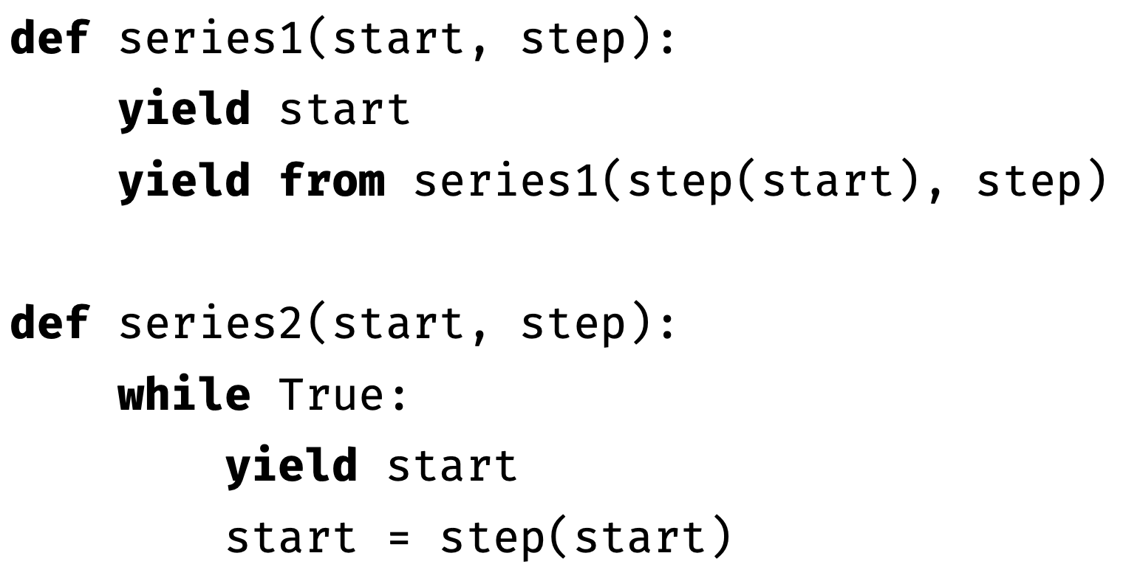
Iterators & Generators
https://sicp.pascal-lab.net/2024/
files/13-Iterators.pdf
$$\left\{a_{n}\right\}: a_{0}=\text{start} a_{n+1}=\text{step}\left(a_{n}\right)$$

Slide 12
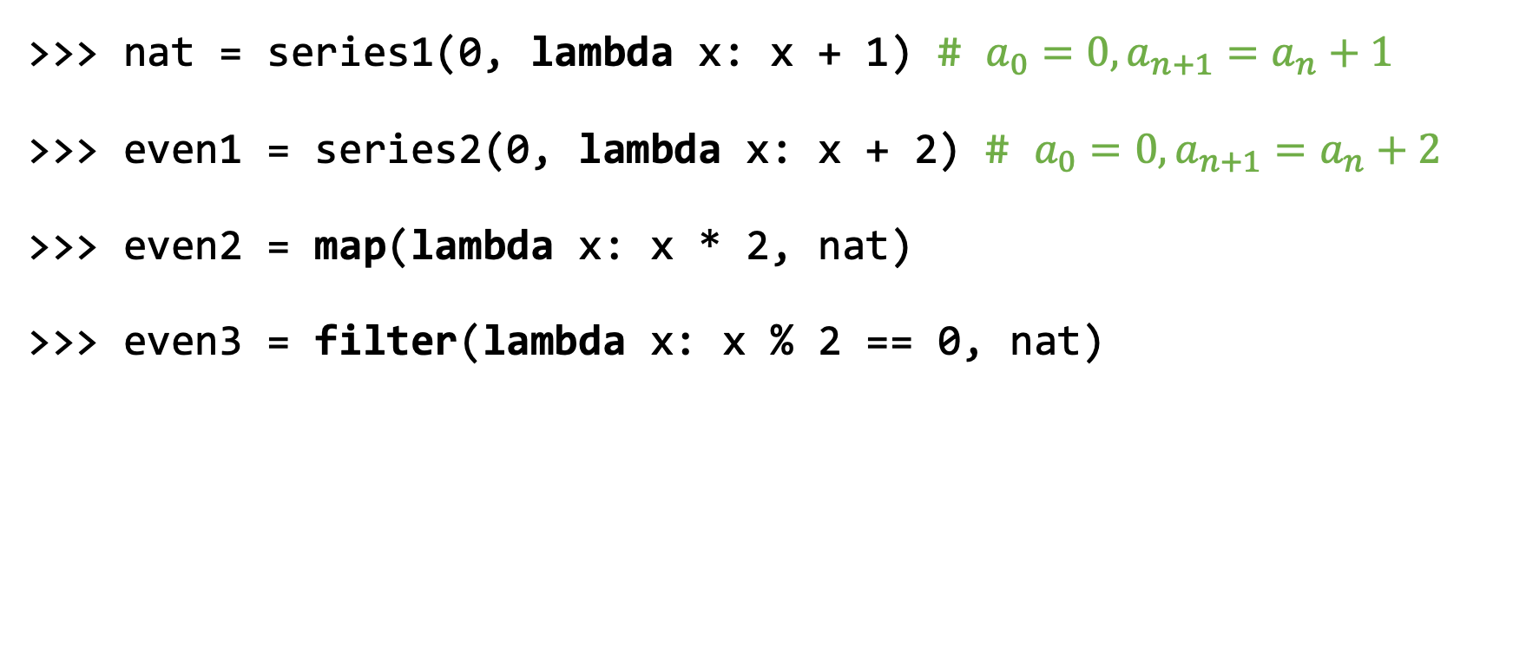
Iterators & Generators
>>> nat = series1(0, lambda x: x + 1) # $a_{0}=0,a_{n+1}=a_{n}+1$
>>> even1 = series2(0, lambda x: x + 2) # $a_{0}=0,a_{n+1}=a_{n}+2$
>>> even2 = map(lambda x: x * 2, nat)
>>> even3 = filter(lambda x: x % 2 == 0, nat)
https://sicp.pascal-lab.net/2024/files/13-Iterators.pdf
https://sicp.pascal-lab.net/2024/labs/lab05/2_2_1.html
https://sicp.pascal-lab.net/2024/labs/lab05/3.html

Slide 13
Iterators & Generators
nat
0 | 1 | 2 | 3 | 4 | 5 | 6 | 7 | 8 | 9 | 10 | 11 | 12 | 13 | 14 | 15 | 16 | 17 | 18 | 19
>>> [next(nat) for _ in range(5)]

Slide 14
Iterators & Generators
nat
0 | 1 | 2 | 3 | 4 | 5 | 6 | 7 | 8 | 9 | 10 | 11 | 12 | 13 | 14 | 15 | 16 | 17 | 18 | 19
>>> [next(nat) for _ in range(5)]
[0,

Slide 15
Iterators & Generators
nat
0 | 1 | 2 | 3 | 4 | 5 | 6 | 7 | 8 | 9 | 10 | 11 | 12 | 13 | 14 | 15 | 16 | 17 | 18 | 19
>>> [next(nat) for _ in range(5)]
[0, 1,

Slide 16
Iterators & Generators
nat
0 | 1 | 2 | 3 | 4 | 5 | 6 | 7 | 8 | 9 | 10 | 11 | 12 | 13 | 14 | 15 | 16 | 17 | 18 | 19
>>> [next(nat) for _ in range(5)]
[0, 1, 2,

Slide 17
Iterators & Generators
nat
0 | 1 | 2 | 3 | 4 | 5 | 6 | 7 | 8 | 9 | 10 | 11 | 12 | 13 | 14 | 15 | 16 | 17 | 18 | 19
>>> [next(nat) for _ in range(5)]
[0, 1, 2, 3,

Slide 18
Iterators & Generators
nat
0 | 1 | 2 | 3 | 4 | 5 | 6 | 7 | 8 | 9 | 10 | 11 | 12 | 13 | 14 | 15 | 16 | 17 | 18 | 19
>>> [next(nat) for _ in range(5)]
[0, 1, 2, 3, 4]

Slide 19
Iterators & Generators
nat
0 | 1 | 2 | 3 | 4 | 5 | 6 | 7 | 8 | 9 | 10 | 11 | 12 | 13 | 14 | 15 | 16 | 17 | 18 | 19
even1
0 | 2 | 4 | 6 | 8 | 10 | 12 | 14 | 16 | 18 | 20 | 22 | 24 | 26 | 28 | 30 | 32 | 34 | 36 | 38
>>> [next(even1) for _ in range(5)]

Slide 20
Iterators & Generators
nat
0 | 1 | 2 | 3 | 4 | 5 | 6 | 7 | 8 | 9 | 10 | 11 | 12 | 13 | 14 | 15 | 16 | 17 | 18 | 19
even1
0 | 2 | 4 | 6 | 8 | 10 | 12 | 14 | 16 | 18 | 20 | 22 | 24 | 26 | 28 | 30 | 32 | 34 | 36 | 38
>>> [next(even1) for _ in range(5)]
[0,

Slide 21
Iterators & Generators
nat
0 | 1 | 2 | 3 | 4 | 5 | 6 | 7 | 8 | 9 | 10 | 11 | 12 | 13 | 14 | 15 | 16 | 17 | 18 | 19
even1
0 | 2 | 4 | 6 | 8 | 10 | 12 | 14 | 16 | 18 | 20 | 22 | 24 | 26 | 28 | 30 | 32 | 34 | 36 | 38
>>> [next(even1) for _ in range(5)]
[0, 2,

Slide 22
Iterators & Generators
nat
0 | 1 | 2 | 3 | 4 | 5 | 6 | 7 | 8 | 9 | 10 | 11 | 12 | 13 | 14 | 15 | 16 | 17 | 18 | 19
even1
0 | 2 | 4 | 6 | 8 | 10 | 12 | 14 | 16 | 18 | 20 | 22 | 24 | 26 | 28 | 30 | 32 | 34 | 36 | 38
>>> [next(even1) for _ in range(5)]
[0, 2, 4,

Slide 23
Iterators & Generators
nat
0 | 1 | 2 | 3 | 4 | 5 | 6 | 7 | 8 | 9 | 10 | 11 | 12 | 13 | 14 | 15 | 16 | 17 | 18 | 19
even1
0 | 2 | 4 | 6 | 8 | 10 | 12 | 14 | 16 | 18 | 20 | 22 | 24 | 26 | 28 | 30 | 32 | 34 | 36 | 38
>>> [next(even1) for _ in range(5)]
[0, 2, 4, 6,

Slide 24
Iterators & Generators
nat
0 | 1 | 2 | 3 | 4 | 5 | 6 | 7 | 8 | 9 | 10 | 11 | 12 | 13 | 14 | 15 | 16 | 17 | 18 | 19
even1
0 | 2 | 4 | 6 | 8 | 10 | 12 | 14 | 16 | 18 | 20 | 22 | 24 | 26 | 28 | 30 | 32 | 34 | 36 | 38
>>> [next(even1) for _ in range(5)]
[0, 2, 4, 6, 8]

Slide 25
Iterators & Generators
nat
0 | 1 | 2 | 3 | 4 | 5 | 6 | 7 | 8 | 9 | 10 | 11 | 12 | 13 | 14 | 15 | 16 | 17 | 18 | 19
>>> even2 = map(lambda x: x * 2, nat)
>>> [next(even2) for _ in range(5)]
def map(func, iterable):
for x in iterable:
yield func(x)

Slide 26
Iterators & Generators
nat
0 | 1 | 2 | 3 | 4 | 5 | 6 | 7 | 8 | 9 | 10 | 11 | 12 | 13 | 14 | 15 | 16 | 17 | 18 | 19
>>> even2 = map(lambda x: x * 2, nat)
>>> [next(even2) for _ in range(5)]
[10,
# 5 * 2
def map(func, iterable):
for x in iterable:
yield func(x)

Slide 27
Iterators & Generators
nat
0 | 1 | 2 | 3 | 4 | 5 | 6 | 7 | 8 | 9 | 10 | 11 | 12 | 13 | 14 | 15 | 16 | 17 | 18 | 19
>>> even2 = map(lambda x: x * 2, nat)
>>> [next(even2) for _ in range(5)]
[10, 12,
# 6 * 2
def map(func, iterable):
for x in iterable:
yield func(x)

Slide 28
Iterators & Generators
nat
0 | 1 | 2 | 3 | 4 | 5 | 6 | 7 | 8 | 9 | 10 | 11 | 12 | 13 | 14 | 15 | 16 | 17 | 18 | 19
>>> even2 = map(lambda x: x * 2, nat)
>>> [next(even2) for _ in range(5)]
[10, 12, 14,
# 7 * 2
def map(func, iterable):
for x in iterable:
yield func(x)

Slide 29
Iterators & Generators
nat
0 | 1 | 2 | 3 | 4 | 5 | 6 | 7 | 8 | 9 | 10 | 11 | 12 | 13 | 14 | 15 | 16 | 17 | 18 | 19
>>> even2 = map(lambda x: x * 2, nat)
>>> [next(even2) for _ in range(5)]
[10, 12, 14, 16,
# 8 * 2
def map(func, iterable):
for x in iterable:
yield func(x)

Slide 30
Iterators & Generators
nat
0 | 1 | 2 | 3 | 4 | 5 | 6 | 7 | 8 | 9 | 10 | 11 | 12 | 13 | 14 | 15 | 16 | 17 | 18 | 19
>>> even2 = map(lambda x: x * 2, nat)
>>> [next(even2) for _ in range(5)]
[10, 12, 14, 16, 18]
# 9 * 2
def map(func, iterable):
for x in iterable:
yield func(x)

Slide 31
Iterators & Generators
nat
0 | 1 | 2 | 3 | 4 | 5 | 6 | 7 | 8 | 9 | 10 | 11 | 12 | 13 | 14 | 15 | 16 | 17 | 18 | 19
>>> even3 = filter(lambda x: x % 2 == 0, nat)
>>> [next(even2) for _ in range(5)]
def filter(func, iterable):
for x in iterable:
if func(x):
yield x

Slide 32
Iterators & Generators
nat
0 | 1 | 2 | 3 | 4 | 5 | 6 | 7 | 8 | 9 | 10 | 11 | 12 | 13 | 14 | 15 | 16 | 17 | 18 | 19
>>> even3 = filter(lambda x: x % 2 == 0, nat)
>>> [next(even2) for _ in range(5)]
[10,
# 10 % 2 == 0 is True
def filter(func, iterable):
for x in iterable:
if func(x):
yield x

Slide 33
Iterators & Generators
nat
0 | 1 | 2 | 3 | 4 | 5 | 6 | 7 | 8 | 9 | 10 | 11 | 12 | 13 | 14 | 15 | 16 | 17 | 18 | 19
>>> even3 = filter(lambda x: x % 2 == 0, nat)
>>> [next(even2) for _ in range(5)]
[10,
# 11 % 2 == 0 is False
def filter(func, iterable):
for x in iterable:
if func(x):
yield x

Slide 34
Iterators & Generators
nat
0 | 1 | 2 | 3 | 4 | 5 | 6 | 7 | 8 | 9 | 10 | 11 | 12 | 13 | 14 | 15 | 16 | 17 | 18 | 19
>>> even3 = filter(lambda x: x % 2 == 0, nat)
>>> [next(even2) for _ in range(5)]
[10, 12,
# 12 % 2 == 0 is True
def filter(func, iterable):
for x in iterable:
if func(x):
yield x

Slide 35
Iterators & Generators
nat
0 | 1 | 2 | 3 | 4 | 5 | 6 | 7 | 8 | 9 | 10 | 11 | 12 | 13 | 14 | 15 | 16 | 17 | 18 | 19
>>> even3 = filter(lambda x: x % 2 == 0, nat)
>>> [next(even2) for _ in range(5)]
[10, 12,
# 13 % 2 == 0 is False
def filter(func, iterable):
for x in iterable:
if func(x):
yield x

Slide 36
Iterators & Generators
nat
0 | 1 | 2 | 3 | 4 | 5 | 6 | 7 | 8 | 9 | 10 | 11 | 12 | 13 | 14 | 15 | 16 | 17 | 18 | 19
>>> even3 = filter(lambda x: x % 2 == 0, nat)
>>> [next(even2) for _ in range(5)]
[10, 12, 14,
# 14 % 2 == 0 is True
def filter(func, iterable):
for x in iterable:
if func(x):
yield x

Slide 37
Iterators & Generators
nat
0 | 1 | 2 | 3 | 4 | 5 | 6 | 7 | 8 | 9 | 10 | 11 | 12 | 13 | 14 | 15 | 16 | 17 | 18 | 19
>>> even3 = filter(lambda x: x % 2 == 0, nat)
>>> [next(even2) for _ in range(5)]
[10, 12, 14,
# 15 % 2 == 0 is False
def filter(func, iterable):
for x in iterable:
if func(x):
yield x

Slide 38
Iterators & Generators
nat
0 | 1 | 2 | 3 | 4 | 5 | 6 | 7 | 8 | 9 | 10 | 11 | 12 | 13 | 14 | 15 | 16 | 17 | 18 | 19
>>> even3 = filter(lambda x: x % 2 == 0, nat)
>>> [next(even2) for _ in range(5)]
[10, 12, 14, 16,
# 16 % 2 == 0 is True
def filter(func, iterable):
for x in iterable:
if func(x):
yield x

Slide 39
Iterators & Generators
nat
0 | 1 | 2 | 3 | 4 | 5 | 6 | 7 | 8 | 9 | 10 | 11 | 12 | 13 | 14 | 15 | 16 | 17 | 18 | 19
>>> even3 = filter(lambda x: x % 2 == 0, nat)
>>> [next(even2) for _ in range(5)]
[10, 12, 14, 16,
# 17 % 2 == 0 is False
def filter(func, iterable):
for x in iterable:
if func(x):
yield x

Slide 40
Iterators & Generators
nat
0 | 1 | 2 | 3 | 4 | 5 | 6 | 7 | 8 | 9 | 10 | 11 | 12 | 13 | 14 | 15 | 16 | 17 | 18 | 19
>>> even3 = filter(lambda x: x % 2 == 0, nat)
>>> [next(even2) for _ in range(5)]
[10, 12, 14, 16, 18]
# 18 % 2 == 0 is True
def filter(func, iterable):
for x in iterable:
if func(x):
yield x

Slide 41
Iterators & Generators
nat
0 | 1 | 2 | 3 | 4 | 5 | 6 | 7 | 8 | 9 | 10 | 11 | 12 | 13 | 14 | 15 | 16 | 17 | 18 | 19
... ...
>>> nat = series1(0, lambda x: x + 1)
...
>>> list(nat)
Error # RecursionError
def list(iterable):
return [x for x in iterable]

Slide 42
Iterators & Generators
even1
0 | 2 | 4 | 6 | 8 | 10 | 12 | ... ...
>>> even1 = series2(0, lambda x: x + 2)
...
>>> list(even1)
Forever
def list(iterable):
return [x for x in iterable]

Slide 43
Bonus
(3pts)

Slide 44

https://sicp.pascal-lab.net/2024/

Slide 45
Summary
Make good use of all course materials.
Be honest to yourself on each assignment.
Quit if you’re not going to be serious with this course.

Slide 46
