Slide 1
Recursion – Merge Sort
A divide-and-conquer sort algorithm.

Slide 2
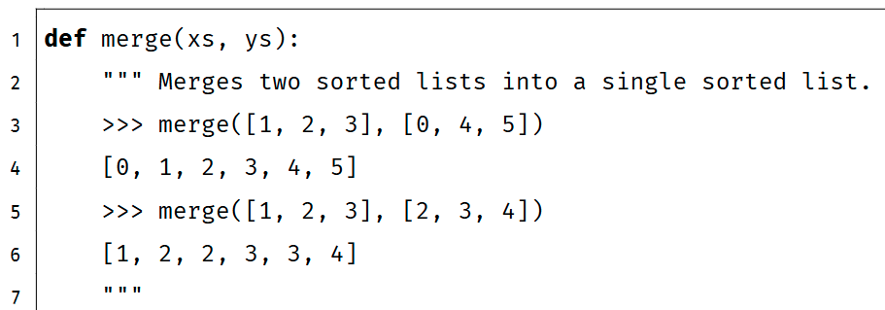
Merge
Implement merge. merge takes two sorted lists xs and ys and return sorted(xs + ys).

Slide 3
Merge – the Idea
Given two sorted lists, how to merge them into a single sorted list?
Example: merge([1, 2, 3], [0, 4, 5])
xs
ys
1
2
3
0
4
5
result
(empty list)

Slide 4
Merge – the Idea
Given two sorted lists, how to merge them into a single sorted list?
Example: merge([1, 2, 3], [0, 4, 5])
xs
ys
1
2
3
0
4
5
compare
result
(empty list)

Slide 5
Merge – the Idea
Given two sorted lists, how to merge them into a single sorted list?
Example: merge([1, 2, 3], [0, 4, 5])
xs
ys
1
2
3
4
5
result
0

Slide 6
Merge – the Idea
Given two sorted lists, how to merge them into a single sorted list?
Example: merge([1, 2, 3], [0, 4, 5])
xs
ys
1
2
3
4
5
compare
result
0

Slide 7
Merge – the Idea
Given two sorted lists, how to merge them into a single sorted list?
Example: merge([1, 2, 3], [0, 4, 5])
xs
ys
2
3
4
5
result
0
1

Slide 8
Merge – the Idea
Given two sorted lists, how to merge them into a single sorted list?
Example: merge([1, 2, 3], [0, 4, 5])
xs
ys
2
3
4
5
compare
result
0
1

Slide 9
Merge – the Idea
Given two sorted lists, how to merge them into a single sorted list?
Example: merge([1, 2, 3], [0, 4, 5])
xs
ys
3
4
5
result
0
1
2

Slide 10
Merge – the Idea
Given two sorted lists, how to merge them into a single sorted list?
Example: merge([1, 2, 3], [0, 4, 5])
xs
ys
3
4
5
compare
result
0
1
2

Slide 11
Merge – the Idea
Given two sorted lists, how to merge them into a single sorted list?
Example: merge([1, 2, 3], [0, 4, 5])
xs
ys
(empty list)
4
5
result
0
1
2
3

Slide 12
Merge – the Idea
Given two sorted lists, how to merge them into a single sorted list?
Example: merge([1, 2, 3], [0, 4, 5])
xs
ys
(empty list)
(empty list)
result
0
1
2
3
4
5

Slide 13
Merge – the Idea
Divide and conquer.
If one of xs or ys is empty, the result is another list.
Otherwise, compare xs[0] with ys[0], the smaller element is the first element of sorted(xs + ys).
Recursively merge the remaining elements.
xs
ys
1
2
3
0
4
5
compare

Slide 14
Merge – the Idea
Divide and conquer.
If one of xs or ys is empty, the result is another list.
Otherwise, compare xs[0] with ys[0], the smaller element is the first element of sorted(xs + ys).
Recursively merge the remaining elements.
xs
ys[1:]
1
2
3
4
5
result
0
+

Slide 15
Merge – the Idea
Divide and conquer.
If one of xs or ys is empty, the result is another list.
Otherwise, compare xs[0] with ys[0], the smaller element is the first element of sorted(xs + ys).
Recursively merge the remaining elements.
subproblem
xs
ys[1:]
1
2
3
4
5
merge
result
0
+
1
2
3
4
5

Slide 16
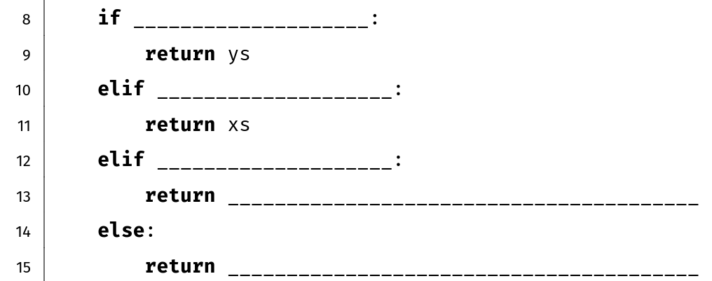
Merge - Answer
xs == [ ]
(1 point)
ys == [ ]
(1 point)
xs[0] <= ys[0]
(1 point)
[xs[0]] + merge(xs[1:], ys)
(2 point)
[ys[0]] + merge(xs, ys[1:])
(2 point)

Slide 17
Merge - Answer
not xs
len(ys) == 0
xs[0] <= ys[0]
[xs[0]] + merge(xs[1:], ys)
[ys[0]] + merge(xs, ys[1:])

Slide 18
Merge - Answer
xs == [ ]
ys == [ ]
xs[0] < ys[0]
[xs[0]] + merge(xs[1:], ys)
[ys[0]] + merge(xs, ys[1:])

Slide 19
Merge - Answer
xs == [ ]
ys == [ ]
xs[-1] > ys[-1]
merge(xs[:-1], ys) + [xs[-1]]
merge(xs, ys[:-1]) + [ys[-1]]

Slide 20
Merge - Answer
xs == [ ]
ys == [ ]
xs[0] <= ys[0]
xs[:1] + merge(xs[1:], ys)
ys[:1] + merge(xs, ys[1:])

Slide 21
Merge – Common Mistakes
REASON
xs == [ ]
ys == [ ]
xs[0] <= ys[0]
[xs[0]] + merge(xs[1:], ys)
[ys[0]] + merge(xs, ys[1:])

Slide 22
Merge – Common Mistakes
Missing base case: xs == [ ] and ys == [ ]
not xs and ys
not ys and xs
xs[0] <= ys[0]
[xs[0]] + merge(xs[1:], ys)
[ys[0]] + merge(xs, ys[1:])

Slide 23
Merge – Common Mistakes
Missing brackets.
xs == [ ]
ys == [ ]
xs[0] <= ys[0]
xs[0] + merge(xs[1:], ys)
ys[0] + merge(xs, ys[1:])

Slide 24
Merge – Common Mistakes
Wrong subproblem.
xs == [ ]
What if xs[1] < ys[0]?
ys == [ ]
xs[0] <= ys[0]
[xs[0], ys[0]] + merge(xs[1:], ys[1:])
[ys[0], xs[0]] + merge(xs[1:], ys[1:])

Slide 25
Merge – Answer (an Alternative Solution)
xs == [ ]
ys == [ ]
(Insert xs[0] into ys)
len(xs) == 1
[y for y in ys if y <= xs[0]] + [xs[0]] + [y for y in ys if y > xs[0]]
merge([xs[0]], merge(xs[1:], ys))

Slide 26
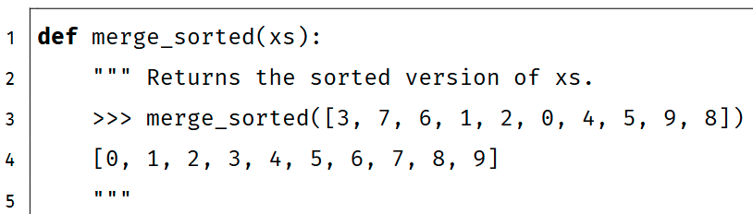
Merge sort
Implement merge_sorted using merge. merge_sorted takes a list xs and return sorted(xs).

Slide 27
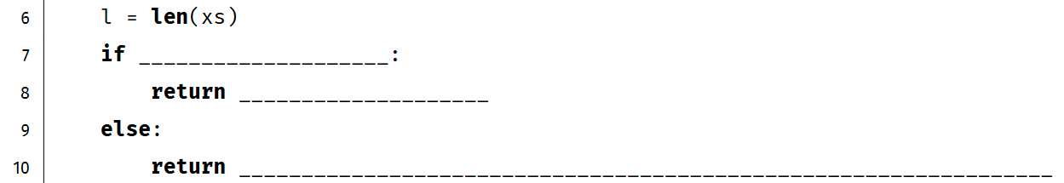
Merge sort – the Idea
merge only works on two sorted lists.
How can we get sorted lists from an unsorted list, without sorted?
Hint!
The empty list [ ] and singleton lists [a] are always sorted.

Slide 28
Merge sort – the Idea
Divide the list into empty or singleton lists, then merge back.
xs
1
3
2
0
4

Slide 29
Merge sort – the Idea
Divide the list into empty or singleton lists, then merge back.
1
3
2
0
4

Slide 30
Merge sort – the Idea
Divide the list into empty or singleton lists, then merge back.
1
3
2
0
4
merge

Slide 31
Merge sort – the Idea
Divide the list into empty or singleton lists, then merge back.
1
3
2
0
4

Slide 32
Merge sort – the Idea
Divide the list into empty or singleton lists, then merge back.
1
3
2
0
4
merge

Slide 33
Merge sort – the Idea
Divide the list into empty or singleton lists, then merge back.
1
3
0
2
4

Slide 34
Merge sort – the Idea
Divide the list into empty or singleton lists, then merge back.
1
3
0
2
4
merge

Slide 35
Merge sort – the Idea
Divide the list into empty or singleton lists, then merge back.
1
3
0
2
4

Slide 36
Merge sort – the Idea
Divide the list into empty or singleton lists, then merge back.
1
3
0
2
4
merge

Slide 37
Merge sort – the Idea
Divide the list into empty or singleton lists, then merge back.
0
1
2
3
4

Slide 38
Merge sort – the Idea
Divide and conquer.
If xs is already sorted, return xs.
Otherwise, divide xs into several smaller lists, sort these lists, merge them and return.

Slide 39
Merge sort – the Idea
Divide and conquer.
xs
1
3
2
0
4
divide
subproblems
1
3
2
0
4
sort
sort
1
3
0
2
4
merge
0
1
2
3
4

Slide 40
Merge sort – Answer
Divide and conquer.
If xs is already sorted, return xs.
Otherwise, divide xs into several smaller lists, sort these lists, merge them and return.
l <= 1
(2 point)
xs
(1 point)
merge(merge_sorted(xs[:l//2]),
merge_sorted(xs[l//2:]))
(2 point)

Slide 41
Merge sort – Answer
Divide and conquer.
If xs is already sorted, return xs.
Otherwise, divide xs into several smaller lists, sort these lists, merge them and return.
l <= 1
xs
merge(merge_sorted(xs[:1]),
merge_sorted(xs[1:]))

Slide 42
Merge sort – Answer
Divide and conquer.
If xs is already sorted, return xs.
Otherwise, divide xs into several smaller lists, sort these lists, merge them and return.
l <= 1
xs
merge(xs[:1], merge_sorted(xs[1:]))

Slide 43
Merge sort – Common Mistakes
REASON
l <= 1
xs
merge(merge_sorted(xs[:l//2]),
merge_sorted(xs[l//2:]))

Slide 44
Merge sort – Answer
Divide and conquer.
If xs is already sorted, return xs.
Otherwise, divide xs into several smaller lists, sort these lists, merge them and return.
all(xs[i] <= xs[i + 1] for i in range(l - 1))
xs
merge(merge_sorted(xs[:l//2]),
merge_sorted(xs[l//2:]))

Slide 45
Merge sort – Common Mistakes
Wrong base case.
l == 1
xs
merge(merge_sorted(xs[:l//2]),
merge_sorted(xs[l//2:]))

Slide 46
Merge sort – Common Mistakes
Wrong base case.
l == 2
merge([xs[0]], [xs[1]])
merge(merge_sorted(xs[:l//2]),
merge_sorted(xs[l//2:]))

Slide 47
Merge sort – Common Mistakes
Wrong slicing.
What if l == 2?
l <= 1
xs
merge(merge_sorted(xs[:l//2+1]),
merge_sorted(xs[l//2+1:]))

Slide 48
Merge sort – Common Mistakes
Missing base case.
l % 2 == 0
merge(ms(xs[:l//2]), ms(xs[l//2:]))
merge(ms(xs[:l//2+1]), ms(xs[l//2+1:]))
(ms stands for merge_sorted)

Slide 49
Merge sort – Common Mistakes
Wrong answers using min.
Missing base case.
xs[0] != min(xs)
merge_sorted(xs[1:] + [xs[0]])
[xs[0]] + merge_sorted(xs[1:])

Slide 50
Merge sort – Common Mistakes
Wrong answers using min.
What if xs contains duplicates?
l <= 1
xs
[min(xs)] + merge_sorted(
[x for x in xs if x != min(xs)])

Slide 51
Merge sort – Common Mistakes
Wrong answers using min.
Unfortunately,
remove returns None.
l <= 1
xs
[min(xs)] + merge_sorted(xs.remove(min(xs)))

Slide 52
Merge sort – Answer
A correct answer using min.
l <= 1
xs
[x for x in xs if x == min(xs)] + merge_sorted(
[x for x in xs if x != min(xs)])

