Slide 1
Sequences

Slide 2
Sequences
A sequence is an ordered collection of values.
"hello world"
"abcdefghijkl"
[1, 2, 3, 4, 5]
[True, "hi", 0]
strings sequence of characters
lists sequence of values of any data type
Demo

Slide 3
Sequence Abstraction
All sequences have finite length.
Each element in a sequence has a discrete integer index.
>>> [4, 5, 1, 10, 2, 3, 0]
[4, 5, 1, 10, 2, 3, 0]
4
5
1
10
2
-3
0
0
1
2
3
4
5
6
Sequences share common behaviors based on the shared trait of having a finite length and indexed elements.
Retrieve an element at a particular position
Create a copy of a subsequence
Check for membership
Concatenate two sequences together
...

Slide 4
What can you do with sequences?
Slice a subsequence: create a copy of the sequence from i to j <seq>[i:j:skip]
Get item: get the ith element <seq>[i]
>>> lst = [1, 2, 3, 4, 5]
>>> lst[2]
3
>>> "cs61a"[3]
'1'
>>> lst = [1, 2, 3, 4, 5]
>>> lst[1:4]
[2, 3, 4]
>>> "lolololololol"[3::2]
'ooooo'
Check membership: check if the value of <expr> is in <seq> <expr> in <seq>
Concatenate: combine two sequences into a single sequence <s1> + <s2>
>>> 3 in [1, 2, 3, 4, 5]
True
>>> 'z' in "socks"
False
>>> 2 + 4 in [7, 6, 5, 4, 3]
True
>>> [1, 2, 3] + [4, 5]
[1, 2, 3, 4, 5]
>>> "hello " + "world"
"hello world"
>>> [-1] + [0] + [1]
[-1, 0, 1]

Slide 5
Sequence Processing

Slide 6
Iterating through sequences
You can use a for statement to iterate through the elements of a sequence:
Rules for execution:
For each element in <seq>:
1) Bind it to <name>
2) Execute <body>
for <name> in <seq>:
<body>
Output
-------
0 : 8
1 : 9
2 : 10
i = 0
for elem in [8, 9, 10]:
print(i, ":", elem)
i += 1

Slide 7
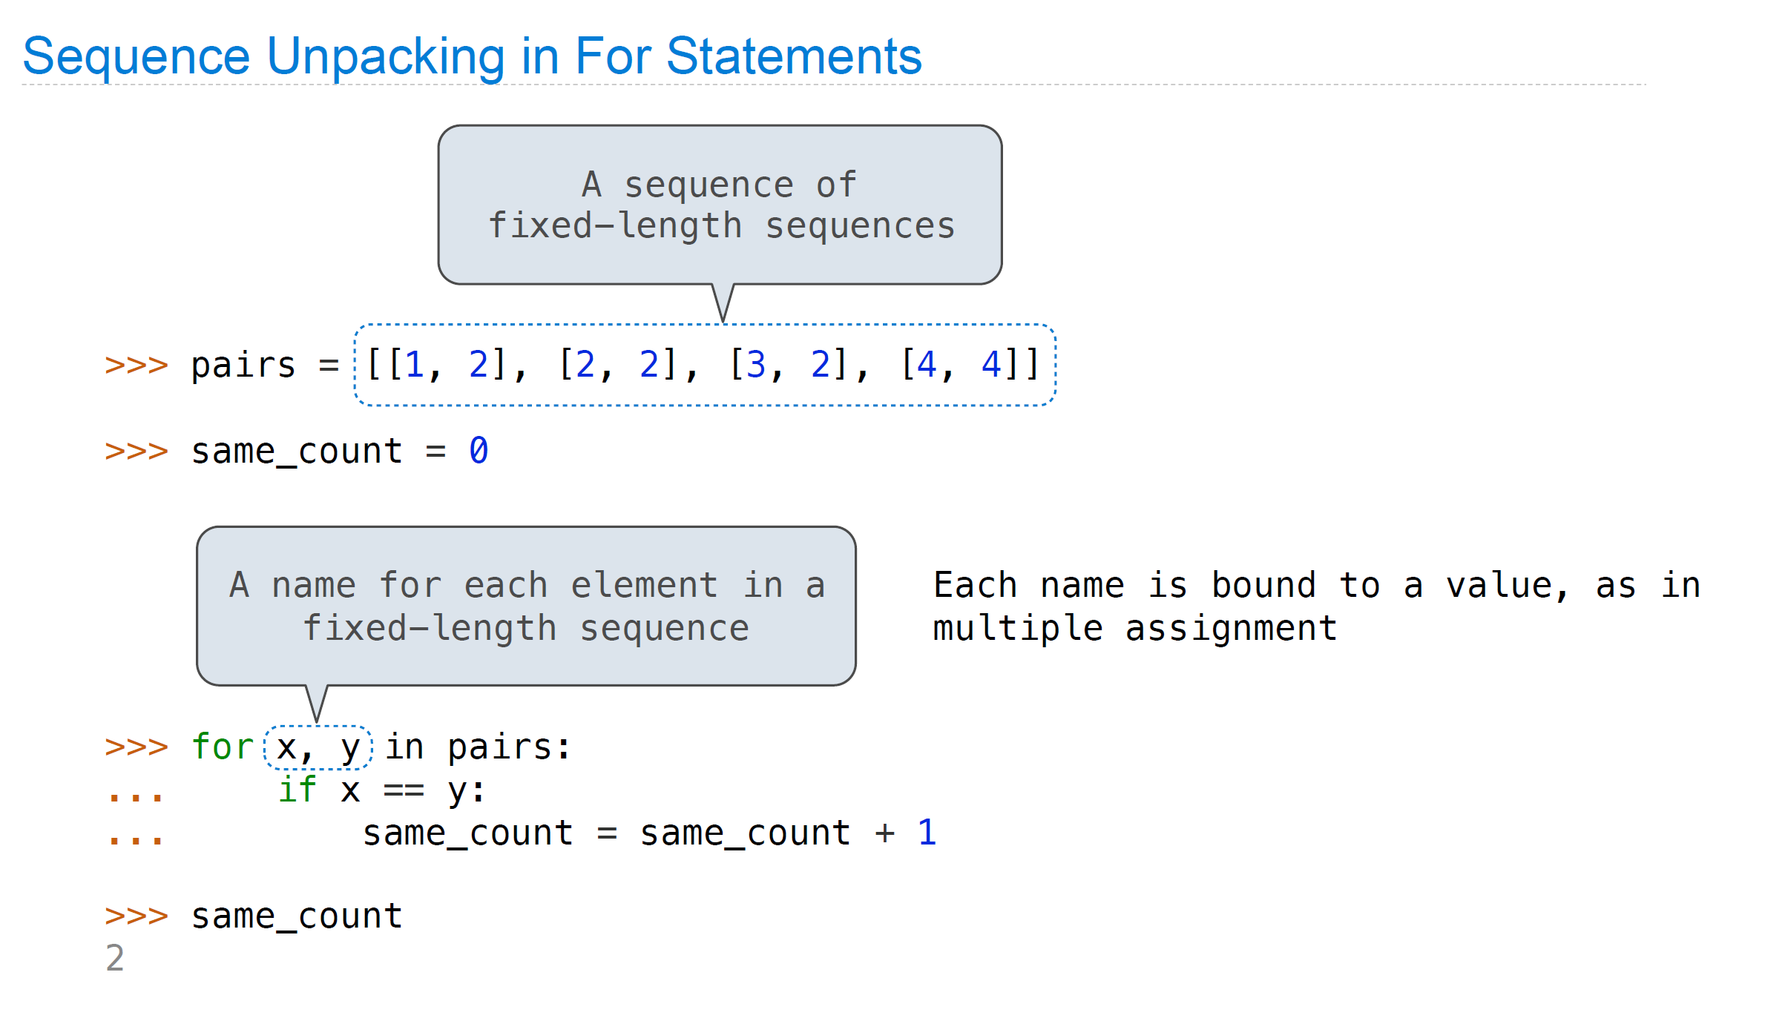

Slide 8
Range
The range function creates a sequence containing the values within a specified range.
range(<start>, <end>, <skip>)
Creates a range object from <start> (inclusive) to <end> (exclusive), skipping every <skip> element
This is useful for looping:
>>> for e in range(1, 8, 2):
... print(e)
1
3
5
7
>>> lst = [8, 9, 10]
>>> for i in range(len(lst)):
... print(i, ":", lst[i])
0: 8
1: 9
2: 10

Slide 9
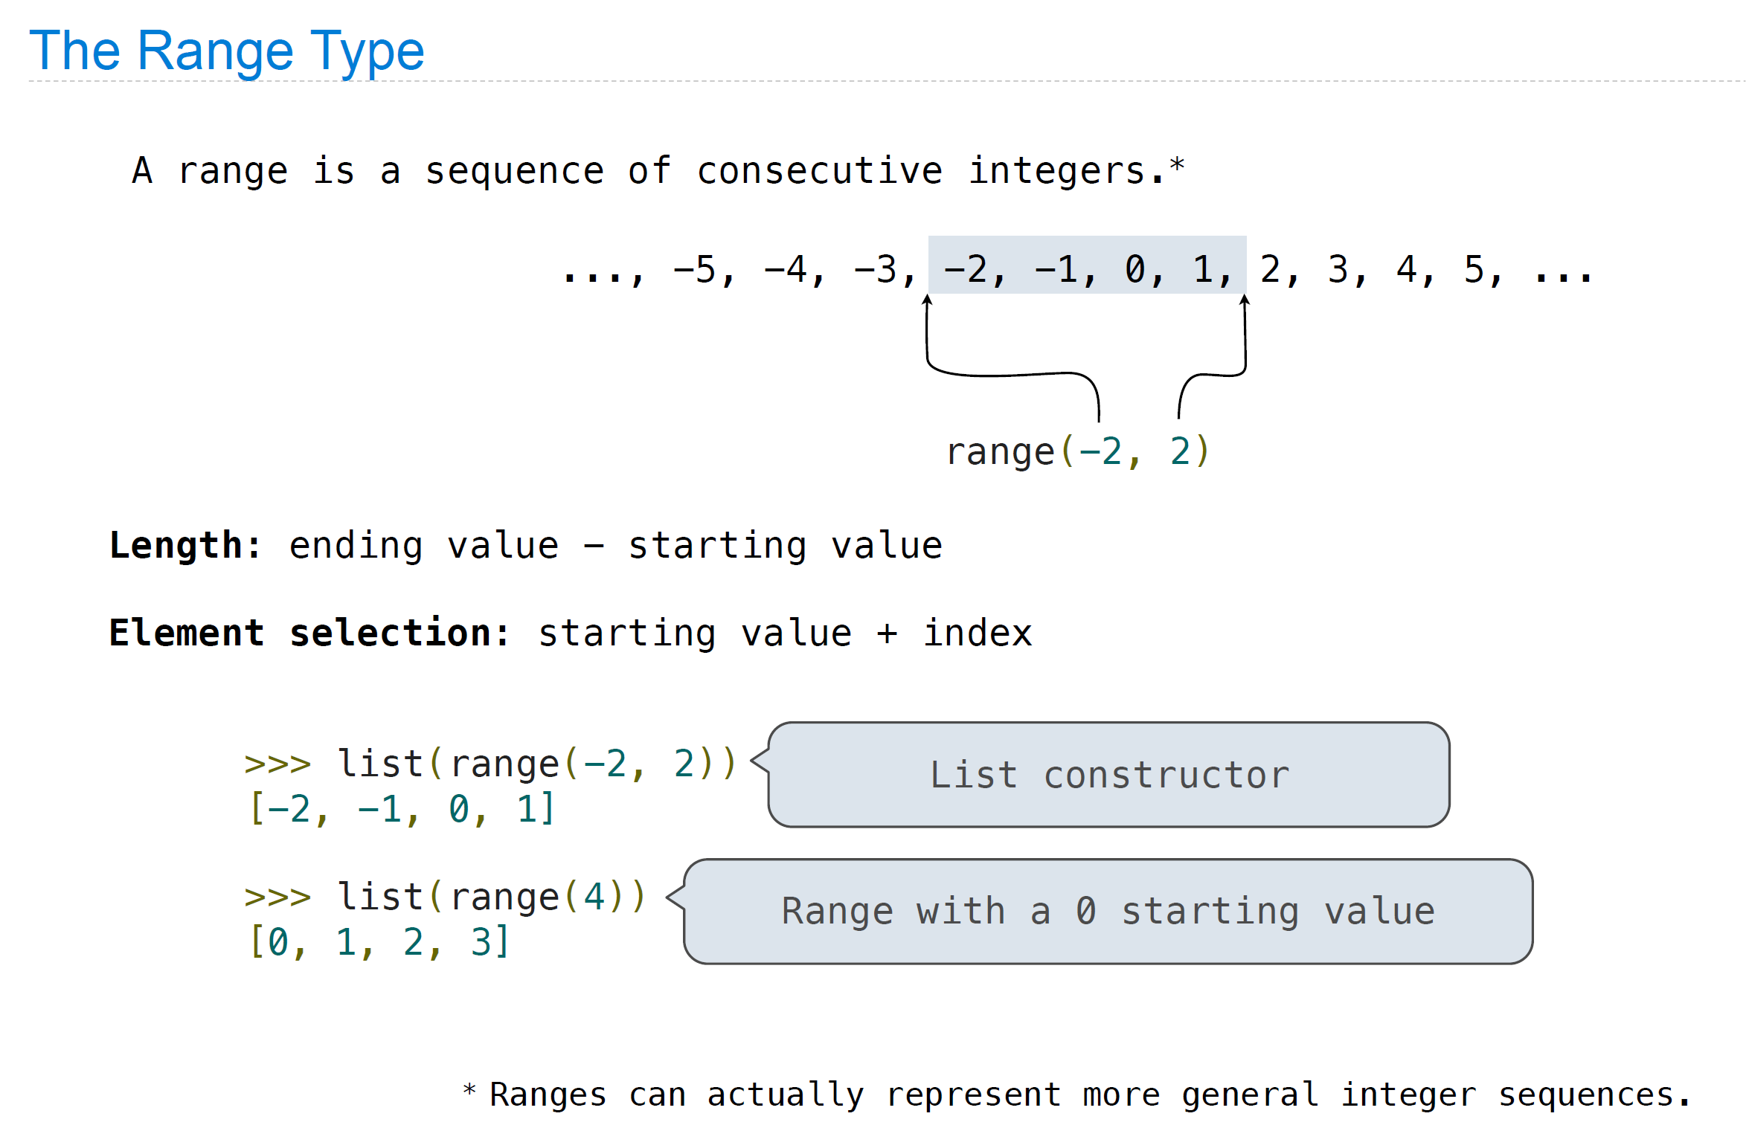

Slide 10
List Comprehensions
You can create out a list out of a sequence using a list comprehension:
[<expr> for <name> in <seq> if <cond>]
Rules for execution
1. Create an empty result list that will be the
value of the list comprehension
2. For each element in <seq>:
A. Bind to that element to <name>
B. If <cond> evaluates to a true value,
then add the value of <expr> to the
result list
Note: binding to <name> will not overwrite local bindings
lst = []
for <name> in <seq>:
if <cond>:
lst += [<expr>]

Slide 11
List Comprehension Examples
>>> [x ** 2 for x in [1, 2, 3]]
[1, 4, 9]
>>> [c + “0” for c in "cs61a"]
['c0', 's0', '60', '10', 'a0']
>>> [e for e in "skate" if e > "m"]
['s', 't']
>>> [[e, e+1] for e in [1, 2, 3]]
[[1, 2], [2, 3], [3, 4]]

Slide 12
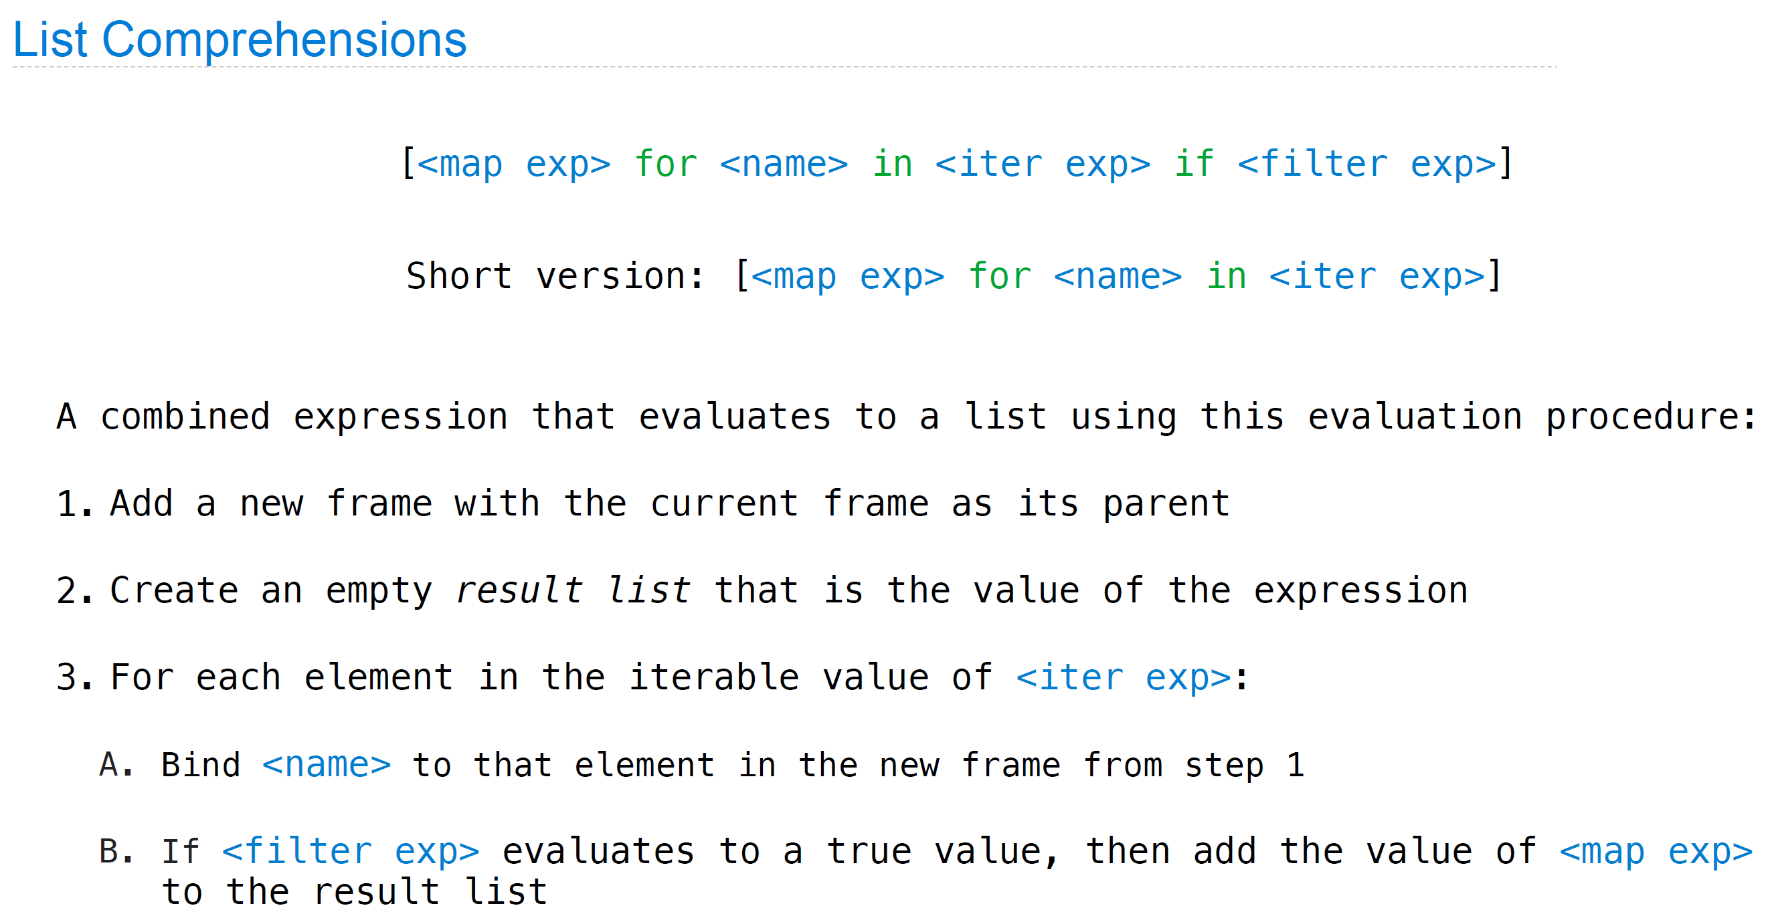

Slide 13
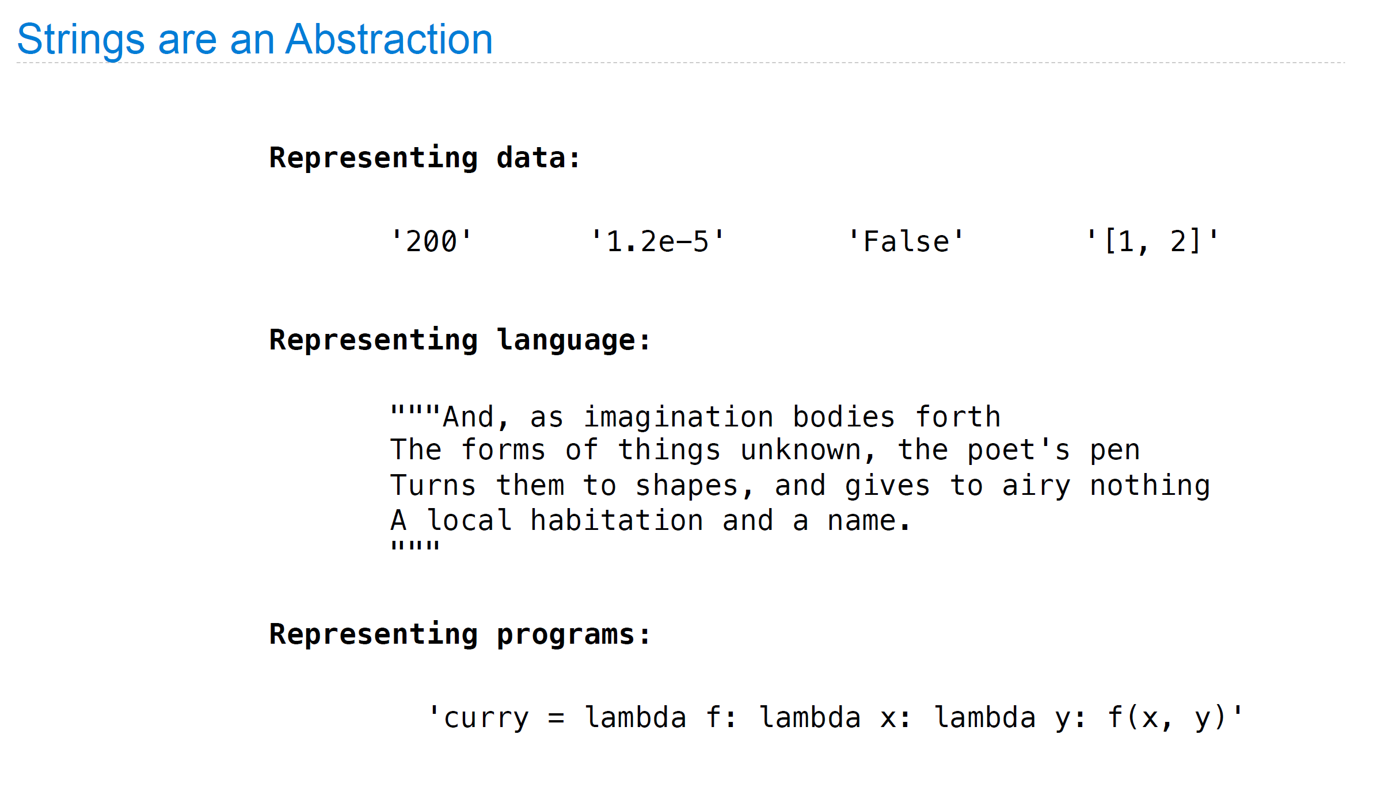

Slide 14
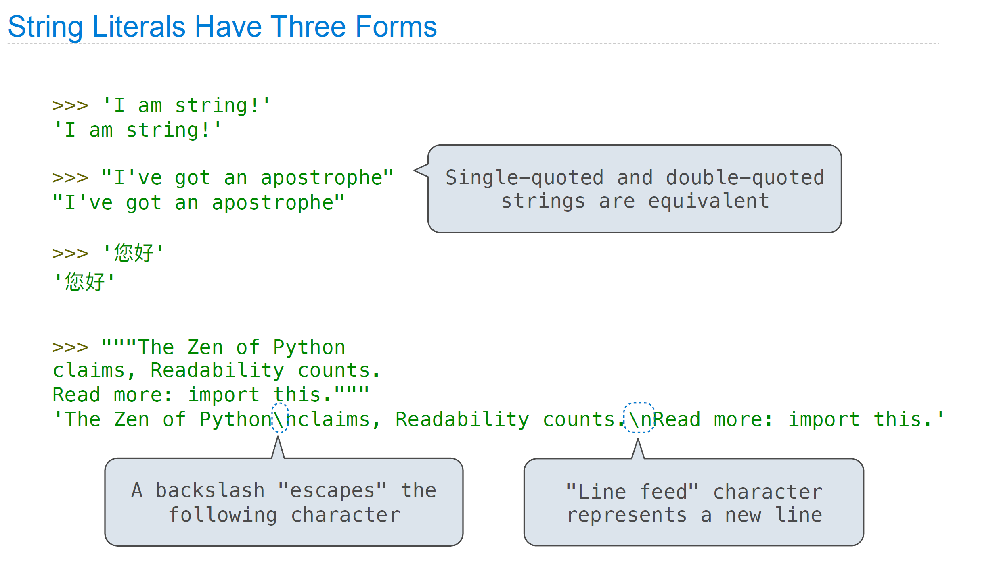

Slide 15
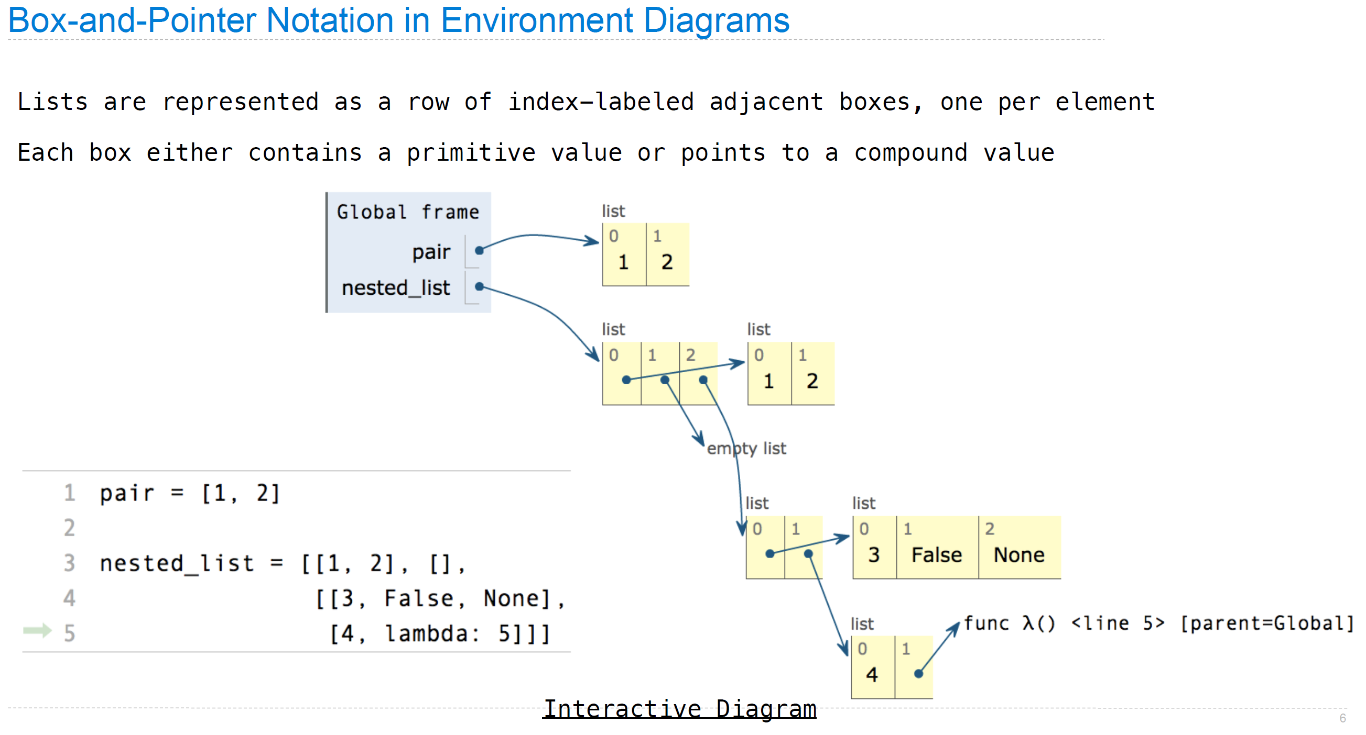

Slide 16
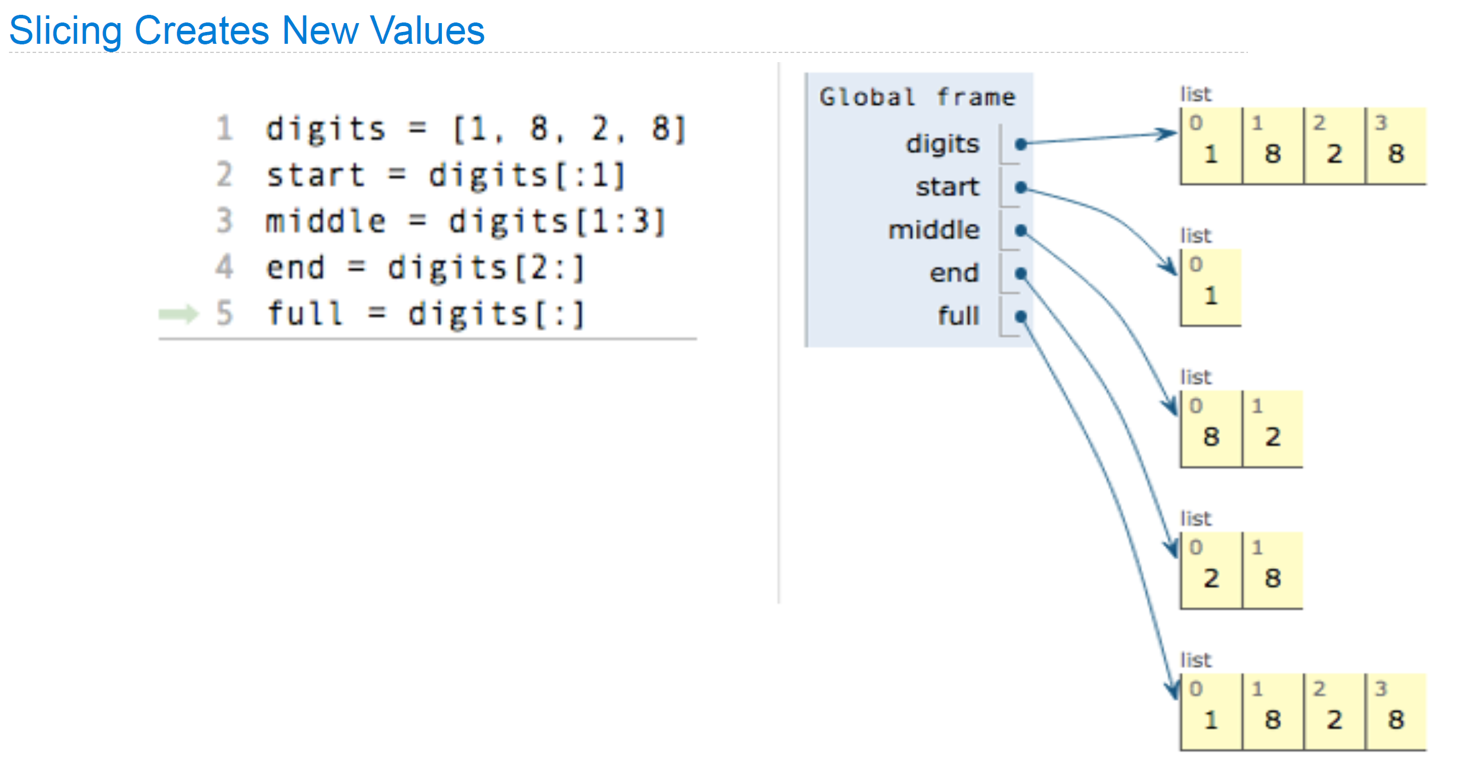

Slide 17
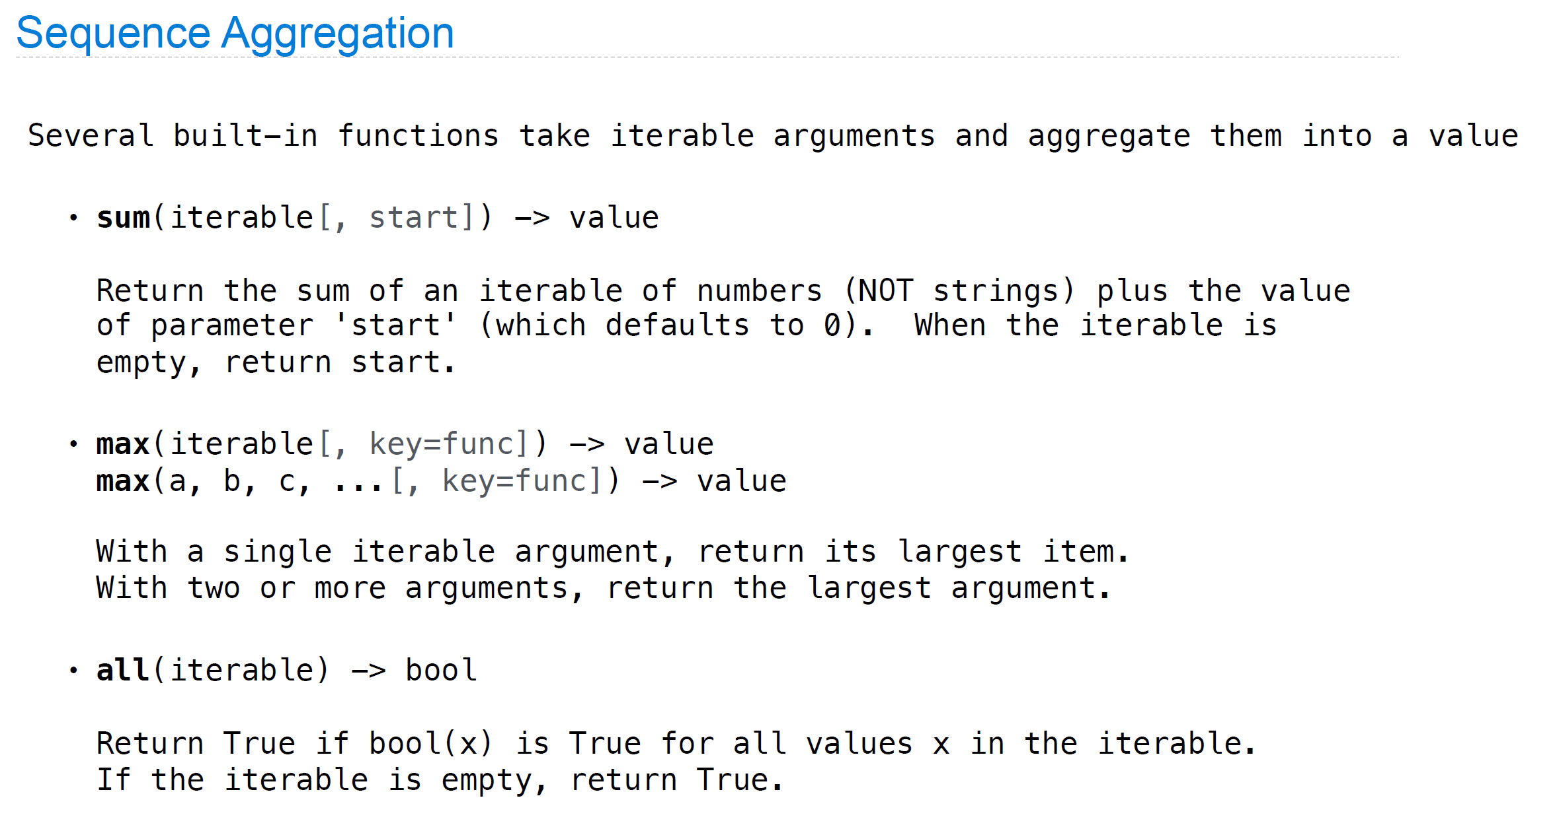

Slide 18
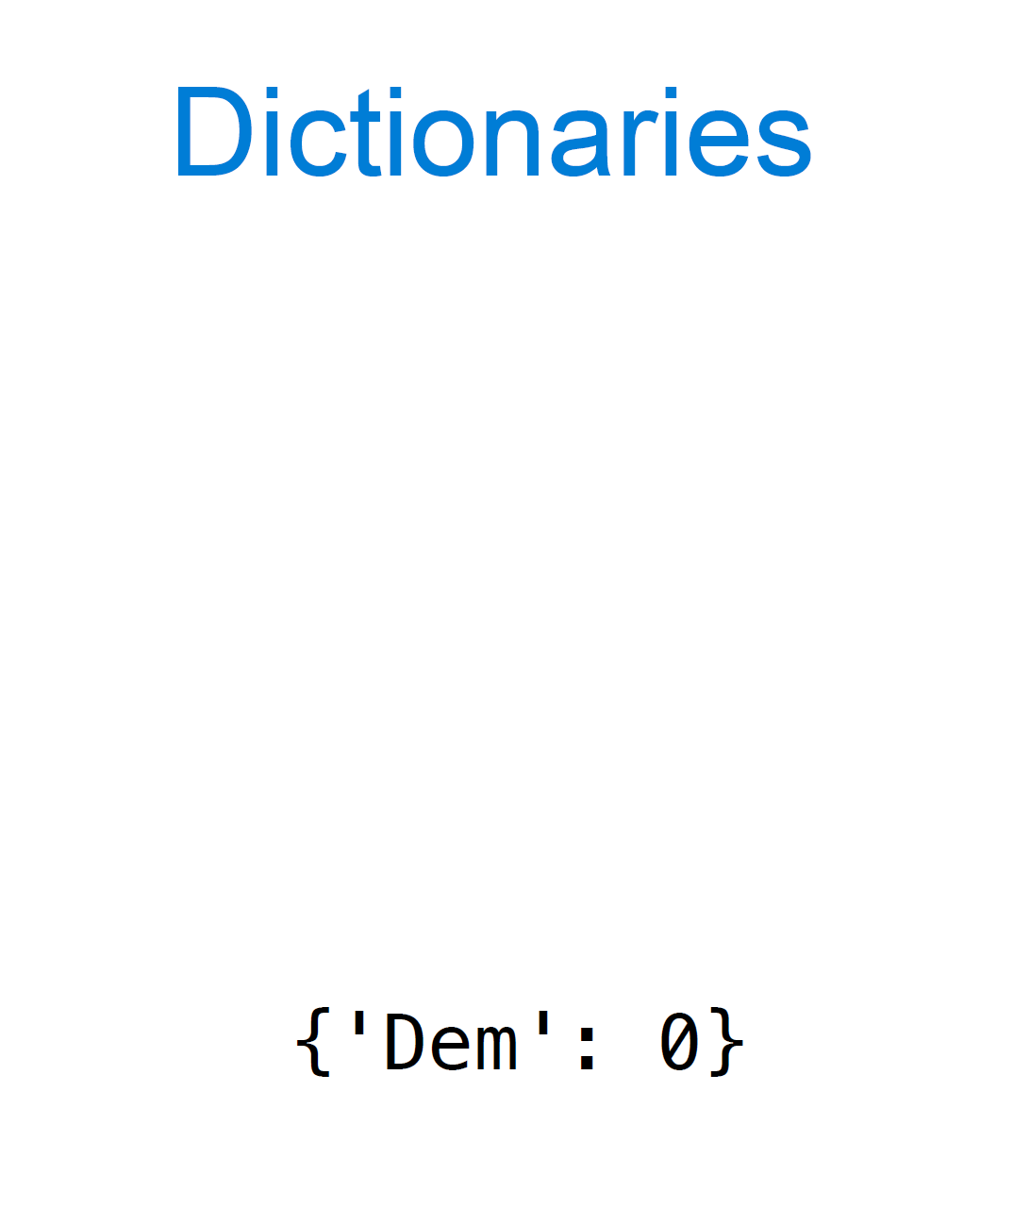

Slide 19
