Slide 1
OFF HOURS
Assignment 2 — Content & Social Media Strategy
What begins when work ends.
A continuation of the Assignment 1 deck
Mumbai + Bengaluru · 10-sachet night drink · melatonin-free
Assignment 2 · Content & Social Media Strategy · submission 5 October 2026

Slide 2
Where we stand — inherited from Assignment 1
— Retention before reach — the 10-night trial is the decision window, not the acquisition vanity metric.
— An understated, proof-led launch — the audience is an evidence-seeking wellness sceptic, not a hype audience.
— We compete with the habit of not switching off — not with pharmacies.
— Deliberately delayed: celebrity blitzes, mass display, TV and print, marketplace-ad dependence, and partnership pushes.
— Persona: Meera Nair, 32, Product Manager, Koramangala. Trials first, reads ingredients, cancels in one click.

Slide 3
1 · Content Marketing Objective
Make Off Hours the brand people go to when the evening won't switch off.
— Primary — Build awareness of the moment, not of a claim.
Recognition of the 10 pm problem comes before any product belief.
— Primary — Educate consumers and own the ingredient question.
The trust gate for an ingested product is the label; answering it is our right to sell.
— Secondary — engagement, community, traffic, conversion support.
Each is a means here, not a headline goal.
— Why not more? Awareness gives recognition; education gives permission. Everything else is downstream of those two.

Slide 4
2 · Brand Story & Communication
The core idea: a landing, not a pill.
— Calm — never urgent, never a countdown. The evening is not a sale to be closed.
— Plain-spoken — ingredient answers in ordinary words. No clinical jargon, no wellness poetry.
— Evidence-led — show the label, the quantity, the reason. Facts, never feelings.
— Quietly warm — as if to one tired person, not to a market.
— Sample line: “You don't have a sleep problem. You have a landing problem.”
— Never: preachy, alarmist, medical-sounding, countdowns, streaks, competitive sneering.

Slide 5
3 · Content Pillars
Five pillars, each with a function.
Pillar | Function | Example | Why Meera cares
Plain Labels | Education & trust | What magnesium glycinate does — in 40 seconds | She reads labels anyway
The Landing | Awareness | 10 pm, laptop closed, brain still on | It describes her night exactly
Quiet Proof | Credibility | Unedited testimonials, including lukewarm ones | Evidence beats promises
After Hours | Depth & loyalty | The sleep-journal letter | She wants the long version
We Won't | Differentiation | Six claims we refuse to make | Refusals are believable
Rotation rule: every piece belongs to exactly one pillar. If it doesn't fit a pillar, it doesn't go out.

Slide 6
4 · Platform Strategy
Three surfaces, chosen on audience behaviour.
Platform | Behaviour | Role | Formats
Instagram | Scrolls Reels at 10 pm | Awareness: name the moment | Reels, carousels, Stories Q&A
YouTube | Watches to research | Education: own the ingredient answer | 6-8 min long-form + Shorts
WhatsApp + e-mail | Consented, private, read-later | Retention: hold the 10-night window | Plain-text notes, letters
Deliberately not in the plan: TV and print · mass display · celebrity blitzes · marketplace-ad dependence · alarm and outrage formats.

Slide 7
5 · One Idea, Different Platforms
Night 1 of 10 — the first landing.
— The idea never changes; only the behaviour does.
— Instagram — 25-second landing film: the kitchen at night, laptop closed, no voiceover, one line at the end.
She sees it.
— YouTube — 6-8 minute explainer plus a 45-second cut: what is in the sachet, plainly, including what it does not do.
She understands it.
— WhatsApp + e-mail — one plain-text note per night for ten nights; night one asks one question.
She lives it.
— Every piece points to the next surface. The referral link closes the loop back to discovery.

Slide 8
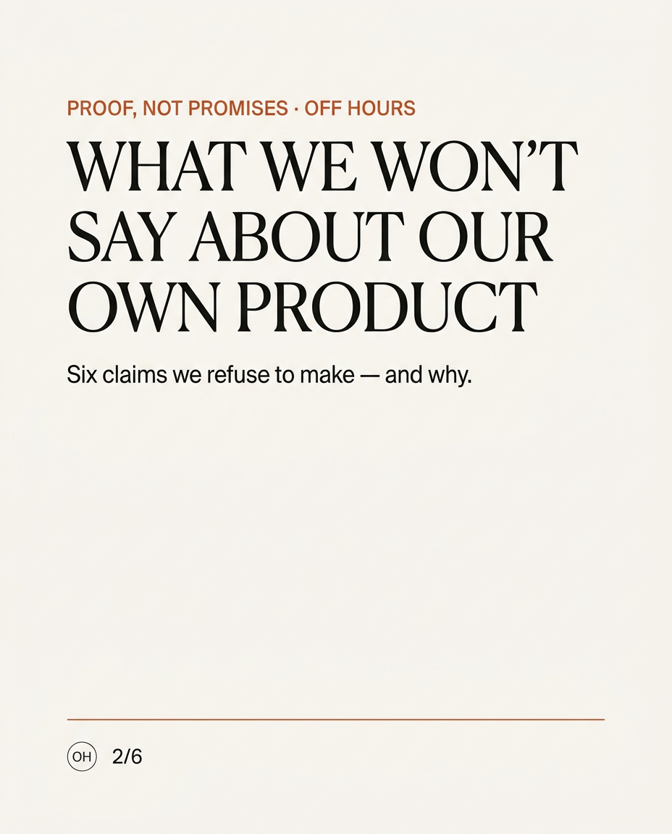
6 · Content Concepts
Six concepts — idea → pillar → platform → format → objective.
Concept 3, “Six things we refuse to say” — carousel slide 2 of 6.
Design direction: warm off-white ground, one burnt-orange accent, editorial serif headline. No badge, no arrow, no urgency device.
1 · What magnesium glycinate actually does
Plain Labels · Instagram carousel · education + saves
2 · We read our own label out loud
Plain Labels · YouTube long-form · education + trust
3 · Six things we refuse to say about our own product
We Won't · Instagram carousel · differentiation + shares
4 · Night 1 of 10 — the landing film
The Landing · Instagram Reel · awareness
5 · The shelf — customers' own notes, unranked
Quiet Proof · Instagram + private channel · trust
6 · Ask us about the label
Plain Labels · Stories Q&A → video · engagement + education

Slide 9
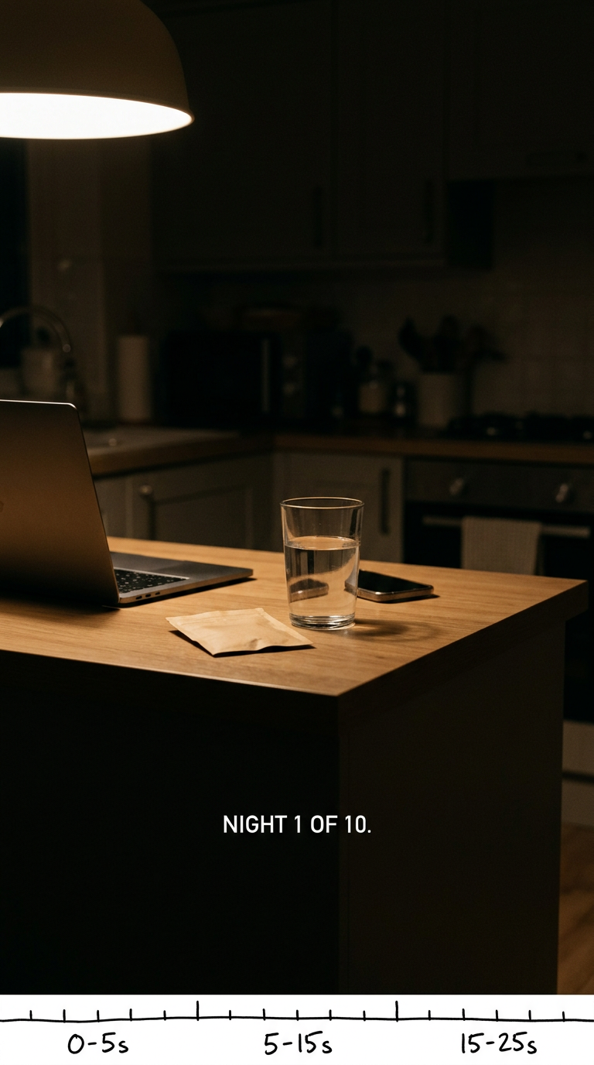
6 · Content Concepts (continued)
Concept 4 — the Reel key frame with timing margin.
Shot discipline: one continuous take in a dim kitchen, single lamp source, hands and objects only, no faces; music only in the middle beat.
The landing film — storyboard beats
25 seconds, one continuous shot
0-5s · A laptop is closed and pushed aside. Room tone only. No music.
5-15s · A hand sets down one sachet and a glass of warm water. Slow, unhurried.
15-25s · Opened, poured, stirred once. Camera holds; the only text is the last line.
On-screen text at 20-25s: NIGHT 1 OF 10.
Why 25 seconds: the audience is scrolling at the exact hour the film shows; the idea must land in three seconds and remain saveable for tonight.

Slide 10
7 · Hero Content / Campaign
The 10-Night Landing — the trial window becomes the campaign.
— Insight — her problem is not sleep, it is the twenty minutes between closing the laptop and getting to bed.
— Big idea — ten nights, ten small pieces, one per night, each a landing rather than a lesson.
— Key message — “We're not asking you to sleep earlier. We're asking you to land better.”
— Arc — name the moment → answer the question → hold the ten nights → let the proof speak.
— Why this hero: it turns the brand's hardest metric, the trial-to-subscription window, into content.

Slide 11
8 · Community & Engagement
Followers become participants by being asked for something they already give.
— Ask-the-coach, answered in public — no question too basic, including the awkward ingredient ones.
— The Shelf — customers' own night notes, unranked and unedited. Inclusion, never competition.
— Quiet Testimony — reviews in the customer's own words; any edit visibly marked.
— The 10-Night Check-in — one private question a night; no scoreboard, no streak to lose.
— Refused: competitive challenges and duets · alarm-driven live formats · announcements broadcast through community channels.

Slide 12
9 · Influencer / Creator Strategy
Fit is a teaching-and-trust test, not a reach test.
 | Creator A | Creator B
Who | Shabbir Ahmed — Sleep Psychologist, Navi Mumbai | Shruti Maheshwari — co-founder, Sleep Gurukul, Mumbai
Credibility | CBT-I practice; author, The Sleep Foundations; MA Psychology; doctoral research | Sleep & wellbeing coach, breath-work; practice recognised at the BW Wellbeing Festival, Mumbai
Audience | Adults seeking behavioural answers, not chemical ones | Indian professionals, metro, breath-work and routine-led
Why fit | The purest carrier of Plain Labels: method-led, explicitly against hacks and unfounded claims | Carries The Landing: teaches the ritual a product cannot demonstrate; India-native practice
Role | Flagship educator: one explainer, one label review, one Q&A | Ritual partner: guided ten-night wind-down series; Phase 2 corporate bridge
Filters first, names second: teaching ratio · private-engagement ratio · reply tone · disclosure comfort. Open checks: category conflicts, disclosure line, Mumbai/Bengaluru audience share.

Slide 13
10 · Two-Week Content Calendar
Ten pieces, four deliberate quiet days.
Day | Platform | Content | Format | Pillar
1 · Mon | YouTube | We read our own label out loud (anchor) | Long-form 7 min | Plain Labels
2 · Tue | — | Quiet day | — | —
3 · Wed | Instagram | What magnesium glycinate actually does | Carousel (5) | Plain Labels
4 · Thu | Instagram | Night 1 of 10 — the landing film | Reel 25s | The Landing
5 · Fri | Instagram | Ask us about the label — weekly answers | Stories Q&A | Plain Labels
6 · Sat | WhatsApp + e-mail | Night 5 check-in: what time did your evening end? | Plain-text note | After Hours
7 · Sun | — | Quiet day | — | —
8 · Mon | YouTube | Why this is not a sleeping pill (anchor) | Long-form 6 min | Plain Labels
9 · Tue | Instagram | Six things we refuse to say about our product | Carousel (6) | We Won't
10 · Wed | — | Quiet day | — | —
11 · Thu | Instagram | The shelf — customers' own night notes | Carousel (6) | Quiet Proof
12 · Fri | Instagram | Short cut of Monday's anchor | Short 45s | Plain Labels
13 · Sat | WhatsApp + e-mail | Night 10: one thing that changed, one that didn't | Note + referral link | Quiet Proof
14 · Sun | — | Quiet day | — | —
Cadence rationale: the brand's job is a habit, not a feed. Four quiet days are a decision, not a gap. One anchor and one visual piece per week; paid only amplifies messages already proven organically.

Slide 14
11 · Measurement & Success
Seven metrics, each tied to an objective — one of them negative.
# | Objective | KPI | Healthy signal | Cadence
1 | Awareness | Reach: Reels vs search arrivals | Search arrivals grow faster than Reels reach | Monthly
2 | Education | Saves and returns on label explainers | Explainers are the most-saved content | Monthly
3 | Consideration | Completion rate on long-form | The “not a pill” film completes best | Monthly
4 | Trust | Private interactions: saves, DM questions, replies | Private at least equals public | Monthly
5 | Conversion support | Trial starts from discovery and search | Rising, with a healthy source mix | Monthly
6 | Retention | Night-5 and night-10 check-in participation | A meaningful share reply or stay | Every 10 nights
7 | Health (stop signal) | Argument threads and complaint mentions | Flat or falling | Monthly
Month one: working if saves lead, private responses equal public ones, check-ins are answered and argument threads stay flat. Not working if reach rises while saves stall.

Slide 15
Continuity, risks and what would change our mind
Every choice here traces back to Assignment 1 — and every risk is named.
— Viable alternative on record: an education-first, newsletter-led plan. It is fully compliant; it simply leaves the display surface idle. The margin is narrow (0.84 vs 0.82) and stated.
— Risk 1 — the quiet channel is favourable but slow: judge it across a full cycle, not a month.
— Risk 2 — restraint can become inaudibility: display content carries reach, and reach is tracked.
— Risk 3 — partnership announcements under-deliver in alliance channels: those channels stay two-way.
— Risk 4 — creator conflicts and audience geography are unverified: three checks run before contracting.
— Strategy first. Design second. Every creative decision has a reason — and the reason is always the same: this brand exists to end the day, not to win the feed.

