Slide 1
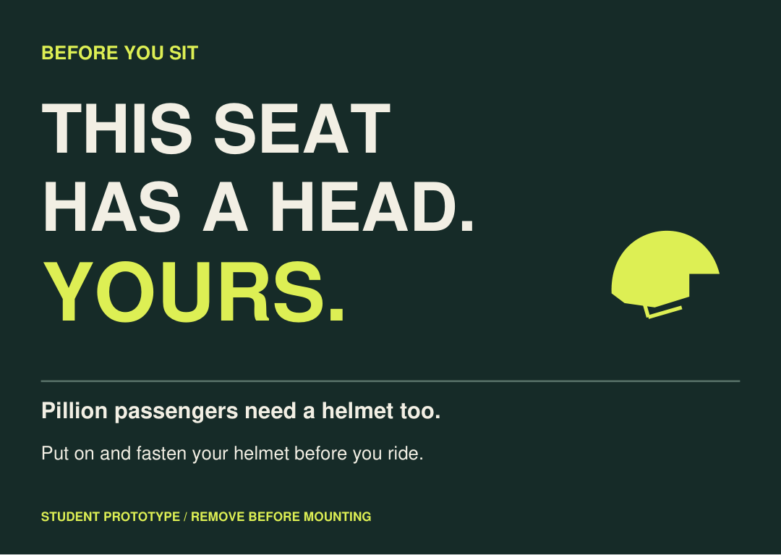
ADVERTISING 2 / CRAFTING FOR A SOCIAL CAUSE
THIS SEAT
HAS A HEAD.
The overlooked second rider.
A campaign on the seat they are about to occupy.
DESIGN PROPOSAL / NOT DEPLOYED
Notes:
DESIGN PROPOSAL / NOT DEPLOYED

Slide 2
01 / NARROW THE CAUSE
The person
on the second seat.
Cause: pillion helmet use on everyday shared journeys.
Focus: adult driver-pillion pairs, stationary before departure.
Not a new product, app, rental scheme or service.
Age 18-30 and private-parking setting are strategic choices, not measured local prevalence.
Notes:
Age 18-30 and private-parking setting are strategic choices, not measured local prevalence.

Slide 3
02 / NATIONAL CONTEXT
14,652
Passenger fatalities recorded in the non-wearing-of-helmet category in India, 2024.
54,122 total fatalities in that category.
MoRTH data via inspected OpenCity table records and Hindustan Times, 12 June 2026. Same underlying dataset; original ministry table cells not directly inspected. Not proof nonuse caused every crash.
Notes:
MoRTH data via inspected OpenCity table records and Hindustan Times, 12 June 2026. Same underlying dataset; original ministry table cells not directly inspected. Not proof nonuse caused every crash.

Slide 4
03 / THE BEHAVIOURAL OPPORTUNITY
Knowing is not
always doing.
346 adult crash patients in one eastern-India hospital sample.
96.6% agreed helmets were essential; 35.7% had used one.
Short-distance travel and forgetfulness were associated with nonuse.
Mishra et al., 2025; data March-December 2021. Hospital sample, not national/Mumbai prevalence. Association, not causation. PMC12020946 / DOI 10.4103/ijciis.ijciis_85_24.
Notes:
Mishra et al., 2025; data March-December 2021. Hospital sample, not national/Mumbai prevalence. Association, not causation. PMC12020946 / DOI 10.4103/ijciis.ijciis_85_24.

Slide 5
04 / AUDIENCE AND INSIGHT
Make the second
person present.
Audience: adult student / early-career driver-pillion pairs.
Hypothesis: on an ordinary shared ride, the second seat can become an afterthought.
Put the reminder where the second person is about to sit.
Creative hypothesis, not a participant quote. Local reasons for nonuse remain to be tested.
Notes:
Creative hypothesis, not a participant quote. Local reasons for nonuse remain to be tested.

Slide 6
05 / SINGLE-MINDED STRATEGY
Their own helmet.
Before the ride.
Proposition: the second person needs their own helmet too.
Action: both helmets on; both chinstraps fastened.
Tone: direct, considerate, no blame or simulated enforcement.
Correct helmet use reduces risk, not all risk. WHO road-traffic fact sheet, 20 July 2026; PIB helmet guidance, 12 July 2025.
Notes:
Correct helmet use reduces risk, not all risk. WHO road-traffic fact sheet, 20 July 2026; PIB helmet guidance, 12 July 2025.

Slide 7
06 / THREE MEDIA CONCEPTS
Three routes.
One campaign.
01 SECOND-SEAT MESSAGE - selected: seat is the placement.
02 TWO-PERSON PARKING SLIP - rejected: close receipt precedent.
03 PLUS-ONE RIDE INVITE - reserve: before-ride social message.
Receipt precedent: HDFC Bank / STUDDS, The Helmet Receipt, reported February 2026. No claim of exhaustive originality clearance.
Notes:
Receipt precedent: HDFC Bank / STUDDS, The Helmet Receipt, reported February 2026. No claim of exhaustive originality clearance.

Slide 8
07 / THE SELECTED MEDIA INNOVATION
The seat supplies
the meaning.
An A6 card rests on the stationary pillion seat.
It addresses the passenger at the mounting decision.
No scan. No sign-up. No new service.
Facilitator removes it before anyone mounts.
Opt-in, permissioned, supervised placement only. No adhesive or vehicle alteration. Stop if safe collection cannot be assured.
Notes:
Opt-in, permissioned, supervised placement only. No adhesive or vehicle alteration. Stop if safe collection cannot be assured.

Slide 9
08 / HERO EXECUTION
THIS SEAT
HAS A HEAD.
YOURS.
Pillion passengers need a helmet too.
Put on and fasten your helmet before you ride.
Finished A6 artwork supplied as PDF, SVG and PNG. Supervised prototype; remove before mounting.
Notes:
Finished A6 artwork supplied as PDF, SVG and PNG. Supervised prototype; remove before mounting.

Slide 10
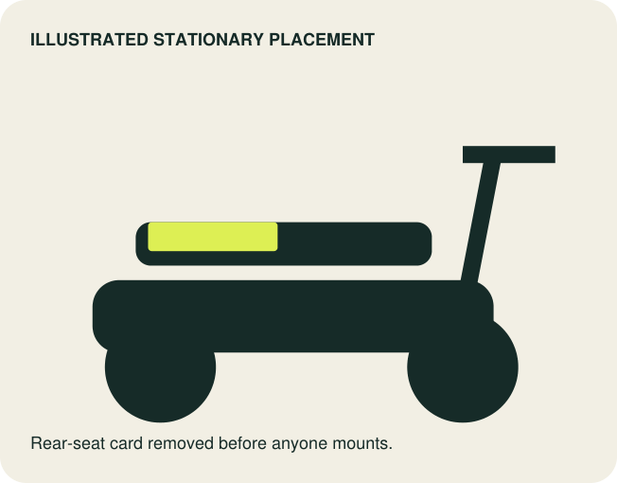
09 / CONTEXT DEMONSTRATION
Where the second
person is about to sit.
A parked vehicle. Engine off. Adult participants opt in.
Message placed briefly on the rear seat.
Card collected and accounted for before mounting.
Illustrated placement mockup, not a photograph or evidence of deployment.
Notes:
Illustrated placement mockup, not a photograph or evidence of deployment.

Slide 11
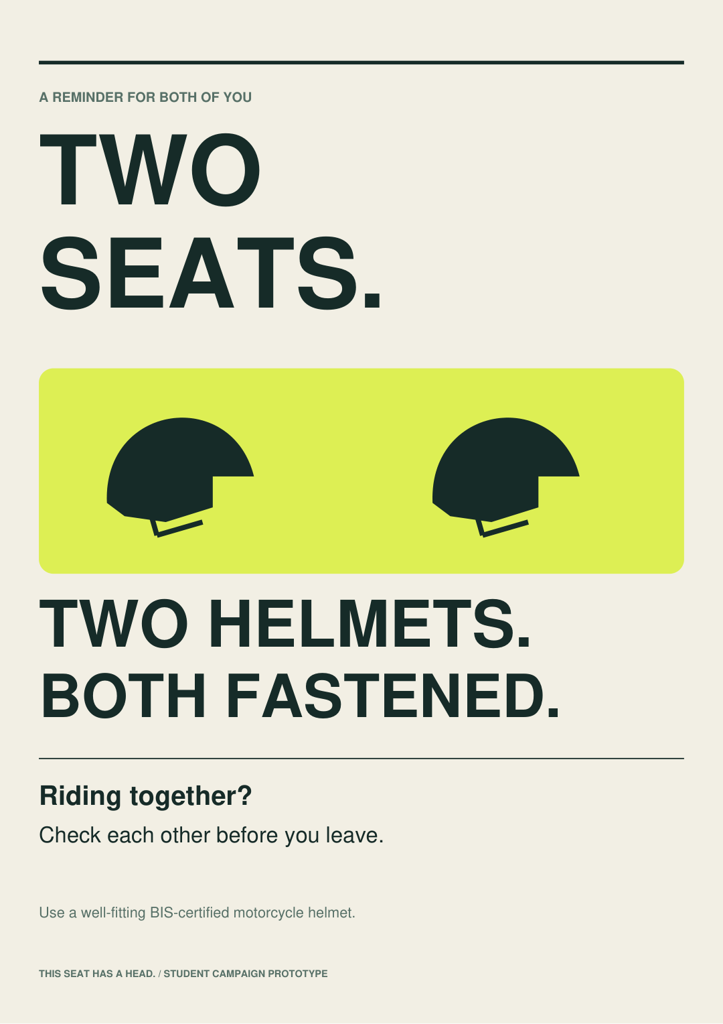
10 / ONE VISUAL SYSTEM
Two seats.
Two helmets.
Equal-scale helmet symbols. One clear instruction.
Deep green + warm ivory + signal yellow-green.
Supporting poster reinforces the pre-ride check.
No certification marks, police styling, sponsor logo, crash imagery or claim of guaranteed protection.
Notes:
No certification marks, police styling, sponsor logo, crash imagery or claim of guaranteed protection.

Slide 12
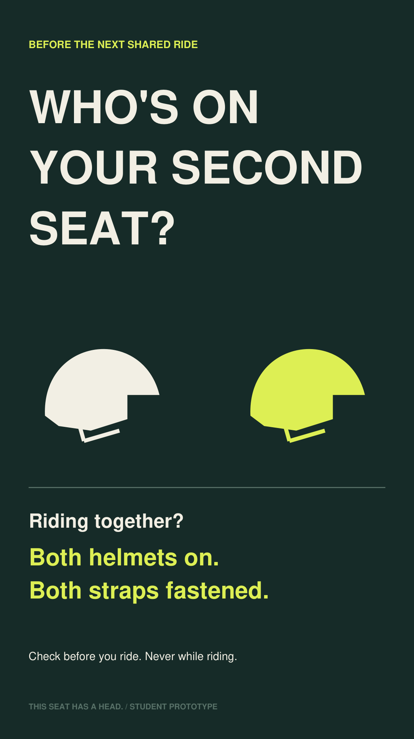
11 / DIGITAL EXTENSION
Who's on your
second seat?
A captioned 15-second illustrated sequence.
One bike / two people / two helmets / both fastened.
Check before the ride, never while riding.
HTML motion prototype and vertical artwork supplied. Not live-action footage or a claimed platform deployment.
Notes:
HTML motion prototype and vertical artwork supplied. Not live-action footage or a claimed platform deployment.

Slide 13
12 / EXECUTION
Small enough
to demonstrate safely.
12 reusable A6 cards + 2 A3 posters.
Permissioned stationary encounter; no unattended placement.
No helmet or vehicle attachments.
No permission? Use the illustrated demonstration only.
No partner, venue access, participant consent or filming is claimed to have been secured.
Notes:
No partner, venue access, participant consent or filming is claimed to have been secured.

Slide 14
13 / FEASIBILITY
INR 700
Cards 180 / Posters 160 / Proofs 160
Consent and tally sheets 50 / Contingency 150
Uses existing print media and a supervised setting.
Planning assumptions, not vendor quotes. Excludes labour, travel, permissions, tax changes and helmet purchase.
Notes:
Planning assumptions, not vendor quotes. Excludes labour, travel, permissions, tax changes and helmet purchase.

Slide 15
14 / VALIDATION, NOT INVENTED RESULTS
Did the message
actually arrive?
Proposed comprehension test: 12 consenting adults.
Proposed revision gate: 10 identify passenger helmet use + fastening before departure.
Ask openly about meaning, tone, timing and confusion.
No tests conducted. Threshold is an operational design gate, not a validated benchmark. Any safety concern triggers revision.
Notes:
No tests conducted. Threshold is an operational design gate, not a validated benchmark. Any safety concern triggers revision.

Slide 16
15 / EVALUATION AND LIMITS
Measure the check.
Do not promise lives saved.
Optional pilot: aggregate observations of paired departures.
Record both helmets, visible straps and unknown observations.
No plates, faces, names or equipment-certification claims.
An uncontrolled small pilot cannot establish causality.
Plan only. Do not report invented lifts, audience quotes, crash reductions or long-term effectiveness.
Notes:
Plan only. Do not report invented lifts, audience quotes, crash reductions or long-term effectiveness.

Slide 17
16 / PROJECT PROGRESSION
From evidence
to one clear action.
14 OCT - cause, research / insight, three concepts.
21 OCT - design WIP and feasible comprehension work.
27 OCT - campaign submission.
28 OCT - presentation and final review.
Dates as supplied in the assignment brief; brief specifies no year. Actual fieldwork, permissions and outcomes remain unclaimed.
Notes:
Dates as supplied in the assignment brief; brief specifies no year. Actual fieldwork, permissions and outcomes remain unclaimed.

Slide 18
17 / RESEARCH AND PRECEDENT
Traceable facts.
Honest limitations.
Mishra et al., 2025 / PMC12020946 / primary hospital study.
MoRTH 2024 data / reproduced OpenCity table + HT reporting.
WHO, Road traffic injuries / updated 20 July 2026.
PIB, Helmet - More Than Just a Shell / 12 July 2025.
MediaNews4u / The Helmet Receipt / 7 February 2026.
Complete URLs and claim limits in CAMPAIGN_REPORT and the research ledger. Sources accessed 14 October 2026.
Notes:
Complete URLs and claim limits in CAMPAIGN_REPORT and the research ledger. Sources accessed 14 October 2026.

Slide 19
THE TAKEAWAY
Two seats.
Two helmets.
Both fastened.
The second person is not an afterthought.
THIS SEAT HAS A HEAD. / STUDENT DESIGN SUBMISSION
Notes:
THIS SEAT HAS A HEAD. / STUDENT DESIGN SUBMISSION

