Slide 1






STUDENTS NAME :M.LENOPHIA REGISTER NO:2426j0668
NM
ID:A62B4BD45A9B8418B6B4BA9B 2FAA0633
DEPARTMENT:BSC[IT]
COLLEGE:KAMALAM COLLEGE OF ARTS AND SCIENCE

Slide 2


My Portfolio Website Project: A Digital Showcase
Welcome! Today, I'll walk you through the journey of creating my personal portfolio website. This project is more than just a collection of work; it's a reflection of my design philosophy and technical skills.

Slide 3



Project Statement: The Vision Behind the Design
My vision for this portfolio was to create an intuitive, aesthetically pleasing, and highly functional platform. It's designed to showcase my diverse skill set in a way that is both engaging and easy to navigate, acting as a dynamic resume that truly reflects my capabilities.
Clarity
Ensure easy understanding of my projects and skills.
Aesthetics
Present a modern, clean, and visually appealing design.
Performance
Guarantee a fast, responsive user experience.

Slide 4

Project Overview: Goals & Scope
The primary goal was to build a comprehensive digital portfolio that effectively communicates my professional identity and project experience to potential employers and collaborators. The scope included front-end development, content creation, and responsive design for various devices.

Slide 5

Who Are the End Users? Target Audience Insights
Understanding my audience was crucial. My primary users are hiring managers, recruiters, and fellow industry professionals who are looking for specific skills and a clear demonstration of past work. They need quick access to information and a seamless browsing experience.
Key Audience Needs:
Clear presentation of projects
Easy navigation to relevant sections Quick access to contact information
Insight into my design process and problem-solving Compatibility across devices

Slide 6





Tools & Techniques Used in Development
I leveraged a combination of industry-standard tools and modern development techniques to bring this project to life, ensuring a robust and scalable foundation.
HTML5 & CSS3
For structuring content and styling with modern aesthetics.
JavaScript
To add interactivity and dynamic user experiences.
React (Framework)
For building a modular and efficient user interface.
Figma
For wireframing, prototyping, and UI/UX design.
Git & GitHub
For version control and collaborative development.

Slide 7
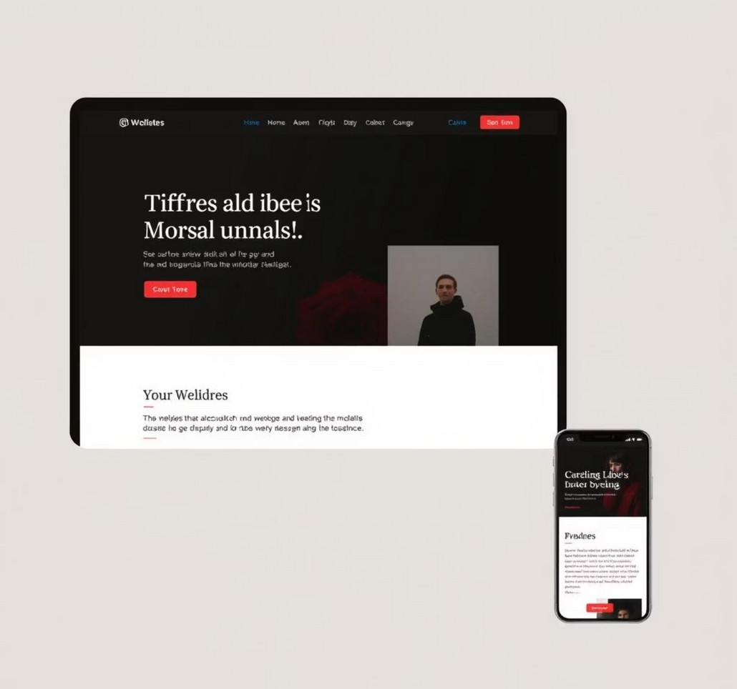
Portfolio Design & Layout: Aesthetic Choices
The design philosophy focused on minimalism, functionality, and a strong visual hierarchy. The layout is clean and responsive, ensuring a consistent experience across all devices, from desktop to mobile.
Clean Typography: Emphasis on readability and modern fonts. Intuitive Navigation: Streamlined menus for effortless browsing. Visual Hierarchy: Guiding the user's eye to key information.
Harmonious Color Palette: Using #C91313, #510C04, and #740B0A as accent colors to define sections and emphasize crucial elements.
Responsive Design: Optimized for all screen sizes.

Slide 8
Key Features & Functionality Showcase
The website integrates several key features designed to enhance user engagement and provide a comprehensive view of my capabilities.
Interactive Project Gallery
Detailed case studies with high-resolution images and project breakdowns.
Integrated Blog/Insights
A section for sharing thoughts on design trends, development, and personal projects.
Dynamic Skill Display
An animated section showcasing proficiency in various tools and languages.
Contact Form & Social Links
Easy ways for visitors to connect directly or through professional networks.

Slide 9
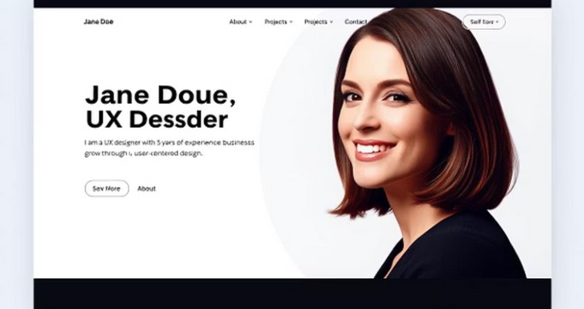
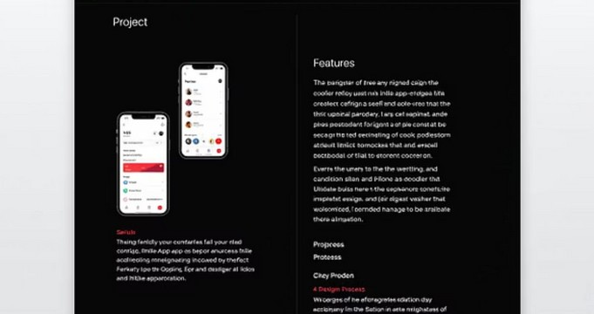
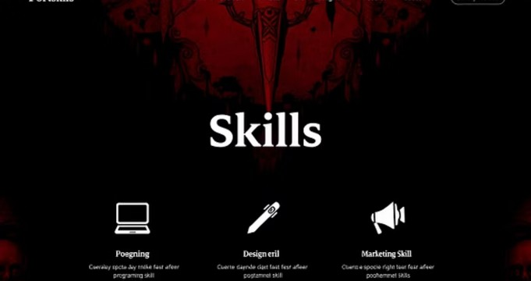
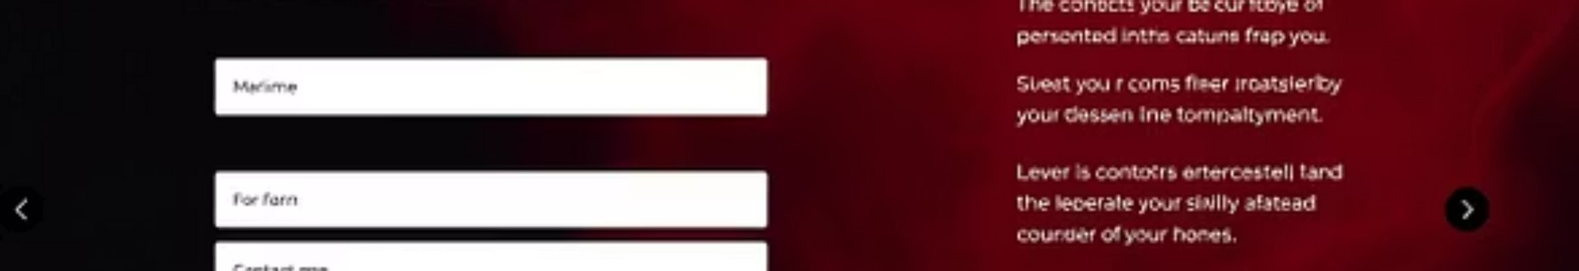
Results & Live Demonstration
The completed portfolio website successfully achieves its goals, providing a professional and engaging platform. Here are some visual highlights:
The website is live and fully accessible, demonstrating real-world application of my skills.

Slide 10
Conclusion: Lessons Learned & Future Plans
This project reinforced the importance of user-centered design and iterative development. I learned valuable lessons in front-end optimization and content strategy.
0 0 0
1 2 3
Continuous Improvement
Regularly update content and optimize performance.
User Feedback Integration
Incorporate feedback to enhance usability.
New Feature Development
Add more interactive elements and potentially a backend for dynamic content.
My portfolio will evolve as my skills and projects grow, reflecting my continuous learning journey.

Slide 11

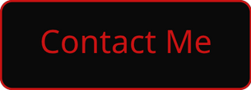
Q&A and Thank You
Thank you for your time and attention. I am now open to any questions you may have about my portfolio website project.
"The only way to do great work is to love what you do."
— Steve Jobs

Slide 12
GitHub Link & Further Exploration
Explore the full source code and contribute:
Live demo and editable version on Codepen:
https://codepen.io/Leno-Leno/pen/empLwLo

