Slide 1
Cross-Platform Mobile Development
Winston Gubantes
Xamarin Developer
Gluon Consulting

Slide 2



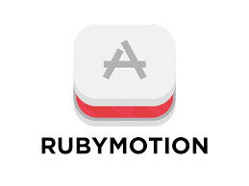







Cross-Platform Mobile Development Tools

Slide 3
Cross-Platform Mobile Development Languages
C++
Qt
Javacript
Cordova / Phonegap
Nativescript
C#
Xamarin
IFactor
Lua
Ruby
Corona
Rubymotion
ReactNative
Kony
Appcellerator

Slide 4
The Big 3
Three of the most popular Cross-Platform Mobile Development tools.

Slide 5
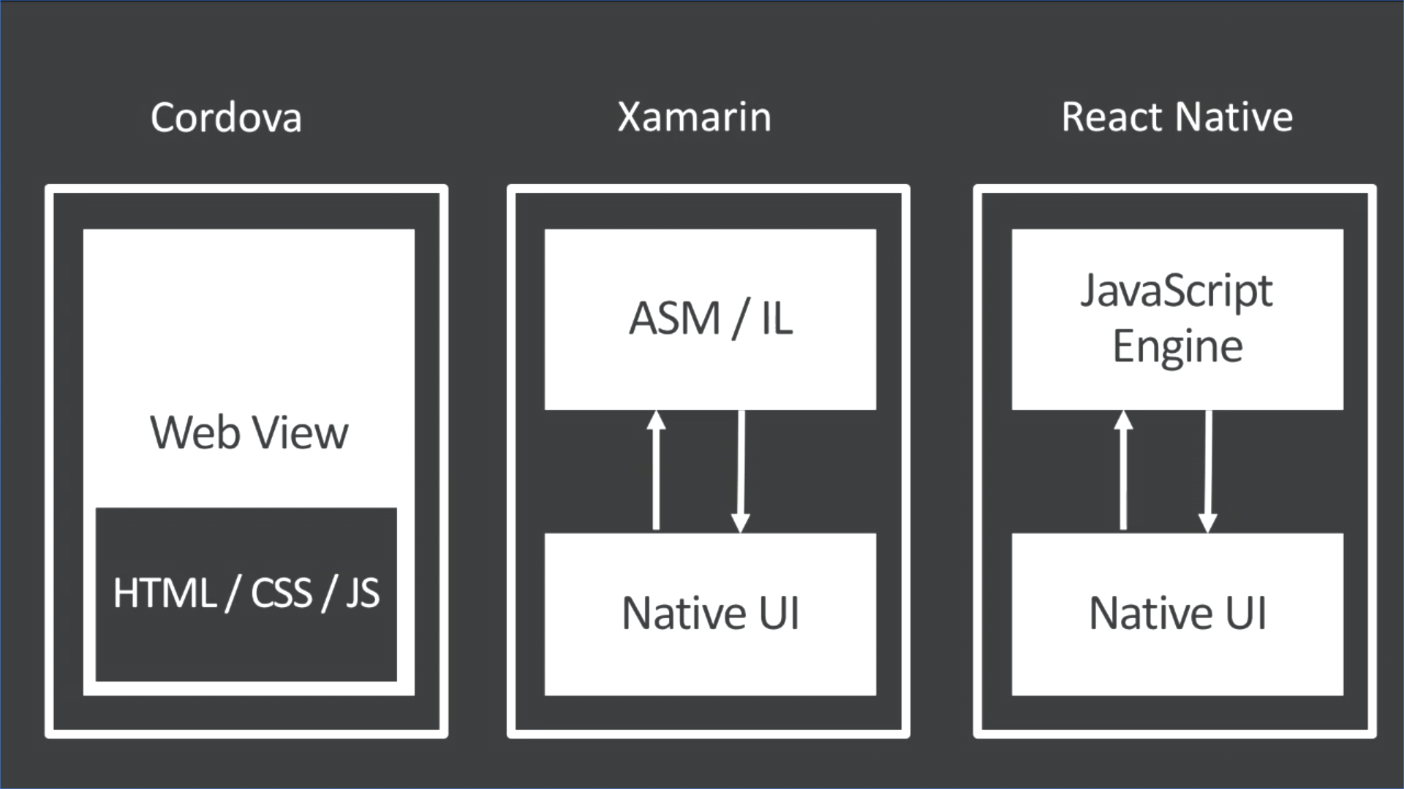
Build Build Build

Slide 6
Demo

Slide 7

Myth Busters
Cross-platform app is not native

Slide 8
Myth Busters
Cross-platform app is slow

Slide 9
Myth Busters
Cross-platform cannot fall back to native

Slide 10
Myth Busters
Cross-platform app is bloated

Slide 11

Commonly Ask Questions
Should I develop an App for iOS or Android first?

Slide 12
Commonly Ask Questions
Where is the best place to go if I get stuck into something?

Slide 13
Demo
Xamarin.Forms

Slide 14

Tips and Tricks
Xamarin.Forms

Slide 15

It's a Disastah!
Disastrous Mistakes for Cross-Platform Mobile Development

Slide 16



