Slide 1
Integrating Power BI with Excel 2016 and Excel Online
Presented by Ted Pattison

Slide 2


About Ted Pattison and Critical Path Training
Ted Pattison
25 years as an author, technical trainer & conference speaker
Specializing in Power BI, Office 365, SharePoint & Azure
SharePoint MVP since 2004
Critical Path Training
Advanced technical training on Power BI, SharePoint & others
Offering Power BI Bootcamp as 3-day deep dive into Power BI
My Upcoming Power BI Training Events
PBIUG Focus Event in Chicago on June 7-8
Power BI Bootcamp in Tampa on Aug 29

Slide 3
Agenda
Building Data Models using Excel 2016
Visualizing Data in Excel 2016
Excel Worksheets: Import versus Connect
The Power BI Publisher for Excel Add-in
The Analyze in Excel Add-in

Slide 4
Revisiting The Excel Data Model
Every Excel Workbook can have a data model
Provides a foundation for BI project solution
When importing data with Power Query…
You can add the data as a table in a worksheet
You can add the data as a table in the data model
Excel Workbook
worksheet
Database
worksheet
worksheet

Slide 5
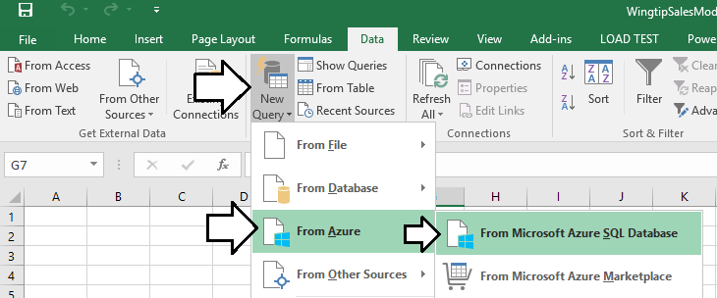
Working with the Power Query Add-In
Power Query Add-In adds a tab to Excel ribbon
Click Manage button display Power Query window
You must switch back and forth between Excel application window

Slide 6
Extracting and Modeling Data in Microsoft Excel 2016

Slide 7
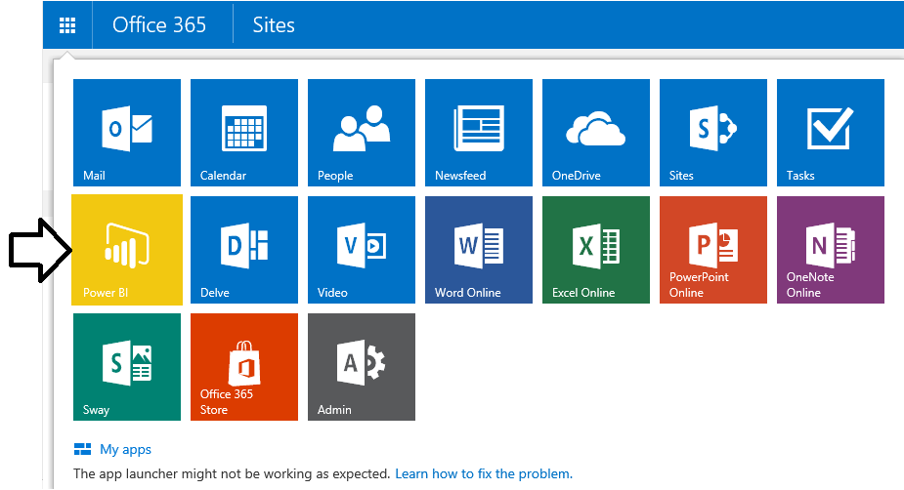
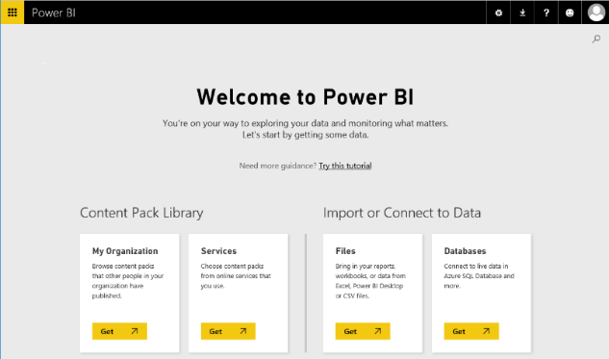
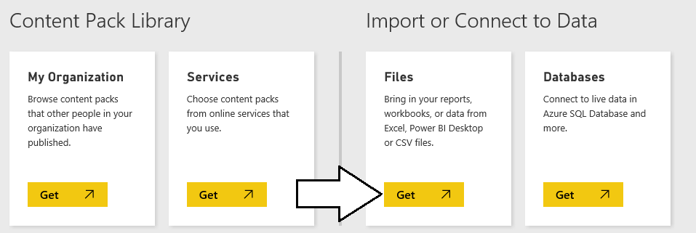
Getting Started with the Power BI Service
2
1
3

Slide 8
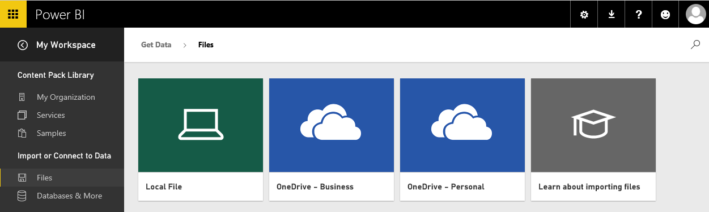
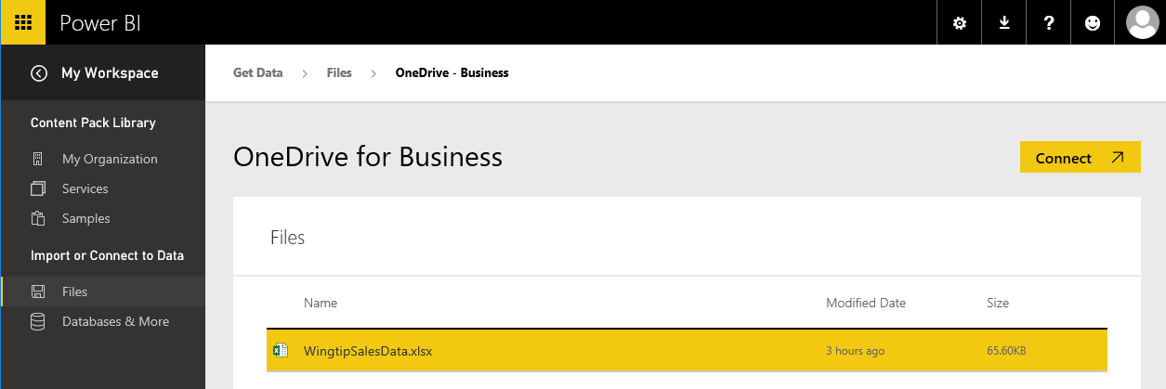
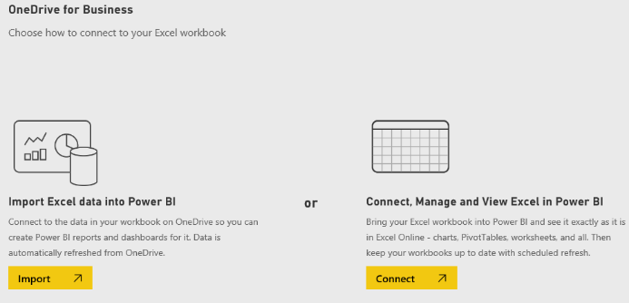
Importing a Dataset
Connect to files in OneDrive
Select the file and click Connect
Choose between Import or Connect

Slide 9
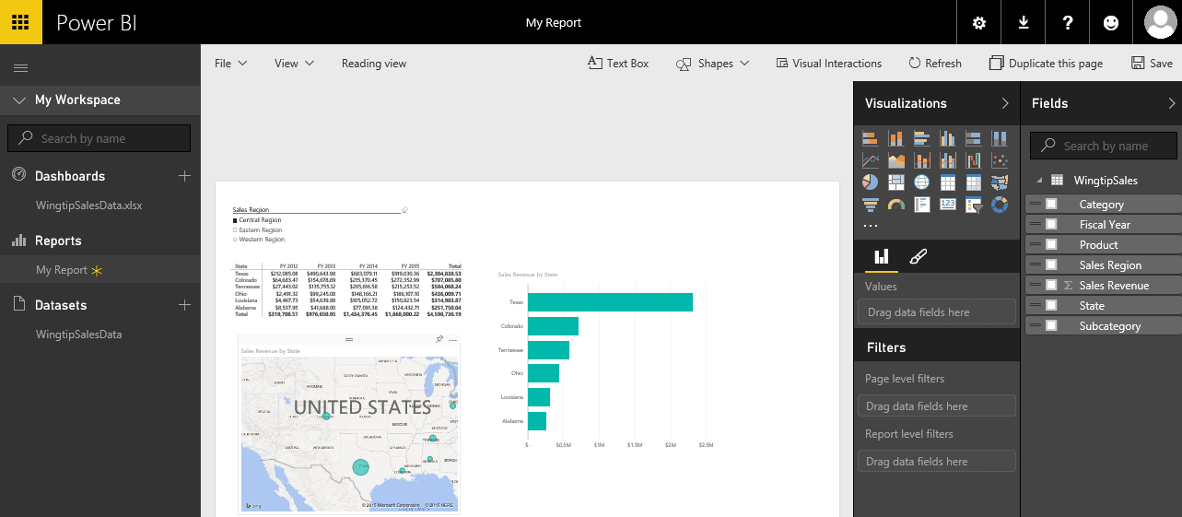
Designing Reports
Power BI service provides browser-based report designer
Report contains one o more pages
Pages contain visuals (aka visualizations)
Visuals display fields from underling data model

Slide 10
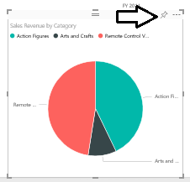
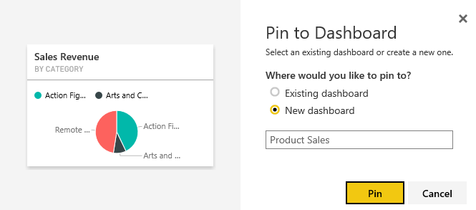
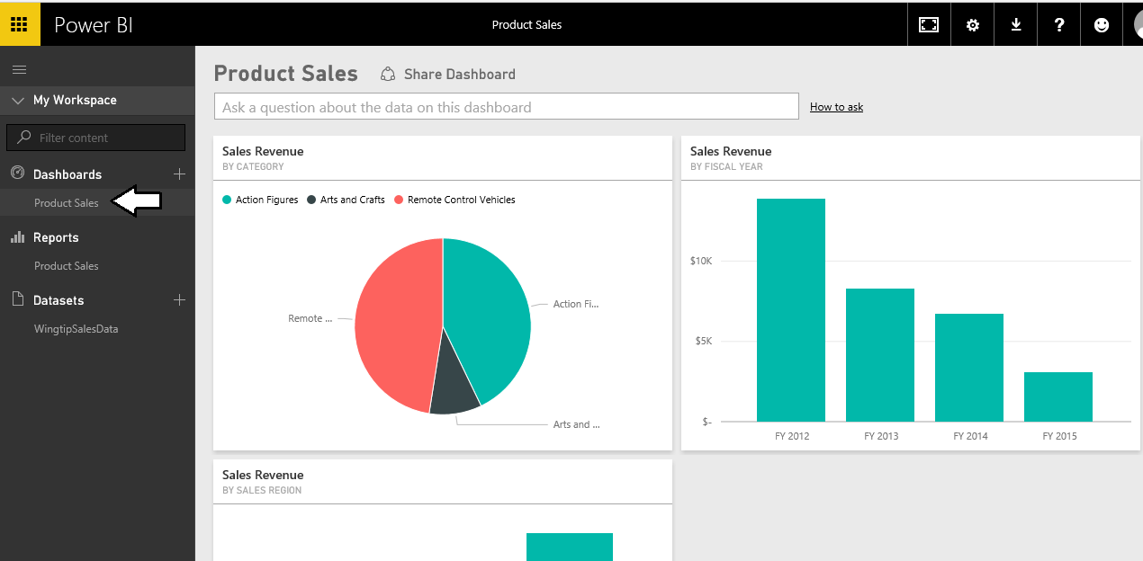
Creating Dashboards
Dashboards contain tiles
Tiles created from visuals on report pages
1
2
3

Slide 11
Workbook Import versus Connect

Slide 12
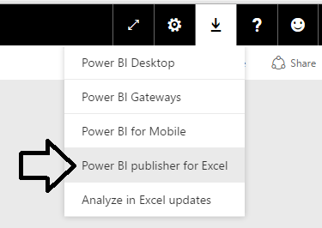

Power BI Publisher for Excel
Power BI Publisher for Excel
Download for free from Power BI service website
Installs as an add-in to Microsoft Excel

Slide 13
Publishing Excel Items to Power BI

Slide 14
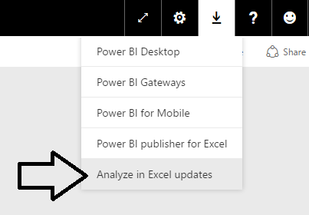
Analyze in Excel
Analyze in Excel Add-in
Allows Excel to connect to Power BI Dataset in Cloud
Provides foundation for SSAS in the cloud

Slide 15
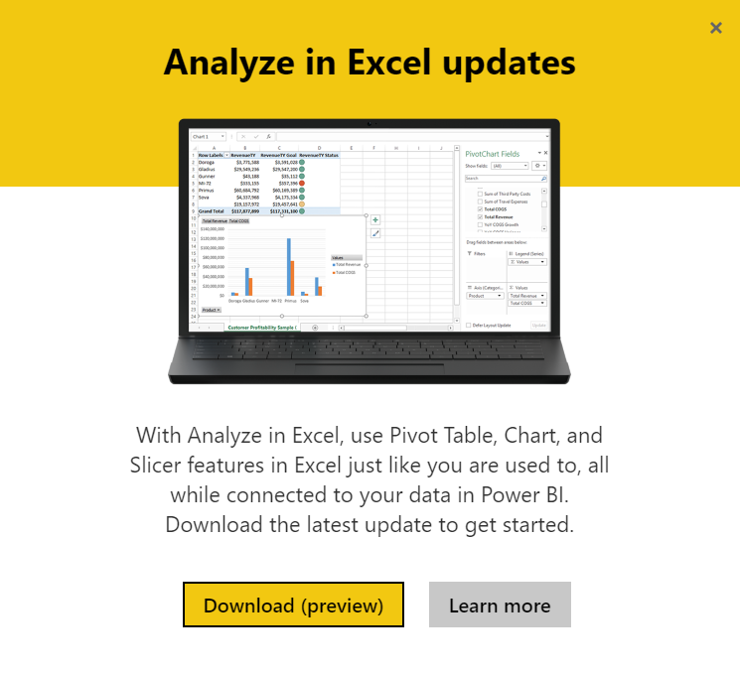

Slide 16
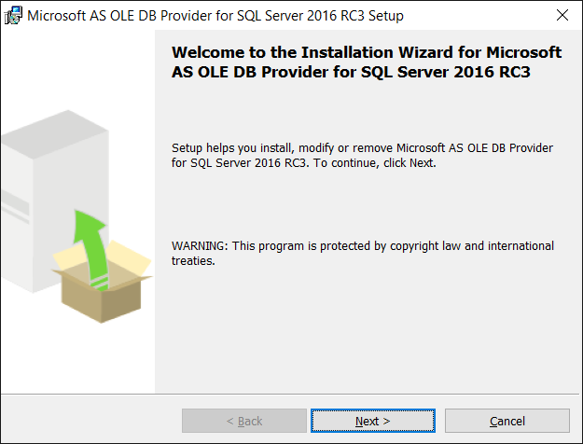

Slide 17
Analyze in Excel

Slide 18
Agenda
Building Data Models using Excel 2016
Visualizing Data in Excel 2016
Excel Worksheets: Import versus Connect
The Power BI Publisher for Excel Add-in
The Analyze in Excel Add-in

