Slide 1
20743C
Upgrading Your Skills to MCSA: Windows Server 2016
Notes:
This introduction module (known as “Module 0”) provides students with an overview of the course content materials and logistics.
Required materials
To teach this course, you need the following materials:
Course Handbook
Trainer materials, including:
Trainer Preparation Guide
Microsoft PowerPoint files for this course
Microsoft Hyper‑V Classroom Setup Guide
Virtual machines (VMs) for the course
Latest error logs for the course, if any
Preparation tasks
To prepare for this course, you must follow and complete the tasks that the Trainer Preparation Guide outlines.
Presentation: 30 minutes

Slide 2

Welcome
Thank you for joining us today.
We’ve worked together with the Microsoft Partner Network and Microsoft IT Academies to bring you a world-class learning experience.
Microsoft Certified Trainers + Instructors. Your instructor is a premier technical and instructional expert who meets ongoing certification requirements.
Customer Satisfaction Guarantee. Our partners offer a satisfaction guarantee and we hold them accountable for it. At the end of class, please complete an evaluation of today’s experience. We value your feedback!
Certification Exam Benefits. After training, consider pursuing a Microsoft Certification to help distinguish your technical expertise and experience. Ask your instructor about available exam promotions and discounts.
We wish you a great learning experience and ongoing career success!

Slide 3

Hello! Instructor introduction
Instructor: <Name>
<Title or other credentials, e.g. Microsoft Certified Trainer>
<Affiliation/Company>
<A few words about my technical and professional experience>
Notes:
Welcome students to the course and introduce yourself. Provide a brief overview of your background to establish credibility.

Slide 4
Hello! Student introductions
Let’s get acquainted:
Your name
Company affiliation
Title/function
Windows Server 2008 or Windows Server 2012 experience
Your expectations for the course
Notes:
Ask students to introduce themselves and to provide their backgrounds, product experience, and expectations for the course.
Record student expectations on a whiteboard or flip chart that you can reference during class.

Slide 5


Facilities
Class hours
Building hours
Parking
Restrooms
Meals
Phones
Messages
Smoking
Internet access
Recycling
Emergency procedures
Notes:
Explain class and facility logistics by using the bulleted list. Inform students about any emergency procedures, such as emergency exits and plans in the event of fire or other emergencies.

Slide 6
About this course: Audience
Candidates who attend this course typically are IT professionals who:
Are experienced Windows Server 2012 or Windows Server 2008 system administrators
Have real-world experience working in a Windows Server 2008 or Windows Server 2012 enterprise environment
Have obtained the Microsoft Certified Solutions Associate (MCSA) credential for Windows Server 2008 or Windows Server 2012, or have equivalent knowledge
Notes:
Describe the audience for this course. This is an opportunity for you to identify students who might not have the appropriate background or experience to attend the course.

Slide 7
About this course: Prerequisites
Before attending this course, students should have:
Two or more years of experience deploying and managing Windows Server 2008 or Windows 2012 environments
Experience with Windows networking technologies and implementation
Experience with Active Directory technologies and implementation
Experience with Windows Server virtualization technologies and implementation
Experience with day-to-day Windows Server 2008 or Windows Server 2012 system administration management and maintenance tasks
Notes:
Describe the course prerequisites.

Slide 8
About this course: Objectives
After completing this course, students will be able to:
Install and configure Windows Server 2016
Describe storage in Windows Server 2016
Implement directory services
Implement Active Directory Federation Services (AD FS)
Describe networking
Implement Microsoft Hyper-V
Configure advanced networking features
Implement Software Defined Networking
Implement remote access
Deploy and manage Windows Server and Hyper-V containers
Implement failover clustering
Implement failover clustering by using virtual machines

Slide 9
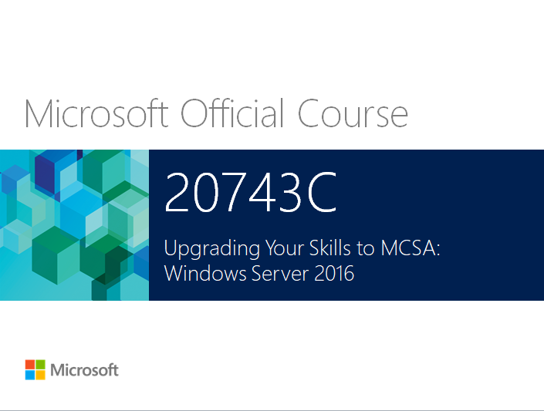
Your course materials
Designed to optimize your classroom learning experience
and support you back on the job
Microsoft Official Course handbook
Organized by modules
Includes Labs and Lab Answer Keys
Module Reviews and Takeaways make great on-the-job references
Digital Companion Content
Supplemental content and helpful links
Download at: http://www.microsoft.com/learning/companionmoc
Notes:
<< Use this slide for printed courseware. Use next slide for digital courseware. >>
Introduce the students to their course materials.
Explain how you intend for students to use the Course Handbook in the class, and the Digital Companion Content outside the class:
Explain that students can refer to the Course Handbook during the lecture because it contains all of the critical technical information that they need in a crisp, tightly-focused format, which is suited for an effective in-class learning experience.
The Digital Companion Content supplements the Course Handbook, and provides an opportunity for extended, self-directed learning beyond the classroom.

Slide 10


Your course materials (OPTIONAL)
Microsoft Official Course Handbook (digital):
Access online using the Skillpipe reader by arvato at https://skillpipe.courseware-marketplace.com /en-GB/Account/Login
Register/sign in and redeem your digital courseware
Easily add notes and comments and highlight content
Organized by module
Includes Labs and Lab Answer Keys
Module Reviews and Takeaways make great on-the-job references
Digital Companion Content:
Supplemental content and helpful links
Download at http://www.microsoft.com/learning/companionmoc
Notes:
<<Use this slide for digital courseware. Use the previous slide for printed courseware.>>
Introduce students to their course materials.
You should take the opportunity to make sure that all students can sign in and access their content. In addition, demonstrate some of the features and functionality.
You also can mention that the courseware is updated over time. Their content will also be updated so that they always have the latest, most technically up-to-date content, and they will not lose any comments, notes, or highlights that they have made.

Slide 11
Course outline
Module 1
Installing and configuring Windows Server 2016
Module 2
Overview of storage in Windows Server 2016
Module 3
Implementing Directory Services
Module 4
Implementing AD FS
Module 5
Implementing network services
Module 6
Implementing Hyper-V

Slide 12
Course outline, continued
Module 7
Configuring advanced networking features
Module 8
Implementing Software Defined Networking
Module 9
Implementing remote access
Module 10
Deploying and managing Windows and Hyper-V containers
Module 11
Implementing failover clustering
Module 12
Implementing failover clustering with Windows Server 2016 Hyper-V

Slide 13

Microsoft Certification Program
Get trained. Get certified.
Get ahead.
Microsoft Certifications demonstrate that you have the skills to design, deploy, and optimize the latest technology solutions.
Ask your Microsoft Learning Partner how you can prepare for certification.
For more information about Microsoft Certifications, go to:
http://www.microsoft.com/learning/
certification
Microsoft Certified Solutions Expert (MCSE)
Microsoft Certified Solutions Associate (MCSA)

Slide 14
Windows Server 2016 certification path
MCSA: Windows Server 2016
Exam 70-740
Exam 70-741
Exam 70-742
Exam 70-743
Installation, Storage, and Compute with Windows Server 2016
Networking with Windows Server 2016
Identity with Windows Server 2016
Upgrading Your Skills to MCSA: Windows Server 2016
OR
Course 20740C
Course 20741B
Course 20742B
Course 20743C
Installation, Storage, and Compute with Windows Server 2016
Networking with Windows Server 2016
Identity with Windows Server 2016
Upgrading Your Skills to MCSA: Windows Server 2016

Slide 15
Preparing for the labs
Your lab activities will involve a fictitious company called Adatum Corporation, through which you will learn how to perform tasks that relate to deploying and managing Windows Server 2016.
You will work in a virtual machine environment to complete the labs.
Notes:
Tell students whether the course labs will be run as on‑premises local labs, or as hosted online labs.
On‑premises labs are run on the local host machines in Hyper‑V.
Hosted online labs are accessed on the local host machines via a web browser, similar to the VMs that are running on a hosted platform and accessed via a browser.

Slide 16
VM environment
VM name | Use as
20743C-LON-DC1 (-B, -C) | Domain controller running Windows Server 2016 in the Adatum.com domain
20743C-LON-SVR1 (-B) | Windows Server 2016 server in the Adatum.com domain
20743C-LON-SVR2 | Windows Server 2016 server in the Adatum.com domain
20743C-LON-SVR3 | Windows Server 2016 server in the Adatum.com domain
20743C-LON-SVR6 | Blank VHD
20743C-LON-CL1 | Client computer running Windows 10 and Microsoft Office 2016
20743C-LON-CL2 | Client computer running Windows 10 and Office 2016
20743C-LON-CL3 | Client computer running Windows 10 and Office 2016

Slide 17
VM environment (continued)
VM name | Use as
20743C-LON-RTR | Standalone Windows Server 2016 computer used as a router
20743C-TREY-DC1 | Domain controller running Windows Server 2016 in the TreyResearch.net domain
20743C-INET1 | Standalone Windows Server 2016 computer used as a simulated internet host
20743C-LON-HOST1 | Virtual hard disk with Windows Server 2016 used for boot from virtual hard disk exercises
20743C-LON-HOST2 | Virtual hard disk with Windows Server 2016 used for boot from virtual hard disk exercises
20743C-LON-NVHOST2 | Nested host Windows Server 2016 virtual machine
20743C-LON-NVHOST3 | Nested host Windows Server 2016 virtual machine
20743C-LON-NVHOST4 | Nested host Windows Server 2016 virtual machine
20743C-NAT | Network address translation (NAT) server

Slide 18
Demonstration: Using Hosted Online Labs (OPTIONAL)
In this demonstration, you will learn how to:
Access the hosted online lab environment
Switch between VMs
Read the online Lab Notes carefully, because some procedures related to on-premises lab versus online labs may have slightly different steps. Any differences will be called out in the Lab Notes.
Notes:
<< Use this slide for hosted online labs. Use next slide for on-premises local labs. >>
<< Delete the slide that you are not using.>>
You should take this opportunity to show students the lab environment.
Take a moment to sign in and describe the lab environment to the students. Be sure to point out the online Lab Notes document, which contains details of any changes to the lab steps.
In addition, there is an optional Navigation in the Windows Server 2012 demonstration (on the last slide), which is relevant if you are using hosted online labs.

Slide 19
Demonstration: Using Hyper-V Manager (optional)
In this demonstration, you will learn how to:
Open Hyper-V Manager
Navigate the various sections and panes in Hyper-V Manager:
VMs, snapshots, and actions (server-specific and VM‑specific)
Identify the VMs that you will use in the labs for this course
Take a snapshot and apply a snapshot
Connect to a VM
Start and sign in to a VM
Switch between full screen and window modes
Revert to the previous snapshot
Shut down a VM:
Know when to shut down versus turn off a VM
Close Hyper-V Manager
Notes:
<< Use this slide for on-premises local labs.>>
<< Delete the slide that you are not using.>>

