Slide 1
Module 2
Overview of storage in Windows Server 2016
Notes:
Presentation: 90 minutes
Lab: 135 minutes
After completing this module, students will be able to:
Describe the new features in Windows Server 2016 storage.
Implement Data Deduplication.
Configure internet small computer system interface (iSCSI) storage.
Configure the Storage Spaces feature.
Required materials
To teach this module, you need the Microsoft PowerPoint file 20743C_02.pptx.
Preparation tasks
To prepare for this module, you should:
Read all of this module’s materials.
Practice performing the demonstrations and labs.
Work through the Module Review and Takeaways section to determine how you will use the information to reinforce student learning and promote knowledge transfer to on-the-job performance.
As you prepare for this class, it is imperative that you complete the labs yourself. This gives you an understanding of how the labs work and the concepts that each covers, so that you can provide meaningful hints to students who might have issues. Furthermore, it will help guide your lecture to ensure that you discuss the concepts that the labs cover.
20743C
2: Overview of storage in Windows Server 2016

Slide 2
Module Overview
Overview of storage in Windows Server 2016 Implementing Data Deduplication Configuring iSCSI storage Configuring the Storage Spaces feature in Windows Server 2016
Notes:
20743C
2: Overview of storage in Windows Server 2016

Slide 3
Lesson 1: Overview of storage in Windows Server 2016
New storage features in Windows Server 2016 What is Software Defined Storage? Overview of ReFS Overview of FSRM Demonstration: Using FSRM to manage quotas, file screens, and storage reports File classification Demonstration: Configuring file classification
Notes:
Question
You can use Windows PowerShell scripts to change the file-classification properties.
( ) False
( ) True
Answer
( ) False
( √) True
Feedback
In addition to folder classifier and string classifier, you can also use the Windows PowerShell classifier to change the file-classification properties.
20743C
2: Overview of storage in Windows Server 2016

Slide 4
New storage features in Windows Server 2016
Windows Server 2016 provides the following new file and storage services features:
Storage Spaces Direct
Storage Replica
Storage QoS
Data Deduplication (improved)
Notes:
Note: This topic has one additional slide. Explain to the students that later sections of this module will discuss most of the new features more in depth. Do not spend too much time on this topic, which has two slides. This is the first slide.
20743C
2: Overview of storage in Windows Server 2016

Slide 5
New storage features in Windows Server 2016
Windows Server 2012 provides the following new file and storage services features:
Multiterabyte volumes
Data Deduplication
iSCSI Target Server
Storage spaces and storage pools; (tiered storage spaces in Windows Server 2012 R2)
Unified remote management of File and Storage Services in Server Manager
ReFS
ODX
Notes:
20743C
2: Overview of storage in Windows Server 2016

Slide 6
What is Software Defined Storage?
Is a concept of managing storage independent of the underlying hardware
Can revolutionize storage in the same way as virtualization has revolutionized servers
Includes the following features in Windows Server 2016:
Storage Spaces
Scale-Out File Servers
Storage Replica
Data Deduplication
Thin provisioning
iSCSI storage
Notes:
Define the concept of Software Defined Storage, and explain that it is not a technology. In Windows Server 2016, several different features provide Software Defined Storage functionality.
20743C
2: Overview of storage in Windows Server 2016

Slide 7
Overview of ReFS
ReFS:
Is a file system introduced in Windows Server 2012
Provides the following benefits:
Metadata integrity with checksums
Integrity streams providing optional user data integrity
Allocation on write transactional model
Large volume, file, and directory sizes
Data striping for performance and redundancy
Disk scrubbing for protection against latent disk errors
Includes a new feature, Accelerated VHDX Operations, that improves performance on Hyper-V storage
Notes:
Resilient File System (ReFS) is not new in Windows Server 2016. However, for students who are familiar with Windows Server 2008 R2, you might want to introduce ReFS. Emphasize the new Accelerated VHDX Operations feature of Windows Server 2016 and ReFS.
20743C
2: Overview of storage in Windows Server 2016

Slide 8
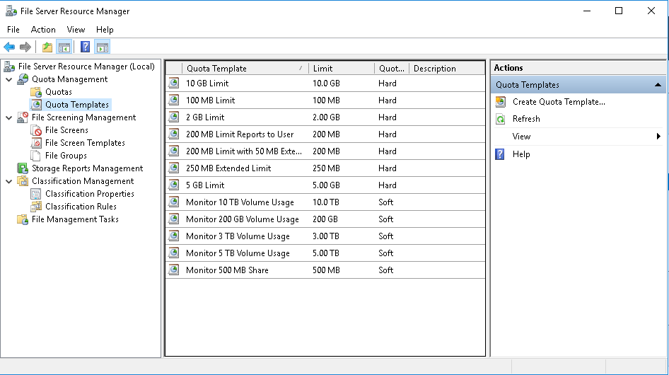
Overview of FSRM
Use FSRM to manage and classify data that is stored on file servers
Notes:
Explain that the purpose of File Server Resource Manager (FSRM) is to manage and classify data that is stored on a file server. You then can discuss its features, or just the features that students either are not aware of or familiar with.
20743C
2: Overview of storage in Windows Server 2016

Slide 9
Demonstration: Using FSRM to manage quotas, file screens, and storage reports
In this demonstration, you will see how to:
Create a quota
Test a quota
Create a file screen
Test a file screen
Generate a storage report
Notes:
Ensure that students understand the commands. Be aware that text wrap in the instructions can make one command appear to be two separate commands.
Keep the virtual machines running for the next demonstration.
Preparation Steps
For this demonstration, you need to use the available virtual machine environment. Before you begin the demonstration, you must complete the following steps:
On the host computer, start Hyper-V Manager.
In Hyper-V Manager, click 20743C-LON-DC1, and then in the Actions pane, click Start.
In the Actions pane, click Connect. Wait until the virtual machine starts.
Sign in by using the following credentials:
User name: Administrator
Password: Pa55w.rd
Domain: Adatum
Repeat steps 2 to 4 for 20743C-LON-SVR1.
Demonstration Steps
Create a quota
On LON-SVR1, click Start, and then click Server Manager.
In Server Manager, click Add roles and features.
In the Add Roles and Features Wizard, click Next.
Confirm that Role-based or feature-based installation is selected, and then click Next.
Confirm that LON-SVR1.Adatum.com is selected, and then click Next.
20743C
2: Overview of storage in Windows Server 2016
(More notes on the next slide)

Slide 10
Notes:
On the Select server roles page, expand File and Storage Services (2 of 12 Installed), expand File and iSCSI Services (1 of 11 Installed), and then select the File Server Resource Manager check box.
In the Add role and features Wizard dialog box, click Add Features.
Click Next twice to confirm the role service and feature selection.
On the Confirm installation selections page, click Install.
When the installation completes, click Close.
In Server Manager, click Tools, and then click File Server Resource Manager.
In the File Server Resource Manager window, expand the Quota Management node, and then click Quota Templates.
Right-click the 100 MB Limit template, and then click Create Quota from Template.
In the Create Quota window, click Browse.
In the Browse for Folder window, expand Allfiles (D:), expand Labfiles, click Mod02, and then click OK.
In the Create Quota window, click Create.
In the File Server Resource Manager window, click Quotas to view the newly created quota.
Test a quota
Click Start, and then click Windows PowerShell.
In the Windows PowerShell window, type the following two commands, pressing Enter after each command:
cd D:\labfiles\Mod02
Fsutil file createnew largefile.txt 123456789
(More notes on the next slide)
20743C
2: Overview of storage in Windows Server 2016

Slide 11
Notes:
Notice that the following message displays: “Error: There is not enough space on the disk.”
Close the Windows PowerShell window.
Create a file screen
In the File Server Resource Manager window, expand the File Screening Management node, and then click File Screen Templates.
Right-click the Block Image Files template, and then click Create File Screen from Template.
In the Create File Screen window, click Browse.
In the Browser for Folder window, expand Allfiles (D:), expand Labfiles, click Mod02, and then click OK.
In the Create File Screen window, click Create.
Test a file screen
Open File Explorer.
In the File Explorer window, expand This PC, expand Allfiles (D:), and then expand Labfiles.
In File Explorer, click the Home tab, click New Item, and then click Bitmap image.
Type testimage, and then press Enter.
Confirm that the file was created successfully.
Right-click testimage, and then click Copy.
Right-click Mod02, and then click Paste.
When you receive a message that you need permission to perform this action, click Cancel.
(More notes on the next slide)
20743C
2: Overview of storage in Windows Server 2016

Slide 12
Notes:
Generate a storage report
In File Explorer, double-click Mod02.
Double-click CreateDemoFiles.cmd.
Close File Explorer.
In the File Server Resource Manager window, in the navigation pane, click and right-click Storage Reports Management, and then click Generate Reports Now.
In the Storage Reports Task Properties window, select the Large Files check box.
Click the Scope tab, and then click Add.
In the Browse for Folder window, expand Allfiles (D:), click Labfiles, and then click OK.
In the Storage Reports Task Properties window, click OK.
In the Generate Storage Reports window, click OK to generate the report.
In the window that displays, right-click the html file, click Open with, and in the How do you want to open this file? dialog box, click Internet Explorer, and then click OK.
Examine the report.
Close the report window.
Close the Interactive window.
Close the File Server Resource Manager window.
20743C
2: Overview of storage in Windows Server 2016

Slide 13




File classification
Provides an automated mechanism to create and assign classification properties to files
Classification
rule
Payroll.xlsx
Is Confidential
Notes:
Spend a lot of time on this topic only if students have no experience with file classification.
20743C
2: Overview of storage in Windows Server 2016

Slide 14
Demonstration: Configuring file classification
In this demonstration, you will see how to:
Create a classification property
Create a classification rule
Modify the classification schedule
Notes:
Keep the virtual machines running for the next demonstration.
Preparation Steps
For this demonstration, you need to use the available virtual machine environment. The virtual machines should be running from the previous demonstration. If they are not running, before you begin the demonstration, you must complete the following steps:
On the host computer, start Hyper-V Manager.
In Hyper-V Manager, click 20743C-LON-DC1, and then in the Actions pane, click Start.
In the Actions pane, click Connect. Wait until the virtual machine starts.
Sign in by using the following credentials:
User name: Administrator
Password: Pa55w.rd
Domain: Adatum
Repeat steps 2 to 4 for 20743C-LON-SVR1.
You must also install the FSRM role service on 20743C-LON-SVR1.
Demonstration Steps
Create a classification property
On LON-SVR1, in the Server Manager window, click Tools, and then click File Server Resource Manager.
In the File Server Resource Manager window, expand the Classification Management node, and then click Classification Properties.
Right-click Classification Properties, and then click Create Local Property.
In the Create Local Classification Property dialog box, in the Name text box, type Confidential. In the Description text box, type Assigns a confidentiality value of Yes or No.
Under Property type, click the drop-down list box, and then click Yes/No.
In the Create Local Classification Property dialog box, click OK.
20743C
2: Overview of storage in Windows Server 2016
(More notes on the next slide)

Slide 15
Notes:
Create a classification rule
In the File Server Resource Manager window, click the Classification Rules node.
Right-click the Classification Rules node, and then click Create Classification Rule.
In the Rule name text box, type Confidential Payroll Documents.
In the Description text box, type Classify documents containing the word payroll as confidential, and then click the Scope tab.
In the Scope section, click Add.
In the Browse for Folder dialog box, expand This PC, expand Allfiles (D:), expand Labfiles, click Mod02, and then click OK.
In the Create Classification Rule dialog box, click the Classification tab.
In the Classification method section, click the drop-down list box, and then click Content Classifier.
In the Property section, click Confidential as the property name, click Yes as the property value, and then click Configure.
On the Parameters tab, below the Expression Type column, click the drop-down list box, and then click String.
Click the Expression column, type payroll, and then click OK.
In the Create Classification Rule dialog box, click OK.
20743C
2: Overview of storage in Windows Server 2016
(More notes on the next slide)

Slide 16
Notes:
Modify the classification schedule
Right-click the Classification Rules node, and then click Configure Classification Schedule.
In the File Server Resource Manager Options window, ensure that the Automatic Classification tab is selected.
In the Schedule section, select the Enable fixed schedule check box.
In the Run at text box, type 8:30 AM, select Sunday, and then click OK.
Right-click the Classification Rules node, and then click Run Classification With All Rules Now.
In the Run Classification window, select the Wait for classification to complete option, and then click OK.
If an Internet Explorer 11 dialog box opens, click Close.
View the report, and ensure that Document1.txt and Document2.txt are listed at the bottom of the report.
Close all open windows, except Server Manager on LON-SVR1.
20743C
2: Overview of storage in Windows Server 2016

Slide 17
Lesson 2: Implementing Data Deduplication
What is Data Deduplication? Data Deduplication components Deploying Data Deduplication Demonstration: Implementing Data Deduplication Usage scenarios for Data Deduplication Monitoring and maintaining Data Deduplication Troubleshooting adverse effects of Data Deduplication Backup and restore considerations with Data Deduplication
Notes:
Provide an overview of the lesson.
Question
Can you enable Data Deduplication on ReFS formatted drives?
Answer
Yes.
Feedback
Yes, Data Deduplication is supported on NTFS and ReFS.
Question
Can you enable Data Deduplication on volumes where virtual machines are running, and apply it to those virtual machines?
Answer
Yes.
Feedback
Yes, you will achieve the same level of optimization with running virtual machines, as with virtual machines that are not running. You will experience no degradation in performance.
20743C
2: Overview of storage in Windows Server 2016
(More notes on the next slide)

Slide 18
Notes:
Question
Which features of Data Deduplication are present in Windows Server 2016? (Select all that apply.)
( ) Option 1: Deduplication of volumes up to 64 TB
( ) Option 2: Deduplication of volumes larger than 64 TB
( ) Option 3: Support for virtualized backup storage
( ) Option 4: Support for storage on Hyper-V virtual machines
( ) Option 5: Support for Nano Server
Answer
( √) Option 1: Deduplication of volumes up to 64 TB
( ) Option 2: Deduplication of volumes larger than 64 TB
( √) Option 3: Support for virtualized backup storage
( ) Option 4: Support for storage on Hyper-V virtual machines
( √) Option 5: Support for Nano Server
Feedback
Standard Hyper-V virtual machines do not support Data Deduplication. Only virtual machines that you use for VDI deployments will support it. Also, because of a limit in Volume Shadow Copy Service (VSS), volumes that you use for Data Deduplication cannot exceed 64 terabytes (TB).
20743C
2: Overview of storage in Windows Server 2016

Slide 19
What is Data Deduplication?
Data Deduplication:
Identifies and removes duplications within data without compromising the data’s integrity
Stores more data in less space
When you enable Data Deduplication on a volume, a background task runs with low priority that:
Segments data into small, variable-sized chunks
Identifies duplicate chunks
Replaces redundant copies with a reference
Compresses chunks
Notes:
Note: This topic has one additional slide.
Describe the basic functionality of Data Deduplication. Describe the deduplication process before discussing areas where administrators should use Data Deduplication.
20743C
2: Overview of storage in Windows Server 2016

Slide 20
What is Data Deduplication?
Metadata
Data
File 1
Name,
attributes,..
A
B
C
M
N
File 2
Metadata
Data
Name,
attributes,..
A
B
C
X
Y
Chunk store
Metadata
Chunk stream A
File 1
Standard info
Sparse
Reparse data
Metadata
Chunk IDs, Offsets
A
B
C
M
N
Metadata
Chunk stream B
File 2
X
Y
Standard info
Sparse
Reparse data
Metadata
Chunk IDs, Offsets
Notes:
20743C
2: Overview of storage in Windows Server 2016

Slide 21
Data Deduplication components
The Data Deduplication role service consists of several components including:
A filter driver, which monitors local or remote I/O
The Deduplication service, which controls the four available job types:
Optimization
Garbage collection
Scrubbing
Unoptimization
Notes:
Note: This topic has two additional slides.
Describe the architecture of the Data Deduplication role service.
20743C
2: Overview of storage in Windows Server 2016

Slide 22
Data Deduplication components
A view of optimized data (80% savings)
After deduplication
Chunk
store
2 TB physical size
Optimized
file stubs
Savings = 8 TB
Non-optimized
files
Before deduplication
10 TB
Notes:
Explain the savings that you gain through Data Deduplication.
20743C
2: Overview of storage in Windows Server 2016

Slide 23
Data Deduplication components
Server
Manager
Power
Shell
WMI
Management
File
I/0
Deduplication service
Collect
garbage
Scrub
data
Optimize
Deduplication jobs
Deduplication filter driver
Deduplication Job Access
Regular storage
File
metadata
NTFS file system
Chunk store
Notes:
Explain the different components of the Data Deduplication infrastructure.
20743C
2: Overview of storage in Windows Server 2016

Slide 24
Deploying Data Deduplication
Prior to installing and configuring Data Deduplication in your environment, plan your deployment using the following steps:
Determine target deployments
Determine which volumes are candidates for deduplication
Evaluate savings with the Deduplication Evaluation Tool
Plan the rollout, scalability, and deduplication policies
Notes:
Note: This topic has one additional slide.
Explain what students must consider while planning Data Deduplication.
20743C
2: Overview of storage in Windows Server 2016

Slide 25
Deploying Data Deduplication
After completing your planning, deploy Data Deduplication to a server in your environment by performing the following steps:
Install Data Deduplication components on the server
Enable Data Deduplication
Configure Data Deduplication jobs
Configure Data Deduplication schedules
Notes:
Explain the steps involved in configuring Data Deduplication.
20743C
2: Overview of storage in Windows Server 2016

Slide 26
Demonstration: Implementing Data Deduplication
In this demonstration, you will see how to:
Install the Data Deduplication role service
Enable Data Deduplication
Check the status of Data Deduplication
Notes:
Keep the virtual machines running for the next demonstration.
Preparation Steps
For this demonstration, you need to use the available virtual machine environment. The virtual machines should be running from the last demonstration. If they are not running, before you begin the demonstration, you must complete the following steps:
On the host computer, start Hyper-V Manager.
In Hyper-V Manager, click 20743C-LON-DC1, and then in the Actions pane, click Start.
In the Actions pane, click Connect. Wait until the virtual machine starts.
Sign in by using the following credentials:
User name: Administrator
Password: Pa55w.rd
Domain: Adatum
Repeat steps 2 to 4 for 20743C-LON-SVR1.
Demonstration Steps
Install the Data Deduplication role service
On LON-SVR1, in Server Manager, click Add roles and features.
In the Add Roles and Features Wizard, on the Before you begin page, click Next.
On the Select installation type page, click Next.
On the Select destination server page, click Next.
On the Select server roles page, in the Roles list, expand File and Storage Services (3 of 12 installed).
20743C
2: Overview of storage in Windows Server 2016
(More notes on the next slide)

Slide 27
Notes:
Expand File and iSCSI Services (2 of 11 installed).
Select the Data Deduplication check box, and then click Next.
On the Select features page, click Next.
On the Confirm installation selections page, click Install.
When the installation is complete, on the Installation progress page, click Close.
Enable Data Deduplication
In Server Manager, in the navigation pane, click File and Storage Services, and then click Disks.
In the Disks pane, click 1.
Under VOLUMES, click D.
Right-click D, and then click Configure Data Deduplication.
In the Allfiles (D:\) Deduplication Settings dialog box, in the Data deduplication list, click General purpose file server.
In the Deduplicate files older than (in days) text box, type 5.
Click Set Deduplication Schedule.
In the LON-SVR1 Deduplication Schedule dialog box, select the Enable throughput optimization check box, and then click OK.
In the Allfiles (D:\) Deduplication Settings dialog box, click OK.
Check the status of Data Deduplication
Click Start, and then click Windows PowerShell.
At the Windows PowerShell command prompt, type the following command, and then press Enter:
Get-DedupStatus
(More notes on the next slide)
20743C
2: Overview of storage in Windows Server 2016

Slide 28
Notes:
Type the following command, and then press Enter:
Get-DedupStatus | fl
Type the following command, and then press Enter:
Get-DedupVolume
Type the following command, and then press Enter:
Get-DedupVolume |fl
Type the following command, and then press Enter:
Start-DedupJob D: -Type Optimization –Memory 50
Repeat steps 2 and 4. If you repeat these steps, you will notice the available space increasing. Notice also that the number of optimized files increases.
Note: It might take a few minutes for you to see the available space increasing.
Close all open windows.
20743C
2: Overview of storage in Windows Server 2016

Slide 29


Usage scenarios for Data Deduplication
Consider using Data Deduplication for the following areas:
File shares
VHD libraries
Software deployment
shares
User
documents
Notes:
Note: This topic has one additional slide. Describe each of the common scenarios for using Data Deduplication.
20743C
2: Overview of storage in Windows Server 2016

Slide 30
Usage scenarios for Data Deduplication
Example deduplication savings on data at rest
0%
10%
20%
30%
40%
50%
60%
70%
80%
90%
100%
User home folder
(MyDocs)
General file share
Software
deployment share
VHD library
Notes:
20743C
2: Overview of storage in Windows Server 2016

Slide 31
Monitoring and maintaining Data Deduplication
By using the Get-DedupStatus and Get-DedupVolume Windows PowerShell cmdlets, you can:
Query the progress of a deduplication job
View the space savings that have been achieved on a volume
View the current status of the deduplication process
Notes:
Consider demonstrating these cmdlets to your students.
20743C
2: Overview of storage in Windows Server 2016

Slide 32
Troubleshooting adverse effects of Data Deduplication
Common causes include:
Copying data with incompatible Robocopy options
Using incompatible backup or restore applications
Using a deduplicated volume on a previous version of Windows Server
Compressing the root of a volume
Hardware issues
General corruption
Troubleshooting includes:
Checking event logs
Running CHKDSK in Read-Only mode
Running deep scrubbing job
Notes:
20743C
2: Overview of storage in Windows Server 2016

Slide 33
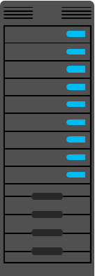


Backup and restore considerations with Data Deduplication
One of the benefits of using Data Deduplication is that backup and restore operations typically are faster
Notes:
Describe the considerations for using backup and restore programs for volumes that are being deduplicated.
20743C
2: Overview of storage in Windows Server 2016

Slide 34
Lesson 3: Configuring iSCSI storage
Overview of iSCSI Components of iSCSI Managing iSCSI targets Demonstration: Configuring the iSCSI target Demonstration: Configuring iSCSI storage Implementing high availability for iSCSI
Notes:
When you introduce this lesson, ask the students about their experience with iSCSI. If they do not have much experience with it, explain the concepts in detail. If they are experienced with using iSCSI, do not spend too much time on this lesson.
Question
What are the required components of an iSCSI solution? (Select all that apply.)
( ) Option 1: IP network
( ) Option 2: iSCSI targets
( ) Option 3: iSCSI initiators
( ) Option 4: iSCSI qualified name
( ) Option 5: Domain Name System (DNS)
Answer
( √) Option 1: IP network
( √) Option 2: iSCSI targets
( √) Option 3: iSCSI initiators
( √) Option 4: iSCSI qualified name
( ) Option 5: Domain Name System (DNS)
Feedback
If you access the iSCSI target through IP addresses, DNS is not a required part of an iSCSI solution. iSCSI has its own name service called internet Storage Name Service (iSNS). DNS is required only if you want to use fully qualified domain names (FQDN) to access your iSCSI storage.
20743C
2: Overview of storage in Windows Server 2016
(More notes on the next slide)

Slide 35
Notes:
Question
You can use Server Manager to configure both the iSCSI Target Server and the iSCSI initiator.
( ) False
( ) True
Answer
( √) False
( ) True
Feedback
You can configure the iSCSI Target Server by using Server Manager and Windows PowerShell. However, you cannot configure the iSCSI initiator by using Server Manager; you can configure the iSCSI initiator only through its own interface, or through Windows PowerShell.
20743C
2: Overview of storage in Windows Server 2016

Slide 36
Overview of iSCSI
iSCSI transmits SCSI commands over IP networks
Component | Description
IP network | Network that provides high performance and redundancy
iSCSI targets | Servers that run on the storage device and enable access to the disks
iSCSI initiators | Software component or host adapter on the server that provides access to iSCSI targets
iSCSI IQN | Globally unique identifier that iSCSI uses to address initiators and targets on an iSCSI network
iSCSI client that runs the iSCSI initiator
TCP/IP protocol
Storage
array
iSCSI Target Server
Notes:
Highlight that iSCSI storage area networks (SANs) typically are easier to implement than Fibre Channel SANs. Because iSCSI uses the standard IP network and network devices, you do not need special skills to deploy the network infrastructure. If your storage device has many disks, and multiple servers connect to the SAN, you should still plan the deployment carefully.
Use the diagram to explain how an iSCSI initiator connects to an iSCSI target.
20743C
2: Overview of storage in Windows Server 2016

Slide 37
Components of iSCSI
The iSCSI Target Server:
Is available as a role service in Windows Server 2016
Provides the following functionality:
Network or diskless boot
Server application storage
Heterogeneous storage
Lab environments
Has the following features:
Authentication
Query initiator computer for ID
Virtual hard disks
Scalability
Manageability
The iSCSI initiator:
Runs as a service in the operating system
Is installed by default on Windows Vista and Windows Server 2008 and later operating systems
Requires only to be started and configured to connect the computer to the iSCSI target
Notes:
Note: This topic has one additional slide.
Provide an overview of the iSCSI Target Server and the features that are available in Windows Server 2016.
Ensure that you understand the requirements of network boot by using iSCSI.
20743C
2: Overview of storage in Windows Server 2016

Slide 38
Components of iSCSI
iSNS provides discovery and zoning of iSCSI targets and initiators
Data Center Bridging provides network convergence by running iSCSI traffic without dedicated cabling
Notes:
Explain the need to create zones with iSNS. You can use Domain Name System (DNS) as a comparison. Explain the two high-availability technologies of iSCSI, and when to use Data Center Bridging.
20743C
2: Overview of storage in Windows Server 2016

Slide 39
Managing iSCSI targets
Type | Create | Import | Expand | Shrink
Fixed VHD | No | Yes | Offline | No
Fixed VHDX | Yes | Yes | Yes | Yes
Differencing VHD | No | Yes | Offline | No
Differencing VHDX | Yes | Yes | Yes | Yes
Dynamic VHD | No | Yes | Offline | No
Dynamic VHDX | Yes | Yes | Yes | Yes
Notes:
Show the table and walk through the different options for managing iSCSI virtual disks.
20743C
2: Overview of storage in Windows Server 2016

Slide 40
Demonstration: Configuring the iSCSI target
In this demonstration, you will see how to:
Add an iSCSI Target Server role service
Create iSCSI virtual disks and an iSCSI target
Notes:
Keep the virtual machines running for the next demonstration.
Preparation Steps
For this demonstration, you need to use the available virtual machine environment. The required virtual machines should be running from the previous demonstration. If they are not, before you begin the demonstration, you must complete the following steps:
On the host computer, start Hyper-V Manager.
In Hyper-V Manager, click 20743C-LON-DC1, and then in the Actions pane, click Start.
In the Actions pane, click Connect. Wait until the virtual machine starts.
Sign in by using the following credentials:
User name: Administrator
Password: Pa55w.rd
Domain: Adatum
Repeat steps 2 to 4 for 20743C-LON-SVR1.
Demonstration Steps
Add an iSCSI Target Server role service
On LON-DC1, on the taskbar, click the Windows button, and then click Windows PowerShell.
In the Administrator: Windows PowerShell window, type the following command, and then press Enter:
Install-Windowsfeature FS-iSCSITarget-Server –IncludeManagementTools
Close the Windows PowerShell window.
20743C
2: Overview of storage in Windows Server 2016
(More notes on the next slide)

Slide 41
Notes:
Create two iSCSI virtual disks and an iSCSI target on LON-DC1
On LON-DC1, in Server Manager, click the refresh button.
In the navigation pane, click File and Storage Services.
In the File and Storage Services pane, click iSCSI.
In the iSCSI VIRTUAL DISKS pane, click TASKS, and then in the TASKS drop-down list box, click New iSCSI Virtual Disk.
In the New iSCSI Virtual Disk Wizard, on the Select iSCSI virtual disk location page, under Storage location, click C:, and then click Next.
On the Specify iSCSI virtual disk name page, in the Name text box, type iSCSIDisk1, and then click Next.
On the Specify iSCSI virtual disk size page, in the Size text box, type 5.
Ensure that GB is selected in the drop-down list box, ensure that Dynamically expanding is selected as an option, and then click Next.
On the Assign iSCSI target page, click New iSCSI target, and then click Next.
On the Specify target name page, in the Name text box, type FileServer, and then click Next.
On the Specify access servers page, click Add.
In the Select a method to identify the initiator dialog box, click Enter a value for the selected type. In the Type drop-down list box, click IP Address, in the Value text box, type 172.16.0.11, and then click OK.
On the Specify access servers page, click Next.
On the Enable Authentication page, click Next.
On the Confirm selections page, click Create.
On the View results page, wait until the creation process completes, and then click Close.
(More notes on the next slide)
20743C
2: Overview of storage in Windows Server 2016

Slide 42
Notes:
In the iSCSI VIRTUAL DISKS pane, click TASKS, and then in the TASKS drop-down list box, click New iSCSI Virtual Disk.
In the New iSCSI Virtual Disk Wizard, on the Select iSCSI virtual disk location page, under Storage location, click C:, and then click Next.
On the Specify iSCSI virtual disk name page, in the Name text box, type iSCSIDisk2, and then click Next.
On the Specify iSCSI virtual disk size page, in the Size text box, type 5.
Ensure that GB is selected in the drop-down list box, ensure that Dynamically expanding is selected as an option, and then click Next.
On the Assign iSCSI target page, click fileserver, and then click Next.
On the Confirm selections page, click Create.
On the View results page, wait until the creation process completes, and then click Close.
20743C
2: Overview of storage in Windows Server 2016

Slide 43
Demonstration: Configuring iSCSI storage
In this demonstration, you will connect LON-SVR1 to an iSCSI target, and verify the presence of the iSCSI drive
Notes:
After you complete the demonstration, revert the virtual machines.
Preparation Steps
For this demonstration, you need to use the available virtual machine environment. The required virtual machines should be running. If they are not, before you begin the demonstration, you must complete the following steps:
On the host computer, start Hyper-V Manager.
In Hyper-V Manager, click 20743C-LON-DC1, and then in the Actions pane, click Start.
In the Actions pane, click Connect. Wait until the virtual machine starts.
Sign in by using the following credentials:
User name: Administrator
Password: Pa55w.rd
Domain: Adatum
Repeat steps 2 to 4 for 20743C-LON-SVR1.
To complete this demonstration, you must have completed the previous demonstration, Configuring the iSCSI Target.
Demonstration Steps
Connect LON-SVR1 to the iSCSI target
On LON-SVR1, in Server Manager, click Tools, and then click iSCSI Initiator.
In the Microsoft iSCSI message box, click Yes.
In the iSCSI Initiator Properties dialog box, on the Targets tab, in the Target text box, type LON-DC1, and then click Quick Connect.
20743C
2: Overview of storage in Windows Server 2016
(More notes on the next slide)

Slide 44
Notes:
In the Quick Connect window, in the Discovered targets section, click iqn.1991-05.com.microsoft:lon-dc1-fileserver-target, and then click Done.
In the iSCSI Initiator Properties dialog box, click OK.
Verify the presence of the iSCSI disks
In Server Manager, in the tree pane, click File and Storage Services, and then click Disks.
In Server Manager, in the content pane, point out the two new 5-GB disks that are offline. Point out that the bus type is iSCSI. (If you are in the File and Storage Services section of Server Manager, you might need to click the refresh button to see the two new disks.)
20743C
2: Overview of storage in Windows Server 2016

Slide 45
Implementing high availability for iSCSI
Two technologies for implementing iSCSI for high availability are:
MCS. In the event of a failure, all outstanding iSCSI commands are reassigned to another connection automatically
MPIO. If you have multiple network interface cards in your iSCSI initiator and iSCSI Target Server, you can use MPIO to provide failover redundancy in the event of network outages
Notes:
20743C
2: Overview of storage in Windows Server 2016

Slide 46
Lab A: Implementing and managing storage
Exercise 1: Implementing FSRM Exercise 2: Implementing Data Deduplication Exercise 3: Configuring iSCSI storage
Logon Information
Virtual machines: 20743C-LON-DC1
20743C-LON-SVR2
20743C-LON-CL1
User name: Adatum\Administrator
Password: Pa55w.rd
Estimated Time: 45 minutes
Notes:
Exercise 1: Implementing FSRM
To control disk-space consumption by users, you are implementing FSRM quotas. You must limit each user’s home folder to 500 MB. You also need to configure an email that will be sent to users to alert them when their home folders exceed 75 percent of their storage quota. An event also is written to the event log so that administrators can track it.
Additionally, managers are concerned that employees are storing large media files in home folders, which violates corporate policy. You need to implement file screening to prevent users from storing media files such as video, audio, and graphics files in their home folders.
Exercise 2: Implementing Data Deduplication
You decide to install the Data Deduplication role service by using Server Manager. You determine that drive E is heavily used and you suspect it contains duplicate files in some folders. You decide to enable and configure the Data Deduplication role to reduce the consumed space on this volume.
Exercise 3: Configuring iSCSI storage
Executives at Adatum are exploring the option of using iSCSI to decrease the cost and complexity of configuring centralized storage. Therefore, you must install and configure the iSCSI targets, and configure the iSCSI initiators to provide access to the targets.
20743C
2: Overview of storage in Windows Server 2016

Slide 47
Lab Scenario
At Adatum Corporation, the cost of storage has decreased significantly over the last few years. However, the amount of data that business groups are producing continues to increase. Organization leaders are considering alternate ways to optimize the cost of storing data on the network and data access in the new branch offices. They also would like to ensure that the data stored on the shared folders is limited to company data, and that it does not include personal files. They want you to test Data Deduplication to save storage. Additionally, the organization is exploring options for making storage highly available, and researching the requirements that it must meet for high availability.
You are responsible for implementing some of the new file-storage technologies for the organization. You will implement FSRM to help optimize file storage at Adatum. You also will implement Data Deduplication to save storage space.
Finally, you will implement iSCSI storage to provide a simpler solution for deploying storage in the organization.
Notes:
20743C
2: Overview of storage in Windows Server 2016

Slide 48
Lab Review
Why would you implement MPIO with iSCSI? What problem does this solve? What is the purpose of the iSCSI initiator component?
Notes:
Question
Why would you implement MPIO with iSCSI? What problem does this solve?
Answer
You must have a Multipath I/O (MPIO) to create a second network route to the iSCSI target. This is useful when you lose a connection to the iSCSI target because of a loss in a network adapter. When you configure an MPIO, you ensure that if a network adapter fails another network adapter can take over.
Question
What is the purpose of the iSCSI initiator component?
Answer
The iSCSI initiator component is the client component that allows iSCSI to connect to an iSCSI target. Windows Vista, Windows Server 2008, and newer Windows client and Windows Server operating systems have this component preinstalled as a service. You only have to start them to use them.
20743C
2: Overview of storage in Windows Server 2016

Slide 49
Lesson 4: Configuring the Storage Spaces feature in Windows Server 2016
What are storage spaces? The Storage Spaces Direct feature Provisioning a storage space Redundancy in storage spaces Tiering storage Monitoring Storage Spaces
Notes:
Question
Which resiliency types can you configure in the Storage Spaces feature? (Select all that apply.)
( ) Option 1: Simple
( ) Option 2: Advanced
( ) Option 3: Two-way mirror
( ) Option 4: Three-way mirror
( ) Option 5: Parity
Answer
( √) Option 1: Simple
( ) Option 2: Advanced
( √) Option 3: Two-way mirror
( √) Option 4: Three-way mirror
( √) Option 5: Parity
Feedback
There is no advanced resiliency type in the Storage Spaces feature.
20743C
2: Overview of storage in Windows Server 2016

Slide 50
What are storage spaces?
Use storage spaces to add physical disks of any type and size to a storage pool, and create highly-available virtual disks from it
To create a virtual disk, you need:
One or more physical disks
A storage pool that includes the disks
Virtual disks (or storage spaces) that are created with disks from the storage pool
Disk drives that are based on virtual drives
Disk drive
Virtual disk
Storage pool
Physical disk
Notes:
Emphasize that with the Storage Spaces feature, you get a storage area network (SAN)-like functionality. The next topic details the Storage Spaces Direct feature.
20743C
2: Overview of storage in Windows Server 2016

Slide 51
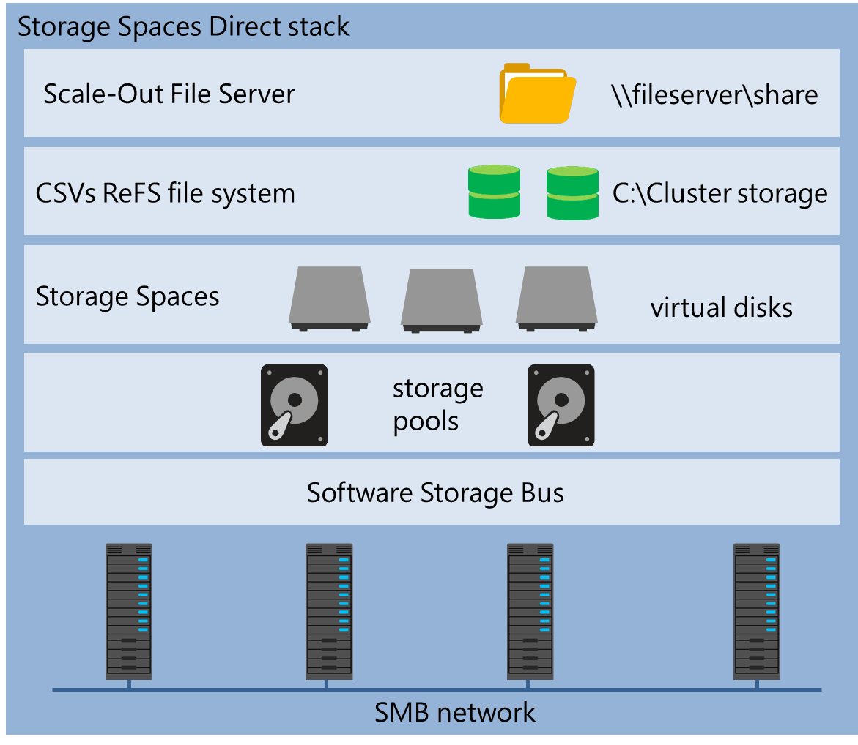
The Storage Spaces Direct feature
Notes:
Note: This topic has two additional slides.
Storage Spaces Direct is a new Windows Server 2016 feature, so you should plan on explaining this in depth to students. Walk through the script that students use in the lab exercise Implementing the Storage Spaces Direct feature, and then explain the different steps to students.
20743C
2: Overview of storage in Windows Server 2016

Slide 52



The Storage Spaces Direct feature
Disaggregated Storage Spaces Direct scenario
Hyper-V cluster
SMB storage fabric
Storage Spaces Direct with Scale-Out File Server
Notes:
Ensure that the students understand the difference between this solution (two clusters) and the next solution (one cluster). Explain to the students that this scenario scales better because you choose when to upgrade the compute side and/or the storage side of the solution.
20743C
2: Overview of storage in Windows Server 2016

Slide 53



The Storage Spaces Direct feature
Hyper-converged Storage Spaces Direct scenario
Hyper-converged stack
Hyper-V VMs
CSVs ReFS file system
C:\Cluster storage
Storage Spaces
virtual disks
storage
pools
Software Storage Bus
SMB network
Notes:
Explain to the students that this is a solution with both storage and Hyper-V on the same servers.
20743C
2: Overview of storage in Windows Server 2016

Slide 54
Provisioning a storage space
Feature | Options
Disk sector size | 512 or 512e
Drive allocation | Automatic Manual Hot spare
Provisioning schemes | Thin provisioning Fixed provisioning
Notes:
If the students have experience with the Storage Spaces feature, you can spend less time on this topic.
20743C
2: Overview of storage in Windows Server 2016

Slide 55
Redundancy in storage spaces
Simple
No resiliency
Two-way mirror
Keeps functioning even with one failed disk
Three-way mirror
Keeps functioning even with two failed disks
Parity
Keeps functioning even with one failed disk
Clustered storage spaces
Keeps functioning in case of both server and disk failure
Notes:
Clustered storage spaces are outside the scope of this course. However, you can direct students to the additional reading link in the handbook so they can research them and learn more about how to configure them.
20743C
2: Overview of storage in Windows Server 2016

Slide 56
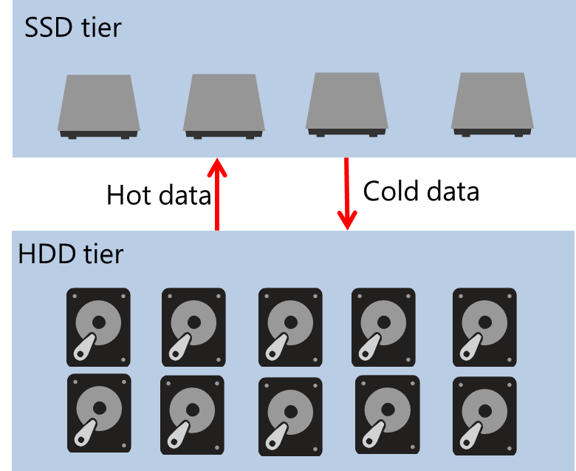
Tiering storage
Storage spaces create SSD and HDD tiers
Blocks are moved between tiers when optimization occurs
You can pin files manually with:
Set-FileStorageTier
Run the optimization task manually with:
Get-ScheduledTask -TaskName "Storage Tiers Optimization" | Start-ScheduledTask
Notes:
If you want to demonstrate storage tiering to the students, you can simulate storage tiers by using the following Windows PowerShell cmdlets:
Get-StoragePool Pool1 | Get-PhysicalDisk | ? Size -lt 20GB | Set-PhysicalDisk –MediaType SSD
Get-StoragePool Pool1 | Get-PhysicalDisk | ? Size -gt 20GB | Set-PhysicalDisk –MediaType HDD
20743C
2: Overview of storage in Windows Server 2016

Slide 57
Monitoring Storage Spaces
Server Manager:
Displays warning signs, which indicate degraded health or performance
Windows PowerShell:
Use the Get-StoragePool, Get-VirtualDisk, and Get-PhysicalDisk cmdlets
Check the OperationalStatus and HealthStatus properties
Event Viewer:
System log event IDs 100–104, 200–203, 300–308
Check the Storage Spaces Events event log
System Center Operations Manager Management Pack
Notes:
You can demonstrate the Windows PowerShell cmdlet to create the Storage Spaces Events event log.
20743C
2: Overview of storage in Windows Server 2016

Slide 58
Lab B: Implementing and managing advanced storage solutions
Exercise 1: Configuring redundant storage spaces Exercise 2: Implementing the Storage Spaces Direct feature
Logon Information
Virtual machines: 20743C-LON-DC1
20743C-LON-SVR1
20743C-LON-SVR2
20743C-LON-SVR3
User name: Adatum\Administrator
Password: Pa55w.rd
Estimated Time: 90 minutes
Notes:
Exercise 1: Configuring redundant storage spaces
To meet some of the requirements for high availability, you decided to evaluate redundancy options in the Storage Spaces feature. Additionally, you want to test the provisioning of new disks to the storage pool.
Exercise 2: Implementing the Storage Spaces Direct feature
You want to test if using local storage as highly available storage is a viable solution for your organization. Previously, your organization only has used SANs for storing virtual machines. The new features in Windows Server 2016 make it possible to use only local storage, so you want to implement Storage Spaces Direct as a test implementation.
You will use a Windows PowerShell script in the exercise to create the Storage Spaces Direct cluster and configure Storage Spaces Direct. The script will perform the following steps:
Install the Remote Server Administration Tools to enable configuration from one server:
Install-WindowsFeature RSAT –IncludeAllSubFeature
Install the required roles and features on the servers that will be a part of the Storage Spaces Direct cluster:
Install-WindowsFeature –Name File-Services, Failover-Clustering –IncludeManagementTools
Validate if you can use the hardware configuration for Storage Spaces Direct:
Test-Cluster-Node <computer names for the nodes in the cluster> –Include “Storage Spaces Direct”
Create the cluster, but not add any storage:
New-Cluster –Name <Cluster name> –Node <computer names for the nodes in the cluster> –NoStorage –StaticAddress <IP address>
Configure the cluster properties to enable the Software Storage Bus and add storage:
Enable-ClusterStorageSpacesDirect -Cluster S2DCluster
20743C
2: Overview of storage in Windows Server 2016
(More notes on the next slide)

Slide 59
Notes:
Create the storage pool in the cluster:
New-StoragePool -StorageSubSystemName <Cluster name> -FriendlyName <Storage Pool name>
Create the volume and add it to the CSVs:
New-Volume -StoragePoolFriendlyName <Storage Pool name> -FriendlyName <Friendly name> -FileSystem CSVFS_ReFS -Size <Size of volume>
Create the Scale-Out File Server on the cluster:
New-StorageFileServer -StorageSubSystemName <Cluster name> -FriendlyName <Name of file server in cluster> -HostName <Virtual host name> -Protocols SMB
Create a folder on the file server and create a new share:
md "C:\ClusterStorage\Volume1\<Folder name>"
New-SmbShare -Name <Share name>-Path "C:\ClusterStorage\Volume1\<Folder name>" -FullAccess <Users with Full Control>
Set-SmbPathAcl -ShareName <Share name>
20743C
2: Overview of storage in Windows Server 2016

Slide 60
Lab Scenario
At Adatum, you need to implement the Storage Spaces feature on the Windows Server 2016 servers to simplify storage access and provide redundancy at the storage level.
You also want to test the feasibility of using highly available storage. You decide to test Storage Spaces Direct.
Notes:
20743C
2: Overview of storage in Windows Server 2016

Slide 61
Lab Review
How many disk failures can you have while remaining functional with a three-way mirrored storage space? How many servers do you need as a minimum to set up the Storage Spaces Direct feature?
Notes:
Question
How many disk failures can you have while remaining functional with a three-way mirrored storage space?
Answer
A three-way mirrored storage space can accommodate two disk failures.
Question
How many servers do you need as a minimum to set up the Storage Spaces Direct feature?
Answer
The Storage Spaces Direct feature requires a minimum of four servers.
20743C
2: Overview of storage in Windows Server 2016

Slide 62
Module Review and Takeaways
Review Questions
Notes:
Review Questions
Question
Is the Storage Spaces feature also available in Windows 10?
Answer
Yes, you can use the Storage Spaces feature in both Windows Server 2016 and Windows 10.
Question
Can you configure Data Deduplication on a boot volume?
Answer
No, you cannot configure Data Deduplication on a boot volume. You can configure Data Deduplication only on volumes that are not system or boot volumes.
Question
Can you use both local and shared storage with the Storage Spaces Direct feature?
Answer
No. Storage Spaces Direct can use only local storage. A standard storage space can use shared storage.
20743C
2: Overview of storage in Windows Server 2016

