Slide 1
Module 3
Implementing Directory Services
Notes:
Presentation: 90 minutes
Lab: 30 minutes
After completing this module, students will be able to:
Deploy Windows Server 2016 Active Directory domain controllers.
Implement service accounts in Active Directory Domain Services (AD DS).
Integrate on-premises AD DS with Microsoft Azure Active Directory (Azure AD).
Required materials
To teach this module, you need the Microsoft PowerPoint file 20743C_03.pptx.
Preparation tasks
To prepare for this module, you should:
Read all of this module’s materials.
Practice performing the demonstrations and labs.
Work through the Module Review and Takeaways section to determine how you will use the information to reinforce student learning and promote knowledge transfer to on-the-job performance.
As you prepare for this class, it is imperative that you complete the labs yourself. This gives you an understanding of how the labs work and the concepts that each covers, so that you can provide meaningful hints to students who might have issues. Furthermore, it will help guide your lecture to ensure that you discuss the concepts that the labs cover.
20743C
3: Implementing Directory Services

Slide 2
Module Overview
Deploying Active Directory domain controllers Implementing service accounts Azure AD
Notes:
Provide an overview of the module.
20743C
3: Implementing Directory Services

Slide 3
Lesson 1: Deploying Active Directory domain controllers
What’s new in AD DS on Windows Server 2016? Deploying domain controllers on Windows Server 2016 Deploying Active Directory domain controllers on Server Core Deploying Active Directory domain controllers by using the Install from Media method Active Directory read-only domain controllers Demonstration: Deploying an RODC Cloning virtual domain controllers Upgrading an Active Directory forest to Windows Server 2016
Notes:
Provide an overview of the lesson.
Question
Which of the following commands would you use to promote Windows Server 2016 Server Core to a domain controller?
( ) Option 1: Adprep /forestprep
( ) Option 2: Adprep /domainprep
( ) Option 3: Install-ADDSDomainController –domainname “Adatum.com”
( ) Option 4: Install-WindowsFeature –name AD-Domain-Services
Answer
( ) Option 1: Adprep /forestprep
( ) Option 2: Adprep /domainprep
( √) Option 3: Install-ADDSDomainController –domainname “Adatum.com”
( √) Option 4: Install-WindowsFeature –name AD-Domain-Services
Feedback
You can install the binaries by using the Install-WindowsFeature –name AD-Domain-Services cmdlet followed by the Install-ADDSDomainController –domainname “Adatum.com” cmdlet to promote a domain controller.
20743C
3: Implementing Directory Services

Slide 4
What’s new in AD DS on Windows Server 2016?
New features introduced in Windows Server 2012 or Windows Server 2012 R2:
Improved support for running virtualized domain controllers
Multi-Factor Authentication
Active Directory-based activation
New features and improvements in Windows Server 2016:
PAM
Group member expiration
Microsoft Passport
Azure AD Connect
Notes:
Use this slide to introduce the new features in AD DS. The rest of this module will cover these features in more detail.
20743C
3: Implementing Directory Services

Slide 5
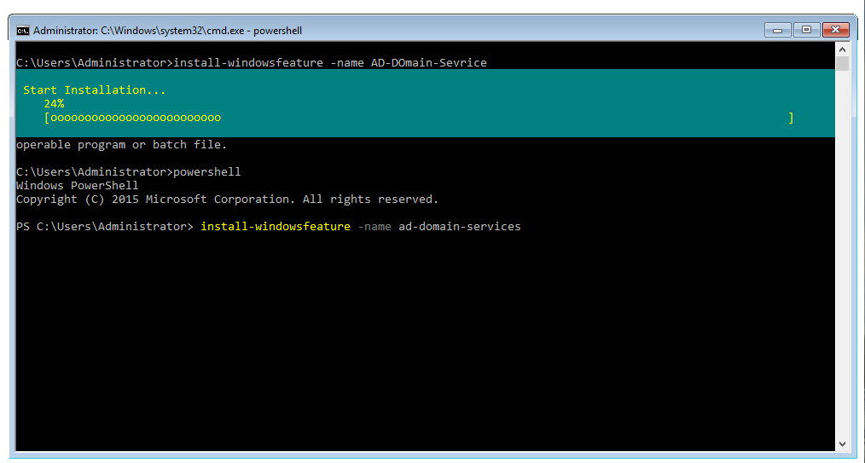
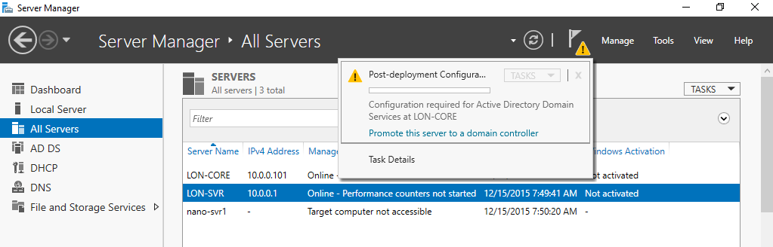
Deploying domain controllers on Windows Server 2016
Notes:
Point out that Active Directory installation is a two-step process. First, you install the binary files, and then you create and configure the domain controller. When you use the new Server Manager Wizard, you can install AD DS in one place. Previously, in Windows Server 2008, you had to use two tools to accomplish this.
Stress that you should use Server Manager or the Windows PowerShell command-line interface to install AD DS because they are the preferred methods. Deployment Image Servicing and Management (DISM) is usually associated with creating images. For deployments on Server Core, point out that you can perform virtually all administration and management remotely.
20743C
3: Implementing Directory Services

Slide 6
Deploying Active Directory domain controllers on Server Core
Installing AD DS is a two-step process regardless of which installation method you use:
Method 1: Use Server Manager to connect to the target server:
Install the files by installing the Active Directory role
Install the domain controller role by running the Active Directory Domain Services Configuration Wizard
Method 2: Use Windows PowerShell:
Install the files by running the Install-WindowsFeature AD-Domain-Services cmdlet
Install the domain controller role by running the Install-ADDSDomainController cmdlet
Notes:
Explain the supported methods for remotely installing the domain controller role on Windows Server 2016 servers.
For more information, refer to: http://aka.ms/Wivzdv
20743C
3: Implementing Directory Services

Slide 7
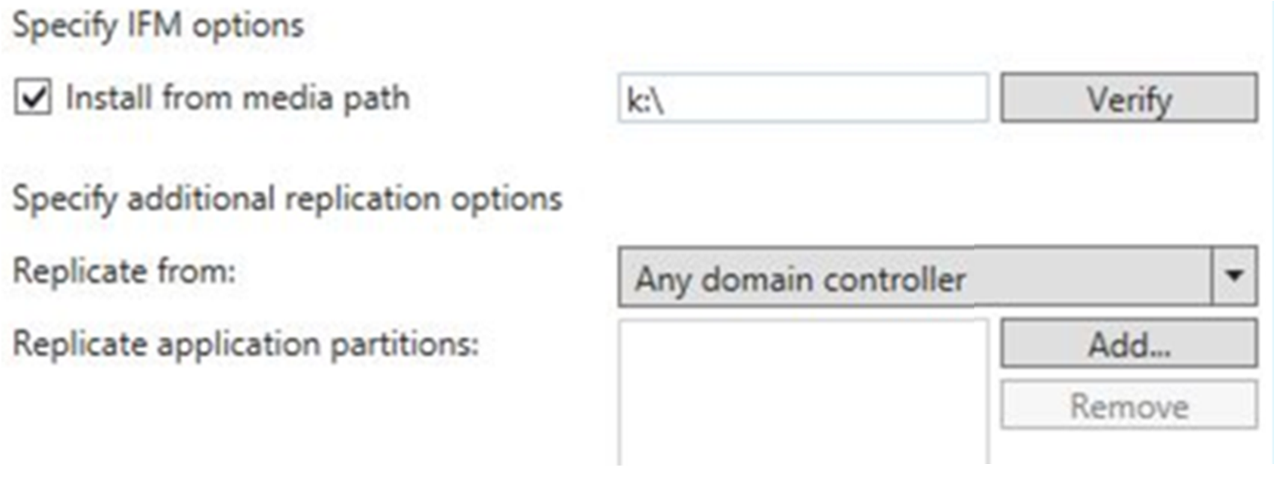
Deploying Active Directory domain controllers by using the Install from Media method
On the Additional Options page of the Active Directory Domain Services Configuration Wizard, the Install from Media section includes the following options:
Notes:
Point out to students that because they are installing the domain controller by using the Install from Media method, they should select the Install from media path check box. Then, they type the path to the snapshot file in the Install from media path text box.
20743C
3: Implementing Directory Services

Slide 8
Active Directory read-only domain controllers
RODCs provide:
Unidirectional replication
Credential caching
Administrative role separation
Read-only DNS
The RODC filtered attribute set
Notes:
Mention that read-only domain controllers (RODCs) are primarily for deployment in branch offices. Emphasize that students should always check system requirements for all apps because not all apps perform correctly on or with an RODC—for example, Microsoft Exchange Server.
20743C
3: Implementing Directory Services

Slide 9
Demonstration: Deploying an RODC
In this demonstration, you will see how to:
Add a server that you will manage
Create a new server group
Install the RODC role remotely
Configure the password replication policy
Notes:
Leave the virtual machines running for subsequent demonstrations.
Preparation Steps
For this demonstration, you need to use the available virtual machine environment. Before you begin the demonstration, you must complete the following steps:
On the host computer, start Hyper-V Manager.
In Hyper-V Manager, click 20743C-LON-DC1, and then in the Actions pane, click Start.
In the Actions pane, click Connect. Wait until the virtual machine starts.
Sign in by using the following credentials:
User name: Administrator
Password: Pa55w.rd
Domain: Adatum
Repeat steps 2 through 4 for 20743C-LON-SVR3.
Demonstration Steps
Add a server to manage
Switch to LON-DC1.
In Server Manager, click Add other servers to manage.
In the Add Servers dialog box, in the Name (CN) text box, type LON-SVR3, and then click Find Now.
In the search results, select LON-SVR3, click the arrow to move it to the Selected pane, and then click OK.
20743C
(More notes on the next slide)
3: Implementing Directory Services

Slide 10
Notes:
Create a new server group
In Server Manager, click Create a server group.
In the Create Server Group dialog box, in the Server group name text box, type DCs.
Select both LON-SVR3 and LON-DC1, click the arrow to move them to the Selected pane, and then click OK.
Install the RODC role remotely
In Server Manager, click Add roles and features.
In the Add Roles and Features Wizard, click Next.
On the Select installation type page, click Next.
On the Select destination server page, select LON-SVR3.Adatum.com, and then click Next.
On the Select server roles page, select the Active Directory Domain Services check box.
In the Add features that are required for Active Directory Domain Services dialog box, click Add Features, and then click Next.
On the Select features page, click Next.
On the Active Directory Domain Services page, click Next.
On the Confirm installation selections page, select the Restart the destination server automatically if required check box, and then click Install.
When installation completes, click Close.
In the Server Manager dashboard, on the menu bar, click the notification icon (the flag icon or yellow triangle).
Locate the Post-deployment Configuration task, and then click Promote this server to a domain controller.
In the Active Directory Domain Services Configuration Wizard, ensure that Add a domain controller to an existing domain is selected.
(More notes on the next slide)
20743C
3: Implementing Directory Services

Slide 11
Notes:
In the Supply the credentials to perform this operation section, click Change.
In the Windows Security dialog box, in the User name text box, type Adatum\Administrator, and then in the password text box, type Pa55w.rd. Click OK, and then click Next.
On the Domain Controller Options page, ensure that the Domain Name System (DNS) Server and the Global Catalog (GC) check boxes are selected, and then select the Read only domain controller (RODC) check box.
Type and confirm the Directory Services Restore Mode (DSRM) password to be Pa55w.rd, and then click Next.
On the RODC Options page, click Next.
On the Additional Options page, click Next.
On the Paths page, click Next.
On the Review Options page, click Next.
On the Prerequisites Check page, click Install.
When the promotion completes, click Close. Note that LON-SVR3 restarts.
Configure the password replication policy
On LON-DC1, in Server Manager, on the Tools menu, click Active Directory Users and Computers.
If necessary, expand Adatum.com, and then click Domain Controllers.
In the details pane, right-click LON-SVR3, and then click Properties.
In the LON-SVR3 Properties dialog box, click the Password Replication Policy tab, and then click Add.
In the Add Groups, Users and Computers dialog box, click Allow passwords for the account to replicate to this RODC, and then click OK.
(More notes on the next slide)
20743C
3: Implementing Directory Services

Slide 12
Notes:
In the Select Users, Computers, Services Accounts, or Groups dialog box, type Managers, and then click OK.
Click the Managed By tab, and then click Change.
In the Select User or Group dialog box, type IT, and then click OK.
In the LON-SVR3 Properties dialog box, click OK.
Close Active Directory Users and Computers.
20743C
3: Implementing Directory Services

Slide 13
Cloning virtual domain controllers
You can safely clone existing virtual domain controllers when you:
Create a DcCloneConfig.xml file and store it in the Active Directory database location
Export the virtual domain controller
Create a new virtual machine by importing the exported virtual domain controller
Create DcCloneConfig.xml to AD DS database location
Export the virtual domain controller
Import the virtual domain controller
Notes:
Describe the problems with cloning domain controllers, such as the presence of checkpoints. Be prepared to talk briefly about update sequence numbers (USNs) and the multimaster replication process.
20743C
3: Implementing Directory Services

Slide 14
Upgrading an Active Directory forest to Windows Server 2016
Ensure that forest and domain functional levels are at least Windows Server 2008
Prepare the Active Directory forest
Prepare the Active Directory domain
Install Windows Server 2016 and add the Active Directory server role
Promote the computer as a new domain controller in an existing domain
Transfer operations master roles
Decommission older domain controllers
Optionally, raise the forest and domain functional level
Notes:
Note: This topic has three slides.
Use the first additional slide to show the process of adding a new domain controller. Use the third slide to show the new features that are available at the Windows Server 2016 functional level.
20743C
3: Implementing Directory Services

Slide 15
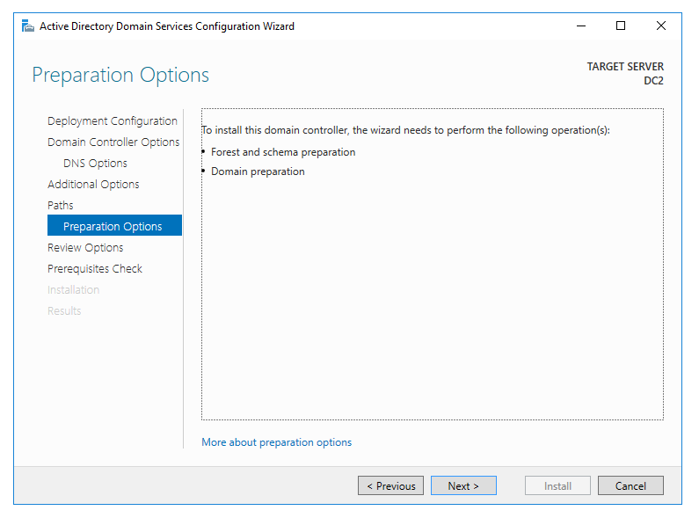
Upgrading an Active Directory forest to Windows Server 2016
Notes:
The screenshot on the slide was captured during the process of adding a new Windows Server 2016 domain controller to an existing Windows Server 2012 R2 domain.
20743C
3: Implementing Directory Services

Slide 16
Upgrading an Active Directory forest to Windows Server 2016
By upgrading to the Windows Server 2016 domain functional level, you enable the following new features in AD DS:
Privileged access management
Azure AD Join
Microsoft Passport
Notes:
Discuss the new features that are available when you upgrade to the Windows Server 2016 domain functional level.
20743C
3: Implementing Directory Services

Slide 17
Lesson 2: Implementing service accounts
Managing SPNs What are managed service accounts and group managed service accounts? Configuring Kerberos delegation Demonstration: Configuring managed service accounts
Notes:
Provide an overview of the lesson.
Question
You can only configure and administer group managed service accounts on computers that run Windows Server 2008 R2 or later.
( ) False
( ) True
Answer
( √) False
( ) True
Feedback
You can only configure and administer group managed service accounts on computers that run Windows Server 2012 or later.
20743C
3: Implementing Directory Services

Slide 18
Managing SPNs
SPNs represent the user accounts under which services run
SPNs support mutual authentication between apps and services
An account can have a different SPN for each service it authenticates and executes
The basic syntax of an SPN is: < service type >/< instance name >: < port number >/< service name >
Notes:
Ask students how they currently manage service accounts.
20743C
3: Implementing Directory Services

Slide 19

What are managed service accounts and group managed service accounts?
Group managed service accounts provide:
Automatic password and SPN management for multiple servers in a farm
A single identity for services that run on a farm of servers such as IIS
Farm server1
Farm server2
Group managed service account
Farm server3
Notes:
Discuss the content of the topic as you show this slide.
20743C
3: Implementing Directory Services

Slide 20
Configuring Kerberos delegation
Kerberos delegation enables a remote computer or service account to act on behalf of a user
Requirements for Kerberos delegation:
A user account cannot be marked as sensitive
SPNs must be registered on both sides of the delegation (the service account that is used for delegation and the service account for the target resource)
The service account that is used for delegation must be enabled for delegation
Notes:
Mention that Kerberos delegation occurs outside of users’ view. Discuss other real-world uses of Kerberos delegation, such as reverse proxy servers and Microsoft SharePoint. Mention the disadvantages of not using Kerberos delegation, such as multiple user authentication, lack of an audit trail in the logs, and the possibility that users could access unauthorized data.
20743C
3: Implementing Directory Services

Slide 21
Demonstration: Configuring managed service accounts
In this demonstration, you will see how to create a group managed service account, and then associate the account with a server
Notes:
After completing the demonstration, revert the virtual machines.
Preparation Steps
For this demonstration, you need to use the available virtual machine environment. These should still be running from the previous demonstration. If they are not, before you begin the demonstration, you must complete the following steps:
On the host computer, start Hyper-V Manager.
In Hyper-V Manager, click 20743C-LON-DC1, and then in the Actions pane, click Start.
In the Actions pane, click Connect. Wait until the virtual machine starts.
Sign in by using the following credentials:
User name: Administrator
Password: Pa55w.rd
Domain: Adatum
Demonstration Steps
On LON-DC1, right-click Start, and then click Windows PowerShell (Admin).
At the Windows PowerShell command prompt, type the following command, and then press Enter:
Add-KdsRootKey –EffectiveTime ((get-date).addhours(-10))
At the Windows PowerShell command prompt, type the following command, and then press Enter:
New-ADServiceAccount –Name Webservice –DNSHostName LON-DC1 –PrincipalsAllowedToRetrieveManagedPassword LON-DC1$
At the Windows PowerShell command prompt, type the following command, and then press Enter:
Add-ADComputerServiceAccount –identity LON-DC1 –ServiceAccount Webservice
20743C
(More notes on the next slide)
3: Implementing Directory Services

Slide 22
Notes:
At the Windows PowerShell command prompt, type the following command, and then press Enter:
Get-ADServiceAccount -Filter *
Note the output of the command.
Close Windows PowerShell.
20743C
3: Implementing Directory Services

Slide 23
Lab: Implementing and managing AD DS
Exercise 1: Cloning a domain controller Exercise 2: Implementing service accounts
Logon Information
Virtual machine: 20743C-LON-DC1
User name: Adatum\Administrator
Password: Pa55w.rd
Estimated Time: 30 minutes
Notes:
Ensure that students revert their virtual machines after completing this lab.
Exercise 1: Cloning a domain controller
You decide to test the procedure for cloning domain controllers and to create a test lab environment. You start the process by preparing the source domain controller, LON-DC1.
Instructor Note: Students might not be able to perform this exercise when using a cloud-based lab environment. This exercise requires that they have local access to their Hyper-V host.
Exercise 2: Implementing service accounts
Until now, there has been no consistent policy about accounts that are used for services. On some servers, local accounts are used, while other servers use domain accounts. Password management for these accounts also has not been consistent. Some accounts have non-expiring passwords, while others are updated manually with new passwords. In this scenario, you decide to implement managed service accounts to replace all of these techniques. You will need to create the account, and then assign the account to a web service.
20743C
3: Implementing Directory Services

Slide 24
Lab Scenario
You are about to deploy additional domain controllers. Your manager asked you to use the clone feature to reduce the administrative effort that is necessary to deploy new domain controllers in the Active Directory forest.
Additionally, Adatum Corporation wants to centralize management of all accounts that are being used for services and to discontinue using local accounts for that purpose.
Notes:
20743C
3: Implementing Directory Services

Slide 25
Lab Review
What are two benefits of using managed service accounts in Windows Server 2016?
Notes:
Question
What are two benefits of using managed service accounts in Windows Server 2016?
Answer
The benefits are:
Automatic password management. A managed service account automatically maintains its own password, including password changes. This can better isolate services from other services on a computer.
Simplified service principal name (SPN) management. If the samAccountName property of a computer changes, or if the DNS host name property is modified, the managed service account SPN automatically changes from the old name to the new name for all managed service accounts on the computer.
20743C
3: Implementing Directory Services

Slide 26
Lesson 3: Azure AD
What is Azure AD? When to use Azure AD Azure AD authentication protocols Multi-Factor Authentication What is Azure AD Join? On-premises AD DS and Azure integration options Integrating Azure AD with applications Deploying Active Directory domain controllers in Azure
Notes:
Provide an overview of the lesson.
Question
Do you think that your organization might use Azure AD? In what capacity will your organization implement it?
Answer
Answers will vary based on students’ organizational needs.
20743C
3: Implementing Directory Services

Slide 27
What is Azure AD?
Azure AD:
Microsoft-managed
A PaaS offering
Multitenant by design
Employs internet-compatible protocols
Supports users, groups, applications, and devices
No OUs or computer objects
Does not support domain join or Group Policy settings
Notes:
Note: This topic has an additional slide.
Students might be unfamiliar with some of the concepts in this topic, so make this presentation as interactive as possible to gauge whether you need to provide additional explanation. Focus on comparing AD DS and Azure AD, but start by briefly reviewing Azure subscriptions and accounts to ensure that students do not confuse them with Azure AD directories and domains.
If students have Microsoft Office 365 experience, they might be familiar with cloud, synchronized, and federated identities. Point out that this module covers authentication and authorization of cloud identities only.
Mention that Azure AD is capable of authenticating and authorizing access to both cloud-based and on-premises applications.
Consider demonstrating the two Azure portals so that students know which is which:
Azure classic portal – http://manage.windowsazure.com
Azure portal – http://portal.azure.com
20743C
3: Implementing Directory Services

Slide 28
What is Azure AD?
No support for forests; relies on federations to extend the scope of authentication and authorization
Delegation model based on RBAC
Easily extensible and includes multi-factor authentication support
Provides authentication and authorization:
Cloud identity
Synchronized identity
Federated identity
Notes:
20743C
3: Implementing Directory Services

Slide 29

When to use Azure AD
Common Azure AD scenarios include:
Cloud-based identity management and access control system
SSO solution with multi-factor authentication
Web application
Azure
Directory sync
Remote worker
SSO
AD FS
AD DS
Company headquarters
Notes:
Discuss the two common scenarios and some of the components in each scenario.
Remind students that you can sync AD DS with Azure AD. Point out that you can configure Azure-based websites and cloud services to use Azure AD authentication, which means that users can access them when they use their on-premises credentials.
Additionally, explain that you can secure Azure services that use Azure AD authentication, including both portals, by enforcing Multi-Factor Authentication. You can also implement single sign-on (SSO) for accessing software as a service (SaaS) applications integrated with Azure.
20743C
3: Implementing Directory Services

Slide 30
Azure AD authentication protocols
Supported Azure AD authentication protocols include:
OAuth 2.0
SAML 2.0
WS-Federation
Notes:
Describe each of the authentication methods that Azure AD supports.
For more information, refer to: http://aka.ms/rng9ls
20743C
3: Implementing Directory Services

Slide 31

Multi-Factor Authentication
Azure Multi-Factor Authentication adds a second level of authentication:
Text message
Phone call
Mobile app
Notes:
Note: This topic has an additional slide.
Provide the following details to enhance students’ understanding of this topic. By default, Azure AD relies on passwords for user authentication. Microsoft Azure Multi-Factor Authentication adds an extra level of authentication, requiring users to utilize a text message, a call to an office or mobile phone, or a smartphone app. You cannot configure Multi-Factor Authentication for users whose accounts are Microsoft accounts or other Azure AD directories.
The range of Multi-Factor Authentication capabilities depends on the Azure AD tier. The options that this topic describes are part of the Azure Free tier, which includes:
The ability to enable and enforce Multi-Factor Authentication for users who are members of the global administrators role (note that using Multi-Factor Authentication for end users is not part of the free service).
The use of text messages, calls to an office phone, or mobile phone apps as a second authentication factor.
Support for app passwords for non-browser clients, such as Microsoft Outlook.
Default voice messages during verification phone calls.
The Azure AD Premium tier includes additional Multi-Factor Authentication features, such as:
The ability to enable and enforce Multi-Factor Authentication for all users.
Deployment of Azure AD–based Multi-Factor Authentication services to protect on-premises infrastructure and applications, including Active Directory Federation Services (AD FS), remote access server (RAS), or Internet Information Services (IIS) web apps.
A one-time bypass that permits skipping Multi-Factor Authentication for a single sign-in to address legitimate emergencies when users do not have their phones readily available but need to sign in to their apps.
Blocking and unblocking of users, temporarily denying the ability to authenticate via Multi-Factor Authentication.
20743C
(More notes on the next slide)
3: Implementing Directory Services

Slide 32
Notes:
Customizable caller ID, identifying the number from which verification calls are made.
Additional reporting and alerting in the form of security reports and fraud alerts. The latter allows users to indicate that an unauthorized authentication attempt triggered a verification call that they received.
Customization of voice messages during verification phone calls.
20743C
3: Implementing Directory Services

Slide 33
Multi-Factor Authentication
The Azure AD Free tier includes some Multi-Factor Authentication features that are available to members of the global administrators role, such as:
Multi-Factor Authentication access to the Azure portal and the Access Panel via a browser
App passwords can be used for non-browser clients, such as Outlook
Notes:
20743C
3: Implementing Directory Services

Slide 34
What is Azure AD Join?
When determining whether to implement Azure AD Join, consider the following usage scenarios:
Your organization’s apps and resources are mostly cloud-based
Your organization employs seasonal workers or students
You want to allow on-premises users to use their own devices
Notes:
Discuss the three usage scenarios with students, and ask them whether any of these scenarios seem relevant in their own organizations.
20743C
3: Implementing Directory Services

Slide 35
On-premises AD DS and Azure integration options
The following are on-premises AD DS and Azure AD integration options:
Extend on-premises AD DS into Azure
Sync AD DS with Azure AD with optional password syncing
Implement federation and SSO between on-premises AD DS and Azure AD
Notes:
Discuss the three methods of extending, syncing, or connecting on-premises AD DS to Azure. Summarize the different requirements and when students are likely to require each option. Highlight that Azure AD also is the primary directory service in Office 365 and Microsoft Intune. Emphasize that Azure AD Connect and SSO can be used with these platforms too.
20743C
3: Implementing Directory Services

Slide 36
Integrating Azure AD with applications
Azure AD:
Integrates with three types of applications:
On-premises applications
Azure applications
Applications hosted with another provider
Offers the ability for multitenant applications:
Privacy and security are critical for multitenant deployments
Azure offers multiple partitioning schemes
Uses WS-Federation, SAML, or OAuth:
LDAP and Kerberos authentication are not available
Notes:
Describe a scenario where Azure AD authentication would be preferable to internal Active Directory authentication. One example is building an application for customers or partners. Regardless of where the application resides, authentication should not be part of the internal organizational Active Directory environment. In such a scenario, Azure AD might be preferable.
20743C
3: Implementing Directory Services

Slide 37
Deploying Active Directory domain controllers in Azure
Deploying domain controllers in Azure:
Provides resilience for the on-premises directory
Keeps authentication requests for Azure-based services within the Azure environment
Extends access to on-premises AD DS to worldwide sites
Enables additional directory synchronization options such as Azure AD Connect and SSO with AD FS
AD DS
AD DS
Notes:
Discuss the benefits of implementing domain controllers in Azure by using infrastructure as a service (IaaS). Then, provide a high-level overview of the procedure for implementing this.
20743C
3: Implementing Directory Services

Slide 38
Module Review and Takeaways
Review Questions
Notes:
Review Questions
Question
To implement Microsoft Passport, which operating systems must be on users’ devices?
Answer
To implement Microsoft Passport, users’ devices must run Windows 10 Pro or Windows 10 Enterprise.
Question
To enable Kerberos delegation, what requirements must be met?
Answer
To enable Kerberos delegation:
The user object must not have the Account is sensitive and cannot be delegated option enabled.
SPNs must be registered for the application service accounts.
The application service account must be trusted for delegation. This enables the account to act on behalf of another user.
Question
What are the benefits of implementing Azure AD?
Answer
Azure AD provides the following benefits:
High availability. Azure AD is generally more highly available than most organizations can provide on-premises.
Scalable. The Azure environment can scale to meet very large workloads on demand.
Disaster recovery. Azure AD provides built-in disaster recovery and the ability to be a disaster recovery site for on-premises AD DS.
20743C
3: Implementing Directory Services
(More notes on the next slide)

Slide 39
Module Review and Takeaways
Notes:
Integration with on-premises AD DS, including directory synchronization and SSO. This includes the ability to limit the data that syncs to Azure AD.
APIs. The Azure Service Management representational state transfer (REST) API provides developers the ability to perform management portal tasks programmatically. The Graph API allows developers to query directory data from their applications.
20743C
3: Implementing Directory Services

