Slide 1
Module 5
Implementing network services
Notes:
Presentation: 100 minutes
Lab: 40 minutes
After completing this module, students will be able to:
Describe the networking enhancements in Windows Server 2016.
Implement IP Address Management (IPAM).
Manage IP address spaces with IPAM.
Required materials
To teach this module, you need the Microsoft PowerPoint file 20743C_05.pptx.
Preparation tasks
To prepare for this module, you should:
Read all of this module’s materials.
Practice performing the demonstrations and labs.
Work through the Module Review and Takeaways section to determine how you will use the information to reinforce student learning and promote knowledge transfer to on-the-job performance.
As you prepare for this class, it is imperative that you complete the labs yourself. This gives you an understanding of how the labs work, as well as the concepts that each lab covers. This enables you to provide meaningful hints to students who might have issues while working in the labs. Furthermore, it will help guide your lecture to ensure that you discuss the concepts that the labs cover.
20743C
5: Implementing network services

Slide 2
Module Overview
Overview of networking enhancements Implementing IPAM Managing IP address spaces with IPAM
Notes:
Briefly introduce the module content to students, and ask them about their experience with IPAM to determine how much time to spend on the IPAM lessons.
20743C
5: Implementing network services

Slide 3
Lesson 1: Overview of networking enhancements
What is converged networking? Overview of software-defined networking Components of a DNS solution New DNS features in Windows Server 2016 DNS policies Demonstration: Configuring DNS policies Overview of DHCP Changes in DHCP features in Windows Server 2016 What is DHCP failover? Demonstration: Configuring DHCP failover
Notes:
Briefly introduce lesson topics to students.
Question
Which of the following options are new or different in Windows Server 2016? (Select all that apply.)
( ) Option 1: DNS policies
( ) Option 2: DHCP failover
( ) Option 3: IPv6 root hints in DNS
( ) Option 4: Hyper-V virtualized networking
( ) Option 5: No DHCP server support for NAP
Answer
( √) Option 1: DNS policies
( ) Option 2: DHCP failover
( √) Option 3: IPv6 root hints in DNS
( ) Option 4: Hyper-V virtualized networking
( √) Option 5: No DHCP server support for NAP
Question
You need more physical NICs when you configure converged networking on a Hyper-V host.
( ) False
( ) True
Answer
( √) False
( ) True
20743C
5: Implementing network services

Slide 4
What is converged networking?
Converged networking:
Uses fewer teamed NICs instead of dedicated NICs for each network traffic type
Is used in Hyper-V solutions
Includes the following components:
Network teaming
Virtual switch
Network QoS
Network isolation
Virtual NICs
Has improved features in Windows Server 2016, including:
Converged RDMA
SET
Notes:
This topic has three additional slides.
Explain the concept of converged networking. The next slides will provide examples of configuring a Hyper-V host.
20743C
5: Implementing network services

Slide 5

What is converged networking?
Hyper-V physical host without converged networking
VMs
Hyper-V host
NIC
Management
NIC
Virtual switch
Backup
Teamed
RDMA
NIC
RDMA
NIC
NIC
NIC
Storage
NIC
Cluster
NIC
Migration
Notes:
Explain the inefficiency and high cost of having multiple network interface cards (NICs) in a physical host, when you do not use all NICs fully.
20743C
5: Implementing network services

Slide 6
What is converged networking?
Semi-converged networking with Windows Server 2012
VMs
Hyper-V host
Virtual
NIC
Management
Virtual
NIC
Virtual switch
Backup
Teamed
RDMA
NIC
RDMA
NIC
NIC
NIC
Storage
Virtual
NIC
Cluster
Virtual
NIC
Migration
Notes:
Explain to the students that, with converged networking, they can use the physically teamed NICs and then create virtual NICs on the host with virtual local area network (VLAN) tags to specify a target network. In Windows Server 2012, they cannot use Remote Direct Memory Access (RDMA) for teaming and virtual switches.
20743C
5: Implementing network services

Slide 7
What is converged networking?
Fully converged networking
VMs
Hyper-V host
Virtual
NIC
Management
Virtual
NIC
Backup
Virtual switch
Teamed
Virtual
NIC
Virtual
NIC
RDMA
NIC
RDMA
NIC
Storage
Virtual
NIC
Cluster
Virtual
NIC
Migration
Notes:
Explain to the students that with converged networking, they can use the physical teamed NICs and then create virtual NICs on the host with VLAN tags to specify the target network. In Windows Server 2016, they can use RDMA-capable NICs in Switch Embedded Teaming (SET).
20743C
5: Implementing network services

Slide 8
Overview of software-defined networking
Software-defined networking is to networks what server virtualization is to physical servers
Windows Server 2016 features in software-defined networking include:
Network Controller
Hyper-V Network Virtualization
Hyper-V virtual switch
RRAS Multitenant Gateway
NIC Teaming
Notes:
This section provides an overview of software-defined networking, so explain how some of the Windows Server 2016 features support software-defined networking.
20743C
5: Implementing network services

Slide 9






Components of a DNS solution
Resource
record
Root (.)
.com
Resource
record
.edu
Internal DNS servers
DNS resolvers
DNS servers on the internet
Notes:
List the components of a Domain Name System (DNS) solution.
20743C
5: Implementing network services

Slide 10
New DNS features in Windows Server 2016
DNS policies
Response rate limiting
DNS-based authentication of named entities
Unknown record support
IPv6 root hints
Enhanced Windows PowerShell support
Notes:
Introduce the new and improved features of the DNS server. Do not spend too much time on DNS policies, because upcoming topics cover this subject.
20743C
5: Implementing network services

Slide 11
DNS policies
Use DNS policies to:
Redirect DNS clients to endpoints based on configurable percentages of traffic
Redirect DNS clients to the closest datacenter
Configure split-brain DNS
Block or allow DNS queries from a list of malicious or approved IP addresses or FQDNs
Redirect DNS clients to different datacenters based on the time of the day
You configure DNS policies by using Windows PowerShell
Notes:
This is a new feature in Windows Server 2016, so be sure that students understand in which scenarios you can use DNS policies. Additionally, be sure to perform the demonstration that follows this topic.
20743C
5: Implementing network services

Slide 12
Demonstration: Configuring DNS policies
In this demonstration, you will see how to configure and verify DNS policies
Notes:
Leave the VMs running after you complete the demonstration.
Preparation Steps
For this demonstration, you will need the 20743C-LON-DC1 and 20743C-TREY-DC1 VMs. On LON-DC1, sign in as Adatum\Administrator with the password Pa55w.rd. On TREY-DC1, sign in as TreyResearch\Administrator by using the password Pa55w.rd.
Demonstration Steps
On TREY-DC1, in Server Manager, click Tools, and then click DNS.
In the DNS console, expand TREY-DC1, and then click Conditional Forwarders.
Right-click Conditional Forwarders, and then click New Conditional Forwarder.
In the New Conditional Forwarder dialog box, in the DNS Domain text box, type Adatum.com, and, in the IP addresses of the master servers list, click <Click here to add an IP Address or DNS Name>, type 172.16.0.10, press Enter, and then click OK.
Click Start, and then click Windows PowerShell.
In the Windows PowerShell window, type the following three commands, pressing Enter after each command:
Clear-DnsClientCache
Clear-DnsServerCache
Resolve-DnsName LON-DC1.Adatum.com
When you receive a prompt, press Y, and then press Enter. Verify that the name resolves to an IP address. If the last command returns an error, repeat the last command.
Switch to LON-DC1.
On LON-DC1, click Start, and then click Windows PowerShell.
20743C
5: Implementing network services
(More notes on the next slide)

Slide 13
Notes:
In the Windows PowerShell window, type the following two commands, pressing Enter after each command:
Add-DnsServerClientSubnet -Name "TreyResearchSubnet" -IPv4Subnet 172.16.10.0/24 -PassThru
Add-DnsServerQueryResolutionPolicy -Name "BlackholePolicyTreyResearch" -Action IGNORE -ClientSubnet "EQ,TreyResearchSubnet" -PassThru
Switch to TREY-DC1.
On TREY-DC1, in the Windows PowerShell window, type the following three commands, pressing Enter after each command:
Clear-DnsClientCache
Clear-DnsServerCache
Resolve-DnsName LON-DC1.Adatum.com
When you receive a prompt, press Y, and then press Enter. Verify that the last command returns an error because the DNS policy no longer allows TREY-DC1 to do name resolution on LON-DC1.
20743C
5: Implementing network services

Slide 14
Overview of DHCP
DHCP components consist of:
The DHCP server service
DHCP scopes
DHCP options
The DHCP database
The DHCP console
When you use DHCP:
Clients request IP configuration through a broadcast
IP addresses are leased to clients for a configurable period and are renewed regularly
DHCP servers must be authorized in AD DS
Notes:
Point out to students that they apply Dynamic Host Configuration Protocol (DHCP) options at the global or scope level, because all clients on a given subnet tend to use the same default gateway and DNS server configurations. Additionally, explain that they typically use reservations to assign an address to a DHCP client, such as a printer.
20743C
5: Implementing network services

Slide 15
Changes in DHCP features in Windows Server 2016
DHCP does not support NAP
Features new to Windows Server 2012 and Windows Server 2012 R2 include:
DHCP failover
DHCP policies
DHCP name protection
Disable PTR record registration
Improved Windows PowerShell support
Notes:
Ask the students if they use Network Access Protection (NAP). If none of them use NAP, do not spend time with the new features that are part of Windows Server 2016. However, not all students might be familiar with all of the new DHCP features in Windows Server 2012 and Windows Server 2012 R2, so you might want to provide some details.
20743C
5: Implementing network services

Slide 16
What is DHCP failover?
DHCP failover:
Enables two DHCP servers to provide IP addresses and optional configurations to the same subnets or scopes
Requires failover relationships to have unique names
Supports the hot standby and load sharing modes
When you use DHCP failover:
The maximum client lead time determines when a failover partner assumes control of the subnet or scope
The auto-state switchover interval determines when a failover partner is considered to be down state
Message authentication can validate failover messages
Firewall rules are configured automatically during DHCP installation
Notes:
Start this topic by talking about the previous methodologies for DHCP high availability, which are split scopes and clustering. Ask students about the advantages and disadvantages of these technologies, and then introduce DHCP failover, and explain how it works.
20743C
5: Implementing network services

Slide 17
Demonstration: Configuring DHCP failover
In this demonstration, you will see how to configure a DHCP failover relationship
Notes:
After you complete the demonstration, revert all of the running VMs.
Preparation Steps
For this demonstration, you will need the 20743C-LON-DC1 and 20743C-LON-SVR1 VMs. Sign in as Adatum\Administrator by using the password Pa55w.rd.
Before you perform this demonstration, you must perform the “Install DHCP on an additional server” task in the “Configure DHCP failover” exercise in the lab.
Demonstration Steps
Configure a DHCP failover relationship
On LON-SVR1, open Server Manager.
Click Tools and then click DHCP.
In the DHCP console, right-click DHCP, and then click Add Server.
In the Add Server dialog box, click the This authorized DHCP server option, click lon-dc1.adatum.com, and then click OK.
In the DHCP console, expand lon-dc1, select and then right-click IPv4, and then click Configure Failover.
In Configure Failover Wizard, click Next.
On the Specify the partner server to use for failover page, in the Partner Server field, type 172.16.0.11, and then click Next.
On the Create a new failover relationship page, in the Relationship Name field, type Adatum.
In the Maximum Client Lead Time field, in the hours text box, type 0, and then, in the minutes text box, type 15.
Ensure that the Mode field is set to Load balance.
20743C
5: Implementing network services
(More notes on the next slide)

Slide 18
Notes:
Ensure that the Load Balance Percentage is set to 50%.
Select the State Switchover Interval check box. Do not change the default value of 60 minutes.
In the Enable Message Authentication Shared Secret field, type Pa55w.rd, and then click Next.
Click Finish, and then click Close.
In the lon-svr1.adatum.com node, click IPv4, and then press F5.
Expand the IPv4 node, and then expand Scope [172.16.0.0] Adatum.
Click Address Pool. Notice that the address pool is configured.
Click Scope Options. Notice that the scope options are configured.
Close the DHCP console.
20743C
5: Implementing network services

Slide 19
Lesson 2: Implementing IPAM
What is IPAM? IPAM architecture Scenarios in which to use IPAM Requirements for implementing IPAM Demonstration: Implementing IPAM IPAM management and monitoring
Notes:
When you introduce this lesson, point out that IPAM is for larger networks that require multiple static addresses or that have multiple DHCP servers and multiple scopes. For example, IPAM would be beneficial for an organization that has many branch offices on different subnets.
Question
Which of the following statements are true? (Choose all that apply.)
( ) Option 1: You can install IPAM on an AD DS domain controller.
( ) Option 2: You can install IPAM on a domain-joined server.
( ) Option 3: IPAM can manage servers that are running Windows Server 2012 and newer only.
( ) Option 4: IPAM can manage servers that are running Windows Server 2008 and newer only.
( ) Option 5: You must install SQL Server locally on the IPAM server.
Answer
( ) Option 1: You can install IPAM on an AD DS domain controller.
(√ ) Option 2: You can install IPAM on a domain-joined server.
( ) Option 3: IPAM can manage servers that are running Windows Server 2012 and newer only.
(√ ) Option 4: IPAM can manage servers that are running Windows Server 2008 and newer only.
( ) Option 5: You must install SQL Server locally on the IPAM server.
20743C
5: Implementing network services

Slide 20
What is IPAM?
IPAM includes administration and monitoring of:
IP addresses
DHCP services
DNS services
IPAM benefits for network administrators include:
Planning and allocation functionality for IPv4 and IPv6 address spaces
Utilization statistics and trend monitoring for IP address spaces
Static IP inventory management, lifetime management, and DHCP and DNS record creation and deletion
Service and zone monitoring of DNS services
Notes:
This topic has one additional slide.
Consider starting the lesson by asking how students’ organizations handle IP addressing. How are static addresses distributed? How do they currently determine which addresses are available? You can then introduce how IPAM might ease the administration of IP addressing.
20743C
5: Implementing network services

Slide 21
What is IPAM?
Windows Server 2016 enhancements to IPAM
Enhanced IP address management:
Support for /31, /32, and /128 subnets
Windows PowerShell cmdlets that return available subnets and IP ranges
Enhanced DNS service management
Integrated DNS, DHCP, and IP address management
Support for multiple AD DS forests
Windows PowerShell support for RBAC
Notes:
Explain the new features. The enhanced DNS service management should be your focus, including the ability to support multiple AD DS forests.
20743C
5: Implementing network services

Slide 22
IPAM architecture
IPAM modules | IPAM topologies | IPAM components
IPAM discovery IP address space management Multi-server management and monitoring Operational auditing and IP address tracking | Centralized Distributed Hybrid | IPAM server IPAM client
Notes:
Point out that IPAM works well in large Windows deployments but falls short in mixed environments that have non-Windows client computers. This is because it cannot discover or manage these computers.
20743C
5: Implementing network services

Slide 23


Scenarios in which to use IPAM
Main IPAM usage scenarios include:
Planning
Managing
Auditing
Tracking
Notes:
Explain the main IPAM deployment scenarios. Present the main deployment scenarios, including centralized and distributed, on a whiteboard. Explain the IPAM usage scenarios, discuss both deployment and usage scenarios, and discuss which scenario is most suited for students’ organizations.
20743C
5: Implementing network services

Slide 24
Requirements for implementing IPAM
Prerequisites to ensure a successful IPAM implementation:
IPAM server must belong to the domain
IPAM server cannot be a domain controller
Enable IPv6
Sign in with a domain account
Ensure correct IPAM local security group
Enable logging of account logon events
Notes:
Point out that the IPAM role can coexist with other server roles, but it cannot coexist fully with the DHCP and DNS roles.
20743C
5: Implementing network services

Slide 25
Demonstration: Implementing IPAM
In this demonstration, you will see how to install and configure IPAM
Notes:
After you complete the demonstration, leave all of the VMs running so that you can perform additional demonstrations, if necessary. Otherwise, revert all of the VMs when the students start the lab.
Preparation Steps
For this demonstration, you will need the 20743C-LON-DC1 and 20743C-LON-SVR2 VMs. Sign in as Adatum\Administrator by using the password Pa55w.rd.
Some sequences in this demonstration can take considerable time. Instead of waiting, discuss the tasks with the students, or move ahead with teaching, and return to this demonstration when you finish this lesson. You can install the IPAM role while students perform the lab in the previous module, because students taking this course should be comfortable with installing roles on the Windows Server operating system.
Demonstration Steps
Install IPAM
On LON-SVR2, click Start, and then click Server Manager.
In the Server Manager console, click Add roles and features.
In the Add Roles and Features Wizard, click Next.
On the Select installation type page, click Next.
On the Select destination server page, click Next.
On the Select server roles page, click Next.
On the Select features page, select the IP Address Management (IPAM) Server check box.
In the Add Roles and Features Wizard dialog box, click Add Features, and then click Next.
On the Confirm installation selections page, click Install.
When Add Roles and Features Wizard completes, click Close.
20743C
5: Implementing network services
(More notes on the next slide)

Slide 26
Notes:
Configure IPAM
In the Server Manager navigation pane, click IPAM.
In the IPAM Overview content pane, verify that in the Connect to IPAM server section, IPAM is connected to LON-SVR2.ADATUM.COM as Adatum\Administrator.
Click Provision the IPAM server.
In the Provision IPAM Wizard, click Next.
On the Configure database page, click Next.
On the Select provisioning method page, ensure that Group Policy Based is selected. In the GPO name prefix text box, type IPAM, and then click Next.
On the Summary page, click Apply. Provisioning will take a few minutes to complete.
When provisioning has completed, click Close.
In the IPAM Overview content pane, click Configure server discovery.
In the Configure Server Discovery dialog box, click Get forests, and then in the Configure Server Discovery dialog box, click OK. Click Cancel. The yellow status bar indicates when discovery is complete.
In the IPAM Overview content pane, click Configure server discovery.
Click Add to add the Adatum.com domain, and then click OK.
In the IPAM Overview content pane, click Start server discovery. Discovery might take 5 to 10 minutes to run. The yellow status bar indicates when discovery is complete.
In the IPAM Overview content pane, click Select or add servers to manage and verify IPAM access. Notice that the IPAM Access Status is blocked for LON-DC1. Scroll down to the Details view, and notice the status report.
In the taskbar, click Start, and then click Windows PowerShell.
20743C
5: Implementing network services
(More notes on the next slide)

Slide 27
Notes:
In the Windows PowerShell window, type the following command, and then press Enter:
Invoke-IpamGpoProvisioning –Domain Adatum.com –GpoPrefixName IPAM –IpamServerFqdn LON-SVR2.adatum.com –DelegatedGpoUser Administrator
When you receive a prompt to confirm the action, type Y, and then press Enter. The command will take a few minutes to complete.
Close the Windows PowerShell window.
Switch to LON-DC1.
In LON-DC1, in the Server Manager console, click Tools, and then click Group Policy Management.
In the Group Policy Management console, expand Forest: Adatum.com, expand Domains, and then expand Adatum.com.
Verify that three Group Policy Objects (GPOs) starting with IPAM_ are linked to the Adatum.com domain.
In the navigation pane, click the IPAM_DNS GPO.
In the Group Policy Management Console dialog box, click OK.
Verify that the Security Filtering section is empty.
Switch to LON-SVR2.
In LON-SVR2, switch to Server Manager. In the IPv4 content pane, right-click the line with LON-DC1, and then click Edit Server.
In the Add or Edit Server dialog box, set the Manageability status field to Managed, and then click OK.
Switch to LON-DC1.
In LON-DC1, in the Group Policy Management console, press F5.
In the Group Policy Management Console dialog box, click OK.
20743C
5: Implementing network services
(More notes on the next slide)

Slide 28
Notes:
Verify that the Security Filtering section no longer is empty. LON-DC1$ is now listed.
Click Start, type cmd, and then press Enter.
In the command prompt window, type Gpupdate /force, and then press Enter.
Wait for the Gpupdate process to complete, and then close the command prompt.
Switch to LON-SVR2.
In LON-SVR2, in the Server Manager window, right-click the line with LON-DC1, and then click Refresh Server Access Status. Discovery might take 5 to 10 minutes to run. The yellow status bar indicates when discovery is complete.
After discovery is complete, refresh IPv4 by clicking the Refresh icon. It might take up to 5 minutes for the status to change. Verify that the IPAM Access Status for LON-DC1 is now Unblocked.
In the IPAM navigation pane, click Overview.
In the IPAM Overview content pane, click Retrieve data from managed servers. This action will take a few minutes to complete.
20743C
5: Implementing network services

Slide 29
IPAM management and monitoring
You can use the IPAM console to:
Configure many DHCP properties and values
Configure DNS zones and resource records
Monitor DHCP and DNS server health
Notes:
Remember to mention that the enhanced management of DNS zones and resource records is new to Windows Server 2016.
20743C
5: Implementing network services

Slide 30
Lesson 3: Managing IP address spaces with IPAM
Using IPAM to manage IP addressing Adding address spaces to IPAM Administering IPAM Implementing IPAM reporting and monitoring
Notes:
20743C
5: Implementing network services

Slide 31
Using IPAM to manage IP addressing
IP address space is divided into blocks, subnets, ranges, and individual addresses
IP address
IP address range
IP address subnet
IP address block
Notes:
This topic has one additional slide.
Regional Internet Registries (RIRs) are the nonprofit entities that allocate blocks of IP addresses to organizations.
Additional Reading: For more information, refer to REGIONAL INTERNET REGISTRIES: http://aka.ms/s8hoes
Use the slides to show the relationships among the IP address ranges that IPAM defines.
20743C
5: Implementing network services

Slide 32
Using IPAM to manage IP addressing
You can view and manage the IP address space by using the following views:
IP address blocks
IP address subnets
IP address ranges
IP addresses
IP inventory
IP address range groups
Notes:
Ask students how they manage IP address usage for DHCP scopes today.
20743C
5: Implementing network services

Slide 33
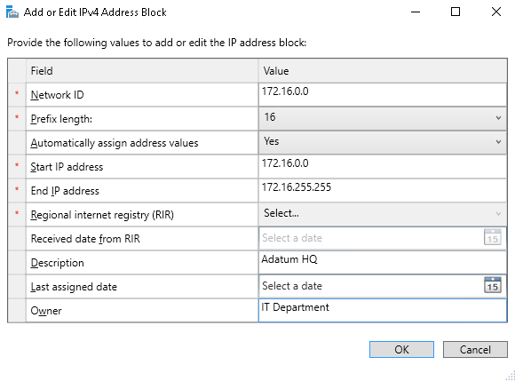
Adding address spaces to IPAM
Add-IpamBlock –NetworkID 172.17.0.0/16 -Description "Adatum HQ" -Owner "IT Department"
Notes:
This topic has three additional slides.
Use the slides to show the various ways to create IP address information in IPAM manually:
The initial screen shows the dialog box for creating an IP address block.
The first click shows the dialog box for creating an IP address subnet.
The second click shows the dialog box for creating an IP address range.
The third click shows the dialog box for creating an individual address.
20743C
5: Implementing network services

Slide 34
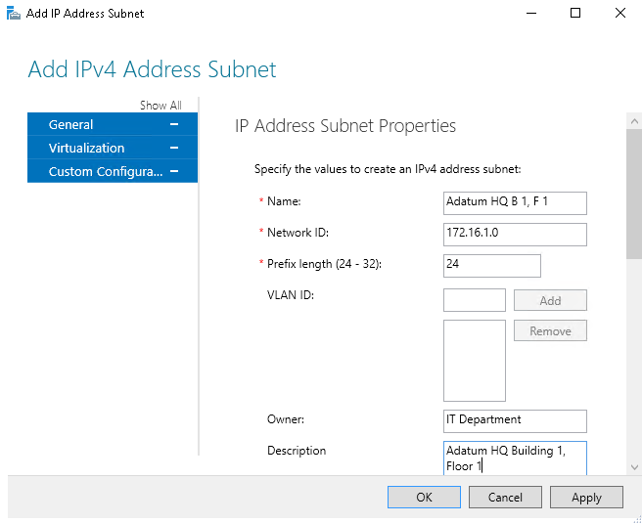
Adding address spaces to IPAM
Add-IpamSubnet -NetworkId 172.16.2.0/24 -Name "Adatum HQ B 1, F 2" -Description "Adatum HQ Building 1, Floor 2" -Owner "IT Department"
Notes:
20743C
5: Implementing network services

Slide 35
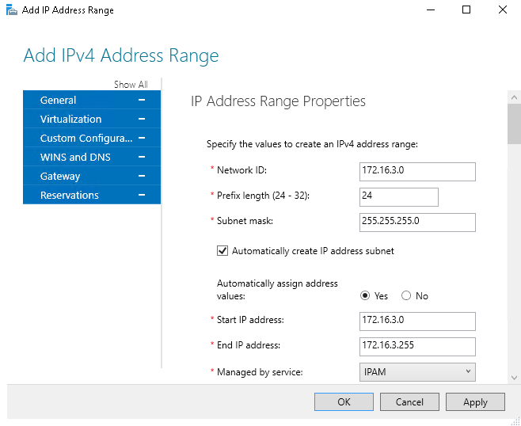
Adding address spaces to IPAM
Add-IpamRange -NetworkId 172.16.4.0/24 -CreateSubnetIfNotFound -Description "Adatum HQ Building 1, Floor 3" -Owner "Adatum Research"
Notes:
20743C
5: Implementing network services

Slide 36
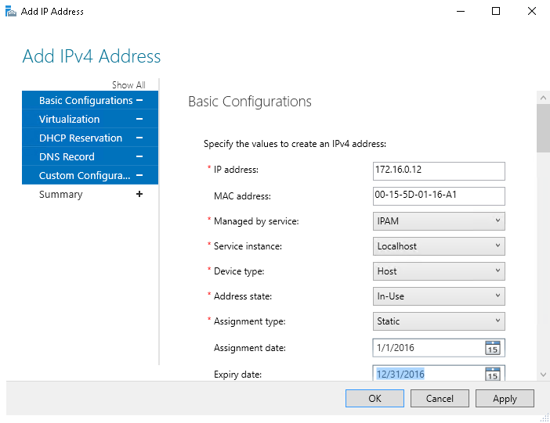
Adding address spaces to IPAM
Add-IpamAddress -IpAddress 172.16.0.13 -ManagedByService IPAM -MacAddress "00-15-5D-01-16-A2" -AssignmentDate "1/1/2016" -ExpiryDate "12/31/2016"
Notes:
20743C
5: Implementing network services

Slide 37
Administering IPAM
Daily operations in IPAM include:
Using .csv files to import individual IP addresses, IP address blocks, subnets, and ranges
Finding available IP addresses
Reclaiming used IP addresses
Creating, modifying, and editing IP addresses
Creating and deleting:
DHCP reservations
DNS Host records
DNS PTR records
Notes:
If time permits, you can demonstrate some of the IPAM features that the slide details.
20743C
5: Implementing network services

Slide 38
Implementing IPAM reporting and monitoring
IPAM reporting includes:
Monitoring IP address space utilization
IP address tracking
IPAM monitoring includes:
Monitoring DNS and DHCP health
Using the event catalog to view a centralized repository for all configuration changes
Use Microsoft SQL Server Reporting Services for extensive reporting
Notes:
You might want to show the students how to use the IPAM event catalog.
20743C
5: Implementing network services

Slide 39
Lab: Implementing network services
Exercise 1: Configuring DNS policies Exercise 2: Configuring DHCP failover Exercise 3: Configuring IPAM
Logon Information
Virtual machines: 20743C-LON-DC1
20743C-LON-SVR1
20743C-LON-SVR2
20743C-LON-CL1
20743C-TREY-DC1
User name: Adatum\Administrator
Password: Pa55w.rd
User name: TreyResearch\Administrator
Password: Pa55w.rd
Estimated Time: 40 minutes
Notes:
Exercise 1: Configuring DNS policies
You want to make DNS zone management easier. You want to configure split-brain DNS by using the new DNS policies in Windows Server 2016 so that partners can connect to a different web server. Trey Research has agreed to test the new DNS setup. If you configure the DNS policies correctly, clients in the TreyResearch domain should receive different name-resolution answers than clients that are internal to the Adatum domain.
Exercise 2: Configuring DHCP failover
The Adatum network expansion, and the increased availability and security requirements, necessitate configuration of DHCP failover.
Exercise 3: Configuring IPAM
Because of Adatum’s expansion, you find it difficult to manage your network and IP address usage. You must implement IPAM to simplify how you manage your IP infrastructure. You need to prepare for a new building that will open soon and for the installation of a new domain controller. You want to try this using the IPAM console instead of the tools that you typically use.
20743C
5: Implementing network services

Slide 40
Lab Scenario
Adatum Corporation has deployed several new branch offices and significantly increased the number of users in the organization. Adatum also has expanded the number of partner organizations and customers that are accessing Adatum websites and applications. This expansion has resulted in increasing complexity of the Adatum network infrastructure, which means that the organization must be much more aware of network-level security.
You are responsible for implementing several new features in the Windows Server 2016 environment, including new DNS and DHCP features, and then implementing IPAM to simplify the process for managing the IP infrastructure.
Notes:
20743C
5: Implementing network services

Slide 41
Lab Review
Will you be implementing DNS policies in your DNS infrastructure? Discuss your answers with the rest of the students. What is the difference between a centralized and a distributed IPAM topology?
Notes:
Question
Will you be implementing DNS policies in your DNS infrastructure? Discuss your answers with the rest of the students.
Answer
Answers will vary but might include split-brain DNS, block malicious attempts, and application load balancing.
Question
What is the difference between a centralized and a distributed IPAM topology?
Answer
In a centralized topology, there is only one IPAM server. In a distributed topology, there is an IPAM server in every site. IPAM servers do not communicate with each other in a distributed topology. You configure each IPAM server independently.
20743C
5: Implementing network services

Slide 42
Module Review and Takeaways
Review Questions Real-world Issues and Scenarios Tools
Notes:
Review Questions
Question
How many DHCP servers can you configure as part of a DHCP failover relationship?
Answer
Each DHCP failover relationship can only contain two DHCP servers. However, each DHCP server can be a part of multiple relationships, as long as the relationship names are unique.
Question
Describe a limitation of IPAM.
Answer
IPAM is not able to manage non-Windows devices, such as network devices. You can use the Network Controller role in Windows Server 2016 to manage network devices.
Real-world Issues and Scenarios
Scenario: What are some scenarios in which you would use DNS policies?
Answer: You can use DNS policies to configure split-brain DNS, DNS load balancing, and DNS responses based on criteria such as time of day, client IP address, DNS server IP address, and query type.
Scenario: What are some methods that you can use to guard against DHCP failures?
Answer: You can use DHCP failover protection, a DHCP split-scope solution, or you can cluster the DHCP servers.
20743C
5: Implementing network services
(More notes on the next slide)

Slide 43
Notes:
Tools
The following table includes the tools that are needed for this module:
20743C
5: Implementing network services

