Slide 1
Module 6
Implementing Hyper-V
Notes:
Presentation: 150 minutes
Lab: 60 minutes
After completing this module, students will be able to:
Configure the Hyper-V role in Windows Server 2016.
Configure Hyper-V storage.
Configure Hyper-V networking.
Configure Hyper-V virtual machines.
Required materials
To teach this module, you need the Microsoft PowerPoint file 20743C_06.pptx.
Preparation tasks
To prepare for this module, you should:
Read all of this module’s materials.
Practice performing the demonstrations and labs.
Work through the Module Review and Takeaways section to determine how you will use the information to reinforce student learning and promote knowledge transfer to on-the-job performance.
As you prepare for this class, it is imperative that you complete the labs yourself. This gives you an understanding of how the labs work, and the concepts that each lab covers, so that you can provide meaningful hints to students who might have issues while working in the labs. Furthermore, it will help guide your lecture to ensure that you discuss the concepts that the labs cover.
20743C
6: Implementing Hyper-V

Slide 2
Module Overview
Configure the Hyper-V role in Windows Server 2016 Configuring Hyper-V storage Configuring Hyper-V networking Configuring Hyper-V virtual machines
Notes:
Using the reference link, consider downloading the Hyper-V component architecture. This link provides a graphical representation of Windows Server 2012 R2 Hyper-V and a visual alternative for students who are interested in studying this technology. Currently, no diagram of the architecture is available for Windows Server 2016. However, the architecture should still be mostly accurate.
Additional Reading: For more information, refer to: “Windows Server 2012 Hyper-V Component Architecture Poster and Companion References” at: http://aka.ms/kl5hes
20743C
6: Implementing Hyper-V

Slide 3
Lesson 1: Configure the Hyper-V role in Windows Server 2016
New features in Windows Server 2012 R2 Hyper-V New features in Windows Server 2016 Hyper-V Hyper-V Manager improvements Prerequisites and requirements for installing Hyper-V on Windows Server 2016 Demonstration: Installing and configuring the Hyper-V role Best practices for configuring Hyper-V hosts Nested virtualization Migration to Azure virtual machines
Notes:
Currently, no diagram of Windows Server 2016 architecture is available. However, most of the basic architecture has not changed from Windows Server 2012 R2 to Windows Server 2016.
Question
In a scenario where you are limited to only one physical server, how can you build a test or development environment with multiple hosts and virtual machines on those hosts?
Answer
Answers might vary but should include:
Ensure that the host is running Windows Server 2016.
Build a virtual machine with a minimum of 4 gigabytes (GB) of static memory.
Enable nested virtualization.
Install the Hyper-V role and create the build by using new virtual machines on a nested virtualization host.
20743C
6: Implementing Hyper-V
(More notes on the next slide)

Slide 4
Notes:
Question
When you are configuring a Hyper-V host, what are some best practice guidelines to follow? Select all that apply.
( ) Option 1: Use Generation 2 virtual machines if the guest operating system supports them.
( ) Option 2: Manage Hyper-V locally.
( ) Option 3: Run Hyper-V by using the Server Core or Nano configuration.
( ) Option 4: Do not collocate other server roles.
( ) Option 5: Provision the host with adequate hardware.
Answer
( √) Option 1: Use Generation 2 virtual machines if the guest operating system supports them.
( √) Option 3: Run Hyper-V by using the Server Core or Nano configuration.
( √) Option 4: Do not collocate other server roles.
( √) Option 5: Provision the host with adequate hardware.
Feedback
All the options are best practices except for managing Hyper-V locally. You should always manage Hyper-V remotely by using Hyper-V Manager, Failover Cluster Manager, or Microsoft System Center 2012 R2 Virtual Machine Manager.
20743C
6: Implementing Hyper-V

Slide 5
New features in Windows Server 2012 R2 Hyper-V
New or improved? | Feature
New in Windows Server 2012 R2 | Shared virtual hard disk Automatic virtual machine activation Enhanced session mode Storage quality of service Virtual machine generation
Improved in Windows Server 2012 R2 | Resize virtual hard disk Live migration Protected network and storage Guest service integration services Export Hyper-V Replica Linux support Management
Notes:
Additional Reading: For more information, refer to: “What’s New in Hyper-V for Windows Server 2012 R2” at: http://aka.ms/y3gvwz
20743C
6: Implementing Hyper-V

Slide 6
New features in Windows Server 2016 Hyper-V
Host Resource Protection
Nested virtualization
Windows PowerShell Direct
Shielded virtual machines
Virtual TPM/BitLocker
Hot add/remove of memory and network adapters
Checkpoints
Linux
Hyper-V Manager
Storage Quality of Service
Notes:
When discussing this topic, determine how to include the features that have improved in Windows Server 2016. In some cases, you might want to explain features for Windows Server 2012, Windows Server 2012 R2, and Windows Server 2016.
20743C
6: Implementing Hyper-V

Slide 7
Hyper-V Manager improvements
Management protocol: WS-Management Protocol, allowing Kerberos authentication, NTLM, or Credential Security Support Provider authentication
Alternate credential support: connect to hosts with various authentication requirements
Previous version support: continue managing older hosts
Notes:
Describe to students the advantages of the Hyper-V Manager improvements, and discuss how it is beneficial during upgrades and for datacenter hosting in large environments with multiple domains.
20743C
6: Implementing Hyper-V

Slide 8
Prerequisites and requirements for installing Hyper-V on Windows Server 2016
Server hardware must support:
Hardware-assisted virtualization
Data execution prevention
SLAT and VM Monitor Mode extensions
4 GB of RAM
Hardware must be adequate to support the needs of virtual machines with respect to:
Memory
Disk I/O
Processing capability
Network throughput, typically NIC Teaming
Notes:
Describe the hardware features that are required to support virtualization. When enabling hardware-assisted virtualization, you will need to switch off the power to the hardware. If you restart the machine without powering off the hardware, you will be unable to use Hyper-V, because the processor setting that allows virtualization will not have taken effect.
20743C
6: Implementing Hyper-V

Slide 9
Demonstration: Installing and configuring the Hyper-V role
In this demonstration, you will see how to configure Hyper-V settings
Notes:
Preparation Steps
Prior to performing this demonstration, you must configure LON-HOST1 with the Hyper-V role. For detailed steps, refer to the first task of Exercise 1, “Installing the Hyper-V server role,” in the lab.
Demonstration Steps
Sign in to LON-HOST1 as Adatum\Administrator with the password Pa55w.rd.
Open Server Manager, and then on the Tools menu, click Hyper-V Manager.
In the navigation pane, right-click LON-HOST1, and then click Hyper-V Settings.
Click Virtual Hard Disks. Show where to change the location of the default virtual hard disks folder.
Click Virtual Machines. Show where to change the location of the default virtual machine configuration files folder.
Click Physical GPUs. Explain that the Remote Desktop Virtualization Host role service must be installed before you can enable Microsoft RemoteFX and GPU management.
Click NUMA Spanning. Explain that when you enable NUMA spanning, servers take advantage of Non-Uniform Memory Access (NUMA) performance optimizations.
Note: Mention that Module 12: “Implementing Failover Clustering with Windows Server 2016 Hyper-V,” discusses live migrations, storage migrations, and replication configuration.
20743C
6: Implementing Hyper-V

Slide 10
Best practices for configuring Hyper-V hosts
Provision the Hyper-V host with adequate hardware resources
Deploy virtual machines on separate disks or CSVs if using shared storage
Do not collocate other Windows Server roles on the Hyper-V host
Manage Hyper-V remotely
Run Hyper-V by using the Server Core or Nano configuration
Use resource metering and the Best Practices Analyzer
Use Generation 2 virtual machines where possible
Notes:
Best practices for configuring Hyper-V hosts primarily focus on ensuring that you have the best experience with hosted virtual machines. If you do not configure the Hyper-V host correctly, there is a significant chance that the virtual machines will not run well.
20743C
6: Implementing Hyper-V

Slide 11
Nested virtualization
Converts a Hyper-V guest virtual machine to a Hyper-V host
Extremely useful with development and test servers
Requirements:
At least 4 GB of static RAM
Windows Server 2016 or Windows 10 Anniversary Update as the host operating system
The virtual machine that is running Hyper-V must be the same build as the host
Some features are disabled or will fail after you enable nested virtualization
Notes:
20743C
6: Implementing Hyper-V

Slide 12
Migration to Azure virtual machines
Use Azure virtual machines to build a test and development environment
Two methods for moving virtual machines from Hyper-V to Azure:
Manual virtual hard disk moves are free but require a virtual hard disk on which you have run Sysprep
Azure Site Recovery:
Supported but not designed for moving single virtual machine
Notes:
20743C
6: Implementing Hyper-V

Slide 13
Lesson 2: Configuring Hyper-V storage
Virtual hard disk file formats Types of virtual hard disks Shared virtual hard disks Virtual machine storage resiliency Converting and resizing disks Fibre Channel support in Hyper-V Location considerations for virtual hard disks Storing virtual machines on SMB 3.0 file shares Demonstration: Managing virtual hard disks in Hyper-V
Notes:
Question
You want to create a guest cluster for which you can manage and resize the shared storage through Hyper-V while the servers are online. What requirement must you consider?
Answer
Answers might vary but should include:
Host and guests should be running Windows Server 2016.
The storage should be a shared .vhdx or .vhds file that is created on a Cluster Shared Volume (CSV) if in a cluster or SMB 3.0 if the guests are not on clustered hosts.
Question
When you configure a virtual hard disk, which of the following options are available? Select all that apply.
( ) Option 1: Pass-through
( ) Option 2: Dynamic
( ) Option 3: Differencing
( ) Option 4: Fixed
Answer
( ) Option 1: Pass-through
( √) Option 2: Dynamic
( √) Option 3: Differencing
( √) Option 4: Fixed
Feedback
All of the options are available except pass-through.
20743C
6: Implementing Hyper-V

Slide 14
Virtual hard disk file formats
Windows Server 2012 introduced the new .vhdx format for virtual hard disks, which:
Supports bigger disks
Is less likely to lose data during unexpected outages
Supports better alignment when deployed to a large-sector disk
Allows larger block size for dynamic and differencing disks, which provides better performance
Windows Server 2016 introduces the .vhds format for virtual hard disks
Windows Server 2012 R2 and Windows Server 2016 support storage QoS for virtual hard disks
Notes:
Ask students in which format Windows Server Backup writes backups. Many students might not be aware that Windows Server Backup writes backups in the .vhd format.
Remind students that using .vhdx files will limit a virtual machine to running on Hyper-V in Windows Server 2016, Windows Server 2012 R2, or Windows Server 2012.
Ask students where it might be appropriate to set a dedicated QoS policy or aggregated QoS policies.
Additional Reading: For more information, refer to: “Ask Premier Field Engineering (PFE) Platforms” at: http://aka.ms/ag3wyd
20743C
6: Implementing Hyper-V

Slide 15
Types of virtual hard disks
Type of disk | Description
Fixed | All of the hard disk space allocates during the creation process
Dynamic | The disk itself only uses the amount of space that needs to be allocated, and it grows as necessary
Pass-through | Virtual machines access a physical disk drive rather than using a virtual hard disk
Differencing | The amount of hard disk space that virtual hard disks consume is reduced at the cost of disk performance
Notes:
Explain the types of disks. Ask students when they would use each disk type, such as when to use a fixed-size disk or a dynamically expanding disk. One possible scenario is when exporting virtual hard disks to Microsoft Azure, which only supports fixed-size disks.
20743C
6: Implementing Hyper-V

Slide 16
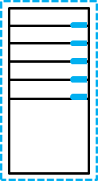
Shared virtual hard disks
In Windows Server 2012 or later, you can share a single virtual hard disk file between multiple virtual machines in a shared storage configuration
Virtual machine cluster node 1
Virtual machine cluster node 2
Shared virtual hard disk
Notes:
When discussing the benefits of using shared virtual hard disks, mention the amount of administrative effort that is necessary to configure Hyper-V guest clustering with a technology such as internet SCSI (iSCSI). You will discuss Hyper-V guest clustering in more detail in Module 12: “Implementing Failover Clustering with Windows Server 2016 Hyper-V.” When presenting that module, you might want to remind students that shared virtual hard disks provide an alternative to using an iSCSI target for virtual machine clustering.
20743C
6: Implementing Hyper-V

Slide 17
Virtual machine storage resiliency
Virtual machine storage resiliency is provided by:
Critical pause state
Shared virtual hard disk automatic removal
Configuration options
Notes:
20743C
6: Implementing Hyper-V

Slide 18
Converting and resizing disks
You can perform the following maintenance operations on virtual hard disks:
Convert a disk from fixed to dynamic
Convert a disk from dynamic to fixed
Convert a virtual hard disk in .vhd format to .vhdx format
Convert a virtual hard disk in .vhdx format to .vhd format
With Windows Server 2012 R2 and Windows Server 2016 Hyper-V, you can resize virtual hard disks while the virtual machine is running
With Windows Server 2016, you can resize shared virtual hard disks while the virtual machine is running
Notes:
Explain how to convert a disk from one format to the other. Some students might be interested in migrating virtual machines that are running on Hyper-V to Azure. In this case, mention that Azure currently only supports virtual hard disks in .vhd format and that importing dynamically expanding disks to Azure automatically converts them to fixed-size.
20743C
6: Implementing Hyper-V

Slide 19
Fibre Channel support in Hyper-V
The Fibre Channel adapter:
Allows a virtual machine to connect to a Fibre Channel SAN directly
Requires that the Hyper-V host has a Fibre Channel HBA
Requires that the Fibre Channel HBA driver supports virtual Fibre Channel
Notes:
Remind students that the Hyper-V host already must have a Fibre Channel host bus adapter (HBA) and that the driver needs to support virtual Fibre Channel.
Ask students if they use Fibre Channel or iSCSI to connect to their storage area networks (SANs).
20743C
6: Implementing Hyper-V

Slide 20
Location considerations for virtual hard disks
When planning the location of virtual hard disks, ensure that the virtual hard disk files are:
Stored on disks that can be accessed quickly from the Hyper-V host
Stored on a volume that is configured for redundancy
Stored on high-performance storage
Placed on volumes with adequate space if they are configured for growth
Notes:
Explain the considerations when you plan the location of virtual hard disks. For example, mention that with traditional hard disks, starting a complex environment that has 10 virtual machines takes approximately 30 minutes. Conversely, it takes only three minutes to do the same with solid-state drives.
20743C
6: Implementing Hyper-V

Slide 21
Storing virtual machines on SMB 3.0 file shares
SMB 3.0 is available in Windows Server 2012, but it is not in earlier Windows Server versions
Hyper-V can store the following on SMB 3.0 file shares:
Configuration files
Virtual hard disk files in .vhd or .vhdx format
Checkpoint files
Notes:
Remind students about the Server Message Block (SMB) 3.0 limitation—you cannot use file shares that are running on Windows Server 2008 or Windows Server 2008 R2 to store virtual machine files. Discuss the enhancements in SMB 3.0 that:
Allow hosting of .vhdx files for shared virtual hard disks.
Allow SMB 3.0 to store virtual machine files to support Hyper-V live migration.
20743C
6: Implementing Hyper-V

Slide 22
Demonstration: Managing virtual hard disks in Hyper-V
In this demonstration, you will see how to create a differencing disk based on an existing disk by using both Hyper-V Manager and Windows PowerShell
Notes:
Preparation Steps
To perform this demonstration, you must have started LON-HOST1 and have completed the previous demonstration. Also, you must complete all tasks from Lab A, Exercise 2 – Configuring virtual networking.
Demonstration Steps
On LON-HOST1, on the taskbar, click File Explorer.
Click This PC, and then go to D:\Program Files\Microsoft Learning\Base.
Note: The drive letter might depend on the number of drives on the physical host machine.
Verify that the Base17C-WS16-1607.vhd hard disk image file is present.
Go to E:\Program Files\Microsoft Learning\20743\Drives, click the Home tab, and then click the New Folder icon twice to create two new folders. Right-click each folder and rename them:
LON-GUEST1
LON-GUEST2
Run the CreateVirtualSwitches.ps1 and LON-HOST1_VM-Pre-Import-20743C.ps1 scripts.
Close File Explorer.
Switch to Hyper-V Manager.
In the Actions pane, click New, and then click Hard Disk.
On the Before You Begin page of the New Virtual Hard Disk wizard, click Next.
On the Choose Disk Format page, select VHD, and then click Next.
On the Choose Disk Type page, select Differencing, and then click Next.
20743C
6: Implementing Hyper-V
(More notes on the next slide)

Slide 23
Notes:
On the Specify Name and Location page, specify the following details, and then click Next:
Name: LON-GUEST1.vhd
Location: E:\Program Files\Microsoft Learning\20743\Drives\LON-GUEST1\
On the Configure Disk page, type D:\Program Files\Microsoft Learning\Base \Base17C-WS16-1607.vhd as the location, and then click Finish.
Click the Start button, and then click the Windows PowerShell icon.
At the command prompt in the Windows PowerShell command-line interface, type the following command to create a new differencing disk to use with LON-GUEST2, and then press Enter:
New-VHD “E:\Program Files\Microsoft Learning\20743\Drives\LON-GUEST2\LON-GUEST2.vhd” -ParentPath “D:\Program Files\Microsoft Learning\Base\Base17C-WS16-1607.vhd”
Close the Windows PowerShell window.
In the Actions pane of the Hyper-V Manager console, click Inspect Disk.
In the Open dialog box, go to E:\Program Files\Microsoft Learning\20743\Drives\LON-GUEST2\, click LON-GUEST2.vhd, and then click Open.
In the Virtual Hard Disk Properties dialog box, verify that LON-GUEST2.vhd is configured as a differencing virtual hard disk with D:\Program Files\Microsoft Learning\Base \Base17C-WS16-1607.vhd as a parent, and then click Close.
20743C
6: Implementing Hyper-V

Slide 24
Lesson 3: Configuring Hyper-V networking
New Hyper-V networking features in Windows Server 2012 New Hyper-V networking features in Windows Server 2012 R2 New Hyper-V networking features in Windows Server 2016 Types of Hyper-V networks Demonstration: Creating Hyper-V network types Hyper-V virtual networking Best practices for configuring virtual networks
Notes:
Question
When configuring a Hyper-V host with multiple network adapters on the same network, what should you do to provide redundancy and performance?
Answer
Answers might vary but should include:
Create a team.
Create a Switch Independent or Link Aggregation Control Protocol (LACP) team, depending on switch requirements.
If the host is Windows Server 2016, creating a software embedded team is also acceptable.
20743C
6: Implementing Hyper-V

Slide 25
New Hyper-V networking features in Windows Server 2012
NIC
Teaming
VMQ
Port mirroring
SR-IOV
Hyper-V
networking
Router guard
IPsec task offloading
Network
virtualization
DHCP guard
Bandwidth management
Notes:
When you go through each of these features, provide an example of how this technology can be useful in the students’ organizational deployments. Do not spend much time on network virtualization because a later topic in this lesson addresses this.
20743C
6: Implementing Hyper-V

Slide 26
New Hyper-V networking features in Windows Server 2012 R2
Virtual switch improvements in Windows Server 2012 R2 include:
Extended port access control lists
Dynamic load balancing
Coexistence with non-Microsoft forwarding extensions
Receive Side Scaling is supported on the virtual machine network path
Network tracing improvements
Notes:
When discussing each of the virtual switch improvements, point out that many of these features will be of interest primarily to organizations with large, high-performance virtual machine deployments. However, if students are likely to manage smaller deployments, remind them that when a technology is designed to work well under stressful conditions, it also works well in smaller deployments.
Additional Reading: For more information, refer to: “What’s New in Hyper-V Virtual Switch in Windows Server 2012 R2” at: http://aka.ms/gd08pi
20743C
6: Implementing Hyper-V

Slide 27
New Hyper-V networking features in Windows Server 2016
Network function virtualization
Network Controller
Switch Embedded Teaming
Remote Direct Memory Access
Virtual machine multi queues
Converged network adapters
Notes:
When discussing each of the improvements in Windows Server 2016 Hyper-V, ensure that students know that the default settings are adequate for most small environments. However, while planning for possible growth, it is always valuable to know which features that might be good to build in small environments can provide quick scalability and good performance from the start.
Additional Reading: For more information about the improvements in Windows Server 2016, refer to: “What's New in Networking” at: http://aka.ms/u2v17v
20743C
6: Implementing Hyper-V

Slide 28
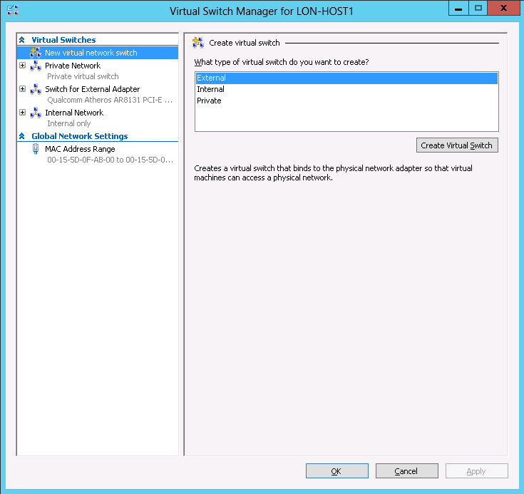
Types of Hyper-V networks
Virtual switches are virtual devices that you can manage by using the Virtual Switch Manager
Notes:
Describe the three types of virtual switches. Ask students to devise a scenario that would be appropriate for the internal switch type but not for the private switch type. Ask students whether they would configure virtual local area networks (VLANs) at the network-adapter level or at the virtual-switch level, and ask them why.
20743C
6: Implementing Hyper-V

Slide 29
Demonstration: Creating Hyper-V network types
In this demonstration, you will see how to create a public and a private network switch
Notes:
Preparation Steps
You must be running LON-HOST1 to perform this demonstration, and you must have completed the previous demonstration.
Demonstration Steps
In Hyper-V Manager, in the Actions pane, click Virtual Switch Manager.
In the Virtual Switch Manager dialog box, select New virtual network switch. Ensure that External is selected, and then click Create Virtual Switch.
In the Virtual Switch Properties area of the Virtual Switch Manager dialog box, specify the following information, and then click OK:
Name: Corporate Network2
Connection type: External Network: mapped to the host computer's physical network adapter. Varies depending on the host computer.
In the Apply Networking Changes dialog box, review the warning, but do not click Yes. Explain to students that this type of network is already created earlier.
In Hyper-V Manager, in the Actions pane, click Virtual Switch Manager.
Under Virtual Switches, select New virtual network switch.
Under Create virtual switch, select Internal, and then click Create Virtual Switch.
In the Virtual Switch Properties section, configure the following settings, and then click OK:
Name: Internal Network2
Connection type: Internal network
20743C
6: Implementing Hyper-V

Slide 30


Hyper-V virtual networking
Production virtual machine
Test virtual machine
Production network
Test network
Virtualization
Physical
server
Physical
network
Switches
Servers
Server virtualization runs
multiple virtual servers
on a physical server
Network virtualization runs multiple virtual networks
on a physical network
Notes:
Explain the benefits of network virtualization, which allows you to replicate production and test servers on the same physical network layer.
The slide shows two different virtual machines that are on the same Hyper-V host. Network virtualization allows you to run these virtual machines separately from each other, to the point where they can even have the same IP address without causing a conflict. In network virtualization scenarios, you can create completely separate virtualized networks that use the same address space, and then you can run them concurrently on the same host.
20743C
6: Implementing Hyper-V

Slide 31
Best practices for configuring virtual networks
When configuring virtual networks:
Use NIC Teaming on the Hyper-V host to ensure connectivity to virtual machines if an adapter fails
Enable bandwidth management to ensure that no single virtual machine is able to monopolize the network interface
Use network adapters that support VMQ
Use network virtualization when you have to ensure that virtual machines keep their original IP addresses after migrating to a new host
Notes:
Remind students that an important aim when configuring virtual machines is to ensure that the virtual machines that are hosted on the network server remain accessible to the network. No one host should be able to monopolize network connectivity in such a way that it stops network connectivity for other hosts. In general, the default settings are appropriate for most circumstances, and you will only need to modify settings to deal with specific scenarios.
20743C
6: Implementing Hyper-V

Slide 32
Lesson 4: Configuring Hyper-V virtual machines
Virtual machine generation versions Overview of virtual machine settings What are virtual machine configuration versions? Demonstration: Creating a virtual machine How memory works in Hyper-V Checkpoints and checkpoint management in Hyper-V Demonstration: Creating checkpoints Importing, exporting, and moving virtual machines in Hyper-V Best practices for configuring virtual machines Demonstration: Using Windows PowerShell Direct to restart a virtual machine
Notes:
Question
When building a guest virtual machine running Windows Server 2016 that will require the ability to expand the startup .vhdx file while the server is running, what generation version should you use?
Answer
You should use Generation 2 virtual machines to build a Windows Server 2016 virtual machine.
Question
You need to build a virtual machine guest that has static memory that you can resize while the server is online. What requirements should you keep in mind?
Answer
Answers might vary, but they should include the following at minimum:
The host must run Windows Server 2016.
The guest virtual machine configuration version must upgrade to Windows Server 2016.
Question
You need to run guest virtual machines on both Windows Server 2012 R2 and Windows Server 2016 servers. What should you avoid doing until you no longer need to run these virtual machines on Windows Server 2012 R2?
Answer
You should avoid upgrading the virtual machine configuration version until you no longer need to run the guest virtual machines on Windows Server 2012 R2.
20743C
6: Implementing Hyper-V

Slide 33
Virtual machine generation versions
Generation 2 virtual machines provide the following functionality:
Secure boot
Boot from a virtual hard disk that is connected to a virtual SCSI controller
Boot from a virtual DVD that is connected to a virtual SCSI controller
PXE boot by using a standard Hyper-V network adapter
UEFI firmware support
Notes:
When discussing the benefits of Generation 2 virtual machines, point out that many features in Generation 1 virtual machines still exist to replicate existing physical hardware functionality. However, by design, a Generation 2 virtual machine only runs in a virtual environment and does not replicate an existing physical machine.
20743C
6: Implementing Hyper-V

Slide 34
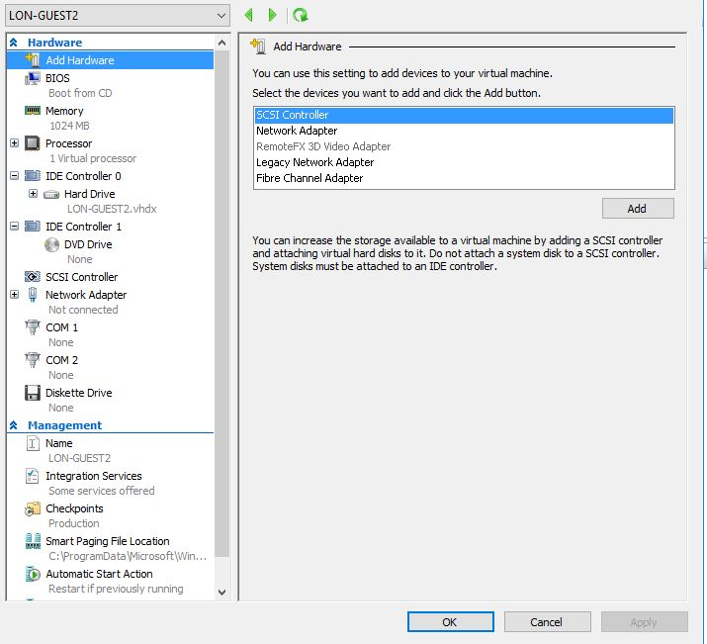
Overview of virtual machine settings
Virtual machine settings are grouped into two general areas
Notes:
Explain the different virtual machine hardware components. Explain the limitations for integrated drive electronics (IDE) and SCSI devices. Ask students when they might choose to connect virtual hard disks to a virtual SCSI controller, as opposed to a virtual IDE controller. One answer is when they want to use many virtual hard disks, or if they need to hot add and expand drives.
20743C
6: Implementing Hyper-V

Slide 35
What are virtual machine configuration versions?
The Windows Server 2012 R2 virtual machine configuration is compatible on Windows Server 2016 hosts
Check the version
Update the version
Notes:
20743C
6: Implementing Hyper-V

Slide 36
Demonstration: Creating a virtual machine
In this demonstration, you will see how to create a virtual machine by using Hyper-V Manager and Windows PowerShell
Notes:
Preparation Steps
Sign in to LON-HOST1 as Adatum\Administrator with the password Pa55w.rd. You must complete the previous demonstrations to perform this demonstration.
Demonstration Steps
In Hyper-V Manager, in the Actions pane, click New, and then click Virtual Machine.
On the Before You Begin page of the New Virtual Machine wizard, click Next.
On the Specify Name and Location page of the New Virtual Machine wizard, select Store the virtual machine in a different location, enter the following values, and then click Next:
Name: LON-GUEST1
Location: E:\Program Files\Microsoft Learning\20743\Drives\LON-GUEST1\
On the Specify Generation page, click Next.
On the Assign Memory page of the New Virtual Machine wizard, enter a value of 1024 MB, select the Use Dynamic Memory for this virtual machine option, and then click Next.
On the Configure Networking page of the New Virtual Machine wizard, select Private Network, and then click Next.
On the Connect Virtual Hard Disk page, choose Use an existing virtual hard disk.
Click Browse, and then go to E:\Program Files\Microsoft Learning\20743C\Drives \LON-GUEST1\lon-guest1.vhd.
Click Open, and then click Finish.
Click the Start button, and then click the Windows PowerShell icon.
20743C
6: Implementing Hyper-V
(More notes on the next slide)

Slide 37
Notes:
At the Windows PowerShell command prompt, enter the following command to create a new virtual machine named LON-GUEST2:
New-VM –Name LON-GUEST2 –MemoryStartupBytes 1024MB –VHDPath “E:\Program Files\Microsoft Learning\20743\Drives\LON-GUEST2\LON-GUEST2.vhd” –SwitchName “Private Network”
Close the Windows PowerShell window.
In Hyper-V Manager, click LON-GUEST2.
In the Actions pane, under LON-GUEST2, click Settings.
In the Settings for the LON-GUEST2 dialog box, click Automatic Start Action, and then set the Automatic Start Action setting to Nothing.
In the Settings for the LON-GUEST2 dialog box, click Automatic Stop Action, and then set the Automatic Stop Action setting to Shut down the guest operating system.
Click OK to close the Settings for the LON-GUEST2 dialog box.
20743C
6: Implementing Hyper-V

Slide 38
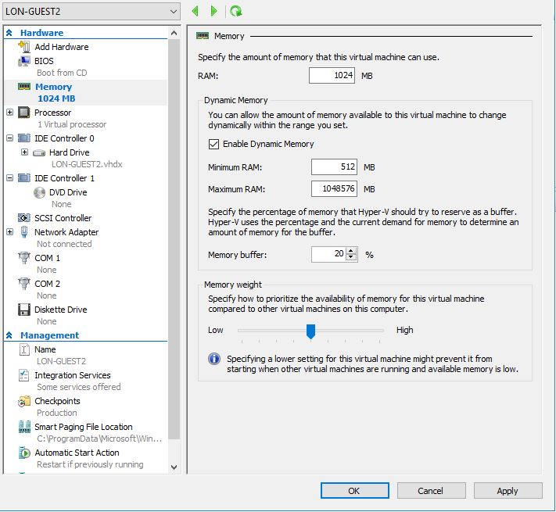
How memory works in Hyper-V
You can use Dynamic Memory settings to configure Hyper-V so that a virtual machine is allocated as much memory as it needs
In Windows Server 2016, you can modify dynamic and static memory settings while a virtual machine is running
Notes:
Discuss with students the benefits of using dynamic memory versus statically allocated memory. Mention how in Windows Server 2016, you can change dynamic and static memory settings while the operating system is running, rather than being able to modify these settings only when the virtual machine is shut down.
20743C
6: Implementing Hyper-V

Slide 39
Checkpoints and checkpoint management in Hyper-V
Checkpoints allow administrators to make a snapshot of a virtual machine at a particular point in time
Checkpoints do not replace backups
Standard checkpoints create differencing disks, .avhd files, which merge back into the previous checkpoint when the checkpoint is deleted
Use VSS to create production checkpoints, and start from an offline state to restore them
Checkpoints were termed snapshots in previous versions of Hyper-V
Notes:
Explain the difference between a checkpoint and a backup. Explain the difference between standard and production checkpoints. Remind students about the limit of 50 checkpoints per virtual machine.
Describe how to use branching checkpoint trees. Point out that checkpoints in Hyper-V in Windows Server 2012 R2 were termed snapshots in previous versions of Hyper-V.
20743C
6: Implementing Hyper-V

Slide 40
Demonstration: Creating checkpoints
In this demonstration, you will see how to create a production checkpoint and a standard checkpoint in Hyper-V Manager
Notes:
Preparation Steps
Sign in to LON-HOST1 as Adatum\Administrator with the password Pa55w.rd. You must complete the previous demonstrations to perform this demonstration.
Demonstration Steps
In Hyper-V Manager, click LON-GUEST1.
In the Actions pane, click Settings, and then under Management, click Checkpoints.
Ensure that checkpoints are enabled and that Checkpoint Type is set to Production Checkpoints, and then click OK.
To create a production checkpoint, in the Actions pane, click Checkpoint.
Note: The checkpoint should now be visible in the Checkpoints pane.
Click LON-Guest1, in the Actions pane, click Settings, and then under Management, click Checkpoints.
Change Checkpoint Type to Standard Checkpoints, and then click OK.
To create a standard checkpoint, in the Actions pane, click Checkpoint.
Click LON-GUEST1, and then in the Checkpoints pane, select the top checkpoint.
In the Actions pane, click Delete Checkpoint Subtree, and then click Delete when prompted to delete and merge all of the previous checkpoints.
20743C
6: Implementing Hyper-V

Slide 41
Importing, exporting, and moving virtual machines in Hyper-V
When importing virtual machines in Hyper-V:
You can access detailed diagnostic information
You can import copied virtual machine files
When exporting virtual machines, you have two options:
Export a checkpoint for a point-in-time export
Export a virtual machine to export all checkpoints
When moving virtual machines:
You can relocate virtual machine files while a virtual machine is online
You can perform a live migration
Notes:
Describe the differences between importing, exporting, and moving virtual machines in Hyper-V. Moving is probably the most useful feature for students because they can move virtual machines from one location to another while keeping the server on the same host. A virtual machine can be online during a move. Point out that Windows Server 2016 Hyper-V supports exporting virtual machines that are running.
20743C
6: Implementing Hyper-V

Slide 42
Best practices for configuring virtual machines
Use Dynamic Memory unless an application does not support it
Avoid using differencing disks
Configure multiple synthetic network adapters
Store each virtual machine’s files on a separate volume
Notes:
When talking about best practices, the key is to remember:
A virtual machine must not monopolize the host's resources to the detriment of other virtual machines.
A virtual machine must achieve the best performance possible.
A virtual machine must be as fault-tolerant as possible.
20743C
6: Implementing Hyper-V

Slide 43
Demonstration: Using Windows PowerShell Direct to restart a virtual machine
In this demonstration, you will see how to restart a virtual machine by using Windows PowerShell Direct
Notes:
This is a very basic representation of the possibilities with Windows PowerShell Direct.
Preparation Steps
Sign in to LON-HOST1 as Adatum\Administrator with the password Pa55w.rd. You must complete the previous demonstrations to perform this demonstration.
Demonstration Steps
In Hyper-V Manager, click LON-GUEST1.
In the Actions pane, click Start, and then click Connect. Wait until the virtual machine completes the startup process.
On the Hi there page, click Next.
On the Licenses Terms page, click Accept.
On the Customize settings page, in the Password and re-enter password text boxes, type Pa55w.rd, and then click Finish.
In Hyper-V Manager, click LON-GUEST1.
In the Actions pane, click Settings, and then click Network Adapter.
Change the Virtual switch to Not connected, and then click OK.
On LON-HOST1, open Windows PowerShell as an administrator.
Enter the following command, and then press Enter:
Enter-PSSession –Vmname “LON-GUEST1”
When prompted for credentials, use Administrator with the password Pa55w.rd. This should enter you into a PSSession with LON-GUEST1.
20743C
6: Implementing Hyper-V
(More notes on the next slide)

Slide 44
Notes:
Enter the following command, and then press Enter, after which LON-GUEST1 should restart:
Restart-Computer
In Hyper-V Manager, click LON-GUEST1, and then click Settings.
In the navigation pane on the left, click Network Adapter.
Change the virtual switch to Private Network, and then click OK.
Shut down LON-GUEST1.
20743C
6: Implementing Hyper-V

Slide 45
Lab: Implementing server virtualization with Hyper-V
Exercise 1: Installing the Hyper-V server role Exercise 2: Configuring virtual networking Exercise 3: Creating and configuring a virtual machine
Logon Information
Virtual machine: 20743C-LON-HOST1
User name: Adatum\Administrator
Password: Pa55w.rd
Estimated Time: 60 minutes
Notes:
You will need to verify that students have performed this step correctly.
Exercise 1: Installing the Hyper-V server role
The first step in exploring a virtualized environment is for Adatum to install the Hyper-V server role on a new server.
Exercise 2: Configuring virtual networking
After installing the Hyper-V server role on the new server, you need to configure the virtual networks. You need to create a network that connects to the physical network and a private network that you can use only for communication between virtual machines. The private network is used when virtual machines are configured for high availability. You also need to configure a specific range of media access control (MAC) addresses for the virtual machines.
Instructor Note: In this exercise, students will perform the same task on each computer.
Exercise 3: Creating and configuring a virtual machine
Your organization has asked you to deploy two virtual machines and to import a third virtual machine. You have copied a generalized .vhd file that hosts a Windows Server 2016 Hyper-V host.
To minimize disk space use—at the cost of performance—you are going to create two differencing files based on the generalized virtual hard disk. You will use these differencing files as the hard disk files for the new virtual machines. You will also import a specially prepared virtual machine to run on the host.
Instructor Note: In the first part of this exercise, students will import LON-DC1.
In the second part of this exercise, students will create differencing disks that will form the basis of a new virtual machine deployment. Students will use Hyper-V Manager and Windows PowerShell to perform this task. Students create two virtual machines on each computer during these tasks.
20743C
6: Implementing Hyper-V

Slide 46
Lab Scenario
IT management at Adatum Corporation is concerned about the low utilization of many of the physical servers that are deployed in the London datacenter. Adatum also is exploring options for expanding into multiple branch offices and deploying servers in public and private clouds. For this purpose, the company is exploring the use of virtual machines.
You will deploy the Hyper-V server role, configure virtual machine storage and networking, and deploy the virtual machines.
Notes:
20743C
6: Implementing Hyper-V

Slide 47
Lab Review
What type of virtual network switch would you create if you want to allow a virtual machine to communicate with a LAN that is connected to the Hyper-V host? How can you ensure that a single virtual machine does not use all of the available bandwidth that a Hyper-V host provides? What dynamic memory configuration task can you perform on a virtual machine that is hosted on Windows Server 2012 Hyper-V or later?
Notes:
Question
What type of virtual network switch would you create if you want to allow a virtual machine to communicate with a LAN that is connected to the Hyper-V host?
Answer
You would create an external virtual network switch if you want to allow a virtual machine to communicate with a LAN that is connected to the Hyper-V host.
Question
How can you ensure that a single virtual machine does not use all of the available bandwidth that a Hyper-V host provides?
Answer
To ensure that a single virtual machine does not use all of the available bandwidth that a Hyper-V host provides, you must configure minimum and maximum bandwidth settings on the virtual network adapters.
Question
What dynamic memory configuration task can you perform on a virtual machine that is hosted on Windows Server 2012 Hyper-V or later?
Answer
You can modify dynamic memory settings while a virtual machine is running on Windows Server 2012 Hyper-V or later. This was not possible in previous versions of Hyper-V.
20743C
6: Implementing Hyper-V

Slide 48
Module Review and Takeaways
Review Questions Real-world Issues and Scenarios Tools Common Issues and Troubleshooting Tips
Notes:
Review Questions
Question
In which situations should you use static memory allocation rather than dynamic memory?
Answer
You should use fixed memory allocation in the following situations:
When the guest operating system or application does not support dynamic memory.
When the host operating system has limited memory resources and you need to ensure that operating systems receive a fair allocation of memory.
Question
In which situations must you use virtual hard disks in .vhdx format rather than virtual hard disks in .vhd format?
Answer
You should use the .vhdx format rather than the .vhd format in the following situations:
You need to support virtual hard disks larger than 2 terabytes (TB); .vhdx files can be a maximum of 64 TB in size.
You need to protect against data corruption caused by power failures. An unexpected power failure is less likely to corrupt the .vhdx format because of the way the file format processes updates.
You need to deploy a virtual hard disk to a large-sector disk.
Question
You want to deploy a Hyper-V virtual machine's virtual hard disk on a file share. What operating system must the file server be running to support this configuration?
Answer
You can deploy virtual hard disks only to file shares that support SMB 3.0. The Windows Server 2016 operating system supports hosting SMB 3.0 file shares.
20743C
6: Implementing Hyper-V
(More notes on the next slide)

Slide 49
Notes:
Real-world Issues and Scenarios
You need to ensure that you provision a virtual machine host with adequate RAM. Having multiple virtual machines paging a hard disk drive because they are provisioned with inadequate memory will decrease performance for all virtual machines on the Hyper-V host.
Additionally, you should monitor virtual machine performance carefully. One virtual machine that uses a disproportionate amount of server resources can adversely affect the performance of all other virtual machines that the Hyper-V server hosts.
Tools
The following table includes the tools that are needed for this module.
(More notes on the next slide)
20743C
6: Implementing Hyper-V

Slide 50
Notes:
Common Issues and Troubleshooting Tips
Common Issue: A virtual machine does not use dynamic memory.
Troubleshooting Tip: The operating system might not support dynamic memory. In some cases, applying a service pack or installing virtual machine integration services will resolve this issue.
Note: Ensure that you cover the common issues and the corresponding troubleshooting tips listed in this section. Encourage students to share tips from their own work environments.
20743C
6: Implementing Hyper-V

