Slide 1
Module 7
Configuring advanced networking features
Notes:
Presentation: 65 minutes
Lab: 30 minutes
After completing this module, students should be able to:
Describe the high-performance networking enhancements in Windows Server 2016.
Configure the advanced Microsoft Hyper‑V networking features.
Required materials
To teach this module, you need the Microsoft PowerPoint file 20743C_07.pptx.
Preparation tasks
To prepare for this module:
Read all of the materials for this module.
Practice performing the demonstrations and the lab.
Work through the Module Review and Takeaways section, and determine how you will use the information to reinforce student learning and promote knowledge transfer to on-the-job performance.
As you prepare for this class, it is imperative that you complete the lab yourself. This gives you an understanding of how the lab works, as well as the concepts that the lab covers. This enables you to provide meaningful hints to students who might have issues while working in the lab. Furthermore, it will help guide your lecture to ensure that you discuss the concepts that the lab covers.
20743C
7: Configuring Advanced Networking Features

Slide 2
Module Overview
Overview of high-performance networking features Configuring advanced Hyper-V networking features
Notes:
Briefly introduce the module content to the students, and ask them about their experience using the advanced networking feature infrastructure and Hyper‑V. Use this to gauge how deeply to go into the advanced details.
20743C
7: Configuring Advanced Networking Features

Slide 3
Lesson 1: Overview of high-performance networking features
What is NIC Teaming? Demonstration: Implementing NIC Teaming Implementing SMB 3.1.1 shared folders Using advanced SMB 3.1.1 functionality Providing highly available remote storage by using SMB 3.1.1 What is QoS? What is RSS? What is RSC?
Notes:
Describe the high-performance networking features in Windows Server 2016.
20743C
7: Configuring Advanced Networking Features

Slide 4
What is NIC Teaming?
NIC Teaming:
Provides redundancy and aggregates bandwidth
Is supported at the host and virtual machine levels
Considerations for NIC Teaming:
Deploy multiple network adapters on a physical host
Configure separate teams on different switches for fault tolerance
Notes:
Explain how NIC Teaming can provide fault tolerance and bandwidth aggregation. Mention that creating a team with only one network adapter will work and allow you to provide network isolation, but it will not provide fault tolerance.
20743C
7: Configuring Advanced Networking Features

Slide 5
Demonstration: Implementing NIC Teaming
In this demonstration, you will learn how to implement NIC Teaming
Notes:
Demonstrate how to implement NIC Teaming.
Preparation Steps
For this demonstration, you need to restart the physical host and select the 20743C-LON-HOST1 item on the boot menu. Sign in to 20743C-LON-HOST1 as Adatum\Administrator with a password of Pa55w.rd.
Note that in order to complete this demonstration, all demonstrations in Module 6 also need to be completed.
Demonstration Steps
On LON-HOST1, open Server Manager, click the Tools menu, and then click Computer Management.
In the Computer Management Console tree, under the System Tools node, select Device Manager.
In Device Manager, in the details pane, right-click LON-HOST1, and then select Add legacy hardware.
In the Welcome to the Add Hardware Wizard window, click Next.
On The wizard can help you install other hardware page, select the Install the hardware that I manually select from a list (Advanced) option, and then click Next.
On the From the list below, select the type of hardware you are installing page, scroll down and select Network adapters, and then click Next.
On the Select the device driver you want to install for this hardware page, in the Manufacturer pane, select Microsoft, in the Model pane, select Microsoft KM-TEST Loopback Adapter, and then click Next.
On The Wizard is ready to install your hardware page, click Next.
On the Completing the Add Hardware Wizard page, click Finish.
In Server Manager, in the console tree, click the Local Server node.
20743C
7: Configuring Advanced Networking Features
(More notes on the next slide)

Slide 6
Notes:
In the Properties details pane, next to the NIC Teaming item, click the Disabled hyperlink.
In the NIC Teaming dialog box, in the Adapters and Interfaces pane, click Ethernet 3, click Tasks, and then select Add to new team.
In the NIC Teaming dialog box, in the Team name box, type Host NIC Team, and then click OK.
In the NIC Teaming dialog box, in the Teams pane, note the following details:
Team: Host NIC Team
Status: OK
Teaming Mode: Switch Independent
Load Balancing: Dynamic
Adapters: 1
Note: Explain that as previously mentioned, you have created a NIC team with only one adapter, which is not fault tolerant but allows for the separation of network traffic when you are also using VLANs.
20743C
7: Configuring Advanced Networking Features

Slide 7
Implementing SMB 3.1.1 shared folders
SMB 3.1.1 is available only in Windows Server 2016; SMB 3.0 is available in Windows Server 2012; both have similar functionality
Hyper-V 10.0 can store the following on SMB 3.1.1 file shares:
XML-based configuration files
Virtual hard disk files (in the .vhd or .vhdx format)
Checkpoint files
Notes:
Discuss the enhancements in Server Message Block (SMB) 3.0 and SMB 3.1.1 that:
Allow the hosting of .vhdx files for shared virtual hard disks.
Allow SMB 3.0 to store virtual machine files to support Hyper‑V Live Migration.
20743C
7: Configuring Advanced Networking Features

Slide 8
Using advanced SMB 3.1.1 functionality
SMB 3.0 features that are introduced in Windows Server 2012:
SMB Transparent Failover
SMB Scale Out
SMB Multichannel
SMB Direct
SMB Encryption.
VSS for SMB file shares
SMB Directory Leasing
Windows PowerShell commands for managing SMB
Notes:
Note: This topic has one additional slide.
Describe the features of SMB 3.0. Explain that the features of SMB 3.0 carry over to SMB 3.1.1.
20743C
7: Configuring Advanced Networking Features

Slide 9
Using advanced SMB 3.1.1 functionality
SMB 3.1.1 features that are introduced in Windows Server 2016:
Preauthentication integrity
SMB Encryption improvements
Cluster Dialect Fencing
The removal of the RequireSecureNegotiate setting
The x.y.z notation for dialects with a nonzero revision number
Notes:
Discuss the additional features of SMB 3.1.1, introduced in Windows Server 2016. Ensure you mention that SMB 3.1.1 retains all the SMB 3.0 functionality.
20743C
7: Configuring Advanced Networking Features

Slide 10
Providing highly available remote storage by using SMB 3.1.1
SMB remote storage enhancements:
Hyper-V over SMB
SMB hardening improvements for SYSVOL and NETLOGON connections
SMB Multichannel
SQL Server over SMB
Storage Spaces Direct
Storage Replica
QoS
Notes:
Describe the various SMB enhancements (Hyper‑V over SMB, Microsoft SQL Server over SMB, Storage Spaces Direct, and SMB Multichannel). Discuss the other enhancements listed for connecting file servers to storage.
20743C
7: Configuring Advanced Networking Features

Slide 11

What is QoS?
QOS enhancements allow you to:
Manage bandwidth utilization
Classify and tag network packets according to filters
Prioritize certain network traffic that needs to be lossless
Provide policies that let you specify traffic handling
Hyper-V support for storage includes:
Virtual hard disks
QoS policies for Hyper-V
Original packet flow
QoS filter
Packet A
Packet B
Packet C
Packet B
Reordered
packet flow
Packet C
Packet A
Notes:
Cover the Quality of Service (QoS) enhancements shown on the slide. Also, mention Hyper‑V support. Go over the slide, illustrating how a simple QoS filter works.
20743C
7: Configuring Advanced Networking Features

Slide 12
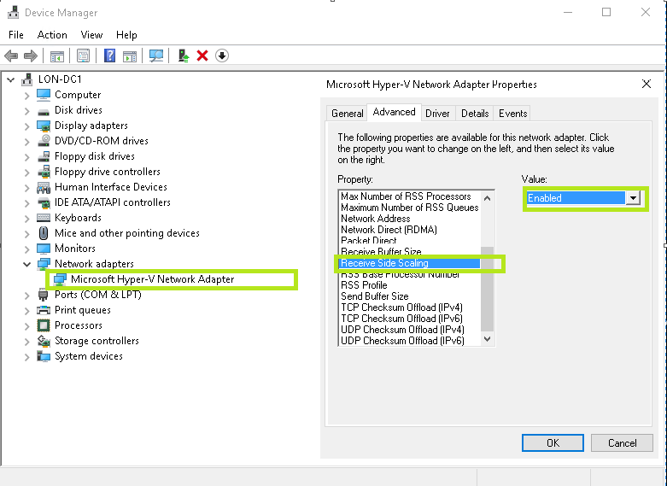
What is RSS?
Notes:
Explain Receive Side Scaling (RSS). Point out the highlighted areas on the slide, or as an alternative, open Device Manager on a virtual machine, and go through the following steps:
In Device Manager, in the console tree, expand Network adapters, select the network adapter, and then click Properties.
In the Properties dialog box, click the Advanced tab, and then in the Property list, ensure that Receive Side Scaling is selected.
20743C
7: Configuring Advanced Networking Features

Slide 13

What is RSC?
Packet A
Packet B
Packet C
Packets related to a specific application
RSC process
Packet A
Packet B
Packet C
A combined, or coalesced, packet is sent to the application
Notes:
Explain receive segment coalescing (RSC).
20743C
7: Configuring Advanced Networking Features

Slide 14
Lesson 2: Configuring advanced Hyper-V networking features
Virtual switch expanded functionality Understanding virtual switch extensibility What is SR-IOV? What is dynamic VMQ? Network adapter advanced features NIC Teaming in virtual machines Demonstration: Configuring network adapter advanced features
Notes:
Question
What is the ping-pong effect”?
( ) Option 1: The ping-pong effect occurs when multiple physical network adapters from the host are matched to several virtual network adapters. They continuously swap physical addresses.
( ) Option 2: The ping-pong effect occurs when a virtual switch extension applies network forwarding. It bypasses the default forwarding, which causes network packets to loop back and forth to the router.
( ) Option 3: The ping-pong effect results from a rare circumstance that can occur in dynamic VMQ when a CPU core is being used, and the processing happens to generates a large amount of inbound traffic. Because of this, another, less-busy CPU core is dynamically selected, and because the traffic load has not changed, it jumps back to the original or another CPU core. This process continues.
( ) Option 4: When you use Remote Direct Memory Access (RDMA), a network adapter can switch repeatedly between Switch Embedded Teaming (SET) and RDMA functionality.
( ) Option 5: The ping-pong effect occurs when a NIC team switches repeatedly among team member adapters.
Answer
( ) Option 1: The ping-pong effect occurs when multiple physical network adapters from the host are matched to several virtual network adapters. They continuously swap physical addresses.
( ) Option 2: The ping-pong effect occurs when a virtual switch extension applies network forwarding. It bypasses the default forwarding, which causes network packets to loop back and forth to the router.
(√ ) Option 3: The ping-pong effect results from a rare circumstance that can occur in dynamic VMQ when a CPU core is being used, and the processing happens to generates a large amount of inbound traffic. Because of this, another, less-busy CPU core is dynamically selected, and because the traffic load has not changed, it jumps back to the original or another CPU core. This process continues.
( ) Option 4: When you use Remote Direct Memory Access (RDMA), a network adapter can switch repeatedly between Switch Embedded Teaming (SET) and RDMA functionality.
( ) Option 5: The ping-pong effect occurs when a NIC team switches repeatedly among team member adapters.
20743C
7: Configuring Advanced Networking Features

Slide 15
Virtual switch expanded functionality
The virtual switch improvements in Windows Server 2016 include:
Extended port ACLs
Dynamic load balancing
Coexistence with third-party forwarding extensions
RSS support on the virtual machine network path
Network tracing enhancements
Router guarding
DHCP guarding
Trunk mode for virtual machines
Port mirroring
VLAN isolation through a private VLAN
Extended bandwidth management
Notes:
The expanded functionality includes router guarding, Dynamic Host Configuration Protocol (DHCP) guarding, port access control lists (ACLs), trunk mode for virtual machines, port mirroring, isolated virtual local area networks (VLANs), and bandwidth management.
20743C
7: Configuring Advanced Networking Features

Slide 16

Understanding virtual switch extensibility
Virtual switch extensions allow third-party vendors to create virtual switches
You can manage virtual switches by using the same tool set that you use to manage physical switches
Physical switches
Virtual switches
Notes:
Explain how the Hyper‑V Extensible Switch provides ways to extend the virtual switch to allow third-party vendors to add their own monitoring, filtering, and forwarding functionality without having to replace all of the Hyper‑V Extensible Switch functionality.
20743C
7: Configuring Advanced Networking Features

Slide 17
What is SR-IOV?
SR‑IOV enables multiple virtual machines to share the same PCI Express physical hardware resources
Physical
network adapter
Virtual
network adapters
Notes:
Explain what single-root I/O virtualization (SR-IOV) is.
20743C
7: Configuring Advanced Networking Features

Slide 18
What is dynamic VMQ?
Hyper-V host
Hyper-V host
Core 1
Core 2
Core 3
Core 4
Core 1
Core 2
Core 3
Core 4
Without VMQ
With VMQ
Notes:
Explain that dynamic Virtual Machine Queue (VMQ) can set the processor affinity with multiple CPU cores, but it might switch cores too rapidly if it perceives a core is too busy. This is known as the ping-pong effect. With RSS, this is less likely to occur.
20743C
7: Configuring Advanced Networking Features

Slide 19
Network adapter advanced features
Network function virtualization
Network Controller
SET
RDMA
VMQ
Converged network adapters
QoS for software-defined networks
Notes:
Note: There is one additional slide for this topic.
When discussing each of the improvements in Windows Server 2016 Hyper‑V, ensure that the students understand that the default settings are adequate in most small environments. However, while planning for possible growth, it is always valuable to know what features might be good to use in small environments to provide quick scalability and good performance from the start.
20743C
7: Configuring Advanced Networking Features

Slide 20
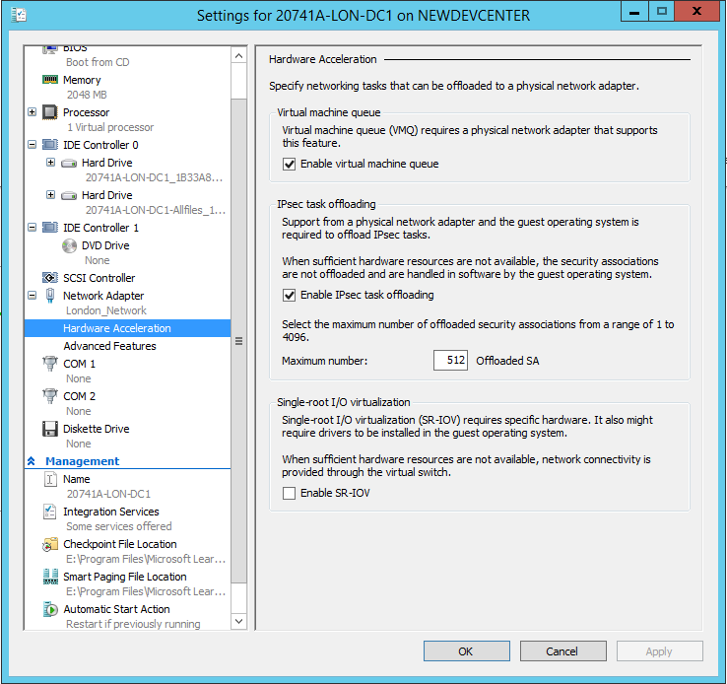
Network adapter advanced features
Hardware acceleration:
VMQ
Ipsec task offloading
SR-IOV
Notes:
You might want to open a virtual machine’s Settings window, expand the Network Adapter node, and then open and describe the Hardware Acceleration page.
20743C
7: Configuring Advanced Networking Features

Slide 21
NIC Teaming in virtual machines
NIC Teaming in virtual machines:
Requires multiple virtual network adapters
Must be enabled on the virtual network adapters
Allows you to then implement it in the virtual machine’s operating system (if supported)
SET:
Allows you to group from one through eight physical network adapters into one or more virtual network adapters
Notes:
Explain why you would want to configure virtual NIC Teaming for virtual machines. Discuss how you can use multiple NIC teams on the host connected to multiple virtual switches and then use NIC Teaming, which you configure through the virtual machine’s host operating system, to add another layer of performance and redundancy.
20743C
7: Configuring Advanced Networking Features

Slide 22
Demonstration: Configuring network adapter advanced features
In this demonstration, you will learn how to implement advanced features for network adapters on virtual machines
Notes:
In this demonstration, show how DHCP guarding works (if enabled on the DHCP virtual machine, it will not distribute the IP settings).
Preparation Steps
To complete this demonstration, you will use the virtual machines that you started in the previous demonstration.
Demonstration Steps
Use Windows PowerShell to enable DHCP guarding
On LON-HOST1, click Start, and then click Windows PowerShell.
At the Windows PowerShell command prompt, type the following commands to prevent LON-DC1 from issuing a DHCP lease, and then press Enter.
Set-VMNetworkAdapter -VMName 20743C-LON-DC1-B -DhcpGuard On
Turn off DHCP guarding
On the physical host computer, at the Windows PowerShell command prompt, type the following command, and then press Enter.
Set-VMNetworkAdapter -VMName 20743C-LON-DC1-B -DhcpGuard Off
20743C
7: Configuring Advanced Networking Features

Slide 23
Lab: Configuring advanced Hyper-V networking features
Exercise 1: Creating and using Hyper-V virtual switches Exercise 2: Configuring and using the advanced features of a virtual switch
Logon Information
Physical computer: restart 20743C-LON-HOST1
Virtual machines: 20743C-LON-DC1-B
LON-GUEST1
LON-GUEST2
User name: Adatum\Administrator
Password: Pa55w.rd
Estimated Time: 30 minutes
Notes:
To configure the advanced Hyper‑V networking features, you must have access to the physical server. If you do not, you cannot complete the labs steps that call for the use of the physical host computer.
Exercise 1: Creating and using Hyper‑V virtual switches
Adatum Corporation has the Hyper‑V virtualization platform already installed. Before deploying Hyper‑V and virtual machines in the production environment, you need to ensure that you understand the different networking options that you can configure in Hyper‑V. First, you will review the current networking configuration of the Hyper‑V host. Then you will create new virtual network adapters in the parent partition. You will also create different types of Hyper‑V virtual switches and explore the connectivity options that exist when using each of the switches.
Exercise 2: Configuring and using the advanced features of a virtual switch
One of your managers wants to see how the Hyper‑V virtual switch can help to protect the network clients from unauthorized DHCP servers. You plan to demonstrate how to configure DHCP guarding and, at the same time, show the manager how simple it is to configure bandwidth management.
20743C
7: Configuring Advanced Networking Features

Slide 24
Lab Scenario
Adatum Corporation has implemented the Hyper‑V virtualization platform in one of its subsidiaries. You have created several test virtual machines and familiarized yourself with many of the configuration options. The next step is to implement and test network connectivity for the virtual machines.
Notes:
20743C
7: Configuring Advanced Networking Features

Slide 25
Lab Review
In the “NIC Teaming” task, you created LON-GUEST2 NIC Team. Is this fault tolerant? In the task named “Create virtual network adapters,” the LON-GUEST2 virtual machine was shut down. Why?
Notes:
Question
In the “NIC Teaming” task, you created LON-GUEST2 NIC Team. Is this fault tolerant?
Answer
Yes it is, you included two network adapters and if one fails, the other will still provide functionality.
Question
In the task named “Create virtual network adapters,” you the LON-GUEST2 virtual machine was shut down. Why?
Answer
You were adding hardware—specifically, a network adapter. This cannot be done while a virtual machine is running.
20743C
7: Configuring Advanced Networking Features

Slide 26
Module Review and Takeaways
Review Question Best Practice
Notes:
Review Question
Question
You want to deploy a Windows Server 2016 Hyper‑V virtual machine’s virtual hard disk on a file share. What operating system must the file server be running to support this configuration?
Answer
You can deploy virtual hard disks only to file shares that support at least SMB 3.0, and only the Windows Server 2012 and Windows Server 2016 operating systems support the physical hosting of SMB 3.0 and SMB 3.1.1 file shares.
Best Practice: When implementing advanced networking features for Hyper‑V, use the following best practices:
Deploy multiple network adapters to a Hyper‑V physical host, and then configure those adapters as part of a team. This helps to ensure that network connectivity will be retained if individual network adapters fail. Configure multiple teams with network adapters that are connected to different switches to help ensure that connectivity will remain if a hardware switch fails.
Use bandwidth management to allocate a minimum and a maximum bandwidth allocation on a per–virtual network adapter basis. You should configure bandwidth allocation to help guarantee that each virtual machine will have a minimum bandwidth allocation. This helps to ensure that if another virtual machine that is physically hosted on the same Hyper‑V server experiences a traffic spike, other virtual machines will be able to communicate normally with the network.
Provision a Hyper‑V physical host with an adapter that supports VMQ. VMQ uses hardware packet filtering to deliver network traffic directly to a virtual machine. This helps to improve performance because the packet does not need to be copied from the physical host operating system to the virtual machine. When you do not configure virtual machines to support VMQ, the physical host operating system can become a bottleneck when it processes large amounts of network traffic.
If you are physically hosting large numbers of virtual machines and need to isolate them, use network virtualization rather than VLANs. Network virtualization is complicated to configure, but it has an advantage over VLAN—it is not necessary to configure VLANs on all the switches that are connected to the Hyper‑V physical host . You can perform all the necessary configurations when you need to isolate servers on a Hyper‑V physical host without needing to involve the network team.
20743C
7: Configuring Advanced Networking Features

